Slide 1

Project 02: The Input Link
The Engineer’s Guide to Soar
Course 01: Soar Essentials
By Dr. Bryan Stearns, 2024

Slide 2
Our Tutorial Task
We are building a “Supplier Sorting” agent
It should sort input items according to various configurable properties.
(Review “ProblemOverview.pdf” in the course directory for a description of the task we are solving.)

Slide 3
Problem
Solution
Our agent does not yet do anything relevant to the task.
Start by parsing some task input!
Print suppliers and weights to std-out
(validates that the agent is reading inputs correctly)

Slide 4
Lesson 02 – Outline
This lesson explains the following new concepts:
Soar dot-notation syntax
Using the ^input-link structure to receive input from the environment
Loading a file using CLI commands
Firing multiple instances of a single rule at once
Using the matches CLI command
Using variables for attributes

Slide 5
Soar Dot-Notation Syntax
A simpler way to code

Slide 6
Explicit Notation
sp {example*rule
(state <s> ^foo <n>)
(<n> ^bar |one|)
-->
(...) }
We’ve seen how to write conditions that test a chain of edges in the WM graph…
bar
“one”
root
foo

Slide 7
Dot Notation
This is equivalent to the rule on the previous slide.
sp {example*rule
(state <s> ^foo.bar |one|)
-->
(...) }
Soar allows a shorthand syntax called dot-notation!
Chain attribute names with a dot in between
You can make the chain as long as you like!
bar
“one”
root
foo

Slide 8
Using the Input Link
To receive input from the environment

Slide 9
The io Structure
Soar provides the WMEs shown on the right
io.input-link
Any input sent to Soar appears here
Input must be created by an outside program that interfaces with Soar
io.output-link
The agent puts WMEs here to send them to the environment
Output must be interpreted by an outside program that interfaces with Soar
root
io
I1
input-link
I2
Input goes here…
output-link
I3
Output goes here…

Slide 10
Project Input
This is a text notation for WM content. Node IDs are a letter+number combo. (“P1”)
S1 ^io.input-link I2
^priorities P1
^total-cost 11.01
^sustainability 11
^quality 11
^availability 8
^packaging 8
^speed 7
^candidate-supplier C1
^name |supplier01|
^candidate-supplier C2
^name |supplier02|
...
^candidate-supplier C6
^name |supplier06|
For this course, default input is provided for your project agents
We’ll see how to enable this input later in this lesson.
The input schema we use for Project 02 is:
^input-link.priorities.<attr> INT/FLOAT
Multiple edges match <attr>, such as “quality”, “speed”, etc.
^input-link.candidate-supplier.name STRING
There are 6 named suppliers included in this input
root
io
I1
input-link
I2
priorities
<attr>
INT/FLOAT
candidate-supplier
name
STRING

Slide 11
Loading a File Using CLI Commands
So we can load our test input

Slide 12
Using Fake Input
For this lesson, we do not have an external environment application sending input or reading output.
We will instead load a .soar file that simulates input.
The file is “fake_agent_input.soar”, found in the main tutorial directory.
It defines rules that create WMEs on the input-link.
Normally you should only let the environment modify the input-link structures!
But this approach is useful for testing during agent development.
You do not need to worry about these rules, but feel free to examine the file content if desired.

Slide 13
Loading a Soar File
The CLI command to load a file into Soar is simply:
load file [filename]
An alias/shorthand for this same command is:
source [filename]
This command will cause Soar to open the indicated file and read all its contents as if they were typed into the Soar CLI.

Slide 14
Loading Test Input
The top of your agent_starter.soar file includes two lines that automatically load our test input for you:
The first line changes the working directory from the lesson directory to the main tutorial directory.
The second line loads the fake_agent_input.soar file that is found there.
cd ".."
load file "fake_agent_input.soar"

Slide 15
Filesystem Commands
Soar includes various CLI commands for interacting with the filesystem:
cd: Change directory (same usage as in normal OS terminals)
load [filename]: Load the contents of the indicated file
ls: List the current directory contents (same usage as in normal OS terminals)
pwd: Print the current working directory path
pushd [dirname]: Enter the indicated directory within the current directory
popd: Exit the most recently pushed directory level
dirs: Print the current directory stack

Slide 16
Firing Multiple Instances of a Soar Rule at Once
With some coding!

Slide 17
Using Our Input
S1 ^io.input-link I2
^priorities P1
^total-cost 11.01
^sustainability 11
^quality 11
^availability 8
^packaging 8
^speed 7
^candidate-supplier C1
^name |supplier01|
^candidate-supplier C2
^name |supplier02|
...
^candidate-supplier C6
^name |supplier06|
When we load our test input file, the agent sees input as shown to the right.
We first write a rule that prints off the name of each input supplier.

Slide 18
Using Our Input
S1 ^io.input-link I2
^priorities P1
^total-cost 11.01
^sustainability 11
^quality 11
^availability 8
^packaging 8
^speed 7
^candidate-supplier C1
^name |supplier01|
^candidate-supplier C2
^name |supplier02|
...
^candidate-supplier C6
^name |supplier06|
What is the attribute path from the root state node (labeled S1) to any supplier’s name?

Slide 19
Let’s Write Some Code!
Open your agent_starter.soar file for Project02.
Find the provided rule starter named: “elaborate*suppliersort-main*input*supplier-name”
Uncomment this rule. (Remove the leading “#” characters.)
Fill in the LHS underscores with the dot-notation path to the input supplier name
Fill in the RHS underscores with the supplier name variable that you referenced on the LHS.
Add a newline character to the end of the rule’s output message.
Proceed to the next slide for the solution when you are done.
sp {elaborate*suppliersort-main*input*supplier-name
"Print any input candidate supplier names”
(state <s> ^___ <sup-name>)
-->
(write |INPUT: Supplier candidate: | ___)}

Slide 20
Let’s Write Some Code!
Here is the completed rule
Run the agent with this rule for 1 step and see what happens!
Proceed to the next slide when you’re done.
sp {elaborate*suppliersort-main*input*supplier-name
"Print any input candidate supplier names”
(state <s> ^io.input-link.candidate-supplier.name <sup-name>)
-->
(write |INPUT: Supplier candidate: | <sup-name> (crlf))}

Slide 21
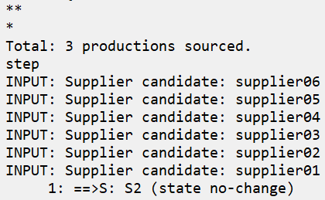
What Happened?
You should have seen this output
The agent printed every supplier name
Though we only coded 1 rule
sp {elaborate*suppliersort-main*input*supplier-name
"Print any input candidate supplier names”
(state <s> ^io.input-link.candidate-supplier.name <sup-name>)
-->
(write |INPUT: Supplier candidate: | <sup-name> (crlf))}

Slide 22
What Happened?
S1 ^io.input-link I2
^priorities P1
^total-cost 11.01
^sustainability 11
^quality 11
^availability 8
^packaging 8
^speed 7
^candidate-supplier C1
^name |supplier01|
^candidate-supplier C2
^name |supplier02|
...
^candidate-supplier C6
^name |supplier06|
Soar rules fire multiple times for every combination of variable bindings.
There are 6 ways that the WM graph can provide a value for <sup-name>
So the rule fires 6 times, once for each value
In no particular order
sp {elaborate*suppliersort-main*input*supplier-name
"Print any input candidate supplier names”
(state <s> ^io.input-link.candidate-supplier.name <sup-name>)
-->
(write |INPUT: Supplier candidate: | <sup-name> (crlf))}

Slide 23
Instantiations
A rule instantiation in Soar is a rule firing for a particular set of variable bindings.
sp {elaborate*suppliersort-main*input*supplier-name
"Print any input candidate supplier names”
(state <s> ^io.input-link.candidate-supplier.name <sup-name>)
-->
(write |INPUT: Supplier candidate: | <sup-name> (crlf))}
RULE
INSTANTIATIONS
Notice both the candidate-supplier ID and the name are different for each instantiation.
{instantiation1
(S1 ^io I1)
(I1 ^input-link I2)
(I2 ^candidate-supplier C1)
(C1 ^name |supplier01|)
-->
(write |INPUT: Supplier candidate: | |supplier01| (crlf))}
{instantiation2
(S1 ^io I1)
(I1 ^input-link I2)
(I2 ^candidate-supplier C2)
(C2 ^name |supplier02|)
-->
(write |INPUT: Supplier candidate: | |supplier02| (crlf))}
Dot notation is expanded to see how each ID is instantiated.

Slide 24
Using the matches CLI Command
For Debugging Soar Rule Firings

Slide 25
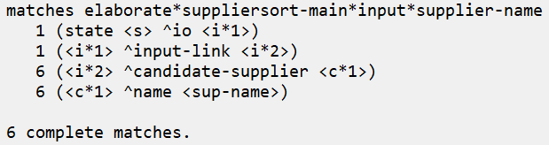
Seeing the Number of Matches
Soar provides the matches CLI command to let you see the different matches of a rule
After your agent prints its output, enter the following command into the CLI input area:
matches elaborate*suppliersort-main*input*supplier-name
You should see the output shown below.
It shows the expanded conditions of our rule and how many WMEs match each condition component
The leading number shows how many WMEs match the WME pattern of that line in the rule.
Notice that there is only 1 input-link edge, but there are 6 candidate-supplier edges, each with 1 name for a total of 6 name edges.
6 instantiations

Slide 26
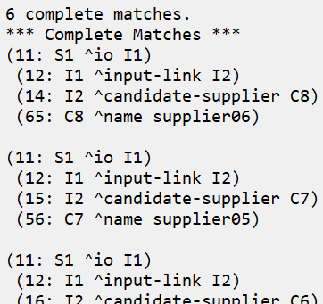
Seeing the Matches
If you add the “-w” / ”--wmes” command option, Soar will print each match of the rule you are inspecting
matches -w elaborate*suppliersort-main*input*supplier-name
This is a very useful command when debugging your rules!
The printout shows each set of WM elements that together satisfy the rule conditions in each instantiation.

Slide 27
Using Variables For Attributes
Finishing Up Our Project

Slide 28
Printing Priorities
S1 ^io.input-link I2
^priorities P1
^total-cost 11.01
^sustainability 11
^quality 11
^availability 8
^packaging 8
^speed 7
^candidate-supplier C1
^name |supplier01|
^candidate-supplier C2
^name |supplier02|
...
^candidate-supplier C6
^name |supplier06|
We also want our agent to print the names of each priority attribute with its weight value.
We could make a rule for each attribute path, such as these:
But there’s an easier way!
sp {elaborate*suppliersort-main*input*config-priorities*total-cost
(state <s> ^io.input-link.priorities.total-cost <weight>)
-->
(write |INPUT WEIGHT: total-cost:| <weight> (crlf))}
sp {elaborate*suppliersort-main*input*config-priorities*quality
(state <s> ^io.input-link.priorities.quality <weight>)
-->
(write |INPUT WEIGHT: quality:| <weight> (crlf))}

Slide 29
Attribute Variables
S1 ^io.input-link I2
^priorities P1
^total-cost 11.01
^sustainability 11
^quality 11
^availability 8
^packaging 8
^speed 7
^candidate-supplier C1
^name |supplier01|
^candidate-supplier C2
^name |supplier02|
...
^candidate-supplier C6
^name |supplier06|
Variables can be used for attributes as well as for IDs and values.
The single rule below will match on every attribute:value pair underneath the priorities input object.
sp {elaborate*suppliersort-main*input*config-priorities
(state <s> ^io.input-link.priorities.<attr> <weight>)
-->
(write |INPUT WEIGHT: | <attr> |: | <weight> (crlf))}

Slide 30
Let’s Write Some Code!
Uncomment the 2nd (“config-priorities”) rule from agent_starter.soar.
Fill in the rule to match the solution shown below.
Run the agent again for 1 step and see what happens!
Proceed to the next slide when you’re done.
sp {elaborate*suppliersort-main*input*config-priorities
"Print any input priority weights"
(state <s> ^io.input-link.priorities.<attr> <weight>)
-->
(write |INPUT WEIGHT: | <attr> |: | <weight> (crlf))}

Slide 31
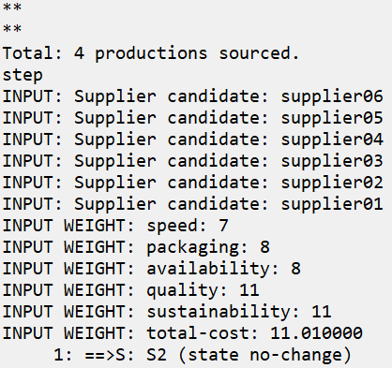
Final Results
Both your rules together should now print the full set of supplier names and priority weights as shown on the right.
If so, congratulations! You have completed Project 02!

