Slide 1

Project 03: Operator Basics
The Engineer’s Guide to Soar
Course 01: Soar Essentials
By Dr. Bryan Stearns, 2024

Slide 2
Problem
Solution
Our agent detects input elements, but it does not yet do anything with them.
Use operators to have the agent choose suppliers from its input.
Use an operator proposal rule to propose an operator for each input supplier that the agent detects.
Use an operator preference rule to have the agent choose them in a particular order.
Use an operator apply rule to print a message for each selected supplier in the order it is selected.

Slide 3
Project Goal
We want our agent to write out each input supplier name in descending order of its total-score.
Its messages should be as follows:
Selected supplier “supplier05” (total-score = 14)
Selected supplier “supplier03” (total-score = 13)
Selected supplier “supplier01” (total-score = 12)
Selected supplier “supplier04” (total-score = 11)
Selected supplier “supplier06” (total-score = 10)
Selected supplier “supplier02” (total-score = 9)

Slide 4
Accessing Supplier Input Properties
S1 ^io.input-link I2
^candidate-supplier C1
^name |supplier01|
^total-score 12
^total-cost 35.0
^total-sats 2
^sustainability 3
^availability 3
^quality 1
^packaging 3
^speed 2
...
^candidate-supplier C6
^name |supplier06|
...
Our input includes many different attributes for each supplier.
In this project, we’ll only use two:
^name STRING
The name of the supplier
^total-score INT
The sum of the non-total numeric inputs

Slide 5
Lesson 03 – Outline
This lesson explains the following new concepts:
Soar Operators
The Decision Cycle
Propose Rules
Preference Rules
Apply Rules
Stateful Actions
Negative Conditions

Slide 6
Soar Operators
Starting with an overview of the main ideas
The Core of Soar Decision Making

Slide 7
The Soar Decision Cycle
The decision cycle is the main processing loop of Soar processing
It begins with updating input-link contents to match the environment
Then agent rules update WM based on the current decision
It ends with sending output-link contents to the environment
Soar Agent
Receive Input
Decision
Send Output

Slide 8
Operator Definition
An operator is a choice that the agent can select during a decision cycle
It is a special WM structure with two forms:
Proposed: (<s> ^operator <o> +)
Selected: (<s> ^operator <o>)
The proposed operator:
Is a decision choice that the agent could select
Is created by programmer-defined rules
The selected operator:
Is a choice that the agent has currently selected
Is created by Soar when the agent selects a proposed operator
Is a copy of the proposed operator structure

Slide 9
Operator Effects
The agent selects one operator per decision cycle
The selected operator influences which rules fire during that cycle.
Soar Agent
Receive Input
selected: “my_operator”
Decision
Some rules fire in response to the selected operator
Send Output
rule
rule
rule
rule
Some rules fire independently from any operator
rule

Slide 10
Soar Processing: Parallel and Serial Together
Satisfied Soar rules fire together at once whenever they can
For effective parallel computation
But a Soar agent selects only a single operator per decision cycle
For serial computation
Soar processing represents a reasoned sequence of parallel rule operations
select: operator1
select: operator2
select: operator3
select: operator4
rule
rule
rule
rule
rule
rule
rule
rule
rule
rule
rule
rule
rule
rule
rule
rule
rule
rule
parallel rule firing
parallel rule firing
parallel rule firing
parallel rule firing

Slide 11
Operator Code
Operators are defined in code via three types of rules:
Proposal rules propose operators to let the agent know what possible operators it can select from at any point in time
Preference rules help the agent select from among the proposed operators
Apply rules carry out the selected operator, once the agent selects one, by making changes to working memory
(We’ll see later that a rule’s type depends on what the rule does in its LHS and its RHS.)

Slide 12
Soar Decision Cycle – Phases
Soar Agent
The decision cycle is in 5 main phases:
Input Phase
When input is updated
Proposal Phase
When rules propose and prefer operators
Selection Phase
When Soar selects an operator
Apply Phase
When rules apply the selected operator
Output Phase
When output is updated
Input Phase
Proposal Phase
Selection Phase
Apply Phase
Output Phase

Slide 13
When Apply Rules Fire
Soar Agent
Apply rules fire at different times from other rules
Input Phase
Non-apply rules can fire at any time
Proposal Phase
Selection Phase
Apply rules only fire after Soar selects an operator
Apply Phase
Output Phase

Slide 14
Soar Decision Cycle – Quiescence
Soar Agent
One rule’s results might satisfy another rule.
So there can be multiple cycles of cascading rule firings within a phase
Each iteration is called an elaboration cycle
The proposal & apply phases loop until quiescence
Quiescence: When no more rules fire
Input Phase
Proposal Phase
Selection Phase
(But Soar will automatically halt if it detects that rules have created an infinite loop.)
Apply Phase
Output Phase

Slide 15
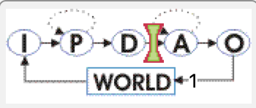
Decision Cycle Breakpoint in the Debugger
The Soar Debugger shows a small chart of the decision cycle for easy reference
You can also click on a link in this chart to control where Soar pauses when it finishes running a given number of decision cycle steps.
By default, Soar will pause immediately after the Decision Phase, before any rules fire in the Apply Phase
current break point
Input
Proposal
Decision
Apply
Output

Slide 16
Soar Operators
Now let’s put the ideas into practice!
The Core of Soar Decision Making

Slide 17
Coding Our First Operator
We want our agent to:
Propose an operator for each input supplier
Prefer the operators in order of the supplier total-score
Apply each operator by writing out the selected supplier’s name
We will need:
A single proposal rule
A single preference rule
A single apply rule

Slide 18
Project Solution Details
We use this sequence for each cycle until we’ve selected and processed each of the input suppliers:
Propose an operator for each input supplier
Prefer the operators in descending order of the supplier total-score
Apply each operator by writing out the selected supplier’s name
supplier01
supplier02
supplier02
supplier03
supplier03
propose:
select:
supplier01
apply: “Selected supplier ‘supplier01’ ”
propose:
…
supplier04
supplier04
supplier05
supplier05
supplier06
supplier06
next decision cycle

Slide 19
Coding Proposal Rules
A proposal rule is any rule that creates an operator object as one of its actions
The attribute ^operator is a reserved keyword in Soar
The attribute should point to a new ID (a new variable name that isn’t on the LHS)
It is convention to use <o> to refer to operators.
The new ID should have a + after it
The + tells Soar to consider this operator as a choice during the selection phase
The new ID should ideally have a ( ^name STRING) WME that describes the operator
It can have any number of other child WMEs too, as desired.
1
2
3
4
sp {propose*my-first-operator
(state <s> ^type state)
-->
(<s> ^operator <o> +)
(<o> ^name |my-first-operator|)}
1
2
3
4

Slide 20
Let’s Write Some Code!
Open your agent_starter.soar file and look at the first rule there.
Fill in the rule to match the solution shown below.
Run the agent again for 1 step and see what happens!
Proceed to the next slide when you’re done.
sp {propose*suppliersort-main*select-supplier
"Print any input priority weights"
(state <s> ^io.input-link.candidate-supplier <sup>)
-->
(<s> ^operator <o> +)
(<o> ^name select-supplier
^supplier <sup>)}

Slide 21

A Tie Impasse!
You should have seen something like the below output:
What happened?
Our single rule proposed multiple copies of the select-supplier operator
One for each input candidate-supplier structure
The Soar agent did not know which operator to choose
So the agent reported that it hit an “operator tie” impasse

Slide 22

What is an Impasse?
An impasse is indicated when you see the “==>” arrow in the agent trace.
An impasse occurs any time the agent is not able to continue its decision cycle.
The text in parentheses after the arrow describes the type of impasse.
We will see later that we can use impasses to design hierarchical reasoning
For now, if we see an impasse that means there is a bug in our code
In this case, our agent is missing knowledge for how to choose an operator

Slide 23
Operator Preferences
Operator preferences
Are special operator properties
Created by rules
Guide the agent to automatically select a single operator from among proposed operators.
Examples:
op1 > op2 (prefer op1 over op2 if both are proposed)
op1 = op2 (choose randomly between op1 and op2 if tied between them)
op2 < (tag op2 as a bad operator – only pick it if there’s nothing better)
op1 > (tag op1 as a good operator – pick it over others missing this tag)

Slide 24
Preference Types
Here is a complete list of the kinds of preferences we can give operators:
Preference Name | Syntax | Description
Acceptable | + | States that a value is a candidate for selection
Reject | – | Removes the value as a candidate for selection
Better / Worse | > value, < value | States, for the two values involved, that one should not be selected if the other is a candidate
Best | > | If a value is best, it will be selected over any other value that is not also best (or required)
Worst | < | States that the value should be selected only if there are no alternatives
Unary Indifferent | = | When two or more competing values both have unary indifferent preferences, choose one randomly
Binary Indifferent | = value | Like unary indifferent, but the operator is only made indifferent to the other operator value given
Numeric-Indifferent | = number | Like unary indifferent, but the number weights the chance of the operator’s selection relative to others
Require | ! | States that the value must be selected (preferred over all others)
Prohibit | ~ | States that the value cannot be selected

Slide 25
Coding Preference Rules
A preference rule is any rule that assigns an operator preference as one of its actions
To test for a proposed operator on the LHS, use a “+” after the operator ID condition
Assign a preference to that operator ID on the RHS
The example below makes any two proposed operators “indifferent” to each other
(Which means that Soar will select between them randomly if tied between them.)
1
2
sp {prefer*my-first-operator
(state <s> ^operator <o1> +
^operator <o2> +)
-->
(<s> ^operator <o1> = <o2>)}
1
2

Slide 26
Using Operator Preferences
For our project, we need to use a preference rule to avoid the tie impasse!
We want rule logic along these lines:
“IF there are two proposed operators where the total-score of the second’s supplier is lower than that of the first, THEN prefer the first over the second.”
That rule should fire for every pair of proposed operators to create a preference between each pair.

Slide 27
Let’s Write Some Code!
Open your agent_starter.soar file and uncomment the second rule there.
Fill in the rule to match the solution shown below.
Proceed to the next slide for a description of how this rule works.
Run the agent again for 2 steps and see what happens!
sp {prefer*suppliersort-main*select-supplier*total-score
(state <s> ^operator <o1> +
^operator <o2> +)
(<o1> ^name select-supplier
^supplier.total-score <sup1-score>)
(<o2> ^name select-supplier
^supplier.total-score < <sup1-score>)
-->
(<s> ^operator <o1> > <o2>)}

Slide 28

The First Operator Selected!
When you run your agent now, you should see output like the following:
What happened?
Soar used our rule to select one of the 6 proposed operators in the 1st cycle

Slide 29
What Does this Preference Rule Do?
Note that ”<“ or “>” has a different meaning on the LHS vs the RHS.
1
It tests for two proposed operators
It tests that one has a lower supplier total-score than the other
It gives the one with the higher total-score better preference over the other
2
3
sp {prefer*suppliersort-main*select-supplier*total-score
(state <s> ^operator <o1> +
^operator <o2> +)
(<o1> ^name select-supplier
^supplier.total-score <sup1-score>)
(<o2> ^name select-supplier
^supplier.total-score < <sup1-score>)
-->
(<s> ^operator <o1> > <o2>)}
1
This compares two values
2
This creates a preference
3

Slide 30
Condition Comparisons
Soar syntax supports many kinds of comparisons:
(See page 53 in the manual for more details)
To test equality, you don’t need a comparison symbol. Use the variable you want equality with.
Example:
Comparison | Semantics
< | Less than
<= | Less than or equal
> | Greater than
>= | Greater than or equal
<> | Not equal
<=> | Same type (int, float, string, or ID)
(<s> ^fizz <same-value> ^buzz <same-value>)

Slide 31
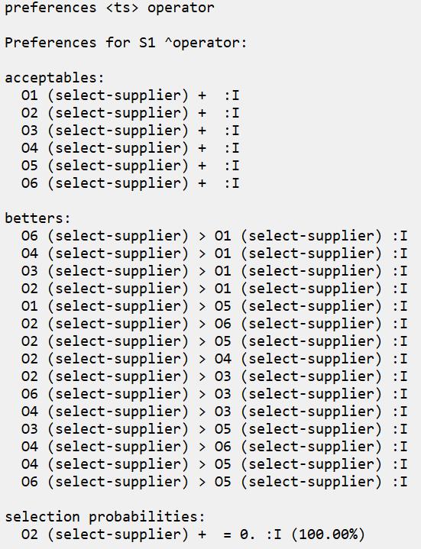
Inspecting Preferences
The “preferences <ts> operator” command lets you see the agent’s current preferences.
Use it after running for one step. You should see this. →
Note: The ID numbers (e.g. “O4”) may vary each run.

Slide 32
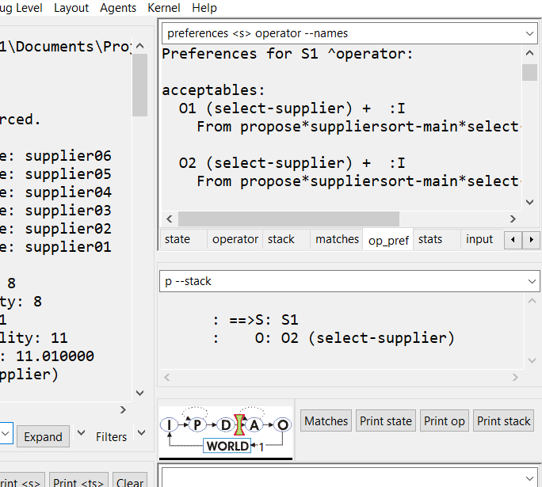
Inspecting Preferences
The “preferences <ts> operator” command lets you see the agent’s current preferences.
Use it after running for one step. You should see this. →
This command is also provided in a Debugger auto-update tab.

Slide 33
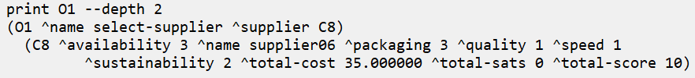
Inspecting Preferences
The “preferences <ts> operator” command lets you see the agent’s current preferences.
Use it after running for one step. You should see this. →
The “O1” … “O6” labels are the IDs of the proposed operators
You can see which operator is which by printing the ID
“print O1 --depth 2”
In this example, O1 is the operator for supplier06:

Slide 34
Another Impasse…
There was another impasse after we ran the agent:
What happened?
The agent is still missing some knowledge
It has no apply rule for this operator!
We need to tell our agent how to apply the (select-supplier) operator!

Slide 35
Coding Apply Rules
An apply rule is any rule that tests a selected operator in its LHS
The ^operator ID is tested without the +.
You usually want to also test the operator’s name so that your rule only applies that operator.
The RHS can include any desired actions.
1
2
3
sp {apply*my-first-operator
(state <s> ^operator <o>)
(<o> ^name |my-first-operator|)
-->
(<s> ^my-attribute |my-value|)
1
2
3

Slide 36
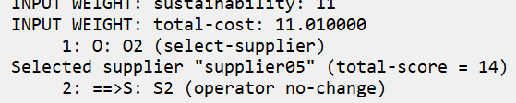
Let’s Write Some Code!
Open your agent_starter.soar file and uncomment the third rule there.
apply*suppliersort-main*select-supplier
On your own: Fill in the blanks to test for a proposed (select-supplier) operator.
Collect the operator’s supplier name to print it out from the RHS
Run your agent for 2 steps and see what happens!
You should see output like the following:
Proceed to the next slide when you’re done.
The impasse you see is not the one you saw before. (Your rule solved that one!)
This impasse is for a new reason that we’ll address in the next section.

Slide 37
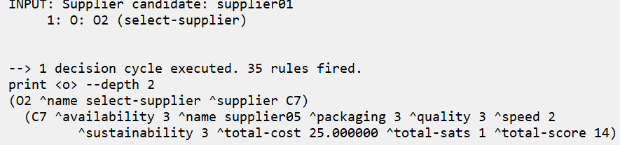
Inspecting Operators
The Soar CLI treats “<o>” as a keyword to refer to the current selected operator, if there is one.
Run your agent from the beginning for only 1 step
Then enter “print <o> --depth 2”
You should see the following:
Note: This print example will only work if you have not yet triggered an impasse, for reasons that will become clear in Lesson 06.

Slide 38
Stateful Actions & Negative Conditions
Finishing Our Project

Slide 39
Progressing Through Operators
Your operator code is almost complete:
An operator is proposed for each supplier that could be selected.
Operators for suppliers with lower names are preferred over those with higher names.
When an operator (and its supplier) are selected, the supplier name is printed.
We want to select a different operator each cycle
But right now, the same operator is still proposed after its apply rule takes effect.
That’s the (operator no-change) impasse: The operator isn’t changing!
How do we get an operator to no longer be proposed after it has been applied?
(So the next-best operator can be selected next)
We need our agent to remember once it has applied an operator
(So that it knows it doesn’t need to keep proposing it)

Slide 40
Stateful Actions
We will modify our apply rule to create a state variable
Marking that the agent has processed a particular supplier
We will modify our proposal rule to only propose unprocessed suppliers
The proposal will retract as soon as the apply rule has fired
Because its conditions will no be longer satisfied
When a proposal rule retracts, the operator proposal is removed from WM
So the next-best operator can be selected during the next decision cycle.

Slide 41
Let’s Write Some Code!
Open your agent_starter.soar file and modify the apply rule as follows:
Modify your proposal rule as follows:
Proceed to the next slide when you’re done.
sp {apply*suppliersort-main*select-supplier
(state <s> ^operator <o>)
(<o> ^name select-supplier
^supplier <sup>)
(<sup> ^name <sup-name>
^total-score <sup-score>) -->
(write |Selected supplier "| <sup-name> |" (total-score = | <sup-score> |)| (crlf))
(<s> ^selected <sup>)}
Mark that the supplier has been selected and processed
sp {propose*suppliersort-main*select-supplier
(state <s> ^io.input-link.candidate-supplier <sup>
-^selected <sup>)
-->
(<s> ^operator <o> +)
(<o> ^name select-supplier
^supplier <sup>)}
Only propose suppliers that have not yet been selected.
(Notice the “–” at the front!)

Slide 42
Negative Conditions
To test that the described WME pattern does not exist in WM, just add a “–” in front.
You can add the “–” in multiple ways:
In front of a condition block (to negate the entire block)
Or just in front of an attribute (to negate just that attribute pattern)
The following pieces of code both demonstrate valid negations:
1
2
“Not (first & second)”
-(<x> ^first |value|
^second |value|)
“(Not first) & (Not second)”
(<x> -^first |value|
-^second |value|)
1
2
Satisfied if either WME is missing
Satisfied if both WMEs are missing

Slide 43
Syntax for Negative Conditions
Soar will give a syntax error if you put a negative condition as the first condition of a rule.
If needed, you can always add “^type state” as a filler starting condition.
Soar allows you to omit the variable after an attribute test if the value doesn’t matter.
You only need to include a value in a negation test if you want to test that a specific value is not there.
This gives an error:
This is fine:
sp {bad*negative-condition
(state <s> -^selected <any>)
...
sp {good*negative-condition
(state <s> ^type |state|
-^selected <any>)
...
This is fine:
sp {good*negative-condition*shorthand
(state <s> ^type |state|
-^selected )
...

Slide 44
Rule Effect Persistence
When our proposal rule retracted, the operator proposal was removed from WM.
But when our apply rule retracted, the ^selected <sup> WME stayed in WM.
Why the difference?
For normal Soar rules:
The action effects are always undone as soon as the rule instance retracts
Apply rules are special:
Apply rule actions are permanent
(Until some other rule makes further changes)

Slide 45
i-support vs o-support
If an i-supported rule removed a WME, the WME will reappear once the instantiation retracts!
More formally:
Non-apply rules are said to have “i-support”
This stands for “instantiation support”
That is, their RHS results are supported in WM by the rule instantiation that created them.
Once the instantiation retracts (its LHS no longer matches), the results lose support and are undone.
Apply rules are said to have “o-support”
This stands for “operator support”
That is, their RHS results are supported in WM by the operator decision.
Even when the instantiation retracts, the results keep their support.

Slide 46
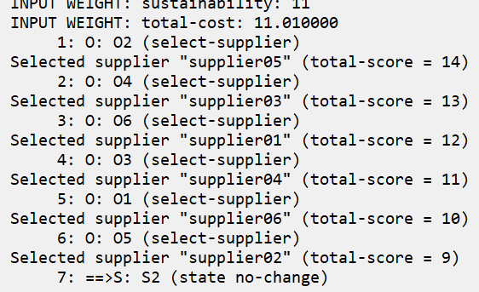
Final Results
After running your agent for 7 steps, you should see the following:
Each input supplier is selected in alphanumeric order!
If so, congratulations! You have completed Project 03!

Slide 47
Extra: Operator No-Change Impasses
When we were missing an apply rule, we got an (operator no-change) impasse
When we had an apply rule but the proposal didn’t retract, we still got the same impasse
Was this the same impasse? Not quite!
In Soar you can get an (operator no-change) impasse for two reasons:
Your operator isn’t applied (no matching apply rules)
Your operator was applied but the apply rules didn’t resolve the proposal (because the propose rule didn’t retract)
If you see this impasse from your code where it shouldn’t be, check for both causes!

Slide 48
Extra: Types of Impasses
Here is a reference table of the types of impasses and their meanings:
Impasse Name | Cause | Description
(state no-change) | When the proposal phase runs to quiescence and no operators are proposed | The agent doesn’t know what it could try to do next. (Such as when there are no rules, or when the task is done.)
(operator no-change) | When the proposal phase runs to quiescence and no new operator has been selected | The agent isn’t making progress toward its goal.
(operator tie) | When there is a collection of equally eligible operators competing for selection | The agent doesn’t know how to choose among two or more operators.
(operator conflict) | When two or more objects are better than each other and not dominated by a third operator | The agent has conflicting preferences among proposed operators.
(constraint-failure) | When there are conflicting necessity preferences | The agent has been told that more than one operator is mandatory to select this cycle.

