Slide 1

Project 05: Multi Apply
The Engineer’s Guide to Soar
Course 01: Soar Essentials
By Dr. Bryan Stearns, 2024

Slide 2
Problem
Solution
Our agent does not output suppliers with any particular order.
It selects suppliers in a particular order, but that order is not represented in the final output.
When the agent selects a supplier, append it to a linked-list data structure (which we'll define) in WM.
After all suppliers have been added to the list, in order, then copy this list to the output-link.
(We will not reuse code from previous projects this time, because we will need to make slight changes to the rules we wrote before.)

Slide 3
Project Goal
We want our agent to output an ordered list of recommended suppliers. The resulting output-link structure should be as follows:
S1 ^io.output-link I3 ^supplier-list C9
^count 6
^first-supplier C10
^last-supplier C15
^supplier C10
^name |supplier05| ^rank 1 ^next C11
^supplier C11
^name |supplier03| ^rank 2 ^next C12
...
^supplier C15
^name |supplier02| ^rank 6)

Slide 4
Lesson 05 – Outline
This lesson explains the following new concepts:
Making a custom linked-list with WMEs
Using an (init) operator
Using the "require" preference
Multiple apply rules for a single operator
Using math RHS Functions

Slide 5
Linked-Lists with WMEs
A Custom Graph Data Structure

Slide 6
Linked-List Elements
Soar’s WM graph format lets us make any data structure we like.
The simplest kind of linked-list would look something like this:
C10
next
C11
next
C12
name
name
name
“supplier5”
“supplier3”
“supplier1”
rank
rank
rank
0
1
2

Slide 7
Linked-List for Soar
For Soar, it is useful to have a parent node with direct links to each list element.
list
count
first
3
last
C10
next
C11
next
C12
name
name
name
“supplier5”
“supplier3”
“supplier1”
rank
rank
rank
0
1
2
We connect from the parent node to every list element so that agent rules can easily access any item in the list without traversing the whole sequence.

Slide 8
Linked-List Format
Here is the structure in text form:
S1 ^supplier-list C9
^count 6
^first-supplier C10
^last-supplier C15
^supplier C10
^name |supplier05| ^rank 1 ^next C11
^supplier C11
^name |supplier03| ^rank 2 ^next C12
...
^supplier C15
^name |supplier02| ^rank 6)

Slide 9
Linked-List Format
Here is the structure in text form:
The count of list elements
S1 ^supplier-list C9
^count 6
^first-supplier C10
^last-supplier C15
^supplier C10
^name |supplier05| ^rank 1 ^next C11
^supplier C11
^name |supplier03| ^rank 2 ^next C12
...
^supplier C15
^name |supplier02| ^rank 6)
Link to the first item in the list
Link to the last item in the list
Individual list items

Slide 10
Building the List
There are 3 distinct kinds of operations we need to do with our list:
Create the empty list structure
Create the empty parent node
Attach to it a ^count of 0
Add the first item to the list
Attach the new item to the parent node
Initialize the ^first-supplier and ^last-supplier links to point to the new item.
Replace the old list “^count 0” value with “^count 1”
Append subsequent items to the list
Attach the new item to the parent node
Add a ^next link from the old ^last-supplier item to the new item
Replace the old ^last-supplier link with a link to the new item
Replace the old list “^count” value with (1 + the old count value)

Slide 11
Using the (init) Operator
To Create the Empty List Structure

Slide 12
The (init) Operator
We want to create our empty list when the agent first starts up.
So we’ll define an (init) operator:
It will create initial structures that the agent will need later.
The agent should select it before anything else.
We can modify the (init) operator later to also create any other structures we might want in addition to our list.
Most Soar agents use an (init) operator of some sort.

Slide 13
Using the Require Preference
To Guarantee an Operator is Selected First

Slide 14
The Require Preference
Require (“!”) is a unary preferences we can use when proposing an operator.
It guarantees that any operator with that preference is selected over other operators.
If more than one operator has the Require preference at once, this creates an impasse.
It is a great way to guarantee that our (init) operator is selected before other operators.
sp {propose*my-required-operator
(state <s> ^type state)
-->
(<s> ^operator <o> + !)
(<o> ^name |my-required-operator|)}
Require

Slide 15
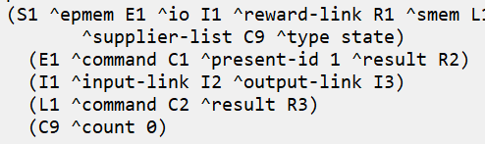
Let’s Write Some Code!
Open your agent_starter.soar file and look at the first 2 rules.
They are propose and apply rule shells for an (init) operator.
Fill out the rules as instructed in comments so (init) creates an empty list.
Run the agent for 2 steps to test it
After 2 steps, enter the command “print S1 -d 2” into the debugger to see if your apply rule worked. You should see the following output:
Proceed to the next slide when you are done.

Slide 16
Updating (select-supplier)
Previously, (select-supplier) created a ^selected WME on the state.
We want it to instead add selected suppliers to our list, in selection order:
apply: “First try supplier05”
propose:
supplier01
select:
supplier03
apply: “Then try supplier03”
supplier02
list
count
1
list
count
2
first
last
supplier03
first
last
…
C10
supplier04
C10
next
C11
name
supplier06
name
name
“supplier5”
“supplier5”
“supplier3”
rank
0
rank
0
rank
1
List of 1
List of 2
next decision cycle
next decision cycle

Slide 17
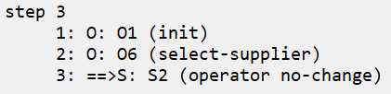
Let’s Write Some Code!
Uncomment the propose rule for (select-supplier)
Note that a preference rule is already provided beneath it.
Fill out the rule so the proposal retracts once the selected supplier exists in the list.
(We’ll make an apply rule later that adds it to the list.)
Test that the list object has no “^supplier” object with the same name as the proposed supplier.
HINT: Use a negation condition with dot-notation: (<sup-list> -^__.__ <name>)
Run the agent for 3 steps to test it.
You should see the following →
Proceed to the next slide when you are ready to make the apply rule(s).

Slide 18
Multiple Apply Rules for One Operator
Using Different Rules For Different Apply Scenarios

Slide 19
No Limit to Apply Rules
Soar Agent
There is no limit to the number of apply rules you give an operator
In Soar, all rules that can fire will fire
If more than one apply rule matches for an operator, they all fire together.
Apply rules can even fire in sequence one after another.
Example:
One apply rule fires: “If no object “parent” exists, then create it.”
Then another apply rule fires: “If object “parent” exists, create object “child” under it.”
And so on.
Input Phase
Proposal Phase
Selection Phase
Apply Phase
The Apply Phase will only end once no more rules fire!
Output Phase

Slide 20
Different Apply Scenarios
The (select-supplier) operator should grow the recommendation list
We need two apply rules, one for each of two scenarios:
The list is empty
If so, initialize “^first-supplier” to the new item, and add the new item
The list is not empty
If so, add the new item and add a “^next” link from the old “^last-supplier” to it.
In both cases, adding a new item must involve three actions:
Attach the new item to the parent node
Replace the old ^last-supplier link with a link to the new item
Replace the old list “^count” value with (1 + the old count value)

Slide 21
Let’s Write Some Code!
Uncomment the first apply rule for (select-supplier)
“apply*suppliersort-main*select-supplier*create-first”
Fill out the rule according to the instructions in the comments
The LHS should end up being about 5 lines long.
For the RHS, you can copy this code for the indicated sections:
You’ll need to add RHS code for updating ^count on your own.
Proceed to the next slide when ready to test your code.
# Add the first supplier to the list
(<sup-list> ^supplier <sup-new>)
(<sup-new> ^name <sup-name>
^rank 1)
# Create the first- and last-supplier augmentations
(<sup-list> ^first-supplier <sup-new>
^last-supplier <sup-new>)

Slide 22
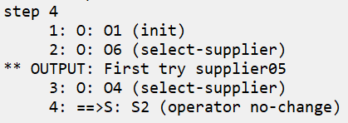
Let’s Write Some Code!
Run the agent for 4 steps to test it
You should see the following →
The first (select-supplier) works.
The second still needs an apply rule.
The one we just wrote won’t match, since the list isn’t empty anymore.
Uncomment the second apply rule for (select-supplier)
“apply*suppliersort-main*select-supplier*append”
Fill out the rule’s LHS according to the instructions in the comments
The first few lines can be the same as for the first apply rule
Instead of testing for ^count 0, test that ^last-supplier‘s name is not the operator’s supplier’s name, so the rule will only fire once.
Proceed to the next slide when you are ready to make the RHS.

Slide 23
Using Math RHS Functions
To Increment the List Element Count

Slide 24
Using the + RHS Function
Other math RHS Functions work similarly. (See the manual for details for each function.)
To increment the ^count WME, we can use the (+) RHS Function
(+) takes any number of arguments and returns their sum
In our case, if <count> is the old count that we want to increment, we can write: to replace the old count with a new count that is 1 more than the old count.
# Update the list's count of items
(<sup-list> ^count <count> -
^count (+ 1 <count>))
Note that RHS Functions only work on the RHS of a rule.
This means that you cannot test the sum of items on the LHS.
If you ever find you want to use math operations on the LHS, you must first perform the operations using a rule’s RHS and store the computed value in WM.
Then you can compare the stored value with something else in another rule’s LHS.

Slide 25
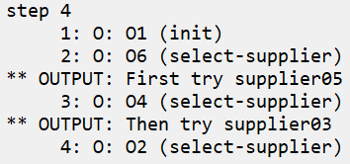
Let’s Write Some Code!
Fill out the rule’s RHS according to the instructions in the comments
You will need to use the (+) RHS Function twice
Once to set the new list item’s ^rank to (1 + the old list count)
Once to set the new list ^count to (1 + the old list count)
Reference instructor_solution.soar if you get stuck.
Run the agent for 4 steps to test it.
You should see the following →
There should be no impasses.
Proceed to the next slide when you are done.

Slide 26
Updated Output Operator
Notice that the (output-supplier-list) operator code is provided at the end of the agent_starter.soar file.
(output-supplier-list) is almost the same as (output-suppliers) from Project 04.
Take a quick look at the code to observe the differences.
We output the single list structure instead of individual suppliers.
Because (output-supplier-list) interrupts the agent, we can now test the whole agent by simply using the “run” command.

Slide 27
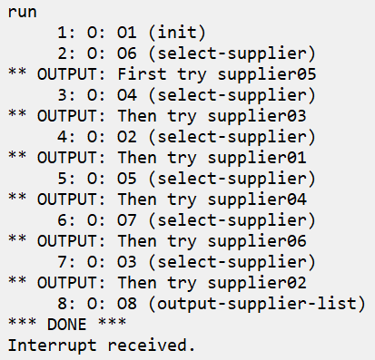
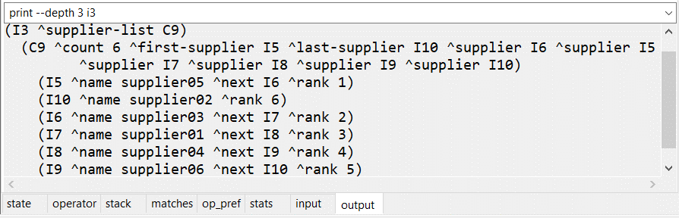
Final Results
After running your agent, you should see the following:
Each of the 6 input suppliers is selected in order.
The list is then output and the agent stops on its own.
You should be able to see the output appear in the output auto-update tab in the debugger, as shown.
All 6 suppliers are present
Each has correct ^next and ^rank values
The list ^first-supplier, ^last-supplier, and ^count values are correct
If so, congratulations! You have completed Project 05!

