Slide 1

Project 06: Substates
The Engineer’s Guide to Soar
Course 01: Soar Essentials
By Dr. Bryan Stearns, 2024

Slide 2
Problem
Solution
Our agent needs to sort suppliers with more complex reasoning.
It will eventually need to account for:
Counts of required supplies satisfied by each supplier
Supplier attribute scores in descending order of configured attribute weights
This can’t easily all be done with a single decision cycle.
Use a substate to evaluate tied suppliers.
A substate will allow us to use any number of decision cycles to derive the desired preferences.
Substate processing will effectively "pause" the top-level (select-supplier) decision-making until the agent finds the solution that lets it select one (select-supplier) operator.

Slide 3
Project Goal
For this project, agent output should be the same as for Project 05,
The agent should select suppliers in order of their total-score.
But the agent should use a substate to create its preferences.
Since our output is the same as before, the preference logic will also be the same.
Our goal here is simply to reimplement our code using a substate.
This will let us use more complex logic in future projects!

Slide 4
Lesson 06 – Outline
This lesson explains the following new concepts:
Hierarchical problem solving in Soar
Substates
Naming states
Using the "^superstate" WME
Using the “run --elaboration” command
Solving impasses in substate processing
Accessing tied operators from a substate
Returning results from a substate
Ensuring result persistence

Slide 5
Hierarchical Problem Solving
Using Impasses for Task Decomposition

Slide 6

Recall: Impasses
Recall from Lesson 03: An impasse occurs any time the agent is not able to continue its decision cycle.
This indicates a bug in our code only if we don’t want the agent to engage in a deeper level of problem solving.
Whenever a Soar agent hits an impasse, Soar treats it as a subproblem
It must be solved before the original decision making can continue.
The agent nests its subproblem solving in a new layer of decision making
Impasses thus let Soar automatically organize hierarchical problem solving
1: Prob A: Step 1
2: Prob A: Step 2
3: Prob A: Step 3
(impasse)
4: Prob B: Step 1
5: Prob B: Step 2
(impasse solved)
6: Prob A: Step 4

Slide 7
Maze Example – Hierarchical Problem Solving
What follows is an example of how a Soar developer can look at a problem hierarchically.
(At a high level without getting into code yet)
(We’ll look at what impasses and subproblems mean for code later on.)
Consider a Soar agent in a simple maze domain
The goal is to move through the maze from the start to the end.
start
end

Slide 8
Maze Example – Main Problem
Decision Making
Problem: Navigate Maze
The main problem action is to move through the maze to the end.
Operators: Propose each currently possible move forward
The agent begins decisions like this:
Step 1: Move to space 1. (the only choice)
Step 2: Move to space 2. (the only choice)
Step 3: Move to space 3. (the only choice)
But then there are 3 possible moves forward! (north, east, south)
The agent does not know which operator to select.
This leads to a Tie Impasse!
1
2
3
impasse!
The impasse entails a subproblem:
Which path should the agent take?
??
1
2
3

Slide 9
Maze Example – Subproblem 1
Decision Making
Problem: Navigate Maze
The subproblem action is to evaluate possible paths forward.
Operators: Propose to evaluate each possible next path
Prefer them in clockwise order (arbitrarily)
Decisions proceed as follows:
Step 4: Evaluate the north path. (dead end)
Step 5: Evaluate the east path…
But let’s say the agent can’t immediately tell where the east path leads.
So the operator cannot be applied.
This leads to another impasse! (operator no-change)
1
2
3
impasse!
Subproblem: Evaluate Paths
4
5
impasse!
4
The impasse entails a new subproblem:
Where does the east path lead?
1
2
3
5

Slide 10
Maze Example – Subproblem 2
Decision Making
Problem: Navigate Maze
The subproblem action is to search down the east path:
Operators: Propose to visually search down the path step by step
Decisions proceed as follows:
Steps 6…8: Scan spaces 6-8
Step 9: Scan space 9; see that it leads to the exit.
Step 9 provides the data needed to apply the operator from Step 5.
This resolves the previous impasse!
1
2
3
impasse!
Subproblem: Evaluate Paths
4
5
4
Subproblem: Look Ahead
1
2
3
5
6
7
6
7
8
9
8
9

Slide 11
Maze Example – Subproblem 1 Cont.
Decision Making
Problem: Navigate Maze
With information about the east path, the agent completes Step 5.
Decisions proceed as follows:
Step 5: Evaluate the east path. (exit in 6 moves)
Step 10: Evaluate the south path. (dead end)
After Step 10, the agent has evaluated all paths forward
It can then prefer the quickest path to the exit
This resolves the remaining impasse!
1
2
3
Subproblem: Evaluate Paths
4
5
10
4
Subproblem: Look Ahead
1
2
3
5
6
7
6
7
8
9
10
8
9

Slide 12
Maze Example – Main Problem Cont.
Decision Making
Problem: Navigate Maze
The agent proceeds solving the main problem from where it left off:
Step 11: Move to space 5
Step 12: Move to space 6
…
Step 15: Move to space 9
Step 16: Exit the maze
And the agent has solved the maze problem!
1
2
3
11
. . .
Subproblem: Evaluate Paths
4
5
10
4
Subproblem: Look Ahead
1
2
3
5
6
7
6
7
8
9
10
8
9

Slide 13
Soar Problem Space Diagramming
Problem
Operator(s) used across the problem
Impasse that leads to a subproblem
1
2
3
Legend
Hierarchical task composition helps us understand what we want a Soar agent to do.
We describe the task in terms of problems and subproblems.
We can diagram the maze task operators to help plan (as shown below).
A diagram could show any number of subproblems per problem, as needed.
2
2
2
Navigate Maze
tie
Evaluate Paths
op no-change
Look Ahead
(move)
3
(evaluate-path)
3
(scan-next)
1
1
1
(fizz)
(blah)
(abc)
(dod)
(def)
(buzz)
(ghi)
(dud)
(abc)
(ghi)

Slide 14
Soar States
But how do we translate the hierarchy of problems and subproblems into Soar code?
We encode agent behavior in terms of states and substates!
Navigate Maze
tie
Evaluate Paths
op no-change
Look Ahead
(move)
(evaluate-path)
(scan-next)

Slide 15
Substates
And How To Use Them

Slide 16
What is a State?
Working Memory
Decision Making
state
Problem: Navigate Maze
S1
A Soar agent is called “stateful” because it can hold memory for its current state of problem solving.
We learned in Lesson 01 that the “state” ID is the root of this memory graph structure
Soar keeps WM states for each active layer of problem solving at once
Each subproblem gets its own partition of the WM graph
Each partition has its own root state ID
The agent works with that partition when solving that subproblem
1
2
3
11
. . .
substate
S2
Subproblem: Evaluate Paths
4
5
10
substate
S3
Subproblem: Look Ahead
6
7
8
9

Slide 17
State Persistence
Working Memory
Decision Making
state
Problem: Navigate Maze
S1
Soar tracks states in a stack
When an impasse arises, Soar pushes a substate onto the stack
You cannot have two substates of a single parent state at the same time.
When an impasse is solved, Soar pops the substate off the stack
All WMEs for the corresponding WM partition are immediately removed from WM
1
2
3
11
. . .
substate
S2
Subproblem: Evaluate Paths
4
5
10
substate
S3
Subproblem: Look Ahead
When processing returns to Step 5 from Step 9, Soar deletes S3.
6
7
8
9

Slide 18
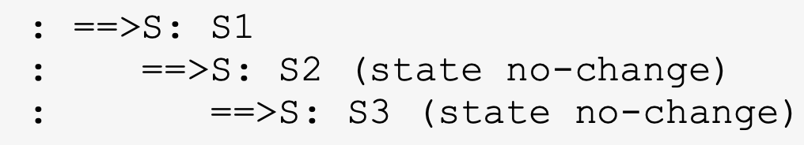
State Terminology
“state”: Can (unfortunately) be used in multiple ways:
A single specific state ID in WM
A point in the theoretical space of possible steps toward solving a problem
The set of WMEs in a problem’s WM partition, which together represent the agent’s current point in the space of problem solving
“topstate”: The initial / default WM state
The Soar CLI lets you use the keyword <ts> to quickly reference the topstate.
“substate”: Any WM state that is not the topstate.
The Soar CLI lets you use the keyword <s> to quickly reference the latest substate ID.
“superstate”: The immediate parent state to a substate
The Soar CLI lets you use the keyword <ss> to quickly reference the superstate of <s>.
Similarly, use <sss> to quickly reference the superstate of <ss>.
S3’s superstate (<ss>)
The topstate (<ts>) (also <sss> in this case)
The latest substate (<s>)

Slide 19
Substate Working Memory
Soar initializes each substate in WM with WMEs like those provided to the topstate (S1).
But only the topstate gets the ^io WME.
Soar also provides the ^superstate WME, which links a state ID to its superstate ID.
This lets rules for the subproblem access WM context from the parent problem
Soar also provides other WMEs that describe the impasse that led to the substate
For instance, (^attribute |state|) and (^impasse |no-change|) tell us that the parent state processing reached a “state no-change” impasse
(See Soar Manual page 85 for more details about these WMEs and their meanings.)
(S3 ^epmem E3 ^reward-link R7 ^smem L3 ^superstate S2 ^type state ^attribute state ^impasse no-change ^choices none ^quiescence t)
(S2 ^epmem E2 ^reward-link R4 ^smem L2 ^superstate S1 ^type state ^attribute state ^impasse no-change ^choices none ^quiescence t)
(S1 ^epmem E1 ^io I1 ^reward-link R1 ^smem L1 ^superstate nil ^type state)

Slide 20
Rule Matching Across States
In a rule, <s>/<ss>/<ts> are not keywords like in the CLI.
But it is still good practice to only use those variable names to refer to the state/superstate/topstate.
All our rules begin with “state <s> …”
The state token indicates that <s> is a state ID.
When there are multiple states in WM, <s> could match any one of them!
sp {elaborate*fizz-buzz*all
(state <s> ^type state)
-->
(<s> ^fizz buzz)}
sp {elaborate*fizz-buzz*topstate
(state <s> ^superstate nil)
-->
(<s> ^fizz buzz)}
<s> matches S1, S2, and S3
<s> matches only S1
(S3 ^epmem E3 ^reward-link R7 ^smem L3 ^superstate S2 ^type state ^attribute state ^impasse no-change ^choices none ^quiescence t)
(S2 ^epmem E2 ^reward-link R4 ^smem L2 ^superstate S1 ^type state ^attribute state ^impasse no-change ^choices none ^quiescence t)
(S1 ^epmem E1 ^io I1 ^reward-link R1 ^smem L1 ^superstate nil ^type state)

Slide 21
Naming States
Why and How

Slide 22
Using Substates for Supplier Sort
The order in which the agent selects (select-supplier) operators determines how it sorts the suppliers.
When preference logic is simple, we can use a handful of preference rules to determine selection order.
As we did in the previous project
But when preferences require step-by-step logic, we need a substate.
Eventually, we will need to support multiple kinds of step-by-step preference logic such as:
Iterating through different configuration weights
Summing and comparing sub-scores for particular input attributes
Sorting by some attributes only after first sorting by others

Slide 23
The (select-supplier) Subproblem
Decision Making
problem
Sort-Main
The subproblem begins any time the agent has a tie among 2 or more (select-supplier) operators.
This tie is an impasse in the decision cycle
Soar creates a substate for this impasse
The agent then does any number of processing steps in the substate to derive preferences among the tied operators.
The agent modifies the parent state’s WM by attaching its derived preferences to the operators there
Once the agent has enough preferences to let it pick a single (select-supplier) operator, the subproblem is solved and it can proceed as before.
1
2
3
11
12
subproblem
Sort-Tie
4
5
10
Modifying the parent state is called “returning a result” to that state.

Slide 24
What’s in a Name?
The first thing you want to do when using a substate is give each state a ^name WME.
This lets you easily control which state(s) your rules fire in.
sp {propose*for*nav-maze
(state <s> ^name nav-maze
^open-dir <dir>)
-->
(<s> ^operator <o> +)
(<o> ^name move
^direction <dir>)}
sp {propose*for*eval-paths
(state <s> ^name eval-paths
^open-dir <dir>)
-->
(<s> ^operator <o> +)
(<o> ^name evaluate-path
^path-dir <dir>)}
<s> matches S1 only
<s> matches S2 only
(S2 ^open-dir |north| ^open-dir |east| ^open-dir |south| ^name eval-paths ^superstate S1 ...)
(S1 ^open-dir |north| ^open-dir |east| ^open-dir |south| ^name nav-maze ^superstate nil ...)

Slide 25
State Names for Supplier Sort
For now, we want two states, each with their own name
S1: Name = “suppliersort-main”
Proposes the (select-supplier) operator for each input supplier
S2: Name = “suppliersort-tie”
Responds to a tie impasse in S1
Creates preferences for S1’s tied operators
One doesn’t have to always make a ^name WME for substates in Soar, but we will, because it is definitely best practice!

Slide 26

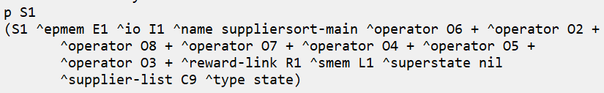
Let’s Write Some Code!
Open your agent_starter.soar file and look at the first 2 rules.
They are propose and apply rules for the (init) operator.
We want to modify our (init) operator in two ways:
It should only be proposed in the topstate.
It should create ^name suppliersort-main on the topstate.
Modify the rules accordingly, as instructed in comments.
Run the agent for 2 steps to test it.
After 2 steps, enter the command “print S1”. You should see the following:
Proceed to the next slide when you are done.

Slide 27
Let’s Write Some More Code!
Open your agent_starter.soar file and uncomment the 3rd rule.
We’ll use this elaboration rule to name the substate
Its LHS should detect that suppliersort-main had a tie impasse, and it should only fire for a substate that results from that tie impasse.
Its RHS names the resulting substate as suppliersort-tie.
Modify the rule so that it matches the following:
Tests that the immediate superstate to <s> is the state we named “suppliersort-main”.
sp {elaborate*suppliersort-tie*name
(state <s> ^superstate.name suppliersort-main
^impasse tie)
-->
(write |** (Figuring out how to sort the suppliers...)| (crlf))
(<s> ^name suppliersort-tie)}
Tests that the current substate <s> was created due to a tie impasse.

Slide 28
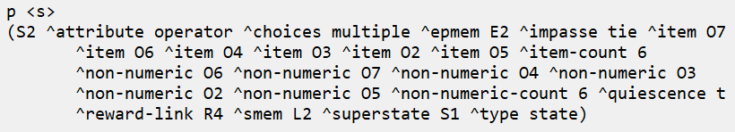
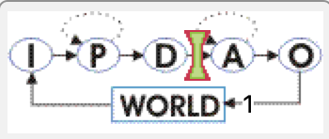
Let’s Write Some More Code!
After running the agent for 2 steps, enter the command “print <s>”. You should see the following:
The conditions are there, but where is the state name??
No worries! Our rule hasn’t fired yet after 2 steps. Soar only just finished making the substate.
Our tie impasse occurred at the end of a Decision Phase
Our rule won’t fire until the first elaboration cycle of the Apply Phase

Slide 29
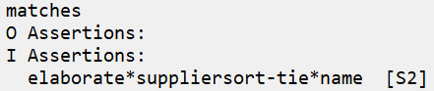
Let’s Write Some More Code!
Enter the command “matches” to see what rules match and are now about to fire. You should see the following:
If there are no bugs, your rule name should appear
It shows which state the rule will fire in: [S2]
To run for only one rule-firing cycle (an elaboration cycle) without proceeding for a full decision cycle, enter the command “run --elaboration” (or just the command “e” for short).
Your rule should then fire, so that you should see the following:
Proceed to the next slide when you are done.

Slide 30
Solving Impasses
In Substate Processing

Slide 31
Using Our Substate
We have a named substate for solving the tie impasse.
We can now use it to propose and apply operators that solve the tie.
We need two more rules, which will fire in our substate to do the following:
Propose an operator to break the tie
Propose if the state is named “suppliersort-tie”
Apply the operator to break the tie
Create preferences among all tied items based on their total-score.

Slide 32
Let’s Write Some Code!
In your agent_starter.soar file, find the commented instructions that are underneath the “## OPERATOR: break-attr-tie” comment header
Write a proposal rule here named propose*suppliersort-tie*break-attr-tie that does the following:
On its LHS: Tests that the state is named “suppliersort-tie”.
On its RHS: Proposes an operator named “break-attr-tie”.
Give it only acceptable (+) preference.
You can use the (init) proposal rule as a reference for overall rule structure.
Proceed to the next slide when you are ready to test your rule.

Slide 33
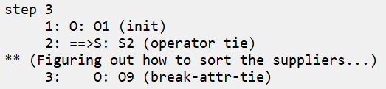
Let’s Write Some Code!
Run your agent for 3 steps. You should see the following:
If so, proceed to the next slide!
If you are stuck, compare with the instructor_solution.soar code

Slide 34
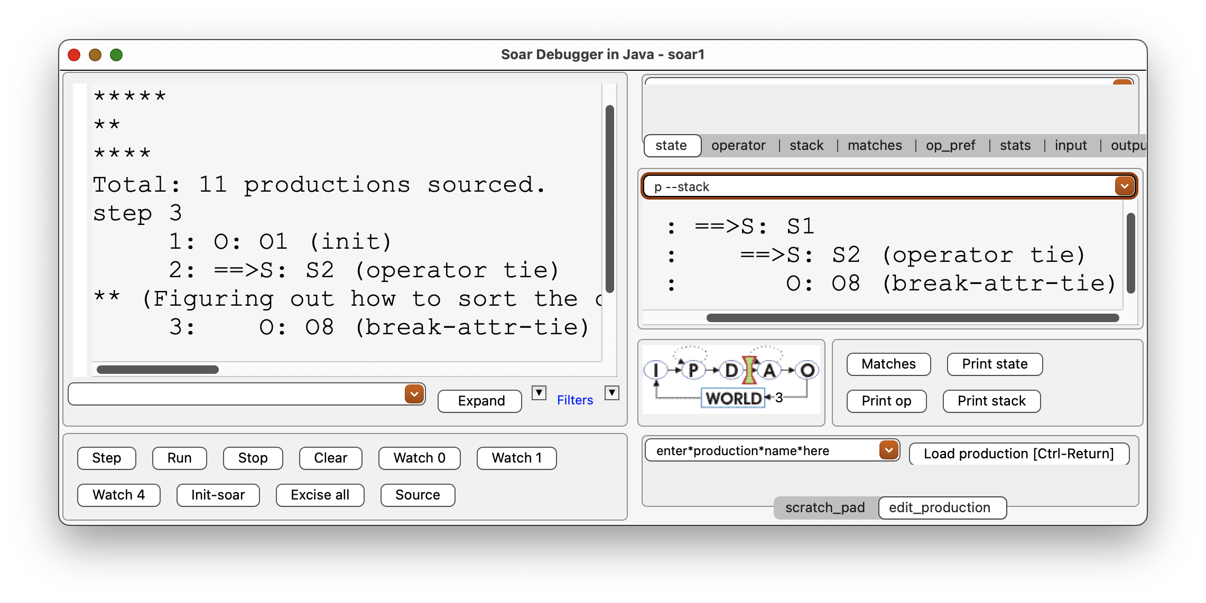
Inspecting the State Stack
You now have an operator selected in a substate (S2) after having used an operator in the topstate (S1). Well done!
At any time, you can use the command “print --stack” to see the stack of states and the operators currently selected in each.
This command is automatically entered into a debugger pane for easy reference:
Notice there is no operator currently selected in S1. (init) is complete. The tie is for the agent’s attempt to select the next operator for S1 after (init).

Slide 35
How To Solve the Impasse?
How do we use our substate operator to solve the impasse?
The solution involves multiple new concepts:
Referencing WMEs from the superstate that define the problem we need to solve
Returning the solution from the substate’s WM to the superstate’s WM
Ensuring that the solution results persist in the superstate once the substate is done

Slide 36
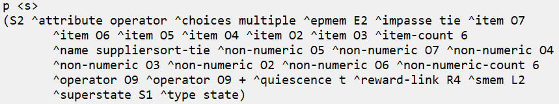
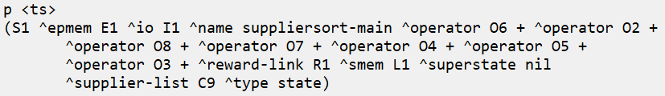
1. Referencing Tied Operators
For a tie impasse, Soar provides the substate with ^item WMEs that reference the tied operators.
Each ^item edge points to a single ^operator ID that is tied in the superstate.
S2:
These are the same IDs that exist on the topstate!
S1:

Slide 37
Referencing Only Tied Operators
Any proposed superstate operators that were not tied will not be included in this set
This is very useful when the agent has some preferences, just not enough to avoid a tie
Example: If the superstate had a preference rule to sort suppliers by ^total-sats, but 3 operators still tied for the most ^total-sats, then the substate would only see ^item WMEs for those 3 operators.
total-sats
2
2
2
1
1
0
operator’s supplier
supplier01
supplier02
supplier04
>
supplier03
supplier05
>
supplier06
Substate would only see these 3 tied winning items

Slide 38
Let’s Write Some Code!
In your agent_starter.soar file, uncomment the final rule
Named apply*suppliersort-tie*break-attr-tie*prefer-total-score
Read the provided rule code to be sure you understand how the rule works.
It is conceptually the same as the preference rule we created in Project 03.
prefer*suppliersort-main*select-supplier*total-score
But now the logic is performed from a substate.
Follow the commented instructions to do the following:
On the LHS: Get a variable reference to the suppliersort-tie state’s superstate.
Call it <ss>.
On the LHS: Get variable references to two tied operators.
Call them <o1> & <o2>.
Note: If the operator name is unique, apply rules don’t need to test the state name.
Proceed to the next slide to learn some more details we’ll need for the RHS.

Slide 39
2. Returning the Solution From the Substate
How do we solve a superstate’s impasse from a substate?
By modifying the superstate’s WM
A rule modifies its state’s superstate WM by adding/removing WMEs from any structure connected to the superstate ID.
X2 is copied from S2 to S1
state
state
state
state
state
S1
S1
S1
S1
S1
A1
A1
A1
A1
A1
impasse!
X2
X2
substate
substate
substate
S2
S2
S2
impasse
solved!
X1
X1
X1
X2
X2

Slide 40
2. Returning the Solution From the Substate
How do we solve a superstate’s impasse from a substate?
By modifying the superstate’s WM
A rule modifies its state’s superstate WM by adding/removing WMEs from any structure connected to the superstate ID.
Remember: Each time the superstate is modified, this modification is called “returning a result” from the substate to the superstate
In this example, ^fizz nil is created directly on S1 from a rule that fires in S2.
sp {elaborate*fizz-buzz*returned
(state <s> ^superstate <ss>
^drink-fizzy false)
-->
(<ss> ^fizz nil)}
(S2 ^superstate S1 ^drink-fizzy false)
(S1 ^superstate nil)
(S2 ^superstate S1 ^drink-fizzy false)
(S1 ^superstate nil ^fizz nil)

Slide 41
Let’s Write Some Code!
Open your rule, apply*suppliersort-tie*break-attr-tie*prefer-total-score
Follow the commented instructions to fill out the RHS to do the following:
Modify the superstate <ss> (“return a result”) by creating a preference between the operator IDs there.
Mark item <o1> as better than item <o2>.
Note: You don’t need to test for (<ss> ^operator <o1>) or (… <o2>), because (<s> ^item <o1> <o2>) gives us the reference to the same IDs.
Proceed to the next slide when you are ready to test your rule.

Slide 42
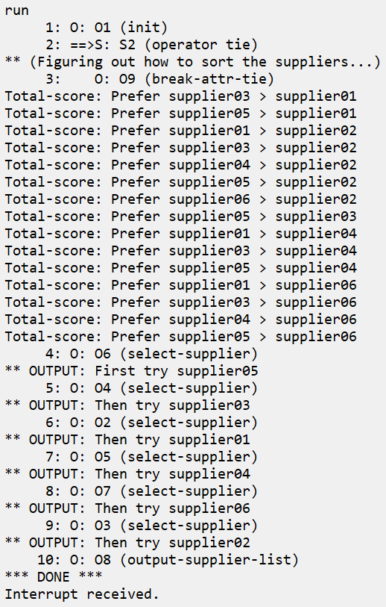
Final Results
Hit “run”, and you should see the following:
The (break-attr-tie) operator completes
Our apply rule fires for each needed preference
Topstate processing is then able to proceed to completion without further impasses, using all these results together
(Using rules imported from previous projects.)
If so, congratulations! You have completed the agent for Project 06!
But don’t close the lesson yet – there is a little bit more to explore…
Proceed to the next slide when you are ready.

Slide 43
3. Result Persistence
Recall from Lesson 03 that the actions of non-apply rules (“i-supported” rules) only persist for as long as the rule instantiation that created them still matches.
As soon as the instantiation no longer matches, the results go away.
Once our substate goes away, we see that the preferences that it created remain.
Is this because we used an apply rule to create them from the substate?
Test the theory: On your own, replace your (break-attr-tie) rules with a single preference rule that fires from the substate.
All you need to do is copy the apply rule and replace the “^operator.name break-attr-tie“ test with “^name suppliersort-tie“.
Run the modified agent. What happens?

Slide 44
Substate Rule Type Doesn’t Affect Result Persistence
The results still persist even if you don’t use an apply rule to generate them!
Why??
Result persistence is not from the substate, but from the superstate
How??
Soar treats substate results as if they were generated by a rule that fired in the superstate
What??
Soar generates a new temporary rule that acts as if it fired in the superstate to create the result
This rule is called a “justification”
Soar generates a justification for every superstate WM change made by a substate
If the justification is an apply rule, the result persists like from any apply rule
Otherwise, the result persists only for as long as the justification’s LHS matches

Slide 45
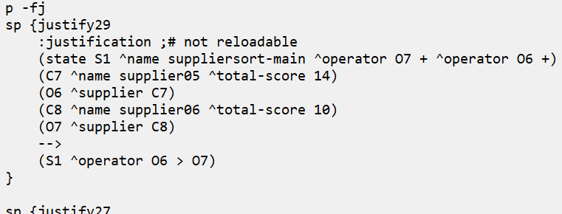
Inspecting Justifications
Run the agent for 4 steps. Then enter this command:
“print --full --justifications” (or “p -fj” for short)
Soar will show all justifications that it currently knows, such as the following:
You should see one justification for each result returned from the substate.
Soar treats these as if they were the rules that created the results.

Slide 46
Justification Properties
It “fires” from the superstate’s context
It references specific IDs and numbers, not variables
It creates the same result as the substate

Slide 47
Justification Generation
How does Soar generate each justification?
Soar automatically tracks the WMEs that each of your rules tests in their LHSs.
IF any substate rule’s LHS references a superstate WME in its LHS, AND that substate rule was needed to produce the result, THEN Soar will include that superstate WME in the justification’s LHS.
The justification’s RHS will simply be the returned result.
Most of this LHS comes directly from the apply rule for break-attr-tie,
which also generated the result.

Slide 48
Backtracing
To determine if a rule was needed for a result, Soar uses a process called backtracing.
It follows the chain(s) of dependance back from the rule that generated the result to any rule(s) that tested a parent state.
For most agents, you don’t have to worry about how this works, but it’s useful to know.
Examine your code to see how results depend on (S1 ^name suppliersort-main).
elaborate*suppliersort-tie*name tested (<ss> ^name suppliersort-main) and created (<s> ^name suppliersort-tie)
propose*suppliersort-tie*break-attr-tie tested (<s> ^name suppliersort-tie) and created (<s> ^operator.name break-attr-tie)
apply*suppliersort-tie*break-attr-tie*prefer-total-score tested (<s> ^operator.name break-attr-tie) and created the result

Slide 49
Well Done!
Congratulations! You have finished Lesson 06!
On your own: Play around with different ways of testing superstate WMEs and creating results from the substate.
Question: How might you get a justification that acted like an apply rule?
(Hint: You need a different kind of impasse than a tie impasse.)
At this point, you have learned most of the concepts you need to program Soar!
Future lessons will expand our understanding of rule coding syntax and techniques as we flesh our agent’s ability to complete its task

