Slide 1

Project 08: Code Organization
The Engineer’s Guide to Soar
Course 01: Soar Essentials
By Dr. Bryan Stearns, 2024

Slide 2
Problem
Solution
Our project code is getting fairly large!
Our agent does not yet handle the case where two weights have the same value.
Adopt better practices for organizing and maintaining a large Soar project!
When attributes share a weight, prefer by the subtotal of their scores.
Let a shared weight trigger an impasse and additional substate.
Calculate and return the subtotal from that substate so that regular processing can continue as normal.

Slide 3
Project Goal
When (evaluate-weight) processes a weight with > 1 attribute:
A new apply rule sorts suppliers by their ^subtotal attribute
This attribute doesn’t exist at first.
A new substate calculates and attaches this attribute.
Then the (evaluate-weight) apply rule can fire.

Slide 4
Lesson 08 – Outline
This lesson explains the following new concepts:
Organizing and documenting larger agents
Augmenting operator structures
Error catching
The cmd RHS Function
Parallel summation
Negated conjunctions

Slide 5
Organizing and Documenting Larger Agents
When One File Isn’t Enough

Slide 6
Outgrowing a Single File
Our agent code is getting too big to navigate in just one or two files.
What are best practices for managing larger Soar agents?
Separate files by their contents
So that related rules are in the same spot
Organize rules in each file by a consistent pattern
So it’s easy to find a rule you want
Write documentation comments in each file
So it’s easy to understand how the rules work

Slide 7
1 Separate Files by Contents
When organizing rules in .soar files, the following convention is suggested:
Have a separate file for loading all other files and setting Soar parameters
Make it responsible for all CLI commands other than “sp {…}”
Tip: Begin its filename with “_” so that it is always first in the directory.
Group rules into separate files so that each substate has its own file.
Though if a substate has only 1 rule, you might include it in its superstate’s file.
Make a separate file for rules that fire in multiple substates.
In this project, we will have 3 states, and each gets its own file:
Take a moment to look through the project folder and familiarize yourself with these files.
File Name | Purpose
_firstload_agent_starter.soar | Loads all other files
existing_code_06_main.soar | Rules for state suppliersort_main
agent_starter_tie.soar | Rules for state suppliersort_tie
agent_starter_find_subtotal.soar | Rules for state suppliersort_find_subtotal
Provided solution files are named with “instructor_solution” instead of “agent_starter”.

Slide 8
2 Organize Rules In Each File
The following convention will help you easily navigate your rules:
Put elaboration rules at the top of the file
Then put preference rules that involve operators of different names, if any (e.g. “op-1 > op-2”)
Then put rules for each operator, in order of rule type:
Proposal rules
Preference rules specific to only this operator, if any
Apply rules
We’ve been using this convention already throughout our projects!

Slide 9
3 Write Documentation in Each File
Rule
Operator / Group
File / Substate
Whole Agent
Rule
Group / Operator
File / State
Whole Agent
Good documentations should explain each level of code design:
What each rule does
What each group of rules does
(such as for a single operator)
What the processing in each state does
What the whole agent does
For each level, documentation should explain:
The LOGIC of the code
(the goal and steps of processing)
The DATA STRUCTURES used by the code
(the WMEs and what they represent)
DATA
LOGIC
DATA
LOGIC
DATA
LOGIC
DATA
LOGIC

Slide 10
Whole Agent README Convention
Whole Agent
In the file that loads all other files (i.e. _firstload_agent_starter.soar):
Have a README at the top that explains the whole agent:
Look at the README in _firstload_agent_starter.soar file for an example.
### AGENT README ###########################################
# AUTHOR: <names here>
# DATE: <date here>
# DESCRIPTION: <one-line description here>
#
## AGENT FILES
# file_1.soar | <one-line file description here>
# file_2.soar | <one-line file description here>
#
## AGENT LOGIC
# <longer whole-agent overview>
#
## I/O
# <required I/O WME schema here>
############################################################
This is a useful reference for app developers who want to interface with your agent!

Slide 11
WME Schema Convention
Using “|” as a column separator makes it easier to copy this into a markdown table if desired.
The following is a recommended way to document WME structures, such as for I/O:
# ^settings ID | 0/1 | The ID of the settings object
# ^max-output-suppliers INT | 0/1 | The maximum suppliers to output
# ^priorities ID | 1 | The ID of the priorities object
# ^total-cost FLOAT | 1 | The weight of the total-cost attribute
# ^<attribute-name> INT | 0+ | The weight of the named attribute
Nested indentation shows tree structure
Data type of the WME value (ID / INT / FLOAT / STRING)
Short description of the WME’s purpose.
Prefix with ”(ss)” if this WME is copied from a superstate.
WME attribute name.
<brackets> indicate a wildcard pattern for WMEs other than those already described.
How many instances of this WME pattern can exist at once.
(0/1) = Zero or One, (0+) = Zero or More, (1+) = One or More

Slide 12
State File README Convention
File / Substate
Use a similar README format for the other files that hold your rules
It should only describe the logic and WMEs used across that file as a whole
Look at the README in existing_code_06_main.soar for an example.
SUBSTATE DEPTH shows how deeply this logic appears in the agent’s reasoning. (The topstate is depth 1.)
If it can be at multiple depths, indicate so here as well.
### <STATE-NAME> STATE README ##############################
# AUTHOR: <names here>
# DATE: <date here>
# SUBSTATE DEPTH: <which layer in the state stack>
# DESCRIPTION: <one-line description here>
#
## OPERATORS
# (op1-name) + > | <one-line operator description here>
# (op2-name) + = < | <one-line operator description here>
#
## WORKING MEMORY
# <WME schema here>
############################################################
After each operator’s name is its set of unary preferences

Slide 13
Operator Header Convention
Group / Operator
Put a multi-line header in front of each operator
If an operator has a non-trivial set of WMEs attached to it, add WME schema documentation to the header for that operator.
Put the schema here instead of with the state-level README, because the WMEs are specific to the operator, not the whole state.
See the header for (evaluate-weight) in agent_starter_tie.soar for an example.
##############################
## OPERATOR: <name here>
# <full description here>
## WORKING MEMORY
# <WME schema here if needed>
##############################

Slide 14
Individual Rule Documentation
Rule
There are 2 main types of comments you can add to rules:
Syntactic documentation strings
These are loaded with the rule and can be inspected in an agent when printing the rule.
Use these to summarize the rule’s purpose.
Regular comments
The parser ignores these when loading rules into the agent.
Use these to label sections of a long rule to make it easier to read
Or use these to explain a single complicated/unusual line.
Look at the rules in existing_code_06_main.soar for more examples.
sp {propose*suppliersort-main*select-supplier
"Propose any supplier given on the input-link."
(state <s> ^io.input-link.candidate-supplier <sup>
^supplier-list <sup-list>)
# Check that there is an input supplier that is not yet in the list
(<sup> ^name <name>)
(<sup-list> -^supplier.name <name>) # Retract the proposal once this supplier is added
-->
(<s> ^operator <o> +)
(<o> ^name select-supplier
^supplier <sup>)}
Describes a section
Describes a single line

Slide 15
That’s a lot of comments!
”But that seems like a lot of work to write all that documentation!”
As with any large project (especially ones that other people might need to look at):
It will save YOU time later when you need to come back and edit your own code!
You will need to write documentation anyway for any formal industry project.
It makes code development and collaboration MUCH EASIER even when it’s fresh in your head!
For navigating your files to find the operators/rules you want to edit
For quickly double-checking a WME’s name/usage without having to read through all the rules that might reference it.
For assisting LLM tools with suggesting meaningful code
It doesn’t actually take that much time if you write it as you write your code!
These are the documentation conventions that I find most useful as a developer.

Slide 16
Other Conventions
There are other conventions you can use for organization and documentation
Such as putting elaborations and each operator into their own files,
(The Visual Soar editor uses this approach.)
Or making a separate markdown file for each README.
But be consistent!
The goal is to make it easy for a programmer to understand what the code is doing.
It’s okay to keep rules for substates or operators in a single file when the code is small.
Like we did for our first projects
Err on the side of more comments, not fewer!

Slide 17
Augmenting Operators
For Detecting Multiple Attributes with a Shared Weight

Slide 18
Lesson 07 Review: Handling Tied Weights
S1 ^io.input-link I2
^priorities P1
^total-cost 11.01
^sustainability 11
^quality 11
^availability 8
^packaging 8
^speed 7
^candidate-supplier C1
^name |supplier01|
^total-score 12
^total-sats 2
^total-cost 35.0
^sustainability 3
^availability 3
^quality 1
^packaging 3
^speed 2
...
What if two attributes share the same weight?
Then we want to sort by the sum of those attribute scores
Example: Say sustainability and quality both have weight 11
sustainability + quality
3+3
3+3
3+2
2+3
3+1
2+1
operator’s supplier
supplier03
supplier05
>
supplier04
supplier02
>
supplier01
>
supplier03
We first need to be able to detect when there are multiple attributes for a single weight!

Slide 19
Goal: Detecting Multiple Attributes
Our proposal for (evaluate-weight) only attaches a single attribute to the operator.
If there are multiple attributes per weight, the proposal fires once for each one.
It would be nice if both attributes for the one weight were attached to the same operator.
Then our apply rules could quickly detect if there was more than one attribute.
O1
name
O2
name
“evaluate-weight”
“evaluate-weight”
weight
weight
11
11
Operator 1
attribute
attribute
Operator 2
”sustainability”
”quality”
O1
name
“evaluate-weight”
weight
Combined Operator
11
attribute
”sustainability”
attribute
”quality”

Slide 20
Solution: Augment the Operator
We can write a rule that will attach these attributes to the operator after it is selected.
We can modify the ^operator object at any time just like any other object.
Our new rule should match for any attribute that matches the current operator’s weight, and then attach that attribute to the current operator.
This rule could be either an elaboration rule or an apply rule.
We prefer to use an apply rule, because it is more computationally efficient.
(The ^operator condition is very specific, so Soar can usually exclude apply rules from match computations very quickly when they don’t match.)
Our apply rule will modify its own operator:
O1
name
“evaluate-weight”
O1
name
weight
“evaluate-weight”
11
weight
11
attribute
”sustainability”
attribute
”sustainability”
propose
select
apply
attribute
”quality”

Slide 21
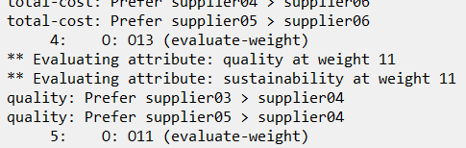
STEP 1: New (evaluate-weight) Apply Rule
Open your agent_starter_tie.soar file and find the comments for STEP 1.
Write the desired rule according to the instructions.
It should fire once for each input priority attribute that has the selected weight value and attach that attribute to the selected operator.
HINT: Reference input priority attributes in the same way the proposal does.
The RHS will add a single ^attribute WME to the selected operator.
Test that your rule by running for 5 steps.
After the agent evaluates total-cost, you should see two messages from your new rule firing for weight 11, one for each of quality and sustainability.

Slide 22
An i-supported Apply Rule?
This new rule is actually i-supported, not o-supported.
Its results are undone as soon as its instantiation no longer matches. (see Lesson 06)
In Soar, any rule that modifies an ^operator object is given i-support, even apply rules.
So operator proposals/preferences will always be i-supported (they modify operators).
See Soar Manual section 2.7.6 (page 32) for more explanation.
This makes no difference for our agent.
Our new rule won’t retract before the proposal does.
But sometimes (rarely) this behavior becomes important.
Main takeaway: Treat rules that augment operators as if they are elaboration rules.
sp {apply*my-op*modify-operator
“An i-supported apply rule”
(state <s> ^operator <o>
^fizz <buzz>)
(<o> ^name my-op)
-->
(<o> ^fizz <buzz>)}

Slide 23
STEP 2: Detecting Multiple Attributes
And Triggering and New Substate

Slide 24
Review: Desired (evaluate-weight) Behavior
If there is only 1 attribute for the selected operator’s weight:
Prefer the supplier with the best score for that attribute.
(This is the behavior we’ve already written.)
But if there are more attributes:
Calculate subtotals for each supplier across these attributes (in a new substate).
Prefer the supplier with the best subtotal.
This means we don’t want our existing apply rules to fire when there is more than 1 attribute!
✗

Slide 25
Conditional Sets of Apply Rules
When there is only 1 attribute for the selected weight:
Our existing apply rules sort by supplier score for that attribute.
When there is >1 attribute for the selected weight:
Initially, no apply rule should match.
This will trigger an operator no-change impasse
We will calculate our subtotal in the resulting substate.
(We need to modify our old apply rules so they don’t match in this case.)
Then an apply rule should match and create a preference via the calculated subtotal.
(We also still need to make this apply rule.)

Slide 26
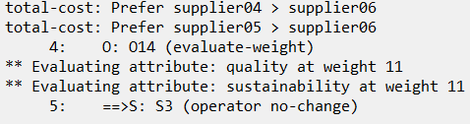
STEP 2: Modify the Old Apply Rules
In agent_starter_tie.soar, find the rule marked with comment “STEP 2.1”.
Add a new LHS condition that tests that the ^operator object has no ^attribute WME values that are not <attr>.
Notice the double negative: You will need both a negation condition and a not-equals (“<>”) comparison.
Find the rule marked “STEP 2.2” and add the same new condition there.
(NOTE: We don’t need to add this negative condition to the prefer*by-total-cost rule, because total-cost is guaranteed to never share a weight with another attribute.)
Test your code by running for 5 steps again.
You should see only an operator no-change impasse after the “** Evaluating attribute …” messages.

Slide 27
STEP 3: Error Catching
For Quicker Debugging

Slide 28
Provided Code For suppliersort-find-subtotal
Open your agent_starter_find_subtotal.soar file.
This file is for the suppliersort-find-subtotal substate
This substate will calculate our subtotals.
It provides rules that name the state and copy important structures down for you.
You will need to fill in the steps for summing the subtotal values,
Referencing the WM Schema provided in the README at the top of the file.
Review the file now and familiarize yourself with the README and the provided content.

Slide 29
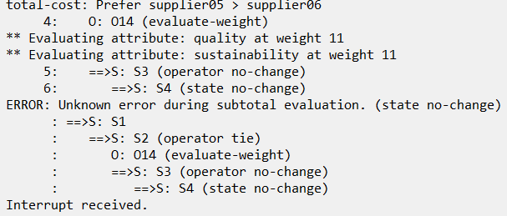
STEP 3: Error Catching
The suppliersort-find-subtotal state is the deepest state our agent should ever reach.
If the agent hits any more impasses, it indicates an error.
It is very good practice to write rules that catch error situations in your agent.
Similar to try/catch blocks in classic programming languages
Uncomment the “STEP 3” rule found at the end of agent_starter_find_subtotal.soar.
Notice the comment section header that notes this rule is technically for a different state than the rest of the file. But the rule is placed in this file because it catches errors from logic in this file.
Fill in the underscores according to the instructions in the comments.
(We’ll explain the provided RHS next.)
Test your rule by entering “run” on your agent.
You should see an interrupt after step 6.

Slide 30
The cmd RHS Function
Running CLI Commands From Rules

Slide 31
Using cmd For Custom Printouts
Our error catching rule included the following in its (write) arguments:
(cmd |print --stack|)
The (cmd) RHS Function:
Runs the given string argument as a CLI command.
(In this case, we use it to tell Soar to print out the state stack.)
Returns the string output of the given command (if any)
You can use (cmd) to print a custom message to help with diagnosing the caught error.
This can be helpful when running your agent from an app rather than from the debugger.
Try replacing the given command with |print <ss> -d 2|.
You can also use it to run any command you like!

Slide 32
Parallel Summation
Using Soar for Multi-Step Math

Slide 33
Parallelism Constraints
We want to sum any number of attribute scores across any number of suppliers:
We can take advantage of Soar’s parallelism when performing math in Soar!
And avoid the need to iterate through individual suppliers!
But we have constraints common to all parallel logic:
We can’t add more than one value to the same variable at once!
supplier01
attribute1 + attribute2 + attribute3 =
subtotal01
supplier02
attribute1 + attribute2 + attribute3 =
subtotal02
supplier_N
attribute1 + attribute2 + attribute3 =
subtotal_N
. . .

Slide 34
Parallelism Constraints – Example
Addend
1
3
2
Subtotal
0
Say we wanted to sum the addends (1,3,2) with an existing subtotal of 0, for a new subtotal of 6.
We could try to use a rule like this:
But each addend would then be added to the same <old-total> value in parallel,
Replacing 1 old subtotal with 3 new subtotals!!!
sp {elaboration*add-to-total
(state <s> ^subtotal <old-total>
^addend <addend>)
-->
(<s> ^subtotal <old-total> -
^addend <addend> -
^subtotal (+ <old-total> <addend>))
Removes the old total and the addend so that they are not added together again.
Replaces the subtotal with the sum.
Subtotal
1
3
2
(<s> ^subtotal 0 –
^addend 1 -
^subtotal 1)
(<s> ^subtotal 0 –
^addend 3 -
^subtotal 3)
(<s> ^subtotal 0 –
^addend 2 -
^subtotal 2)

Slide 35
Guided Parallelism with Operators
We can only add a single value to each subtotal at a time.
But we can add to each subtotal in parallel!
We can use operators to select a particular attribute to add at a time,
And then add the selected attribute’s scores to all supplier subtotals in parallel:
 | Ch 01 | Ch 02 | Ch 03
Attr 1 | 1 | 3 | 1
Attr 2 | 3 | 3 | 1
Attr 3 | 2 | 2 | 1
supplier01
attribute1 + attribute2 + attribute3 =
subtotal01
supplier02
attribute1 + attribute2 + attribute3 =
subtotal02
supplier_N
attribute1 + attribute2 + attribute3 =
subtotal_N
step 1
. . .
step 2
step 3
 | Ch 01 | Ch 02 | Ch 03
subtotal | 1 | 3 | 1
 | Ch 01 | Ch 02 | Ch 03
subtotal | 1 | 3 | 1
subtotal | 4 | 6 | 2
 | Ch 01 | Ch 02 | Ch 03
subotal | 1 | 3 | 1
subtotal | 4 | 6 | 2
subtotal | 6 | 8 | 3
step 1: attribute1
step 2: attribute2
step 3: attribute3

Slide 36
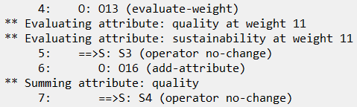
STEP 4: Proposing (add-attribute)
We want to propose an instance of the (add-attribute) operator for each attribute that shares the given weight for this substate.
Find the rule marked “STEP 4” in your agent_starter_find_subtotal.soar file.
Uncomment it and fill in the underscores as directed to make the proposal rule.
Test your code by running your agent until your error-catch rule interrupts it.
Notice the provided apply rule (right below your new rule) that prints the attribute.
If your rule works correctly, it should trigger this apply rule before reaching an impasse:

Slide 37
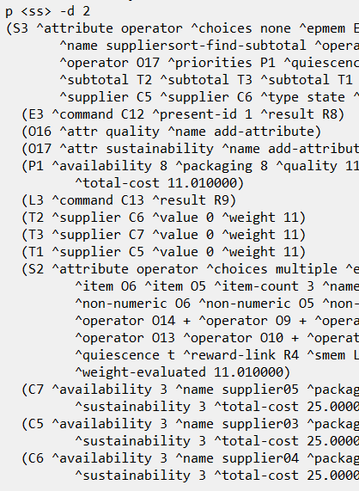
STEP 5: Applying (add-attribute) – Initialize Subtotals
We want to use an apply rule to initialize the subtotal for each supplier
Only whenever the subtotal doesn’t yet exist.
Find the apply rule marked “STEP 5” in the same file.
Uncomment it and fill in the underscores as directed.
You’ll want to use a negated condition chain. (e.g. <s> -^fizz.buzz <var>)
You’ll need to read the README’s WM schema and create the ^subtotal structure to match what is described there.
Test your code by running your agent until interrupted.
“print <ss> --depth 2” should show your initialized subtotals under S3 in WM.

Slide 38
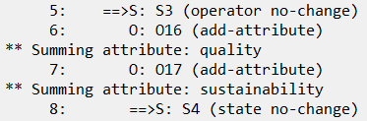
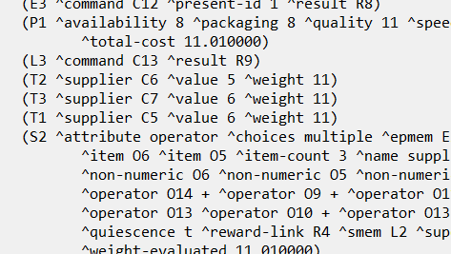
STEP 6: Applying (add-attribute) – Add to Subtotals
We want to use an apply rule to add appropriate attribute scores to each subtotal
Find the apply rule marked “STEP 6” in the same file.
Uncomment it and fill in the underscores as directed. It should:
Remove the old subtotal’s value and replace it with the sum of the old subtotal plus a single attribute addend.
Mark the selected attribute as summed, so your proposal retracts.
(Make sure your proposal tested for -^addends-summed <attr>.)
Test your code by running your agent until interrupted.
You should now see (add-attribute) selected and applied twice,
Followed by a state no-change instead of an operator no-change.
“print <ss> -d 2” should show non-zero values for subtotals.

Slide 39
Negated Conjunctions
Testing That a Particular Combo Doesn’t Exist

Slide 40
Almost There: Returning Results
Our (add-attribute) operator calculates subtotals now!
The only step remaining for this substate is to return the subtotals to the superstate.
We want to return a supplier’s subtotal as soon as all its attributes have been summed.
Return any supplier’s subtotal as soon as there is an “^addends-summed” WME for each of its attributes for this substate’s weight.
Can we use another apply rule to do that?
Not easily: Our proposal retracts as soon as the ^addends-summed WME is added.
The operator will end before an apply rule could react to ^addends-summed.
The simplest approach is to instead use an elaboration.
It can return the results whether an operator is selected or not.

Slide 41
Detecting Completion
A more formal way to say that there is an ^addends-summed WME for each of a supplier’s attributes for the substate’s weight is as follows:
For a given supplier’s subtotal and a given substate’s weight, It is NOT the case that:
The supplier has an attribute score for that weight, AND
There is no ^addends-summed WME for that attribute.
This is a bit more complex than LHS tests we’ve worked with so far.
Notice that neither of the following would work:
(<s> ^weight <weight>
^priorities.<attr> <weight>
^subtotal.supplier.<attr> <score>
^addends-summed <attr>)
(<s> ^weight <weight>
^priorities.<attr> <weight>
^subtotal.supplier.<attr> <score>
-^addends-summed <attr>)
✗
✗
“Any 1 attribute has a matching ^addends-summed.”
“Any 1 attribute is missing a matching ^addends-summed.”

Slide 42
Negated Conjunctions
In Lesson 03 we learned about negative WME tests.
e.g. “–(<s> ^fizz |buzz|)”
In Lesson 07 we learned about condition conjunctions.
e.g. “(<s> ^fizz {<buzz> <> |bizz|})”
Soar lets you surround whole WME blocks with “{ }” brackets to form a conjunction that you can negate!
e.g. “–{(<s> ^fizz <buzz> ^child <c>) (<c> ^fizz <buzz>)}”
This example tests, “It is not the case that any (<s> ^fizz <buzz>) has the same value as any (<s> ^child.fizz <buzz>).”

Slide 43
Using a Negated Conjunction
To represent our desired test:
It is NOT the case that:
The supplier has an attribute score for that weight, AND
There is no ^addends-summed WME for that attribute.
We can use the following:
(<s> ^weight <weight> ^subtotal.supplier <sup>)
-{(<sup> ^<attr> <score>)
(<s> ^priorities.<attr> <weight>
-^addends-summed <attr>)}

Slide 44
Using a Negated Conjunction
To represent our desired test:
It is NOT the case that:
The supplier has an attribute score for that weight, AND
There is no ^addends-summed WME for that attribute.
We can use the following:
…the supplier has an attribute score for the selected weight…
(<s> ^weight <weight> ^subtotal.supplier <sup>)
-{(<sup> ^<attr> <score>)
(<s> ^priorities.<attr> <weight>
-^addends-summed <attr>)}
It is NOT the case that…
…AND there is no ^addends-summed WME for that attribute.

Slide 45
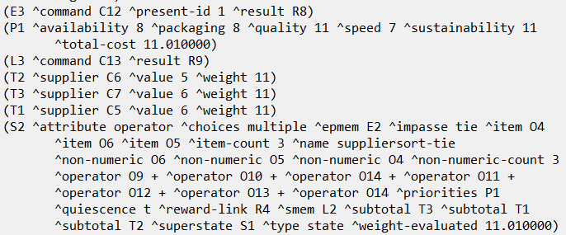
STEP 7: Returning Subtotals
Find the elaboration rule marked “STEP 7” in agent_starter_find_subtotal.soar.
Uncomment it and fill in the underscores as directed.
Use the negated conjunction shown on the previous slide.
Read it carefully to make sure you understand the logic behind it!
Test your code by running your agent until interrupted.
“print <ss> -d 2” should show that your subtotals have been copied to S2.
(We still impasse because the superstate doesn’t respond to subtotal results yet!)

Slide 46
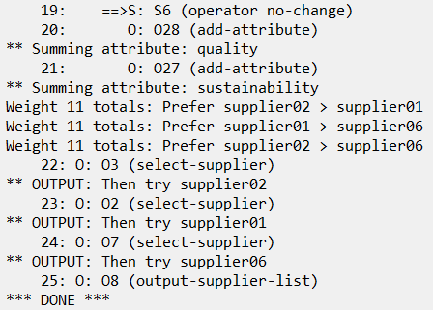
STEP 8: Respond to Returned Subtotals
We’re almost done!
Open agent_starter_tie.soar and find the rules for STEP 8.1 and STEP 8.2.
Uncomment these. They are already written for you.
They respond to returned subtotals by creating preferences for the topstate,
Very similar to other rules we wrote previously for the suppliersort-tie state.
But they still need proper documentation!
Examine the rules to figure out how they work.
Write meaningful comments and documentation strings that explains them.
Write what would explain them best to you as a programmer!
Test the agent by running it.
It should now run to completion, using subtotals to make preferences from the suppliersort-tie state!
Congratulations! You have completed Lesson 08!

