Slide 1

Project 09: Combining Preferences
The Engineer’s Guide to Soar
Course 01: Soar Essentials
By Dr. Bryan Stearns, 2024

Slide 2
Problem
Solution
Our agent is supposed to filter input suppliers before sorting by weighted scores.
Our agent is supposed to limit the number of recommendations it gives.
Our agent can only handle a single round in input/output.
Use preferences to add the needed behavior.
Learn how to reset our agent after it sends output.
Finish our Supplier Sort agent code!

Slide 3
Lesson 07 Review: Sorting Steps
S1 ^io.input-link I2
^priorities P1
^total-cost 11.01
^sustainability 11
^quality 10
^availability 8
^packaging 8
^speed 7
^candidate-supplier C1
^name |supplier01|
^total-score 12
^total-sats 2
^total-cost 35.0
^sustainability 3
^availability 3
^quality 1
^packaging 3
^speed 2
...
Recall from Lesson 07 the following goal for our agent’s sorting:
Exclude suppliers where total-sats == 0
Sort suppliers by total-sats in descending order
Iteratively sort suppliers by attributes in priority weight order
Sort remaining tied suppliers by total-score
Sort remaining tied suppliers randomly
We’ve implemented steps 3-4.
We implement the rest now!

Slide 4
Project Goals
Combine (select-supplier) preferences to filter and pre-sort suppliers before sorting them with (evaluate-weight):
Reject any suppliers that have a total-sats value of 0.
Prefer suppliers with a higher total-sats value.
Limit the output list size based on an input setting.
Be able to process new input after giving output
Without killing and respawning the agent

Slide 5
Deployable File Names
In the past, we’ve named files that we’ve imported from previous projects with the prefix:
“existing_code_X_...”
And files that we edited in that lesson were named:
“agent_starter_...”
“instructor_solution_...”
Obviously, this naming scheme is not what you want to see in a real-world agent.
In this lesson, we wrap up our agent code, so we use a more deployable naming scheme:
All your “agent_starter_...” files are simply named for their state.
(Not to worry: There are still “instructor_solution_...” files too for reference.)
By the end of this lesson, all your agent files will look production-ready!

Slide 6
Lesson 09 – Outline
This lesson explains the following new concepts:
Using the "reject” (-) preference
Using the “soar init” command
And we finish our agent code!

Slide 7
STEP 1: Pre-Sort by total-sats
To Meet Client Constraints

Slide 8
What Does total-sats Mean?
S1 ^io.input-link I2
^priorities P1
^total-cost 11.01
^sustainability 11
^quality 10
^availability 8
^packaging 8
^speed 7
^candidate-supplier C1
^name |supplier01|
^total-score 12
^total-sats 2
^total-cost 35.0
^sustainability 3
^availability 3
^quality 1
^packaging 3
^speed 2
...
Each input supplier has the ^total-sats augmentation
This metric is independent from other augmentations.
It represents the count of data elements that the client needs that can be supplied by this supplier.
Example: The client needs to choose a set of suppliers from which to purchase the following two pieces of data:
The member’s colorectal screening status
The member’s BMI
If a supplier cannot provide either of these, its ^total-sats is 0.
If a supplier has one of these but not the other, ^total-sats is 1.
And so on.

Slide 9
Pre-Sort: Combining Preferences
We want to use ^total-sats to pre-sort the suppliers:
Prefer suppliers that provide more required data over others.
If any ties remain after sorting by ^total-sats, then break the tie with our tie substate.
If desired, we could combine any number of preference rules on the topstate to create relative orderings among suppliers in parallel.
But we would need to be careful to avoid creating conflicting preferences
Example:
Prefer A > B because A.fizz > B.fizz
Prefer B > A because B.buzz > A.buzz

Slide 10
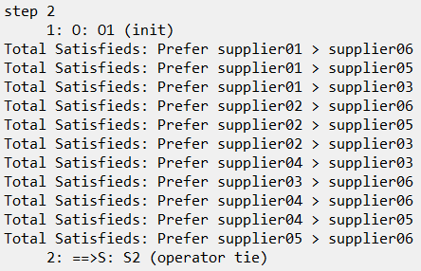
STEP 1: Let’s Write Some Code!
Open suppliersort_main.soar.
Find the comment instructions for STEP 1.
Write a preference rule that that prefers one (select-supplier) operator over another if it has a higher ^total-sats value.
Recall that to test for a proposed operator, test for: (state <s> ^operator <o1> + )
total-sats is then under the operator: (<o1> ^supplier.total-sats <y1>)
Don’t forget to add a (write …) statement so you can quickly see what preferences your rule makes.
Test your code by running for at least 2 steps.
You should see the following preferences created →

Slide 11
STEP 2: Using the Reject Preference
Filtering Out Invalid Suppliers

Slide 12
The Reject Preference
The Reject (“–”) preference is one of the unary preferences we saw in Lesson 03.
A Soar agent will never select an operator that has the Reject preference,
Even if it has other preferences like Best (“>”) or Require (“!”).
sp {prefer*my-operator*reject*completed
(state <s> ^operator <o1> +
^work-completed <w>)
(<o1> ^work <w>)
-->
(<s> ^operator <o1> - )}
The difference between Reject (“–”) and Prohibit (“~”) has to do with Soar’s “Chunking” learning algorithm, which is beyond the scope of this course.

Slide 13
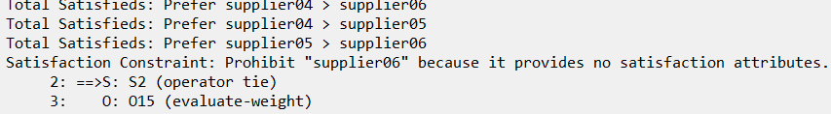
STEP 2: Reject Suppliers With 0 total-sats
If a supplier does not satisfy any client’s needs, the agent should not recommend it.
Rejecting its (select-supplier) operator will prevent it from being added to the output list!
Find the comment instructions in suppliersort_main.soar for STEP 2.
Add a preference rule there that rejects any (select-supplier) operator that proposes a supplier that has a total-sats count of 0.
Don’t forget to add a (write …) statement so you can quickly see what preferences your rule makes.
Test your rule by running your agent to completion.
You should see ”supplier06” rejected now.
The agent’s output list should not include supplier06 anymore.

Slide 14
STEP 3: Limit List Size
Another Use for Reject Preferences

Slide 15
Responding to List Length
Agent input includes a structure named “^settings”.
It has one augmentation, ^max-output-suppliers, which sets the maximum number of suppliers that should be in the agent’s output recommendation list.
The list can be smaller, but it should not be larger than this count.
We can add a single Reject preference rule to implement this behavior!
S1 ^io.input-link I2
^settings I4
^max-output-suppliers 3
...

Slide 16
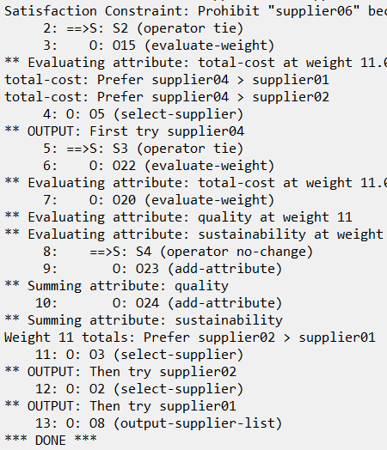
STEP 3: Reject (select-supplier) Once the Max is Met
Find the comment instructions in suppliersort_main.soar for STEP 3.
Add a preference rule there that:
Tests if the current size of ^supplier-list is greater or equal to max-output-suppliers.
Rejects any (select-supplier) operator if so.
Test your rule by running your agent to completion.
The agent should finish after about 13 steps. →
The agent’s output list should only include 3 suppliers.

Slide 17
STEP 4: Break True Ties Randomly
Using Indifferent Preferences

Slide 18
Lesson 07 Review: Sorting Steps
S1 ^io.input-link I2
^priorities P1
^total-cost 11.01
^sustainability 11
^quality 10
^availability 8
^packaging 8
^speed 7
^candidate-supplier C1
^name |supplier01|
^total-score 12
^total-sats 2
^total-cost 35.0
^sustainability 3
^availability 3
^quality 1
^packaging 3
^speed 2
...
Recall from Lesson 07 the following 5-step goal for our agent’s logic:
Exclude suppliers where total-sats == 0
Sort suppliers by total-sats in descending order
Iteratively sort suppliers by attributes in priority weight order
Sort remaining tied suppliers by total-score
Sort remaining tied suppliers randomly
We’ve implemented the first 4 steps.
Only 1 step left to add!

Slide 19
Where To Code Final Sorting Step?
We can describe our agent as having 3 stages of sorting:
Preferences that fire before (evaluate-weight)
Preferences generated by (evaluate-weight)
Preferences that fire after (evaluate-weight), using (break-attr-tie)
We want to sort suppliers randomly if they are still tied after these 3 stages.
Can we do this without adding a new operator?
Yes!
We can add this final step as a second apply rule of (break-attr-tie).
Recall: The existing apply rule sorts suppliers by total-score.
The new rule should only sort suppliers randomly if their total-scores are the same!

Slide 20
Using Different Test Input
The test input we’ve used so far will not test our desired behavior.
We need an alternate test case!
Open your Project 09 folder and look at “fake_agent_input_2.soar”.
The suppliers have different values than we’ve used so far.
The max-output-suppliers setting is set to 5 instead of 3.
Figure out how the agent ought to sort these suppliers and why:
First Supplier01 (why?)
Then Supplier02 (why?)
Then Supplier03 (why?)
Then two of Suppliers 04, 05, or 06 in random order.

Slide 21
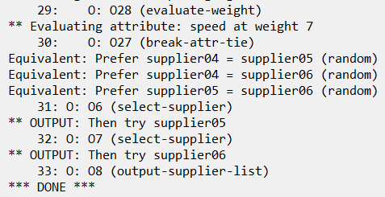
STEP 4: Let’s Write Some Code!
Open _firstload_suppliersort.soar and uncomment the line that loads fake_agent_input_2.soar.
(You can comment out the previous line that loads the other input.)
Now find the comments in suppliersort_tie.soar labeled “STEP 4.”
Write a new apply rule there for break-attr-tie that creates a binary indifferent preference between any two tied suppliers that have the same total-score.
Hint: You can copy most of the rule code from the other apply rule, (apply*suppliersort-tie*break-attr-tie*prefer-total-score)
Include an appropriate (write) statement that shows which pairs of suppliers are given binary indifference.
Test your rule by running your agent to completion.
You should see suppliers 4, 5, and 6 given binary indifference relative to each other. →

Slide 22
The soar init Command
So One Agent Can Process Many Jobs

Slide 23
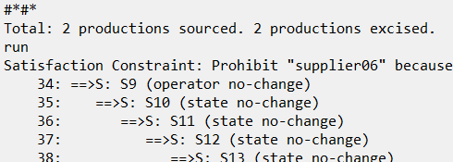
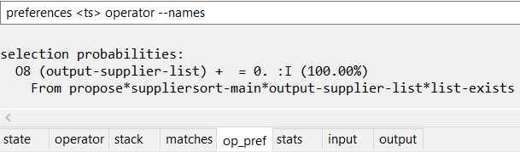
Multi-Job Agents
Reminder: Use the “Source” button in the Java Debugger to quickly load a .soar file to your agent.
After our agent sends output, what if we want it to then process different inputs?
Test it:
Run your agent to completion using fake_agent_input_2.soar as an initial set of inputs.
Then manually load fake_agent_input.soar into your agent as a new set of inputs.
The fake_agent_input_... rules use the same rule names, so one file will overwrite the other.
Run your agent from its current state. What happens?
The agent enters a state no-change loop.
The problem: Our supplier-list object is still there.
So our agent still tries to apply (output-supplier-list)
This causes an operator no-change impasse, followed by the state no-change impasses.

Slide 24
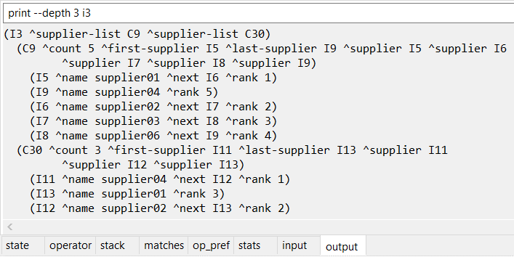
Attempt: Remove Old Output Manually
We can remove the supplier-list object from the state at the same time as we send it to output.
Find the comment labeled “STEP 5” and add a line there that removes supplier-list.
Test it:
Run your agent to completion using fake_agent_input_2.soar as an initial set of inputs.
Then manually load fake_agent_input.soar into your agent as a new set of inputs.
Run your agent again from its current state. What happens?
The agent seems to run okay again…
But check the output:
The old output is still being sent!
In addition to the new output!
The problem: o-supported WMEs (like the output list) don’t go away on their own!

Slide 25
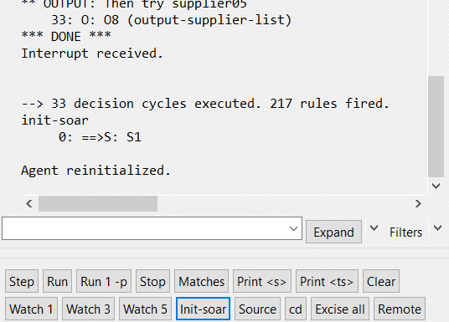
The soar init Command
Soar provides an easy way to reset the agent’s memory
So that it can be ready to receive a new task
The “soar init“ CLI command completely resets an agent’s state while preserving its long-term memories (i.e. rules).
“init-soar” or simply “init” also work as aliases.
The Java Debugger also provides an “Init-soar” button that does the same thing.
Try it:
Repeat the same steps as on the previous slide, but this time re-initialize the agent between runs.
Your agent should run properly with the new input!
External code environments are able to send Soar the init command before they send new inputs.

Slide 26
Extra Credit: Alternate Solution
Instead of using init, you could manually remove the output as well…
That is: remove the supplier-list WME from output-link once there is new input
On your own, experiment with different ways of accomplishing this.
HINT: Is there an existing operator you could use for this?
(By adding a new apply rule to the existing operator?)

Slide 27
Wrapping Up
The Agent Itself, Anyway

Slide 28
Final Checks
Think about edge cases. Does your agent still work:
If no suppliers are valid (all have total-sats = 0)?
The file fake_agent_input_3.soar is provided for you to test this case.
If max-output-suppliers is 0?
If the input changes part-way through the agent’s processing?
Extra Credit: Add rules to catch bad input:
Candidate suppliers that are missing required fields like total-cost
No candidate suppliers at all
No priorities for different attributes
A cost and non-cost attribute sharing the same priority weight
And so on.
A good engineer pursues quality.

Slide 29
Congratulations!
You have completed Lesson 09!
And you have completed all required Soar rules for your agent!
One lesson remains:
Complete the next lesson to learn how to run a Soar agent from app code, with proper I/O
(You won’t need to edit any .soar files for that lesson.)

