Slide 1

Project 10: Soar Markup Language (SML) Basics
The Engineer’s Guide to Soar
Course 01: Soar Essentials
By Dr. Bryan Stearns, 2024

Slide 2
Problem
Solution
Our agent relies on fake_agent_input… rules that simulate input.
Make a Python script that runs our Soar agent and its I/O.

Slide 3
Lesson 00 Review – How Does Soar Fit Into Software?
An interfacing application calls Soar’s run methods from its code
It can use event listeners if desired.
Using Direct Control
Using Event Listeners
Application
Soar Agent
Application
Soar Agent
loop:
process_stuff()
update_input()
run_agent(1)
collect_output()
Receive Input
update_input()
run_agent_forever()
output_event:
collect_output()
process_stuff()
if done:
stop_agent()
update_input()
Receive Input
Decision
Decision
Send Output
Send Output

Slide 4
Long-term Project Goal
Make a standalone Python app that:
Sends inputs of our choice to our Soar agent
Read the supplier-list output from our agent
Can repeat this process for many input jobs given in a list
We will develop our code in 4 app iterations
Each will represent its own mini-project and lesson
Each app iteration will introduce new concepts
The 4th app iteration should provide our desired final product!

Slide 5
Lessons 10-13 – Outline
Each of the ensuing SML lesson explains the following new concepts:
App 1: SML Basics
Kernels and Agents
Identifier and WME classes
Agent creation, I/O, and shutdown
App 2: WME Management
Removing input WMEs properly
Opening a linked debugger
App 3: I/O Management
Using custom input classes
Looping over output WMEs
App 4: Event Handlers
Using event listeners
Stopping Soar from code
You are here

Slide 6
SML Concepts
Connecting with Soar Kernels and Agents

Slide 7

Soar: Agent Environment
To connect a Soar agent to an interactive domain, you must build an app that interfaces between that domain’s processing and the Soar agent’s I/O.
Files
Files
Files
Soar
App
Agent
Your Code Here
Programs
I/O
API
Services
Hardware

Slide 8
SML: Messages vs API
The Soar process communicates with your app via SML messages
SML = “Soar Markup Language” (a variant of XML)
Soar comes with an API that handles SML messaging for you.
Soar coders almost never need to interact with XML-level messages directly,
So people usually say “SML” to refer to the API, not to the messaging language.
Soar provides SML libraries for C++, Java, Python, C#, and Tcl.
(Generated when Soar’s source code is bult with SWIG)
We will follow this convention here.
Soar
App
Agent
Your Code Here
I/O
API
SML Messages

Slide 9
What’s in the SML API?
SML (the API) provides the library of functions that let application code:
Create and destroy the Soar instance
Send input and receive output
Send any CLI command and get its result string
And more!
Using Direct Control
Using Event Listeners
Application
Soar Agent
Application
Soar Agent
loop:
process_stuff()
update_input()
run_agent(1)
collect_output()
Receive Input
update_input()
run_agent_forever()
output_event:
collect_output()
process_stuff()
if done:
stop_agent()
update_input()
Receive Input
Decision
Decision
Send Output
Send Output

Slide 10
Soar Kernels and Agents
Process
Soar agents run inside a Soar Kernel:
Soar Kernel: Runs the architecture
Soar’s static functionality
I/O with your app code
Can create/maintain multiple Soar agents
Max one kernel per CPU process
Soar Agent: Applied instance of Soar
Runs with agent knowledge, task state, decision cycle, etc.
Soar Kernel
Agent1
Agent2
…
I/O with App

Slide 11
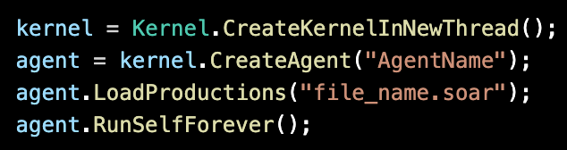
Using SML to Run Soar
You can create and run a Soar agent in just a few lines of code!
Create a kernel instance
Create one or more agents in that kernel
Load rules for your agent(s)
Run the agent(s)!
SML function names (like RunSelfForever()) are the same across all programming languages!

Slide 12


Closing Kernel Resources
Your code should always close a kernel when you are done with it!
This frees up resources from it and any agents it maintains
You can also free up resources from an agent but keep the kernel:

Slide 13
Python Import of SML
There are two ways to use Soar for Python:
Download the latest Soar release
Must manually set up env variables on your machine (see Lesson 00).
In Python: use import Python_sml_ClientInterface
Use pip install soar-sml
Automatically sets up Soar environment for your system.
In Python: use import soar_sml
This course uses the 1st option, because we can distribute the installation with this tutorial.
It will also better equip you to use Soar in non-Python environments.
But if starting from scratch and you only need Python, the 2nd option is much simpler.
(Importing the run_soar.py file included in this tutorial sets up env vars for you.)

Slide 14
App 1
SML Basics

Slide 15
App 1 Goals
Our first app will be a single Python script that:
Creates a Soar agent in a Soar kernel
Loads that agent with our agent rules
Give the agent some input
For now, we’ll just create a single candidate-supplier as input.
Runs the agent
The agent will output a list of recommended suppliers.
Reads the agent’s output
For now, we’ll just read the count of list items, and the first supplier in the list.
Shuts down Soar

Slide 16
Let’s Write Some Code – Import SML!
First we need to import our Python SML library.
Open your app1/code_starter.py file
Notice the provided imports set up your environment variables for you
Find the comment labeled “STEP 1” and follow the instructions there.
Import the Python SML library with the following line of code:
Test that the import works without errors by running the Python file
Nothing should happen, but you should see no error messages.
import Python_sml_ClientInterface as sml

Slide 17
Let’s Write Some Code – Create a Kernel!
Let’s set up a Soar kernel instance in Python!
Find the comment labeled “STEP 2.1” and follow the instructions there.
Uncomment the “print” and “kernel = ” lines.
Replace the underscores with the appropriate function call:
Find the comment at the end of the file labeled “STEP 2.2” and follow its instructions.
Uncomment the “print” line.
Close the kernel using the appropriate function call:
Test your code by running the script.
You should see both your print messages on the terminal without errors.
kernel = sml.Kernel.CreateKernelInNewThread(SOAR_PORT)
kernel.Shutdown()

Slide 18
Let’s Write Some Code – Create an Agent!
Now let’s create a Soar agent instance in our new kernel!
Find the comment labeled “STEP 3” and follow the instructions there.
Replace the underscores with the appropriate function call:
Find the comment labeled “STEP 4.1” and follow its instructions.
Uncomment the “print” line.
Load the agent rules using the appropriate function call:
Find the comment labeled ”STEP 4.2” and follow its instructions to test your code.
Uncomment the “print” line.
Run the script. You should see the named rule printed on the terminal without errors.
(You can comment this line out again once you’ve tested it.)
Pick any agent name. It doesn’t matter here.
(Names act as unique identifiers if you have >1 agent in a kernel.)
agent = kernel.CreateAgent("My Agent")
agent.LoadProductions(AGENT_PATH)

Slide 19
Interacting with Agent WMEs using SML
To manage agent I/O, we access its ^input-link and ^output-link WMEs.
Then we can add/remove/read WMEs underneath them!
SML code maintains a parallel copy of the agent’s WMEs that it has references for.
Reading WMEs in code pulls the updates from the agent’s WM as needed.
After SML code modifies the WMEs, changes are committed to the agent’s WM
You can optionally turn off auto-commit behavior and control when commits are sent.
Application
Soar Agent
il_id = agent.GetInputLink()
il_fizz_id = il_id.CreateIdWME(“fizz”)
il_fizz_id.CreateStringWME(“label”,“buzz”)
S1 ^io I1
I1 ^input-link I2
I2 ^fizz F1
F1 ^label |buzz|
I1 ^output-link I3
I3 ^result R1
R1 ^question |??|
R1 ^answer 42
ol_id = agent.GetOutputLink()
ol_res_wme = ol_id.GetChild(0)
answer = (ol_res_wme.ConvertToIdentifier()
.FindByAttribute(”answer", 0)
.ConvertToIntElement().GetValue() )

Slide 20
SML Classes
You use two SML classes in particular when navigating/modifying a Soar graph from SML:
WMElement
An object that represents a single WME
Lets you access any of the WME’s ID, Attribute, or Value data
Identifier
An object that represents a single ID / memory object
Lets you access any child WMEs / augmentations under that ID
There are also classes for the different Value data types:
IntElement, FloatElement, StringElement, IdentifierSymbol
WMElement is a parent class to all these other classes
To get a WME’s Value in its appropriate type, you must convert the WMElement to the right class
(See the ”ConvertTo…” functions in the example on the previous slide.)

Slide 21
Let’s Write Some Code – Send Soar Input
Now let’s use the input-link!
Find the comment labeled “STEP 5” and follow the instructions there.
Uncomment the code and replace the underscores as follows to get the input-link ID:
Find the comment labeled “STEP 6” and follow its instructions.
Uncomment the code and replace the underscores appropriately.
You want to create the following structure on the input-link:
The comment instructions describe the functions you need.
First use il_id to create the candidate-supplier WME.
Then use the returned Identifier to create the remaining WMEs.
il_id = agent.GetInputLink()
I1 ^input-link I2
I2 ^candidate-supplier C1
C1 ^name |supplier01|
C1 ^total-cost 24.99
C1 ^total-yeses 2

Slide 22
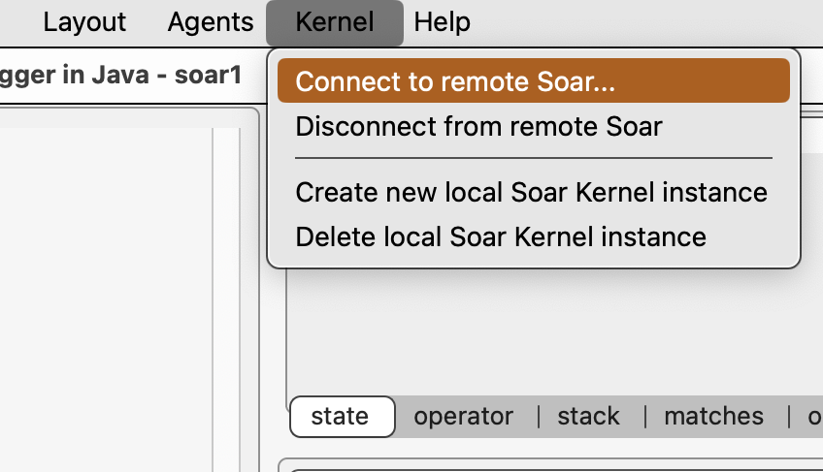
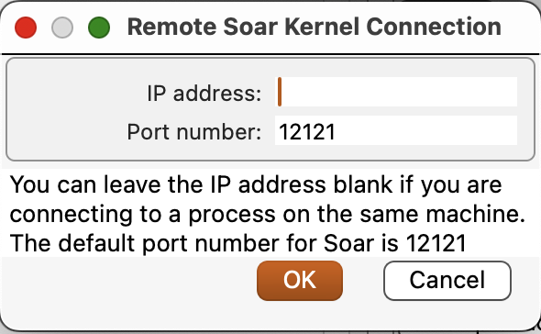
Connecting the Debugger to the Kernel
We can connect a Java Debugger window to inspect the agent we created with SML
Put a break point before you shut down your kernel
Run your SML script in Debugging mode
Open a Soar Java Debugger window
Run the SoarJavaDebugger.sh/.bat file (See Lesson 00.)
From the Debugger, navigate to Kernel > Connect to remote Soar
Click Ok to shut down the kernel that was created for the Debugger when it launched.
Change the Port number to 12345 to match your code.
Leave the IP address blank to indicate a local connection.
You should now be connected to the kernel run by your paused script!
Run it for one step and inspect the input-link to see your WMEs.

Slide 23
Be Mindful of Ports!
When you open the Debugger, it creates its own kernel that uses the default port 12121.
It will use a different port if 12121 is already claimed.
If you run your script and it tries to use the same port that the Debugger already claimed, you will get an error:
This error won’t prevent your app from running your kernel locally, but it will prevent other apps (like the Debugger) from connecting to your kernel via an internet socket:port.
Try it: Change your script to use port 12121 and run it after opening the Debugger.
Creating Soar Kernel using port 12121
Error: Error binding the listener socket to its port number
Failed to create the internet listener socket. Shutting down listener thread.

Slide 24
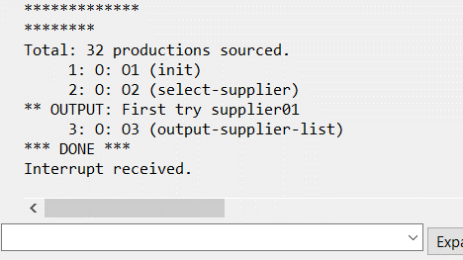
Let’s Write Some Code – Run the Agent
We could run the agent using the Debugger after we connect it to our agent…
But we want to run the agent from SML!
Find the comment labeled “STEP 7” and follow the instructions there.
Uncomment the print statement
Add this function call to run the agent until something stops it:
Test it by seeing the agent run on its own in the Debugger
Put a breakpoint on this new line in your SML code
Run the app in debug mode up to this line
Open a Soar Debugger window and connect it to your agent
Step over the agent.RunSelfForever() line to execute it
See the Soar Debugger run the agent to completion!
Recall that our agent will interrupt itself when it sends output!
agent.RunSelfForever()

Slide 25
Let’s Write Some Code – Reading the Soar Output-Link
Now let’s get our app to read the output created by our Soar agent!
Find the comment labeled “STEP 8” and follow the instructions there.
Uncomment just these lines:
Replace the underscores with this to get the output-link ID:
Run your script
You should see the “No output detected yet.” message. What happened?
GetOutputLink() will return None until the agent has sent its first output.
But if you check the Soar Debugger, you’ll notice that your agent has sent output. So why does ol_id == None?
Our agent interrupted itself as soon as it generated its output. That means it also stopped Soar from transmitting its output-link updates!
# ol_id = ____
# if ol_id is None:
# print("No output detected yet.")
ol_id = agent.GetOutputLink()

Slide 26
Let’s Write Some Code – Run a Single Step
We need our agent to run just a little longer
Go back to the comment labeled “STEP 9” and follow the instructions there.
Use the following to run the agent for a single decision cycle:
Now run your script again
You should not see the “No output detected yet.” message anymore!
This means that ol_id will now let you read the agent’s output-link.
Now we just need to read the WMEs that are on this output-link ID….
agent.RunSelf(1)

Slide 27
Reading the Agent’s Output
We just want to read 2 parts of the agent’s output for now:
The count of items in the output recommendation list
The name of the first supplier in the recommendation list (if the count is >0)
Recall that the agent’s output is structured as follows:
So we’ll want to access:
output-link.supplier-list.count INT
output-link.supplier-list.first-supplier.name STRING
^output-link ID
^supplier-list ID # The ID of a single supplier list
^supplier ID # The ID of a supplier object in the list
^name STRING # The name of the supplier
^rank INT # The position of this supplier in the list
^next ID # The next supplier in the list
^first-supplier ID # The ID of the first supplier in the list
^last-supplier ID # The ID of the last supplier in the list
^count INT # The number of suppliers in the list

Slide 28
Finding a WME By Attribute
SML provides the <ID>.FindByAttribute(attribute, N) function
It iterates through the child WMEs of the calling Identifier object and returns the Nth one that matches the given attribute name.
N is 0-indexed, so setting N=0 returns the first matching WME
If there is no match, the function returns None.
For example: ol_id.FindByAttribute(“supplier-list”,0) will return this WME:
But if you want to then find a WME connected under the result, you must use <WME>.ConvertToIdentifier() to get the Identifier that is the Value of the WME. (C1 in the example to the right.)
You can then use FindByAttribute(…) again to get that Identifier’s children.
^output-link I3
^supplier-list C1
^supplier C2
^name |supplier01|
^rank 1
^first-supplier C2
^last-supplier C2
^count 1

Slide 29
Getting a WME’s Value
To get an ID Value from a WME, use:
To get a String Value from a WME, use:
To get an Integer Value from a WME, use:
To get a Float Value from a WME, use:
You can also always get the String form of a Value without converting first using:
For String, Integer, or Float, to get the literal value, use:
<WME>.ConvertToIdentifier()
--> returns Identifier object
<WME>.ConvertToStringElement()
--> returns StringElement object
<WME>.ConvertToIntElement()
--> returns IntElement object
<WME>.ConvertToFloatElement()
--> returns FloatElement object
<WME>.GetValueAsString()
--> returns str
<String/Int/Float-Element>.GetValue()
--> returns str/int/float

Slide 30
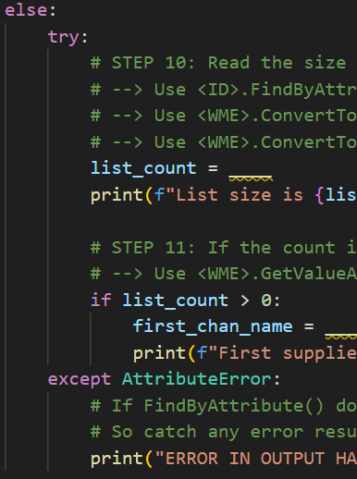
Let’s Write Some Code – Read the Agent’s Output
Uncomment everything from the “else” through to the end of the try/except block.
STEP 10: Read the list count
Replace the underscores to set list_count appropriately.
You can do this in one line by chaining <ID>.FindByAttribute(...) and <WME>.ConvertToIdentifier().
Convert the count to an IntElement before getting the integer value.
Running the script should then print: “List size is 1.”
STEP 11: Read the first supplier’s name
Replace the underscores to set first_chan_name appropriately.
The pattern of code is similar to STEP 10, but you can use GetValueAsString() at the end instead of ConvertToIntElement().GetValue().
Running the script should then print “First supplier: supplier01”

Slide 31
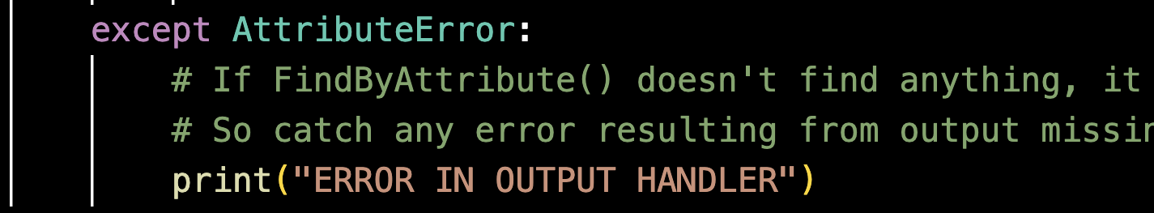
Exception Handling
Any time we read a WME path that might not exist, we should check for an AttributeError.
This will be raised if FindByAttribute() returns None, and then we try to call a ConvertTo… on that None

Slide 32
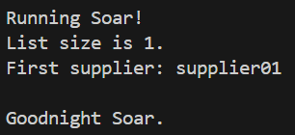
Congratulations!
You now have an SML app that can
Send input to Soar
Read output from Soar!
Check out the next lesion to learn more about how to change input values over time on a single agent!

