Slide 1
Uber
LatAm Automation & Advanced Analytics (A&A) Application Case Study (ML Ops)
By Zucoloto, João Pedro

Slide 2
Problem Definition
- The main goal of this case study is to build a model to predict the duration of Uber rides in São Paulo, Brazil from November 2022 to March 2023.
- The dataset consists of 2.1 million ride observations: 1.5 million training data and 600k test observations.
- The model aims to provide accurate predictions based on various features such as time, distance, and traffic conditions.

Slide 3
Assumptions
- In order to build a statistical model capable of predicting the duration of a trip, some adjustments need to be made, including data cleaning and adding new columns.

Slide 4
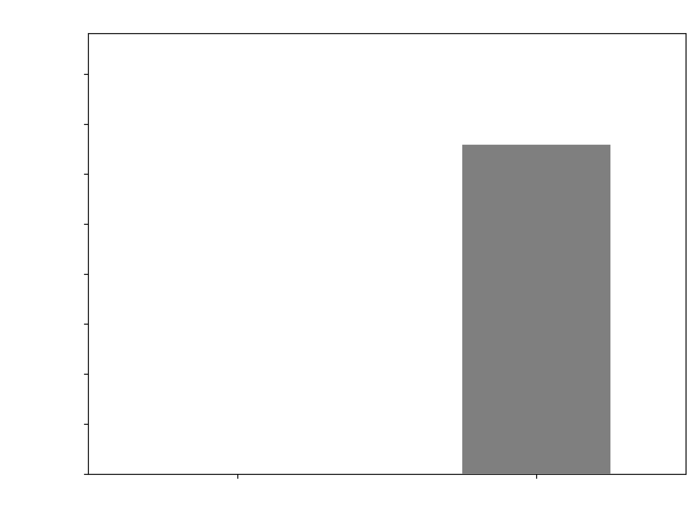
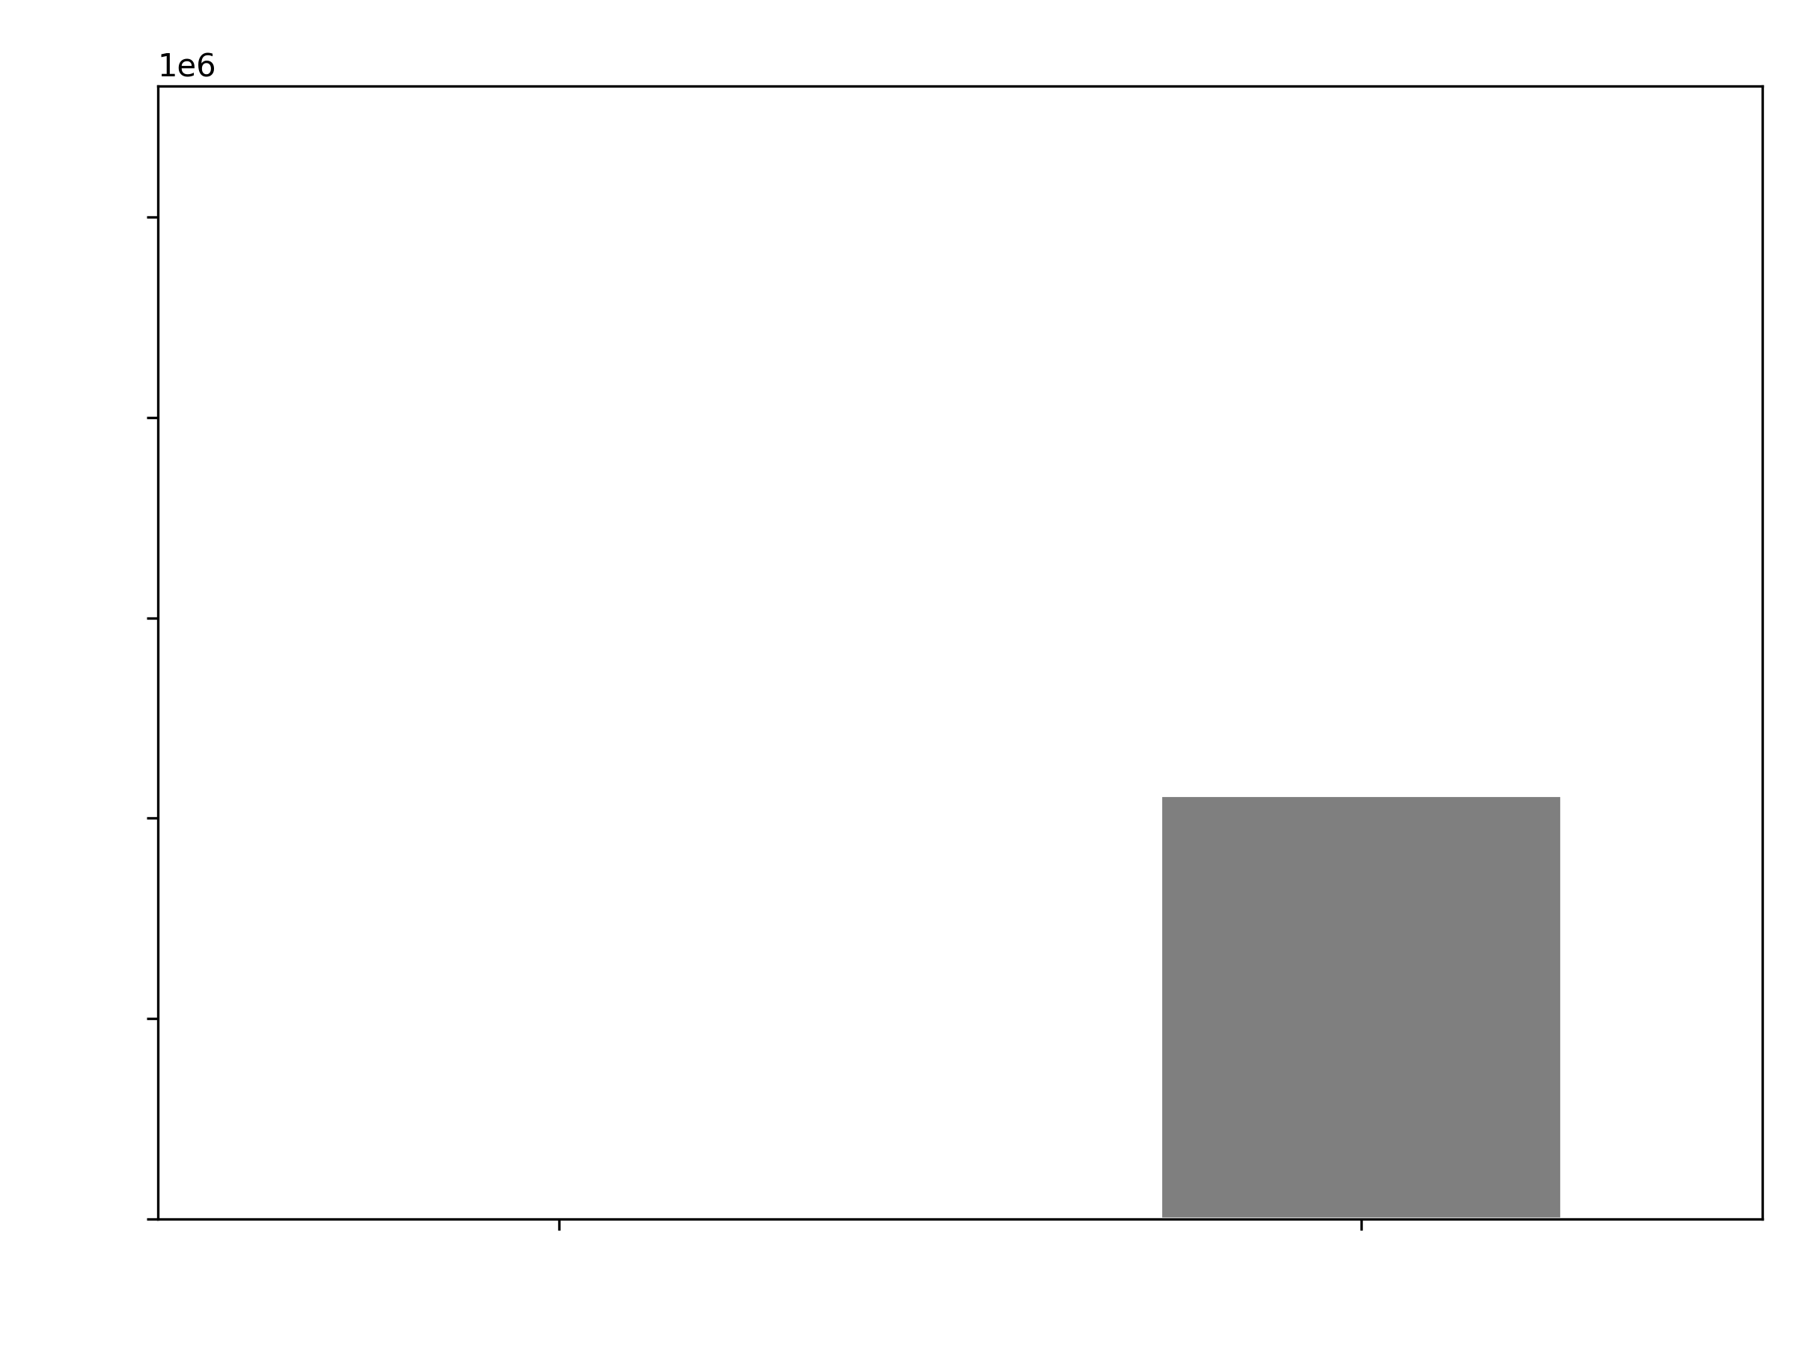
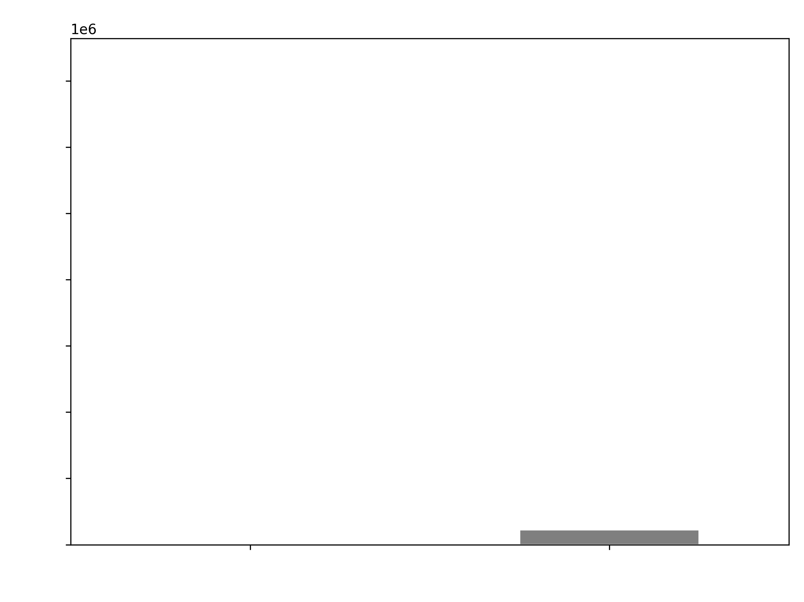
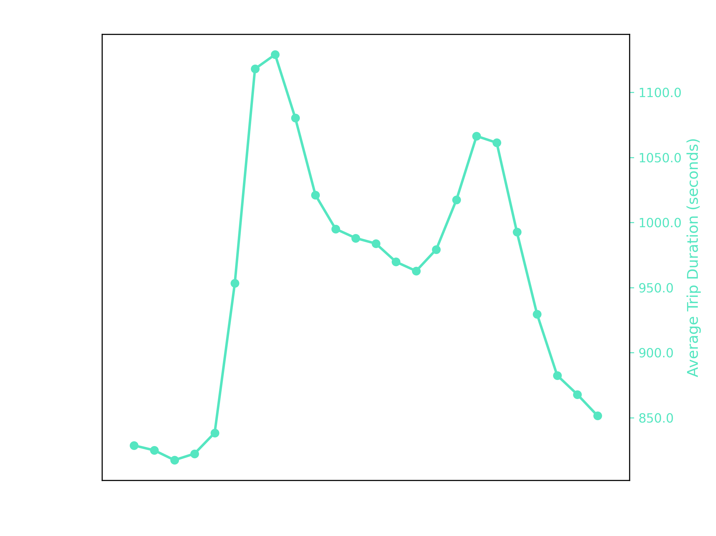
Assumptions
Data analysis for datetime pickup

Slide 5
Assumptions
Data analysis for datetime pickup

Slide 6
Assumptions
Data analysis for datetime pickup

Slide 7
Assumptions
Data analysis for datetime pickup

Slide 8
Assumptions
Data analysis for datetime pickup

Slide 9
Assumptions
Data analysis for datetime pickup

Slide 10
Assumptions
Data analysis for datetime pickup

Slide 11
Assumptions
Data analysis for datetime pickup

Slide 12
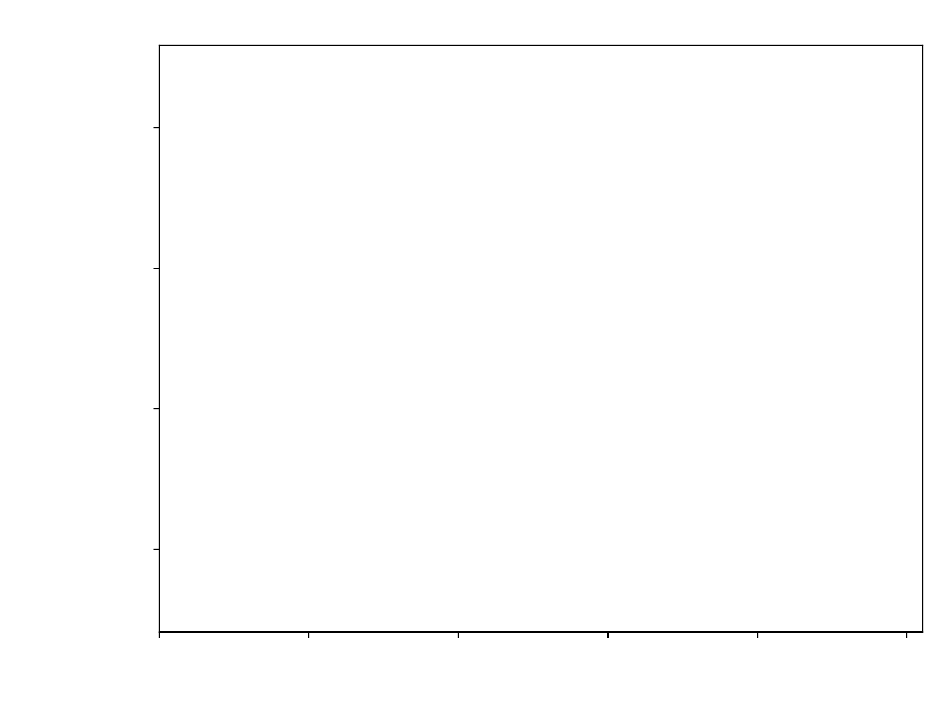
Assumptions
Importance for each feature

