Slide 1
Uber
LatAm Automation & Advanced Analytics (A&A) Application Case Study (ML Ops)
By Zucoloto, João Pedro

Slide 2
Problem Definition
- The main goal of this case study is to build a model to predict the duration of Uber rides in São Paulo, Brazil from November 2022 to March 2023.
- The dataset consists of 2.1 million ride observations: 1.5 million training data and 600k test observations.
- The model aims to provide accurate predictions based on various features such as time, distance, and traffic conditions.

Slide 3
Assumptions
- In order to build a statistical model capable of predicting the duration of a trip, some adjustments need to be made, including data cleaning and adding new columns.

Slide 4
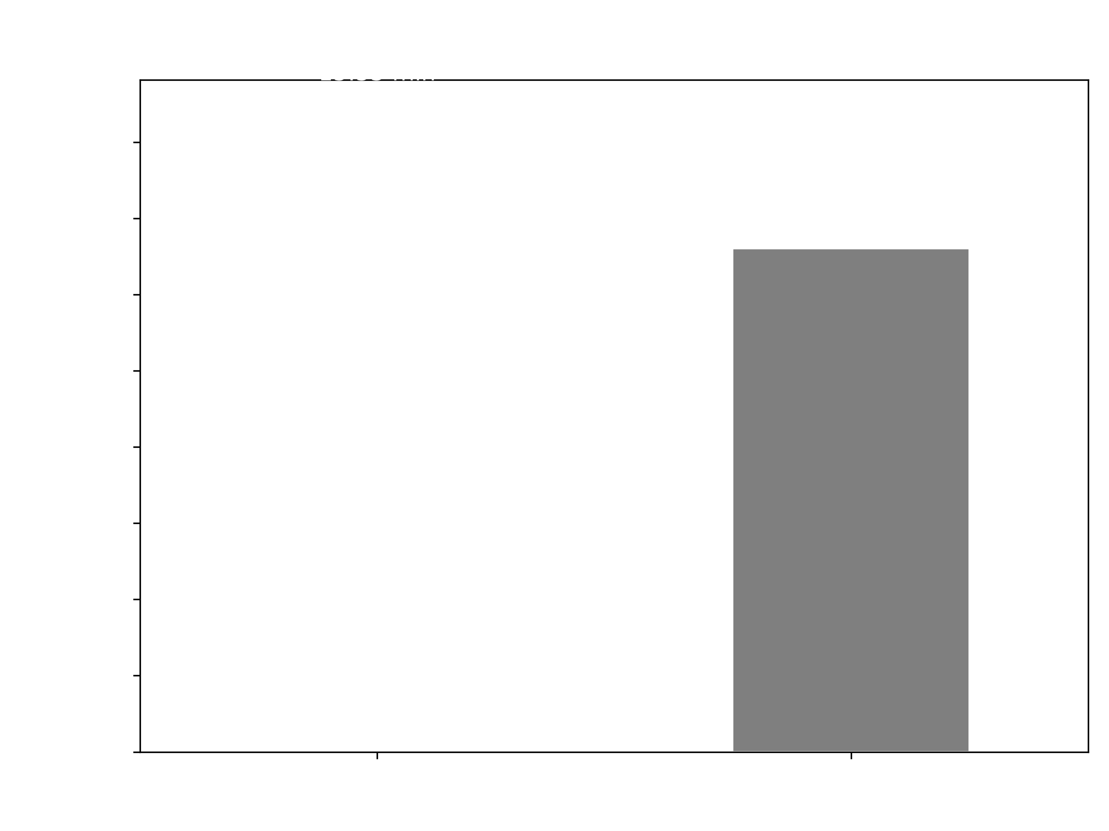
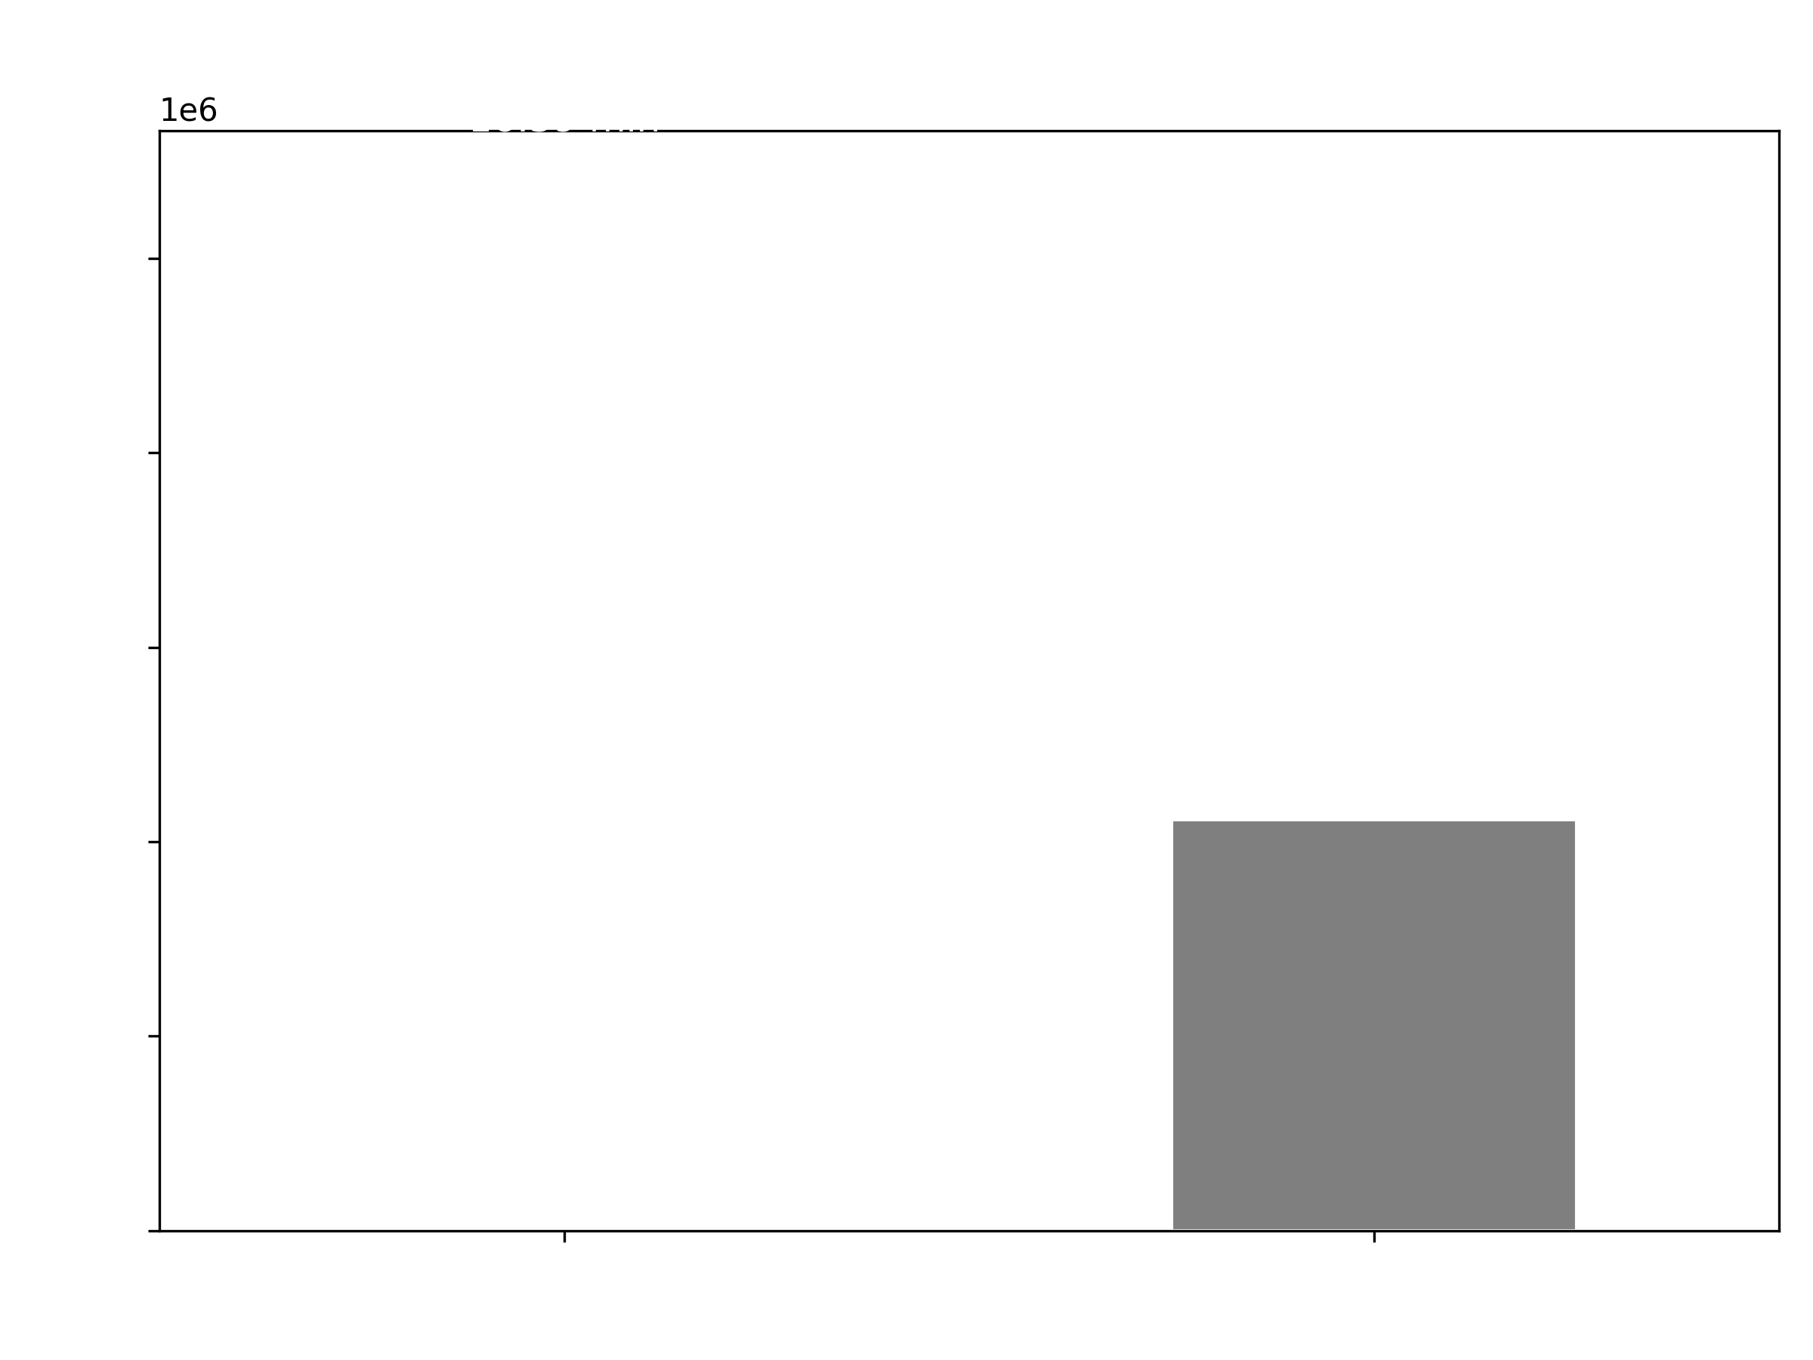
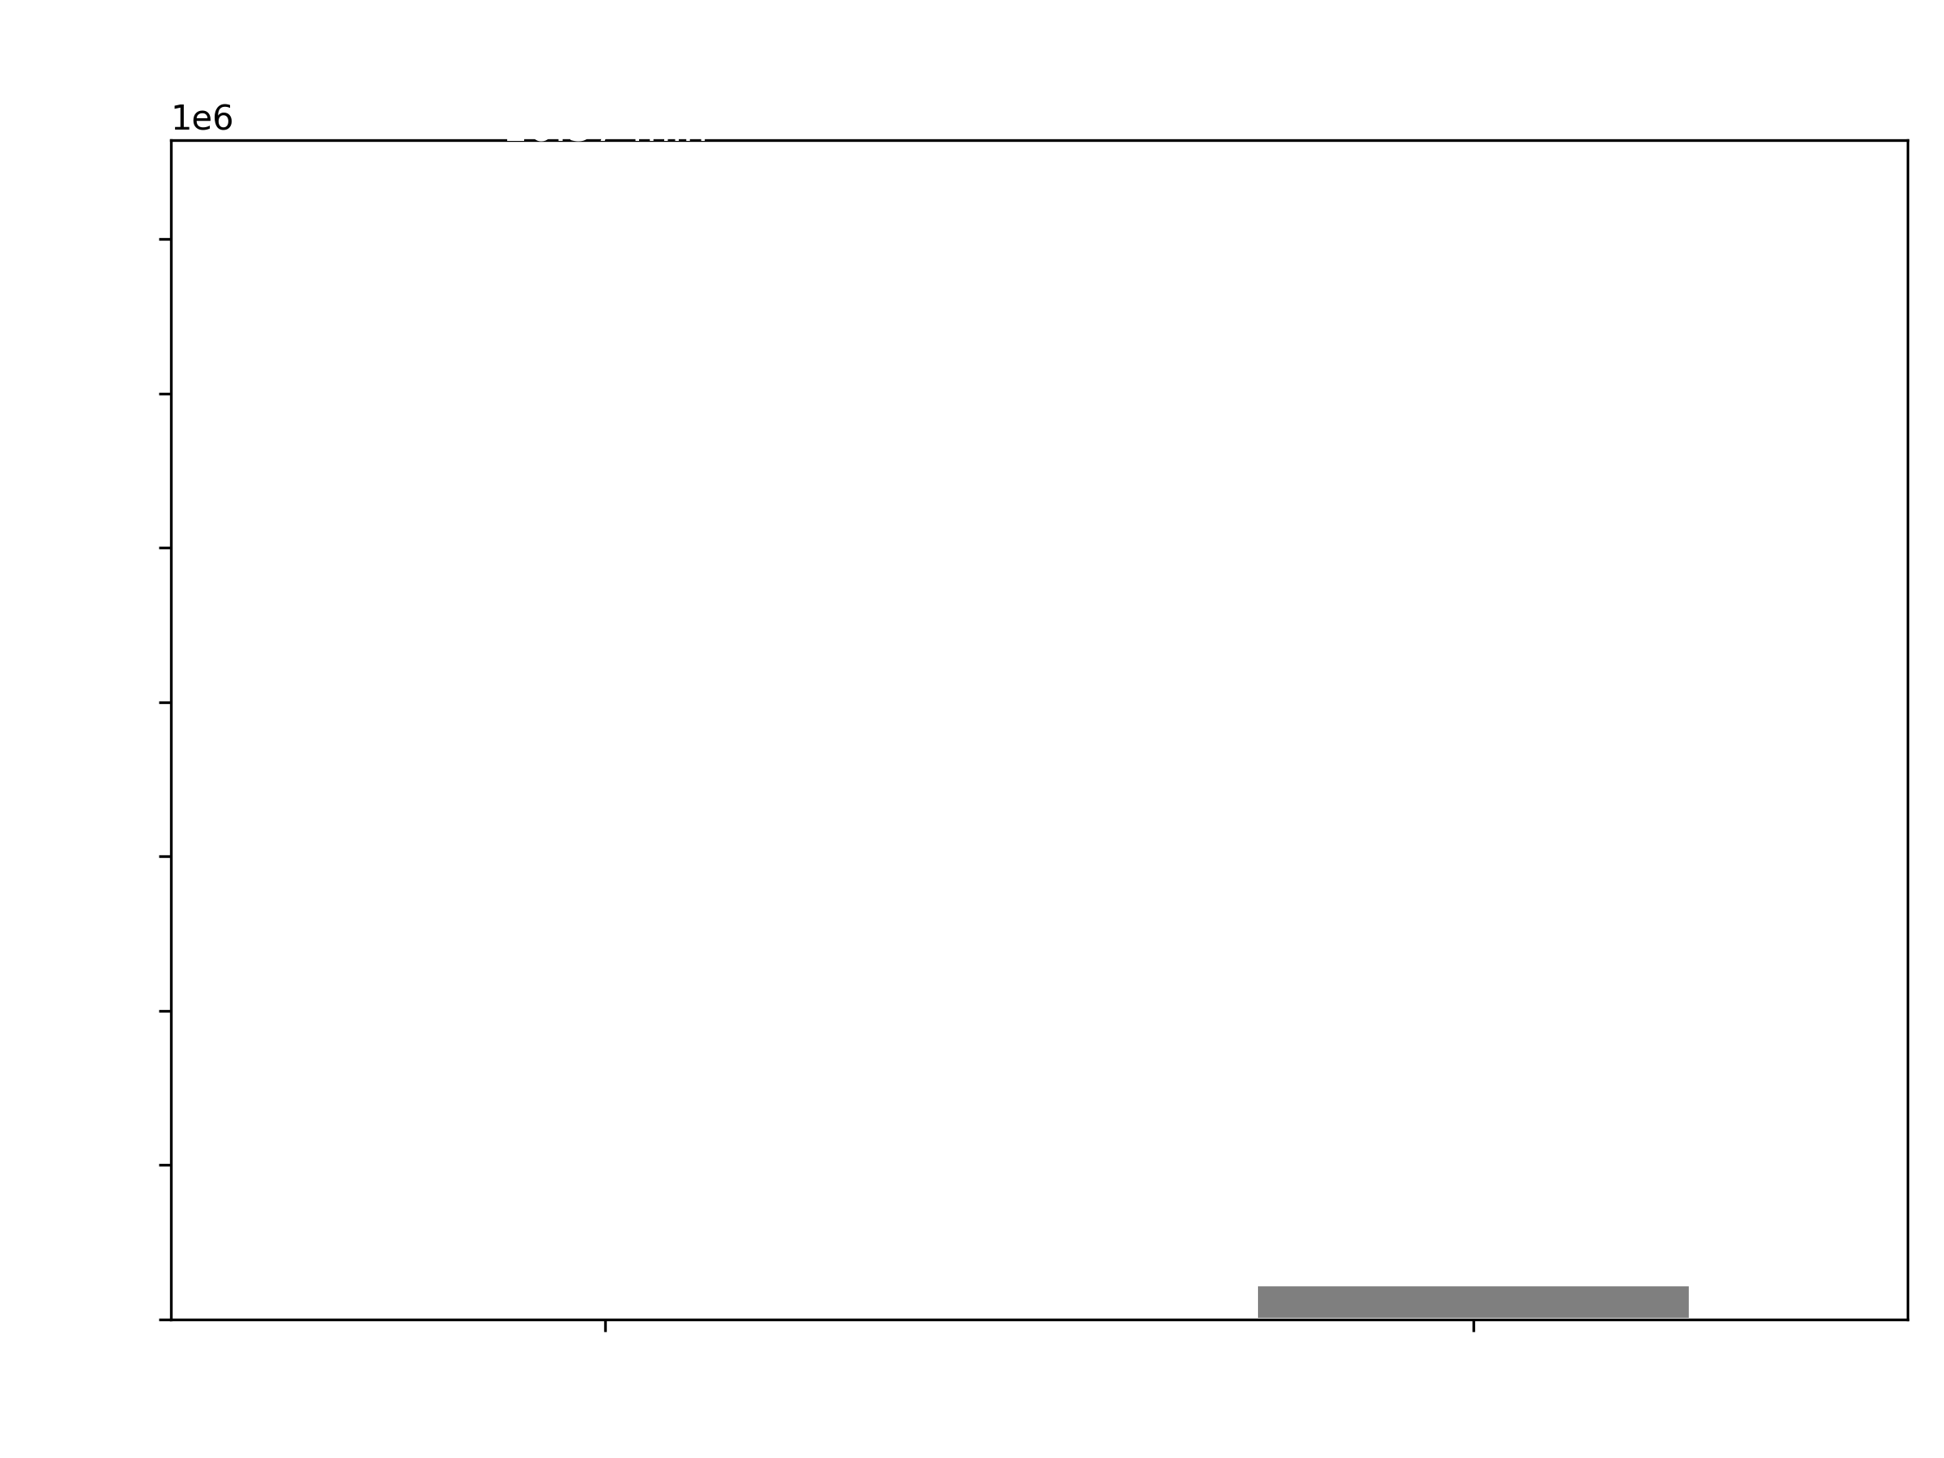
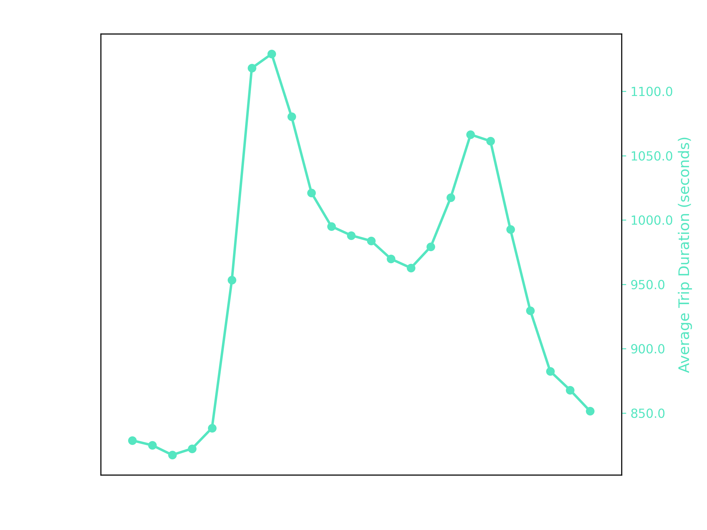
Assumptions
Data analysis for datetime pickup

Slide 5
Assumptions
Data analysis for datetime pickup

Slide 6
Assumptions
Data analysis for datetime pickup

Slide 7
Assumptions
Data analysis for datetime pickup

Slide 8
Assumptions
Data analysis for datetime pickup

Slide 9
Assumptions
Data analysis for datetime pickup
Source: https://capital.sp.gov.br/w/noticia/prefeitura-divulga-calendario-de-feriados-pontos-facultativos-e-suspensao-de-expediente-para-2024

Slide 10
Assumptions
Data analysis for datetime pickup

Slide 11
Assumptions
Data analysis for datetime pickup

Slide 12
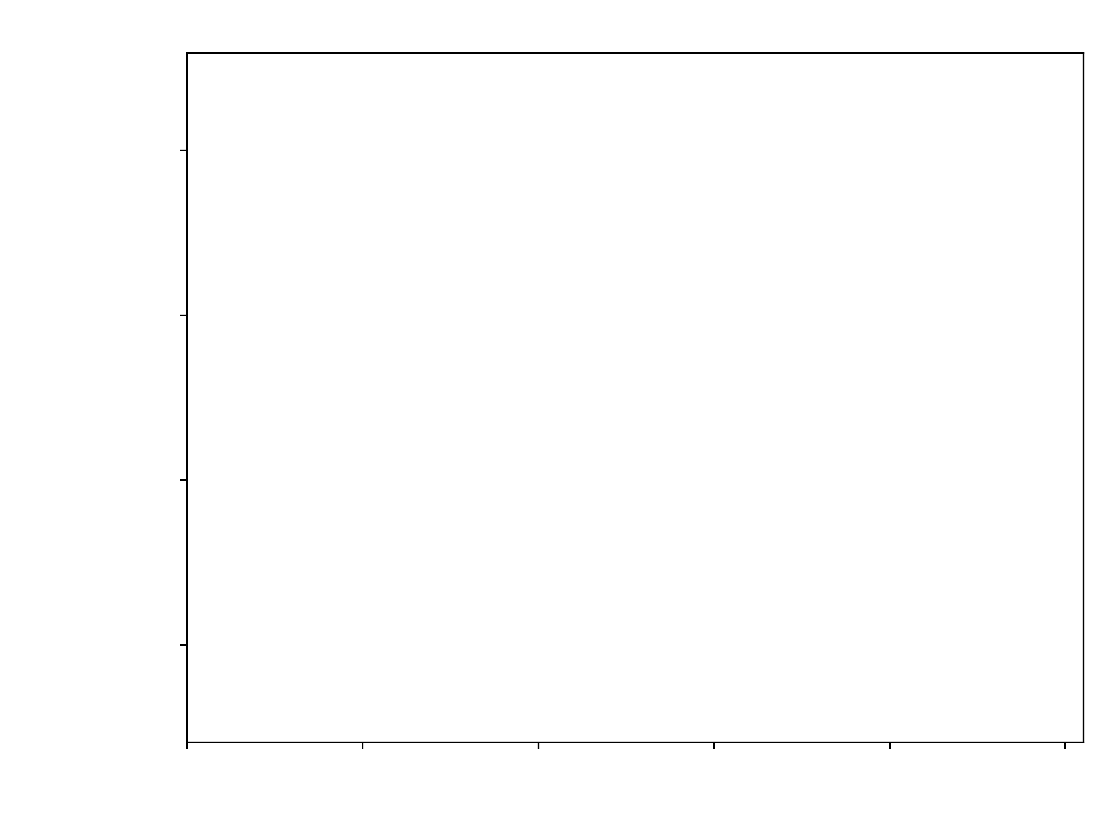
Assumptions
Importance for each feature

Slide 13
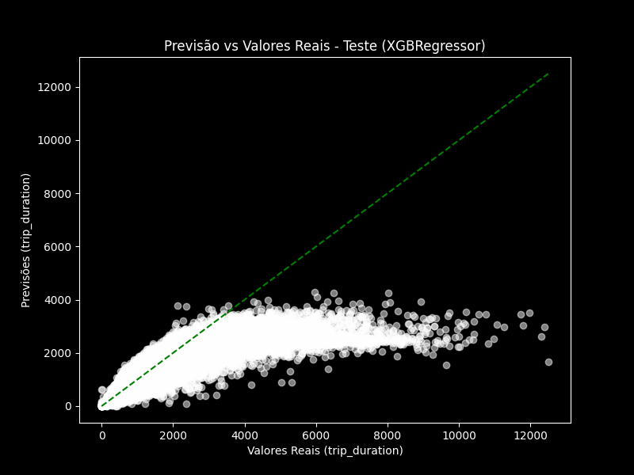
Assumptions
Weather conditions

Slide 14
Final Model
- In order to build a statistical model capable of predicting the duration of a trip, some adjustments need to be made, including data cleaning and adding new columns.

Slide 15
Assumptions
Importance for each feature
Tempo que mostra para o usuário esta em minutos cheios então o mod

