Slide 1


Controllable Chord Progression Reharmonization via RVAE-LSTM using Perceptually-Grounded Complexity Score
A model that changes a chord progression to a chosen level of complexity.
José Pinto-Muñoz
Departamento de Informática
Universidad Técnica Federico Santa María
jose.pintom@usm.cl
Nicolás Rojas-Morales
Departamento de Informática
Universidad Técnica Federico Santa María
nicolas.rojasm@usm.cl
Jornadas Chilenas de la Computación, 10 al 12 noviembre 2026 | Talca, Chile
Notes:
0:20 — This talk presents PEARL, an RVAE-LSTM that enriches a chord progression to a user-selected level of perceptual complexity. The level is measured by PCS, a score obtained from a listening study. No musical background is assumed: each term is defined when it first appears. Joint work with Nicolás Rojas-Morales, UTFSM.

Slide 2
OUTLINE
Problem
Setup and Metrics
What is missing today
Data, baselines, measures
Complexity Score
Results
A score from listeners [3, 4]
Comparison with earlier systems
Model
Conclusions
How PEARL works
Limits and next steps
Jornadas Chilenas de la Computación, 10 al 12 noviembre 2026 | Talca, Chile
2
Notes:
0:15 — Roadmap: motivation and the gap, the perceptual complexity score, the architecture, the experimental setup, results and conclusions.

Slide 3

01
Motivation
Most songs use a few simple chords. Reharmonization can enrich them, but tools cannot control how much changes.
• Chord: three or more notes played together; progression: a series of chords in order.
• Reharmonization: replacing the chords of a progression with different ones.
PEARL: Perceptual Enrichment via Anchored Regularized Latent-space
Jornadas Chilenas de la Computación, 10 al 12 noviembre 2026 | Talca, Chile
JCC 2026| Jornadas Chilenas de la Computación
Notes:
0:40 — Context: large-scale analyses of Western popular music, such as the McGill Billboard corpus, show a narrow repertoire of triads and repeating cadential formulas. Definitions used in this talk follow standard tonal theory: a chord is three or more notes sounded together; a progression is a series of chords played in order; reharmonization replaces the chords of a progression with different ones while keeping the song's key, as in the enrichment line of work [2, 6]. Existing tools can transform a progression, but they do not let the user choose how much complexity to add or which property should change.

Slide 4
What Others Did and What Is Missing
Earlier systems, the gap, and our proposal
Earlier systems
• Comanducci et al. [2]: one complexity number from a statistical model. 4 chord types; synthetic 5-chord loops in C major/minor.
• Uemura et al. [6]: moves chords inside a trained model; no target level.
• MusicVAE [5]: generates music; not for controlled enrichment.
The gap, and what we propose
• Missing: a target, a choice of property, and a measure based on listeners.
• PCS: a complexity score from listening tests [3, 4].
• PEARL: reaches a chosen score on 877k real progressions [1], 11 keys, 4–12 chords.
Jornadas Chilenas de la Computación, 10 al 12 noviembre 2026 | Talca, Chile
4
Notes:
1:10 — Comanducci et al. [2] is the closest work: their complexity is a single number produced by statistical models that predict the next chord (prediction by partial matching, HMM and RNN); their chord vocabulary has four types and their data are 6,311 synthetic five-chord loops in C. Uemura et al. [6] morph chords inside a VAE, without a target. MusicVAE [5] organises a latent space for generation. What is missing is a target expressed in perceptual terms, a choice of which property changes, and validation on real, multi-key data. That is what PCS and PEARL add.

Slide 5
How Chords Are Represented
48 yes/no values per chord, readable as a chord name
• 48 yes/no values per chord.
• Seven slots: root, type, seventh, extensions, alterations, added notes, bass.
• One row per chord; the values decode back to a chord name.
• 877k real progressions [1]; split 80/10/10 by song.
Slot | Dims | Meaning
Root | 12 | Root pitch class (C–B)
Quality | 8 | maj, min, dim, aug, sus, no3d
Seventh | 5 | none, dom7, maj7, dim7, aug7
Extensions | 3 | 9, 11, 13 (multi-label)
Alterations | 4 | b9, #9, #11, b13
Added notes | 3 | add9, add11, add13
Bass | 13 | Bass note (C–B) + inversion
Jornadas Chilenas de la Computación, 10 al 12 noviembre 2026 | Talca, Chile
5
Notes:
0:55 — The encoding is explicit, not learned: 48 binary values in seven slots. The vector is reversible, so any output can be read as a chord symbol. A progression of T chords is a T by 48 matrix. Training data are 877k progressions from Chordonomicon [1], and jSymbolic [3] computes the features used for PCS. The split is by song, so no song appears in two subsets.

Slide 6
A Complexity Score from Listeners (PCS)
We asked listeners instead of writing a formula
• 43 listeners; 1,032 pairwise comparisons on a 5-point scale.
• 11 properties measured [3]; 4 matched the listeners.
• Score: weighted average, 0 = simple, 1 = complex.
• v1: listener weights. v2: all four weighted equally.
Property | Meaning | Weight
Seventh chords | How often they appear | 0.443
Notes per chord | How much it varies | 0.378
Interval spacing | Distance between them | 0.338
Dissonance | How often it appears | 0.201
Seventh chords are the strongest signal of complexity: twice the weight of dissonance.
Jornadas Chilenas de la Computación, 10 al 12 noviembre 2026 | Talca, Chile
6
Notes:
1:40 — Harmonic complexity is defined as the degree to which chord changes are varied, rich and unexpected. We do not use a language-model proxy as [2] does; we run a paired-comparison test: 53 participants, 2 control pairs, 43 valid, 1,032 pairwise judgements on a five-point scale, stratified into three groups by the Goldsmiths index [4]. From 11 jSymbolic features [3], four pass the two criteria (p < 0.05 in at least one group; same sign across groups): 7C = share of chords with a seventh; VNSPC = variability of simultaneous pitch-class density; DTMCVI = distance between the two most common vertical intervals; VDR = share of dissonant vertical intervals. Weights are mean absolute correlations, normalised by 1.360. 7C has twice the weight of VDR (0.443 vs 0.201) and its correlation is r = 0.580, p = 0.003 at high training.

Slide 7
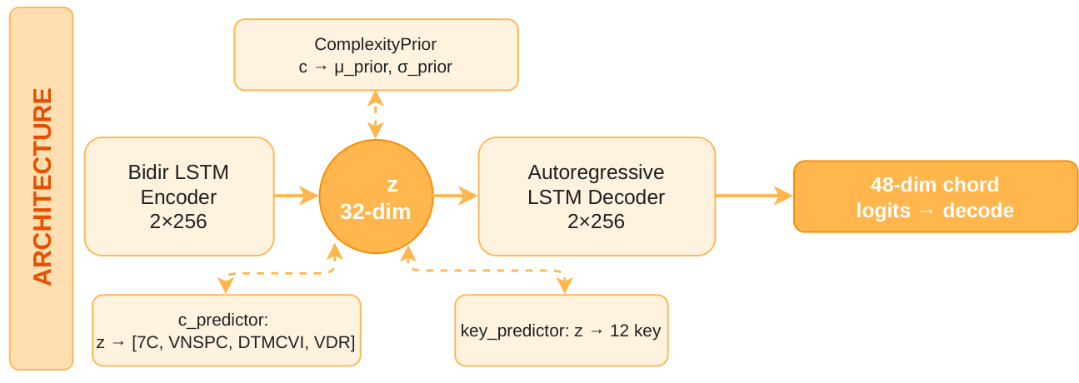
The PEARL Model
A network that turns a progression into 32 numbers, then rebuilds it [2, 5]
• Encoder: a progression → 32 numbers (z).
• Decoder: 32 numbers → a progression.
• Two predictors: one reads complexity, one reads key.
• We move z to change complexity; the key stays readable.
Jornadas Chilenas de la Computación, 10 al 12 noviembre 2026 | Talca, Chile
7
Notes:
1:20 — PEARL is a regression VAE with an LSTM encoder and decoder [2, 5]. The encoder is a two-layer bidirectional LSTM with 256 units and outputs the parameters of a 32-dimensional Gaussian; z is a sample of it. The decoder is a two-layer autoregressive LSTM that rebuilds the progression chord by chord from z. Two auxiliary heads shape z: the complexity predictor maps z to the four PCS values (MSE 0.0034), and the key predictor maps z to 12 key classes (98.4% accuracy). Training combines binary cross-entropy reconstruction, a KL term and the two prediction losses.

Slide 8
Reaching a Target Complexity
The model is frozen; we only move the 32 numbers
• Goal: move z until complexity = target.
• About 20–30 small steps.
• A penalty keeps z close to the original.
• One property at a time: sevenths, dissonance, or variety.
Example: seventh chords, target 1.0
Input
Cmin – Gmaj – Cmin – Fmin – Cmin
Output
Cmaj7 – Dmin7 – Cmin7 – Gmin7 – Cmin7
The same model serves any target in [0, 1]; no retraining.
Jornadas Chilenas de la Computación, 10 al 12 noviembre 2026 | Talca, Chile
8
Notes:
1:10 — Inference optimises z directly. We minimise the MSE between the predicted PCS and the target, plus a regularisation term that anchors z to the original code, with λ_reg = 0.005. We use Adam with learning rate 0.5 for 90 steps and gradient clipping at 1.0; in practice the target is reached in 20 to 30 steps. The procedure is deterministic: no sampling or reranking. Setting the loss to one dimension targets it alone: 7C from 0.002 to 0.982 with five seventh chords, VDR from 0.005 to 0.987 without seventh chords, VNSPC from −0.002 to 0.983 with the other dimensions almost unchanged.

Slide 9
Experimental Setup
Data, training and baselines
• One model, trained once on 877k real progressions [1].
• Split: 80/10/10 by song; results on unseen songs.
• Same test for CVAE and RVAE [2]; outputs from their authors.
• Five targets: 0.00, 0.25, 0.50, 0.75, 1.00.
Jornadas Chilenas de la Computación, 10 al 12 noviembre 2026 | Talca, Chile
9
Notes:
0:45 — Training uses 30 epochs on 877k progressions [1], Adam with learning rate 5e-4 and batch 256; the full table is in the paper. All 32 latent dimensions are active, with KL around 6 to 7 nats, and the bypass delta of 2.77 BCE shows that the decoder relies on z. The split is 80/10/10 by song, and every reported number comes from the test set. Baselines are CVAE and RVAE [2]; their weights are unavailable, so we compare on the outputs their authors released. Everyone performs the same task: enrich one loop at five PCS levels.

Slide 10
Evaluation Metrics
The score comes from listeners, not statistics. These metrics check the target and the key
Metric | What it measures
Target reached | Complexity of the output vs the target.
Property changed | Change in each of the four properties.
Stays in key | Share of roots in the original key [7].
Keeps roots | Share of positions with the same root.
Keeps quality | Share of chords with the same major/minor quality.
Distance moved | How far z moved from the original.
Jornadas Chilenas de la Computación, 10 al 12 noviembre 2026 | Talca, Chile
10
Notes:
0:55 — Two groups of metrics. Target reach: PCS achieved vs target; the change in each of the four dimensions; and the 7C share, Δ7C divided by the sum of the other three changes. Tonal preservation: scale adherence, the percentage of chord roots in the input key's scale [7]; positional overlap, the percentage of positions with the same root as the input; quality preservation, the percentage of chords keeping the input major/minor quality; key consistency from key_predictor; and latent displacement, the Euclidean distance between the optimised and original z. PCS itself is perceptual: it comes from the listening study, not from a PPM/HMM/RNN language model as in [2].

Slide 11
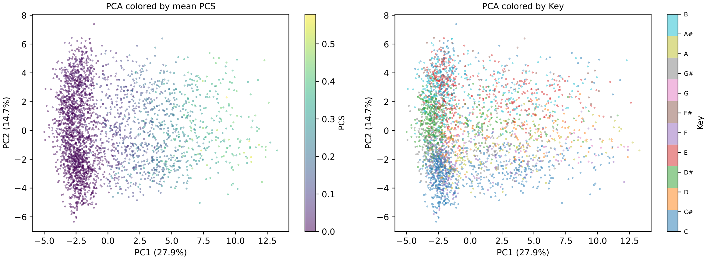
What the Model Learned
3,000 progressions: complexity forms a gradient, keys form clusters
Complexity and key are organised, so we can move z in a controlled way.
32/32 dimensions used · complexity error 0.0034 · key accuracy 98.4%
Jornadas Chilenas de la Computación, 10 al 12 noviembre 2026 | Talca, Chile
11
Notes:
0:45 — This is a PCA of 3,000 encoded progressions. On the left, colour is mean PCS: the gradient is smooth, so complexity is organised in z. On the right, colour is the detected key: progressions in the same key cluster together. All 32 dimensions are active, c_predictor MSE is 0.0034, key accuracy is 98.4%, and the first two components capture 42.6% of the variance. This organisation is what makes gradient ascent reliable.

Slide 12
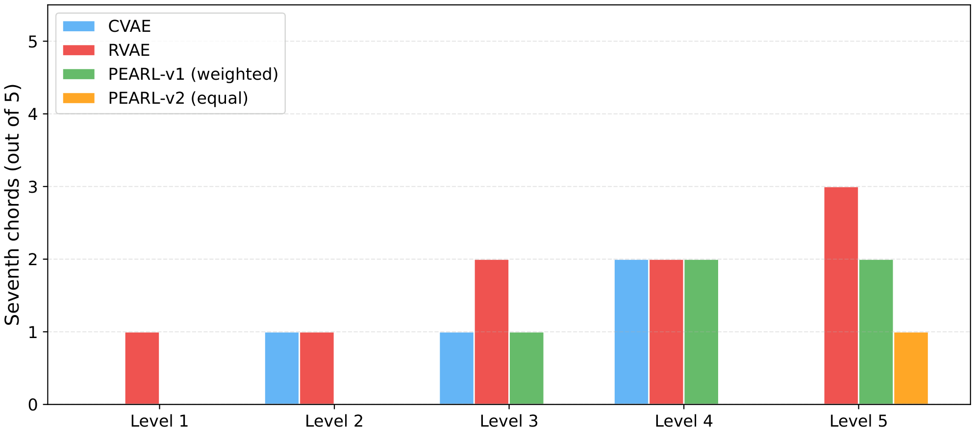
Results: Five Complexity Levels
How many seventh chords each model uses at each level
• Both versions reach the target in 20–30 steps.
• v1: about 1/5 of the change is seventh chords; v2: 1/10.
• v2 spreads the change over the four properties.
Baselines use a different scale; seventh-chord counts still show how much each model enriches.
Jornadas Chilenas de la Computación, 10 al 12 noviembre 2026 | Talca, Chile
12
Notes:
1:05 — The chart counts seventh chords per model at the five levels. Both PEARL variants reach the requested PCS in 20 to 30 steps. In v1 the perceptual weight of 7C is 0.443, and at target 1.0, 20% of the total dimension change goes through 7C; in v2 the share is 12%. v2 spreads the change over the four dimensions and produces more suspended, diminished and no3d chords. Latent displacement grows from about 0.1 at level 1 to about 7 at level 5. The baselines use another complexity scale, but both increase with level, so the seventh-chord count is a coarse common indicator.

Slide 13
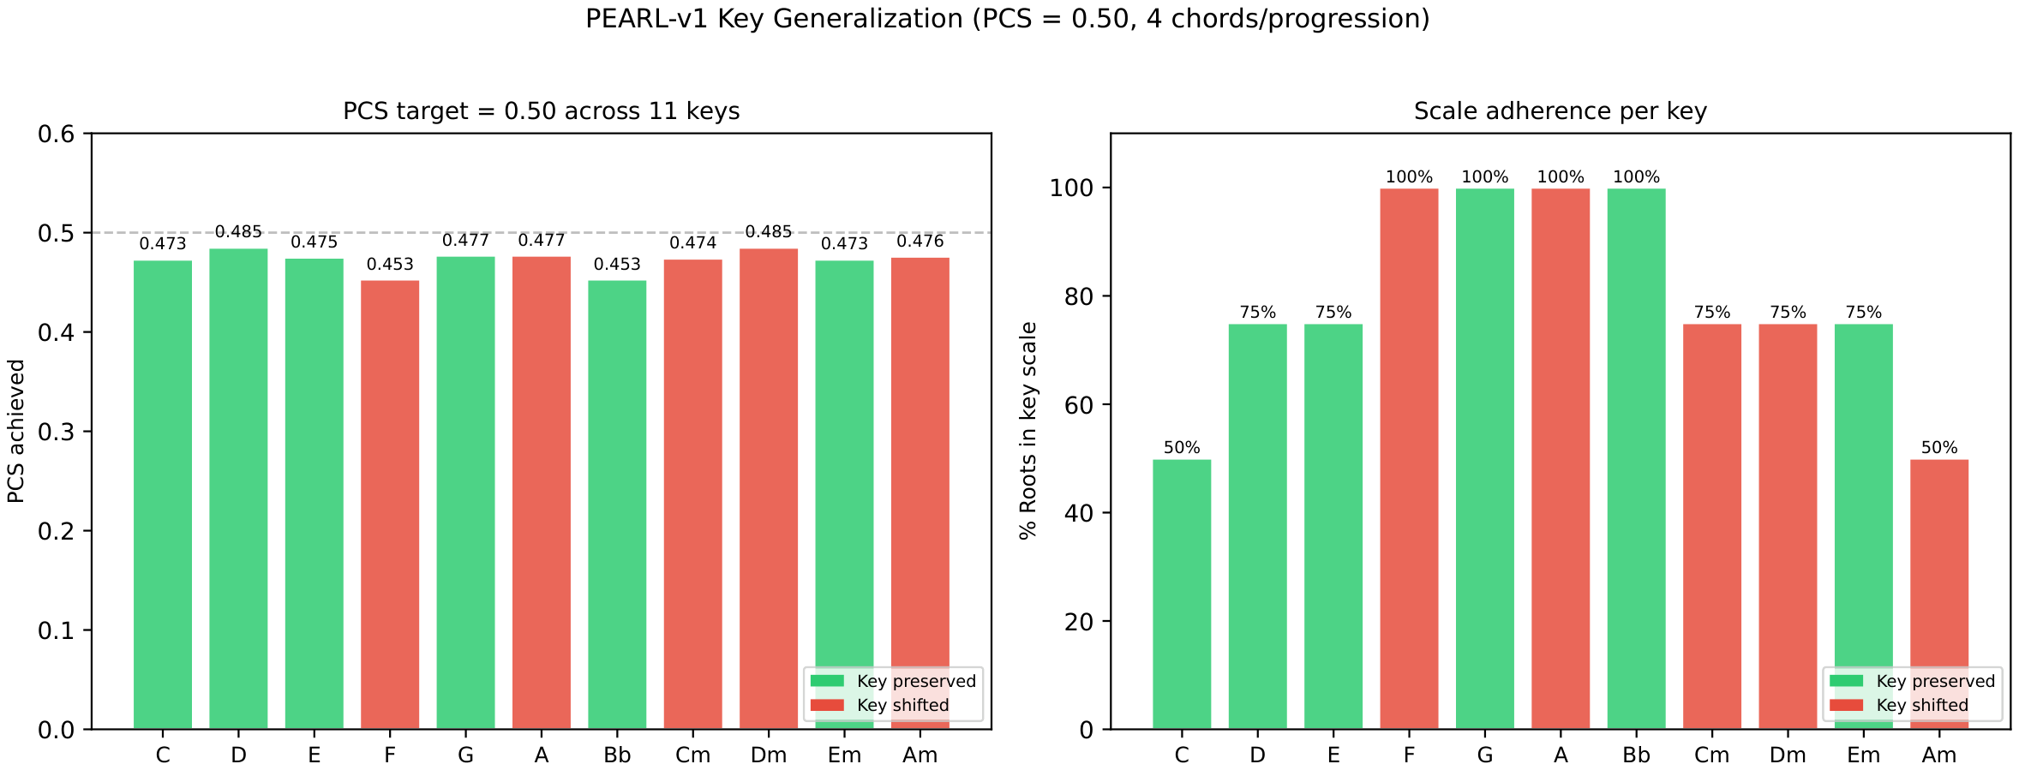
Results: Other Keys and Lengths
11 keys (7 major, 4 minor) and 4–12 chords, target PCS = 0.50
• All 11 keys reach the target (0.45–0.49).
• 80% of roots stay in key; 100% at every length.
• Key kept in 6 of 11; the others move to a related key.
Jornadas Chilenas de la Computación, 10 al 12 noviembre 2026 | Talca, Chile
13
Notes:
0:50 — Generalisation: 11 keys, seven major and four minor, and lengths from 4 to 12 chords, all enriched to PCS 0.50. The target is reached in every key, between 0.453 and 0.485. Scale adherence averages 80% and is 100% at every length. The key_predictor keeps the input key in 6 of 11 cases, 55%; the other five move to the relative or parallel key, so the roots stay largely in scale but the tonal centre is not always anchored.

Slide 14
Results: Staying in Key
Five levels, input in C minor
• 88% of roots stay in key (CVAE 84%, RVAE 76%) [2].
• 32–36% keep the same root; CVAE 84%.
• 32–44% keep major/minor quality; CVAE 72%.
• Low overlap is expected: the penalty favours the target.
Model | In key | Same roots | Same quality
CVAE | 84% | 84% | 72%
RVAE | 76% | 64% | 60%
PEARL-v1 | 88% | 32% | 32%
PEARL-v2 | 88% | 36% | 44%
Means of five levels, input in C minor. 'Same roots' = same root at the same position.
Jornadas Chilenas de la Computación, 10 al 12 noviembre 2026 | Talca, Chile
14
Notes:
1:00 — Tonal coherence combines three measures. Scale adherence is 88% for both variants, against 84% for CVAE and 76% for RVAE [2]. Positional overlap is 32–36%, against 64–84% for the baselines: most chord identities change, which is expected when complexity rises. Quality preservation is 32% for v1 and 44% for v2; CVAE keeps 72%, partly because it copies the input at level 1. The key_predictor stays stable across the five levels. The low overlap is a consequence of λ_reg = 0.005, which favours reaching the target; tonal structure is maintained by the key-organised latent space.

Slide 15
Conclusions
Summary, limitations and future work
• Score: from listeners, not statistics.
• Control: any target in under 30 steps, globally or per property.
• Key: 88% of roots stay in key, across 11 keys and 4–12 chords.
• Limits: harmony only; 43 listeners; key kept in 6 of 11.
• Next: user-controlled penalty, rhythm, larger studies.
Code, checkpoint, audio/MIDI and survey data: github.com/Pepebeats-flp/pearl-sc
Jornadas Chilenas de la Computación, 10 al 12 noviembre 2026 | Talca, Chile
15
Notes:
0:50 — Summary: PCS is a perceptual score with four interpretable dimensions, obtained from 1,032 pairwise judgements by 43 listeners. Gradient ascent on z reaches any PCS target in under 30 steps, globally or per dimension, and keeps 88% of roots in the input scale, against 84% for CVAE and 76% for RVAE [2]. Limitations: harmony only, 43 listeners, baselines compared on released outputs, and the key is kept in 6 of 11 generalisation tests. Next: λ_reg as a user parameter, stronger key anchoring, rhythm and structure conditioning, and larger listening studies.

Slide 16
Thank you — Questions?
PEARL — Controllable Chord Progression Reharmonization
José Pinto-Muñoz · Nicolás Rojas-Morales
Departamento de Informática, Universidad Técnica Federico Santa María
github.com/Pepebeats-flp/pearl-sc
Notes:
0:20 — Thank the audience and invite questions, musical or technical. The next slide lists the references, which can be left on screen during Q&A.

Slide 17
References
Works cited in this talk — full details in the paper
[1] S. Kantarelis et al., “Chordonomicon: A Dataset of 666,000 Songs and Their Chord Progressions,” arXiv:2410.22046, 2024.
[2] L. Comanducci, D. Gioiosa, M. Zanoni, F. Antonacci and A. Sarti, “Variational Autoencoders for Chord Sequence Generation Conditioned on Western Harmonic Music Complexity,” EURASIP J. Audio Speech Music Process., 2023.
[3] C. McKay, J. Cumming and I. Fujinaga, “jSymbolic 2.2: Extracting Features from Symbolic Music for Use in Musicological and MIR Research,” in Proc. ISMIR, 2018.
[4] D. Müllensiefen, B. Gingras, J. Musil and L. Stewart, “The Musicality of Non-Musicians: An Index for Assessing Musical Sophistication in the General Population,” PLoS ONE, 2014.
[5] A. Roberts, J. Engel and D. Eck, “Hierarchical Variational Autoencoders for Music,” in NeurIPS Workshop on Machine Learning for Creativity and Design, 2017.
[6] A. Uemura and T. Kitahara, “Morphing-Based Reharmonization with VAE: Reducing Dissonance with Consonance-Based Loss Function,” in Proc. AIMC, 2022.
[7] D. Temperley, The Cognition of Basic Musical Structures. MIT Press, 2004.
Jornadas Chilenas de la Computación, 10 al 12 noviembre 2026 | Talca, Chile
17
Notes:
0:00 — Reference slide. Not presented; useful during Q&A. [1] dataset, [2] CVAE/RVAE baselines, [3] jSymbolic features, [4] musical sophistication index, [5] VAEs for music, [6] VAE reharmonization, [7] tonal theory.

