Slide 1
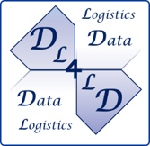

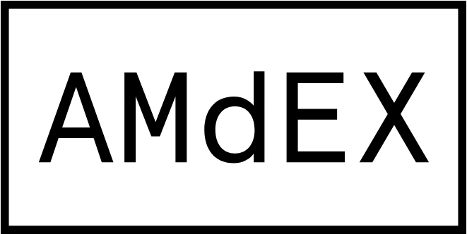
Energy cost and machine learning accuracy impact of k-anonymisation and synthetic data techniques
Pepijn de Reus, Ana Oprescu, Koen van Elsen

Slide 2


Getting to know us
Ana Oprescu Assistant Professor in the Complex Cyber Infrastructure research group (UvA)
Pepijn de Reus Student MSc. Artificial Intelligence (UvA)

Slide 3
Why should we bother?
EU Green Deal: policies fit for reducing net greenhouse gas emissions by at least 55% by 2030
no net emissions of greenhouse gases by 2050
economic growth decoupled from resource use
no person and no place left behind

Slide 4
Why should we bother?
EU Green Deal: policies fit for reducing net greenhouse gas emissions by at least 55% by 2030
no net emissions of greenhouse gases by 2050
economic growth decoupled from resource use
no person and no place left behind
GDPR
the protection of personal data
access to data which has been collected and the right to have it rectified
exception for anonymised data, e.g., k-anonymisation or synthesisation

Slide 5
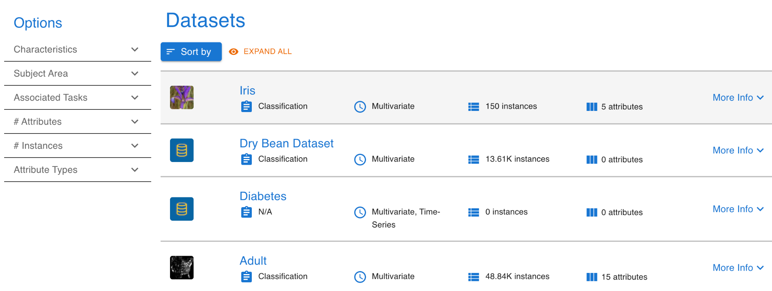
What we do not know yet
What is the energy cost of privacy enhancing techniques?
What is the accuracy impact of privacy enhancing techniques on the machine learning models?
Given a dataset:
https://archive-beta.ics.uci.edu/ml/datasets

Slide 6
What we do not know yet
What is the energy cost of privacy enhancing techniques?
What is the accuracy impact of privacy enhancing techniques on the machine learning models?
Given a dataset:
What is the impact of the number of entries?
What is the impact of the number of attributes?
https://archive-beta.ics.uci.edu/ml/datasets

Slide 7
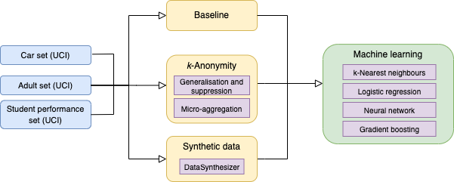
Currently explored privacy enhancing techniques
k-anonymity
Micro-aggregation
Generalisation and suppression
Synthetic data
Experiment overview

Slide 8
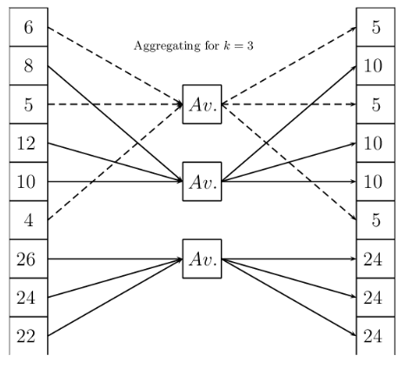
k-anonymisation techniques
Micro-aggregation:
First introduced by Defays & Nanopoulos "The small aggregates method." 1993.
Clusters of size ≥ k, each element in a cluster is replaced by its cluster’s representative
Aggregate the representative values, could also be:
Geometric mean, median, mode, set, interval
Perturbation method: disturb individual data cells, while maintaining statistical properties of the result
Unsuitable for operations that require uncompromised information in data cells
Works best on metric spaces, categorical data needs treatment
NP-hard if it has to find clusters
Can work with predefined hierarchies

Slide 9
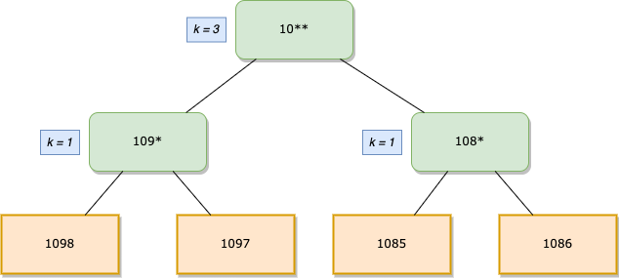
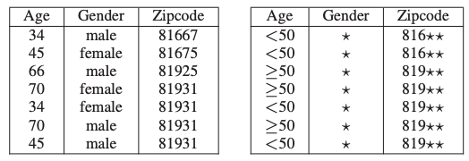
k-anonymisation techniques
Generalisation + suppression
First introduced by P. Samarati, "Protecting Respondents' Identities in Microdata Release," in IEEE TKDE 2001
Hierarchies are ways to ‘zoom out’ on the set of values of the attributes
used by ARX (memory intensive)
classes of size < k are removed from the dataset as long as their total number remains under the suppression threshold.
Kohlmayer, Prasser et al, Flash: Efficient, Stable and Optimal K-Anonymity. SocialCom/PASSAT 2012.

Slide 10
Energy measurement approaches
Current system power Cumulative
Hardware: accurate, expensive set-up
https://github.com/lukaskoedijk/Green-Software for a Ractivity PDU based framework
Software: less accurate, more accessible
https://github.com/sandervano/GreenCodeSmells for RAPL based C implementation
https://github.com/PepijndeReus/Privacy-Enhancing-ML for a use of pyRAPL
depends on the architecture
counters present on most Intel Chips, some AMD
✓
✓
✓

Slide 11
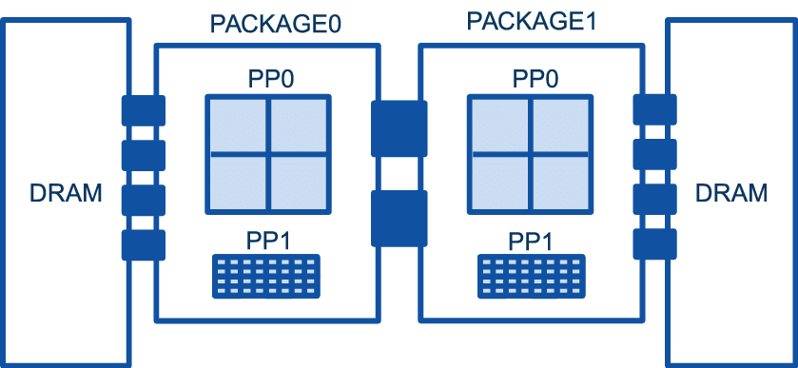
RAPL
Intel’s Running Average Power Limit
Correlates with 0.99 when compared to hardware setup*
* K. N. Khan, M. Hirki, T. Niemi, J. K. Nurminen, and Z. Ou, “RAPL in action: Experiences
in using rapl for power measurements,” ACM TOMPECS, 2018.
Model of a Dual core. Veiga et al., Energy efficiency and microarchitectural characterization of Big Data processing frameworks. FGCS 86(11)
Notes:
Inside each package, separated energy values are provided for the processing cores, labeled as PP0 (Power Plane 0), and the integrated graphic card (if any), labeled as PP1. These energy values always have the following relationship: PP0 + PP1 <= package. RAPL also provides independent values for the memory modules that are associated to each package, labeled as DRAM. Note that the figure shows the architecture of a dualsocket system, each socket providing a quad-core processor and a graphic card

Slide 12
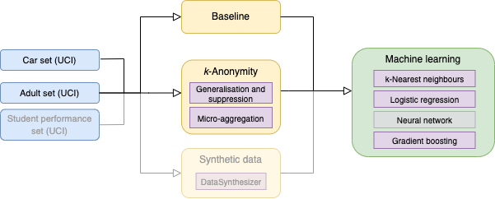
Related work

Slide 13
Related work - impact of k-anonymisation
k-value has a statistically significant impact on the energy consumption of the chosen anonymisation algorithms
The generalisation and suppression performs better in almost all cases, provided that proper anonymization hierarchies are used in the anonymisation process
Models trained on generalisation and suppression perform better.
By Oprescu et al., ICT4S 2022.

Slide 14


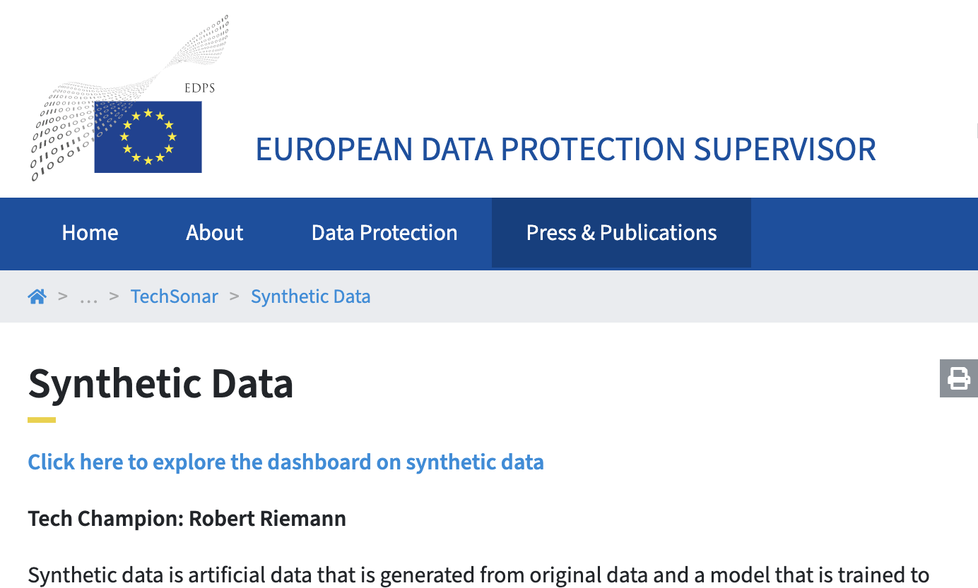
Synthetic data in the news

Slide 15
Extending research to synthetic data
Why synthetic data?
Enhances privacy of data
Promise is that synthetic data is similar to the original dataset
No research done on energy consumption yet

Slide 16
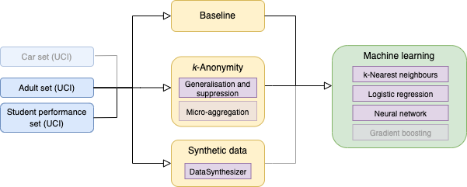
Extending our research to Synthetic data
Using a different data set
Neural net instead of gradient boosting

Slide 17
Method
Literature shows that DataSynthesizer has the lowest information-loss* of the currently available Python packages for synthetic data generation.
* M. Hittmeir, A. Ekelhart, and R. Mayer, “On the utility of synthetic data: An empirical evaluation on machine learning tasks,

Slide 18
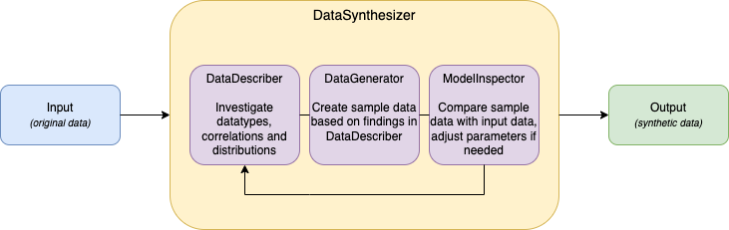
Method
Literature shows that DataSynthesizer has the lowest information-loss* of the currently available Python packages for synthetic data generation.
How does it work?
* M. Hittmeir, A. Ekelhart, and R. Mayer, “On the utility of synthetic data: An empirical evaluation on machine learning tasks,

Slide 19
Experimental setup - synthetic data
Datasets
Adult: hierarchy height range 2-5
Student Performance: hierarchy height range 1-2
Data Set | Data Set Characteristics: | Attribute Characteristics: | Associated Tasks: | Number of Instances: | Number of Attributes
Student Performance | Multivariate | Categorical, Integer | Classification | 649 | 33
Adult | Multivariate | Categorical, Integer | Classification | 48842 | 14

Slide 20
Experimental setup - synthetic data
Machine learning techniques
Logistic regression: computes probabilities, chooses most likely
kNN: regression based on k-nearest neighbors (k set to 5).
Neural network: using 8 neurons as input, 16 hidden layer and 1 output
K-anonymity in the set {3, 10, 27} (as proven to be best in related work)
Synthetic data generation
Two sets of experiments:
Measure energy consumption of each anonymisation method
Measure accuracy of ML techniques on each anonymised dataset

Slide 21
Experimental setup - synthetic data

Slide 22
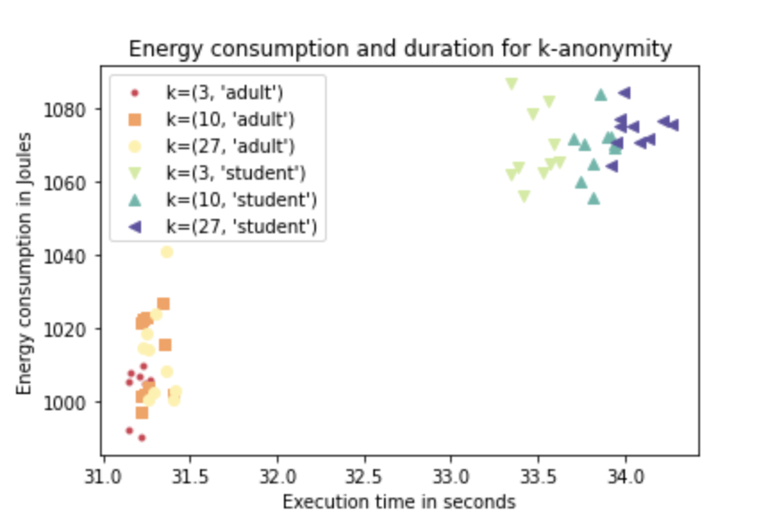
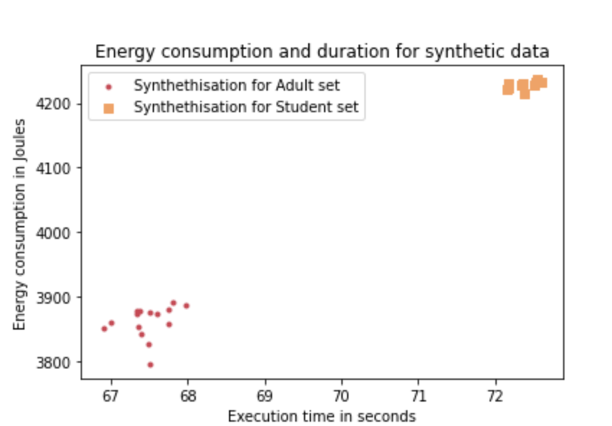
Result: Energy cost of gen+sup & synthetic data

Slide 23
Poll #1: Would you deem ±4x higher energy consumption for generating synthetic data acceptable because of enhanced privacy?

Slide 24
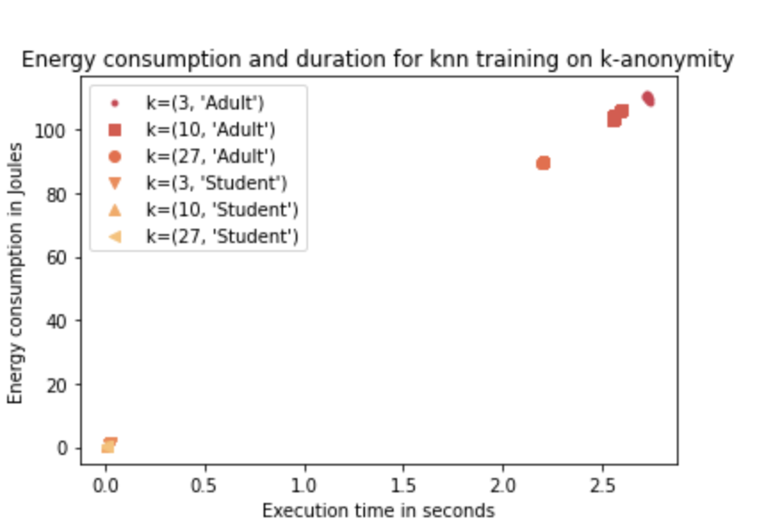
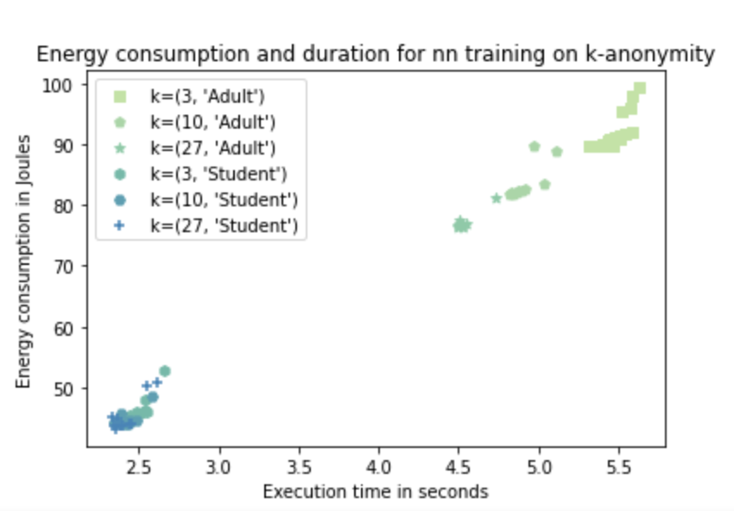
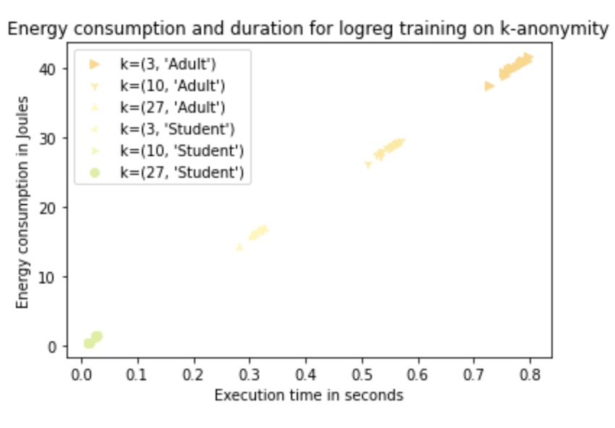
Result: Energy cost of training on k-anonymised

Slide 25
Result: Energy cost of training on k-anonymised
What do we see?
→ Energy consumption and training time decrease as k-anonymity increases
→ Student Performance set takes less time to run

Slide 26
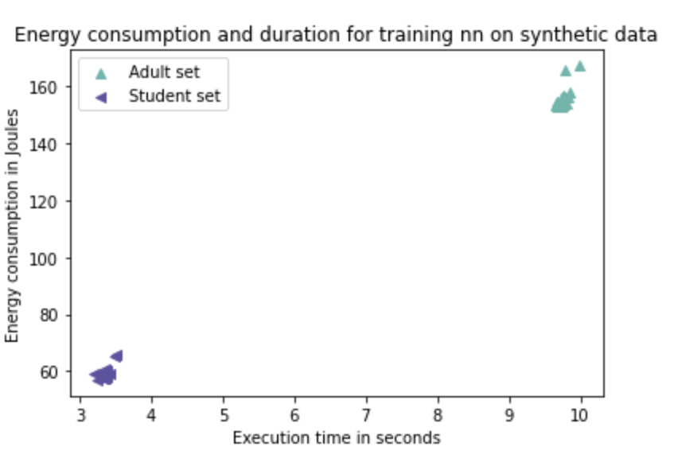
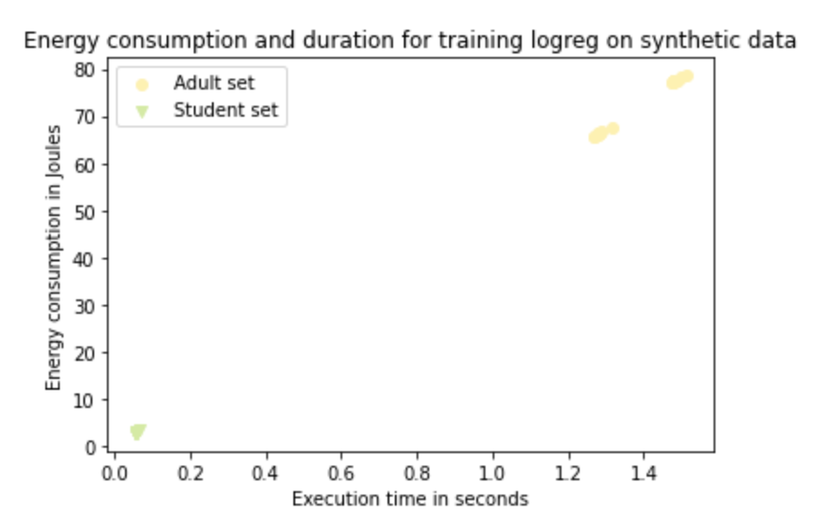
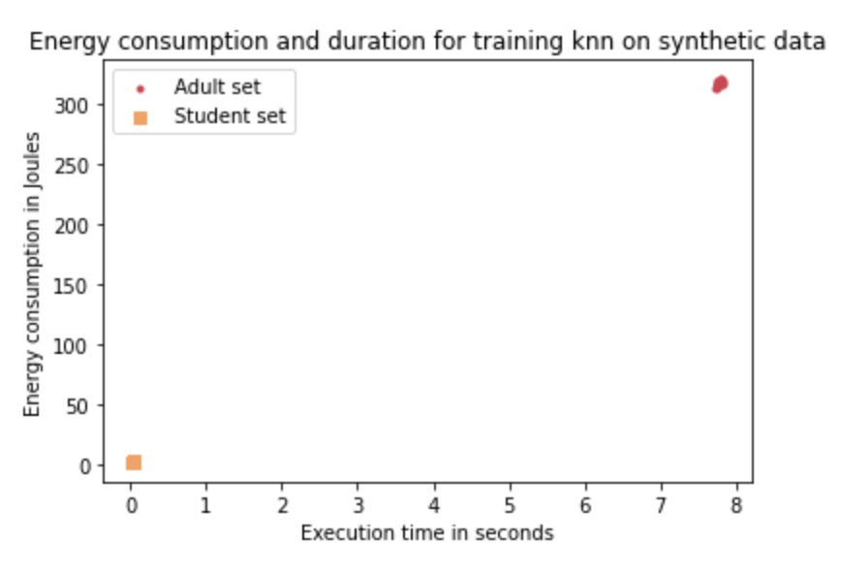
Result: Energy cost of training on synthetic data

Slide 27
Result: Energy cost of training on synthetic data
What do we see?
→ Very little variance in the measurements
→ Training on synthetic data uses more energy compared to k-anonymity

Slide 28
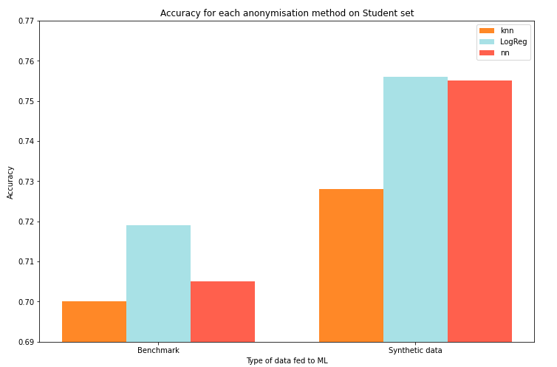
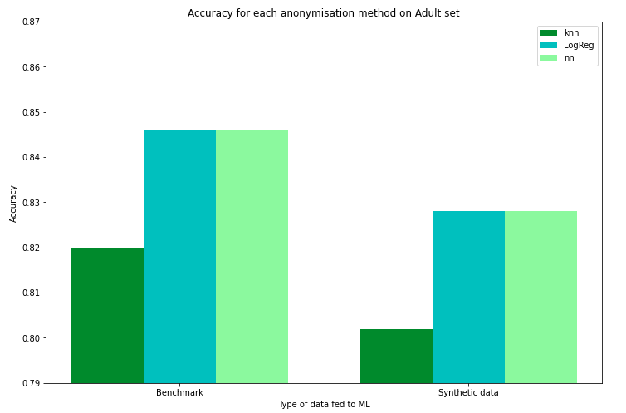
Accuracy impact of synth
Findings: Synthetic data outperforms (+3%) benchmark on Student set Synthetic data underperforms (-2%) on Adult set, compliant with related work

Slide 29
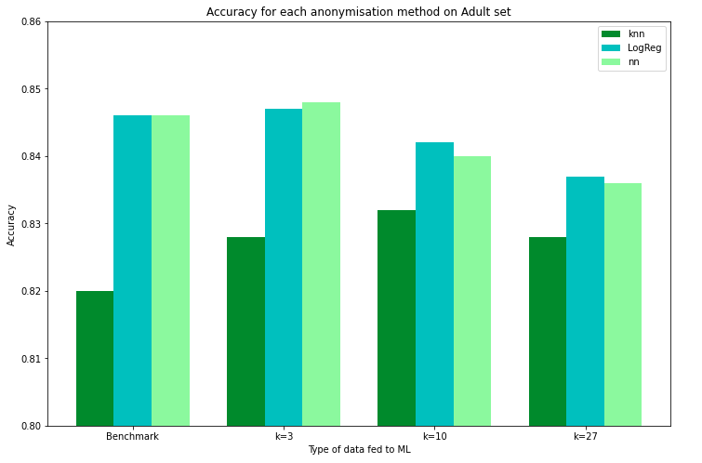
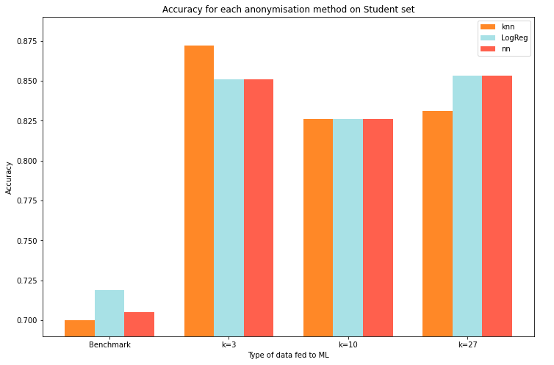
Accuracy impact of gen+sup
Findings: kNN performs better on k-anonymised data than on the benchmark LogReg and neural net have a very similar performance, rather stable over k

Slide 30
Take me home – synthetic data
Synthetic data tends consume up to 4x more energy to generate than anonymisation
Models trained on synthetic data tend to perform slightly less (-2%) or better (+3%), but rather similar to original data.

Slide 31
Take me home – synthetic data
Synthetic data tends consume up to ±4x more energy to generate than anonymisation
Models trained on synthetic data tend to perform slightly less (-2%) or better (+3%), but rather similar to original data.
Poll #2: Would you say the benefits of enhanced privacy outweigh a 2% loss in accuracy?

Slide 32
Take me home – general
Energy cost of privacy enhanced data is lower for k-anonymity than synthetic data
Accuracy impact on models trained on k-anonymised data is inconclusive, however at a lower energy consumption compared to models trained on original data.
Models trained on synthetic data have a similar accuracy and energy consumption compared to models trained on the original data.
Techniques such as k-anonymity and synthetic data could enhance privacy whilst also improving the energy consumption without any accuracy cost.

Slide 33

Poll #3: What are further research directions that should be explored?
Interested in seeing more?
See our use cases!
https://amdex.eu/usecases/
or via:

