Slide 1
Skyline cohesive group queries in Large Road-social Network
組員
工科系111 許中瑋
工科系111 謝獻霆

Slide 2
Motivation
the problem from the past works:
lack of flexibility
impracticality of spatial distance
In this work:
Find a set of skyline cohesive
contain uq (querying user)
satisfy the spatial and size constraint
use real world distance
Social network Gs
Road network Gr

Slide 3
Road-Social Group Query Problem
Densest RSGQ
Location-specified
Skyline RSGQ
Skyline RSGQ
Given querying user Uq, social network constraint c ,distance threshold r
Return the vertex set with max core number ,and min cost as possible
Given Uq ,c ,r, minimum core number kmin, specified meeting point o
Return the skyline group with given meeting point
Given Uq ,c ,r, kmin
Return the skyline group

Slide 4
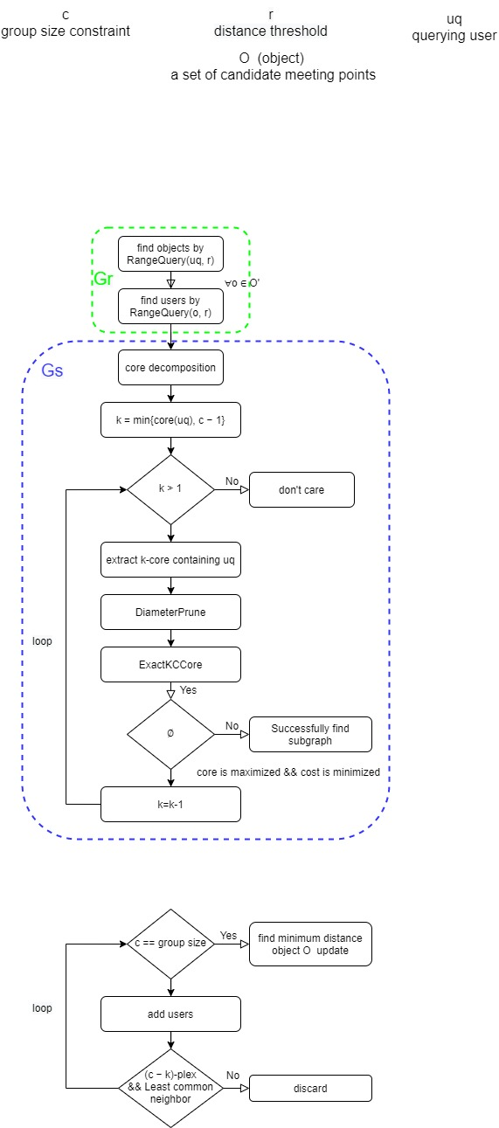
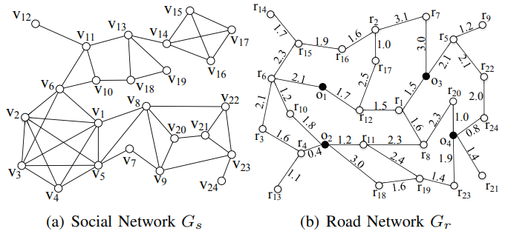
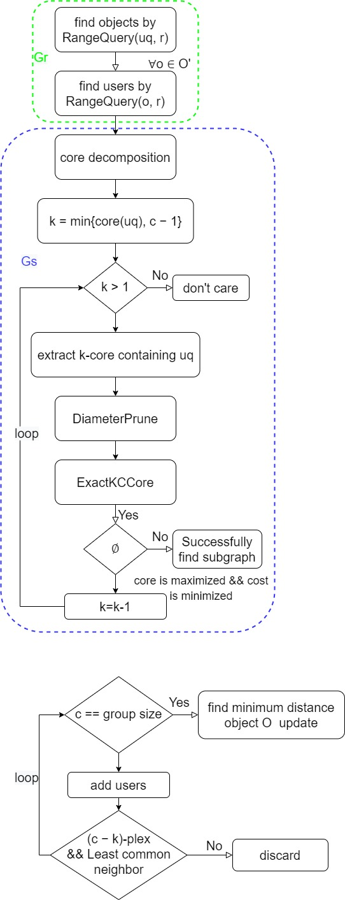
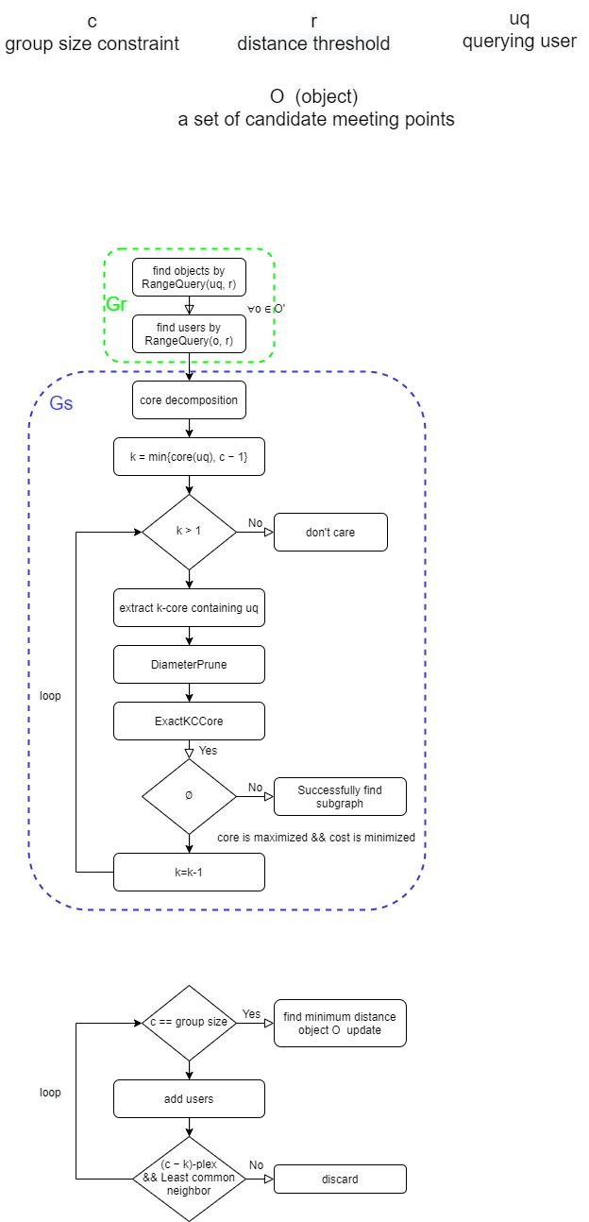
Exact RSGQD Algorithm

Slide 5
Exact RSGQD Algorithm
3.2
1.5
5.1
4.9

Slide 6
Exact RSGQD Algorithm

Slide 7
Exact RSGQD Algorithm
K=3
K=2
K=1
K=4

Slide 8
Exact RSGQD Algorithm
K=4

Slide 9

Exact RSGQD Algorithm
(k,c)-core -> (c-k)-plex -> N-plex
u
v
Assume diameter > 2
Vertices except u,v = c-2 = neighbor(u) U neighbor(v) = 2(c-N) > c-2 (-><-)
V0
V1
V2
V3
…
Vr
Non-neighbor(V0) >= V0 U {V2…Vr} U (neighbor(V3) - {V2, V4})

Slide 10
Exact RSGQD Algorithm
任取兩點 neighbor >= 2k-c+2
可知each node N-1 non-neighbor
任取兩點最少 neighbor=c-2(N-1)=2k-c+2

Slide 11
Exact RSGQD Algorithm
Ans ({v1, v2, v3, v4, v5}, o1, 4, 24.9)

Slide 12
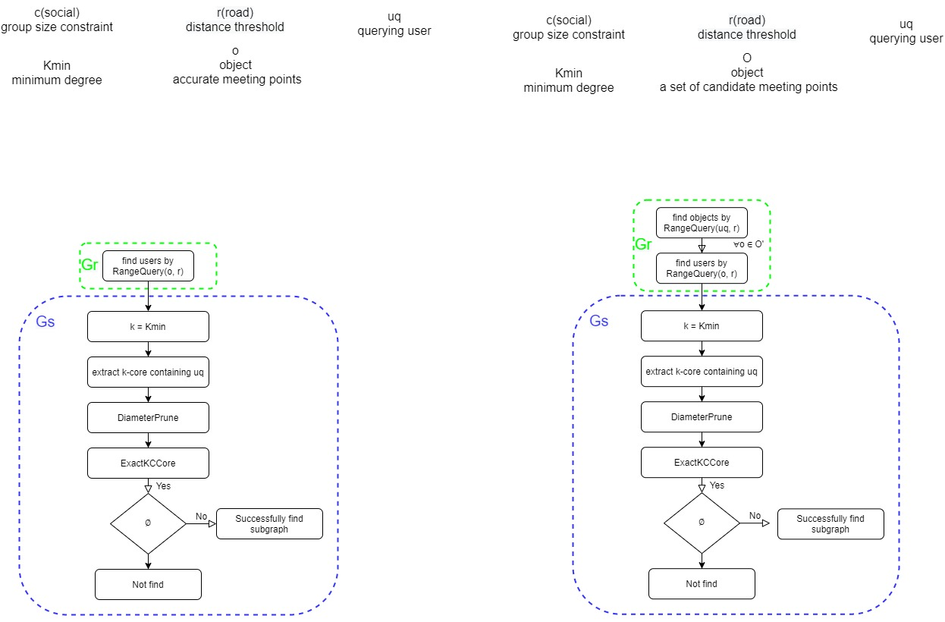
Exact RSGQLS Algorithm

Slide 13
Exact RSGQS Algorithm
Notes:
列舉k,c core費時

Slide 14
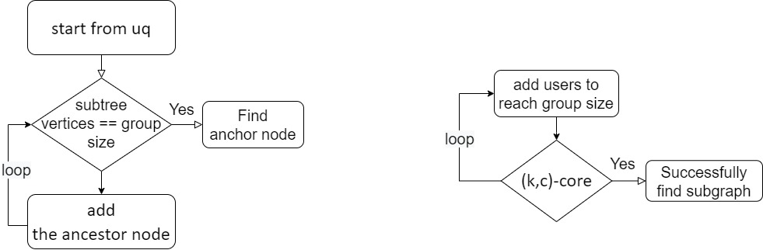
GreedyKCCore
Node4
v
dist
12
1.7
6
2.1
10
3.3
1
4.2
3
4.2
17
4.2
15
4.4
8
4.8
2
5.2
4
5.5
14
6.1
16
6.3
11
6.3
13
6.6
5
6.8
Notes:
需要suppor他的data structure
含meeting point distance

Slide 15
K=3
Core-Distance Tree
K=2
V17
V12
V16
K=1
V13
V11
1-core
node1
V14
v
dist
V10
V15
12
1.7
V6
8
4.8
K=4
V8
2-core
V2
V1
Node2
v
dist
10
3.3
11
6.3
13
6.6
V3
V5
3-core
V4
node3
Node4
v
dist
v
dist
6
2.1
17
4.2
15
4.4
4-core
14
6.1
Node5
16
6.3
v
dist
1
3.2
3
4.2
2
5.2
4
5.5
5
6.8
With given c ,uq ,kmin we can find an anchor node
Notes:
要能保證我找的k,c core要有uq

Slide 16
Anchor node
1-core
node1
v
dist
12
1.7
8
4.8
2-core
Node2
v
dist
10
3.3
11
6.3
13
6.6
3-core
node3
Node4
v
dist
v
dist
6
2.1
17
4.2
15
4.4
4-core
14
6.1
Node5
16
6.3
v
dist
1
3.2
3
4.2
2
5.2
4
5.5
5
6.8

Slide 17
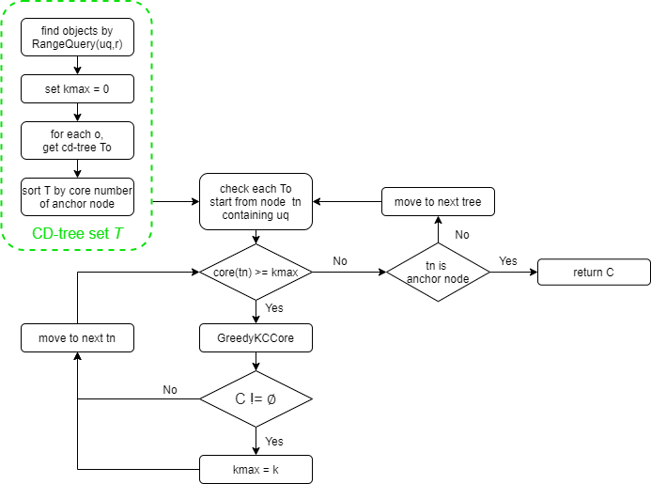
RSGQD-CDtree algorithm
Given Uq, c, r
Kmax > core(anchor node)
Core(anchor node) > core(remaining anchor node)

Slide 18
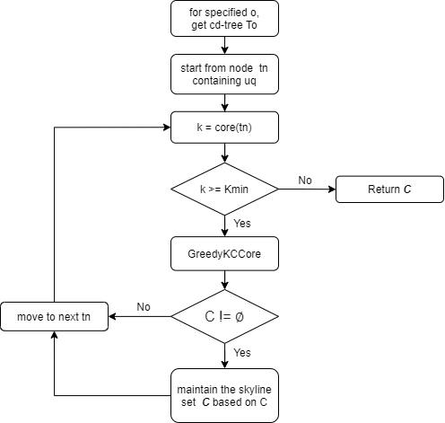
RSGQLS-CDtree algorithm
Given Uq, c, r, kmin, o

Slide 19
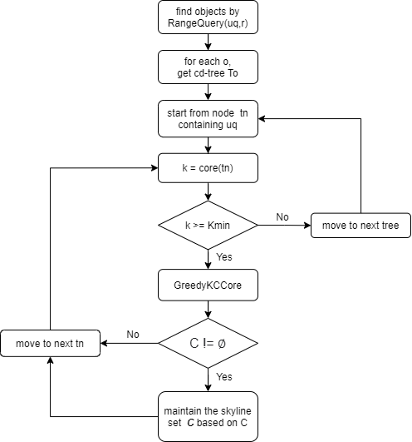
RSGQS-CDtree algorithm
Given Uq, c, r, kmin

Slide 20
Commit
Social network is hard to define

