Slide 1
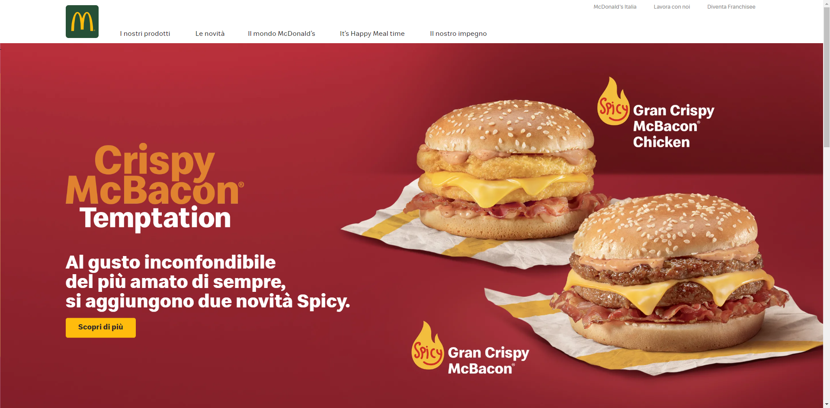
https://www.mcdonalds.it/

