Slide 1

PAC-MAC : Fine Grained Memory Access Control for Inter-VM Communication
Course of Real Time Systems and Industrial Applications
Students :
Giuseppe Alfieri M63001675
Domenico Coppola M63001695
Tutors
Giorgio Farina
Francesco Pizzo

Slide 2


Short Summary
Virtio issues
High/Low Level Architecture
FPD-DMA features
Jailhouse configuration
Design FPGA
System Analysis
References

Slide 3

VIRTIO limitations
In classical VIRTIO scheme the back-end has unrestricted access to all VM Memory.
Also the backend typically is developed on a priviled VM
This two points could be very dangerous for security
  The backend could be malicious and could harm the VM host
The idea of Mutual distrust model is :
  Devolop the backend on an Unpriviled VM
  Restrict the access of backend to VM memory to predefined sections

Slide 4
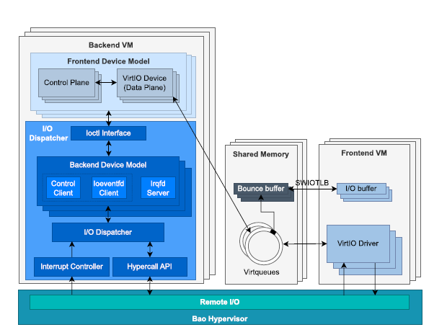

Software solutions (1)
In Dec 2024 it was presented BiRtIO, a software architecture where:
  Bao Static Paritioning hypervisor is modified to allow the requests forwarding between front-end VM and back-end VM, which executes I/O operations
  Back-end and Front-end communicate via Shared memory.
  The Bounce-Buffers are used to prevent the Front-end from allocating outside the shared memory.
This solution is completely software-based and has some overhead due to copying data to bounce buffers.
Reference : J. Peixoto, J. Martins, D. Cerdeira, S. Pinto, “BiRtIO: VirtIO for Real-Time Network Interface Sharing on the Bao Hypervisor”, Dec 2024.

Slide 5
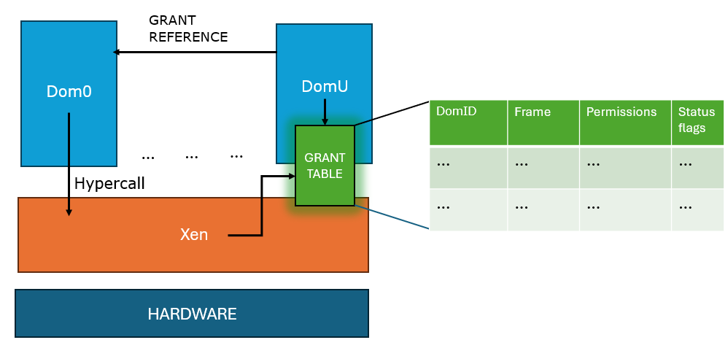

Software solutions (2)
A significative example of software solution is Grant tables in Xen hypervisor:
  DomU chooses a page to share, updates the grant table (with permissions and so on..) and sends a grant reference (numeric id) to Dom0
  Dom0 invokes the hypercall, using the grant reference, to request memory mapping to Xen
  Xen checks the validity of permissions in Grant table and if so allocates the required memory
This solution is completely software-based and has a limitation due to the granularity at the "page" level.

Slide 6
Project Proposal
The purpose of this project is to try to address the limitations of software implementations, moving the implementation of the memory access control mechanism to hardware
The project will include a first prototype on ZCU104 (Zynq UltraScale + MPSOC)
The request will be redirected on DRAM
Building of Jailhouse on PS of ZCU104
Creation of bare metal non root cell, which will write or read on FPGA page via FPD-DMA
FPGA Design which will intercept and analyze the write/read request
Valid address
Invalid address
  The request will be blocked, and an error will be sent to PS

Slide 7

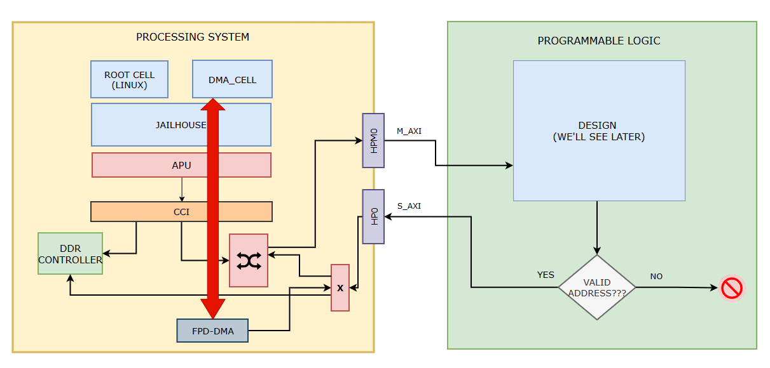
High Level Architecture
Thanks to Jailhouse the FPD-DMA will be allocated to DMA_CELL, which is a bare metal non root cell
The CCI is responsible of cache coherence management
FPD-DMA doesn’t pass through CCI!!!

Slide 8
FPD-DMA features
FPD-DMA (full-power domain DMA) is one of the two DMA masters that can be found into PS-side of ZCU104
It is part of the full-power domain, one of the two domains of MPSOC, which is designed for high performance transfers
It can transfer data towards FPGA (also known as Programmable Logic)
It is not coherent with cache, so proper operations are required to perform a correct transfer.
It can operate in different modes, in this project was used the simple mode, which allows to transfer a contiguos block of elements (page)

Slide 9
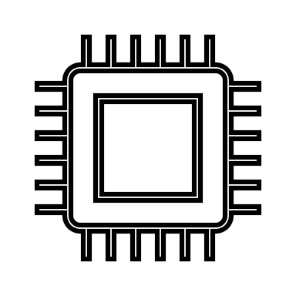
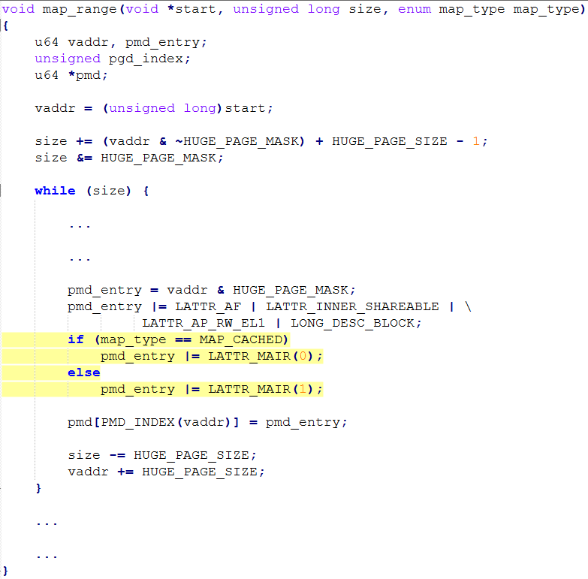
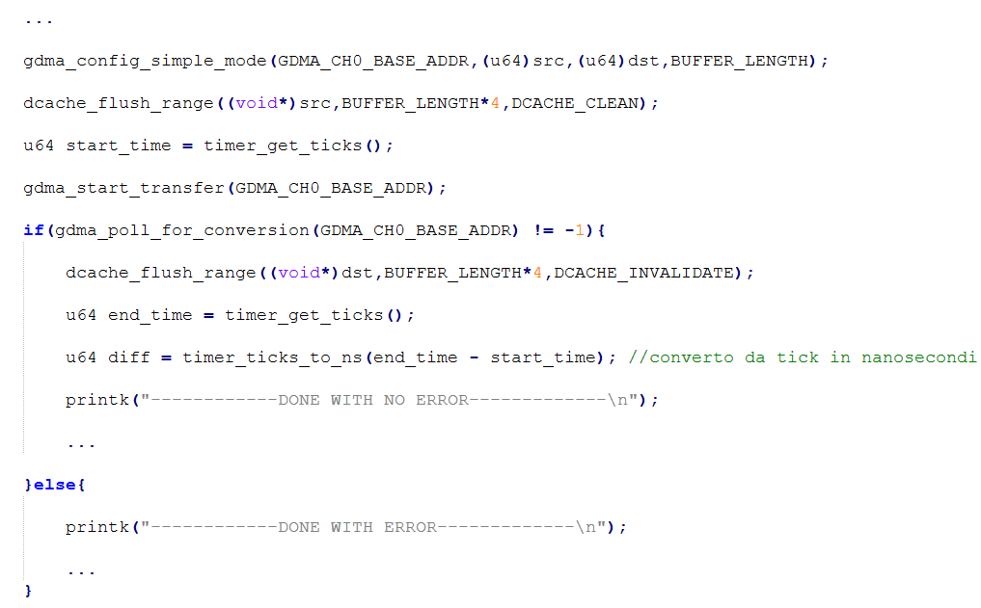
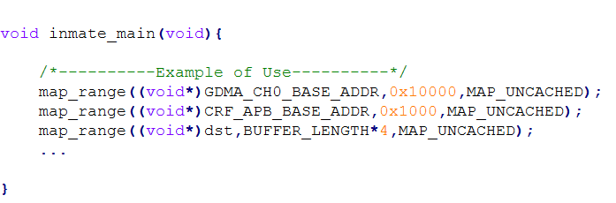
FPD-DMA & Cache management
The two options are not necessary exclusive (e.g you can declare a mem region as MAP_CACHED and then use the function implemented by us and shown below)
Before the transfer start the cache must be cleaned, instead at the end it must be invalidated
Or mark the mem region as MAP_UNCACHED using map_range function available in Jailhouse

Slide 10

Jailhouse configuration (1)
...
.mem_regions = {
...
/* FPD-DMA */{
.phys_start = 0xFD500000,
.virt_start = 0xFD500000,
.size = 0x00010000, // 64 KB
.flags = JAILHOUSE_MEM_READ | JAILHOUSE_MEM_WRITE | JAILHOUSE_MEM_IO,
},
/* CRF_APB */{
.phys_start = 0xFD1A0000, .virt_start = 0xFD1A0000,
.size = 0x00001000, // 4 KB .flags = JAILHOUSE_MEM_READ | JAILHOUSE_MEM_WRITE | JAILHOUSE_MEM_IO, },
},
...
.irqchips = {
/* GIC */ {
.address = 0xf9010000,
.pin_base = 32,
.pin_bitmap = {
(1<<(52 - 32)),
0,
0,
(1 << (140 - 128)) | (1 << (141 - 128)) | (1 << (156 - 128)), }, },
},
A Jailhouse cell can use this peripheral if it is specificied into cell configuration a mem_region with following features :
  JAILHOUSE_MEM_IO flag because the peripheral is memory mapped.
  Base address and memory size.
If you want to use interrupt, you have to define the IRQ number into cell configuration
Another mem_region (called CRF-APB) has been added because the FPD_DMA_REF_CTRL register is located there and it allows to enable the FPD-DMA clock
Example :
GDMA channel 0 (or FPD-DMA channel 1)
Interrupt number (GIC) = 156 (it can be found into Reference manual of MPSOC)

Slide 11
Jailhouse configuration (2)
In non root cell configuration there are defined other two mem_regions:
  The first one is where the FPGA will write the data if the address is considered valid and it is used also for testing to see the written value
  The first one started at phys_address 0x10_xxxx_xxxx and is visible from FPGA
  The FPD-DMA will start a transfer from a source buffer to FPGA reserved page (a)
  The FPGA will intercept the write request and will direct her to the other mem_region after address analysis (b)
/* Mem for DMA */{ .phys_start = 0x50A00000, .virt_start = 0x50A00000,
.size = ...,
.flags = JAILHOUSE_MEM_READ | JAILHOUSE_MEM_WRITE | JAILHOUSE_MEM_DMA
},
/*Mem for FPGA */{ .phys_start = 0x1050A00000, .virt_start = 0x1050A00000, .size = ...,
.flags = JAILHOUSE_MEM_READ | JAILHOUSE_MEM_WRITE | JAILHOUSE_MEM_DMA, },

Slide 12
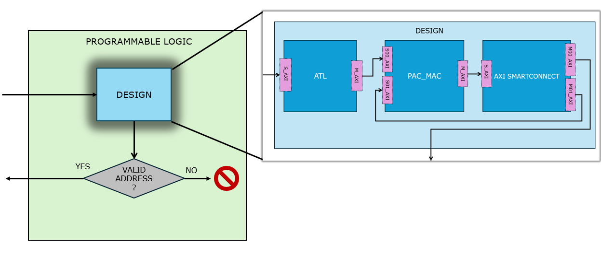
Design FPGA
Let’s focus on how the design is done internally
The design is made of two main components :
  ATL
  PAC_MAC (which is in turn composed of two components analyzed subsequently)

Slide 13
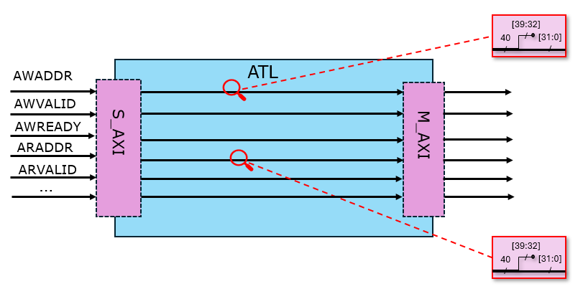
ATL (Address Translation Logic)
The ATL translates FPGA addresses to their corresponding memory addresses
ATL is mapped to addresses in range [0x10_0000_0000,0x10_7FFF_FFFF] and it simply ignores the two most significant digits of AWADDR and ARADDR signals
For the remaining signals it makes passthrough
References :F. Pizzo, “FPGA-Based Memory Traffic Analysis” , Jun 2023

Slide 14
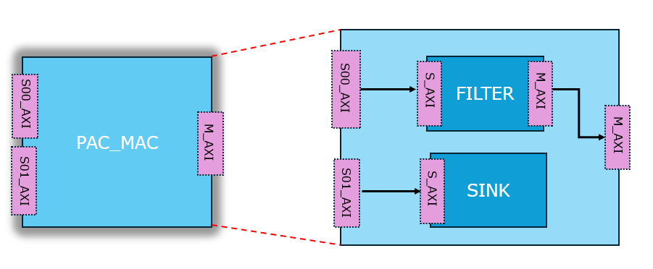
PAC_MAC
PAC_MAC is the core of the design
Internally it is composed of two components :
  FILTER : Addresses DRAM or SINK module (through AXI Smart connect) depending on the validity of transaction
  SINK : Addressed by the Filter when the transaction is considered invalid , and it responds with a AXI error (SLVERR)

Slide 15
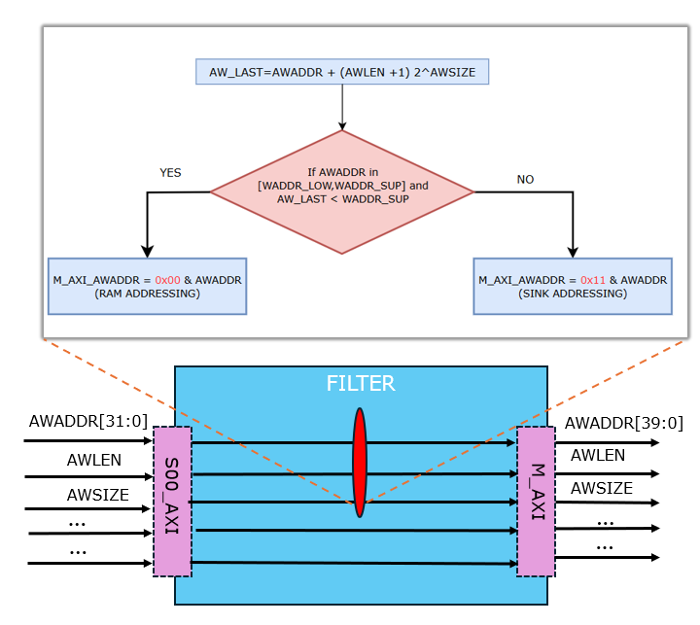
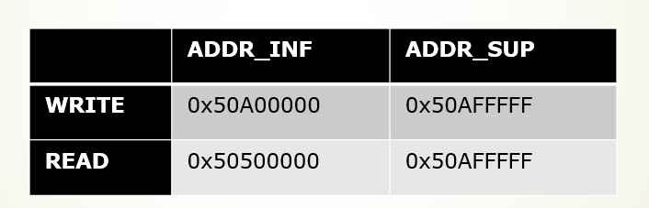
FILTER
Combinatorial component implemented in VHDL.
The Filter concatenates :
  0x00 to address DRAM if the transaction is valid
  0x11 instead; the range [0x11_0000_0000,0x11_7FFF_FFFF] is reserved for SINK-module
How the filter works is shown for AW channel but the same is for AR channel.
For the others signal passthrough is used
N.B. In current implementation the interval is fixed !!!
FILTER ranges

Slide 16

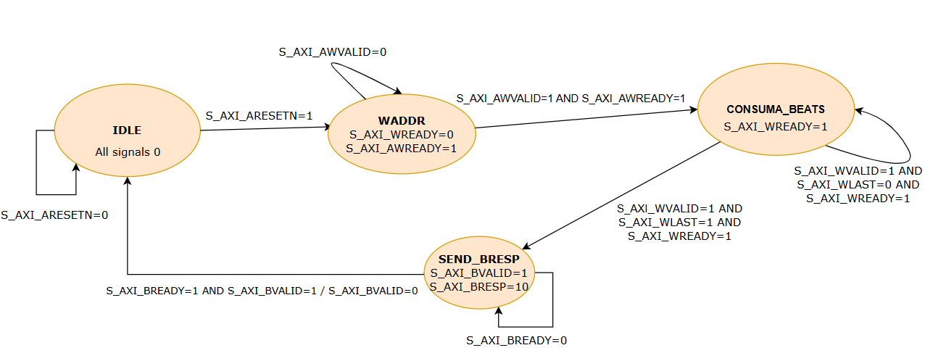
SINK (1)
The SINK module implements two FSM, one for writing and one for reading
It is mapped in range [0x11_0000_0000,0x11_7FFF_FFFF] and not visible outside of design
Writing FSM : responds to AXI-FULL handshake with BRESP=SLVERR (“10”) on channel B , ignoring all burst beats (in CONSUME_BEATS state)
This module is mandatory to end the master AXI transaction and avoid blocking the master

Slide 17
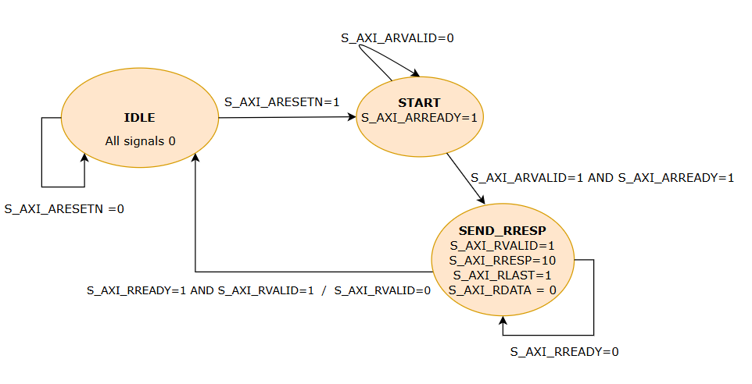
SINK (2)
Reading FSM : answers immediately with RLAST=1 to signal the end of burst, and responds to handshake AXI with a RRESP=SLVERR on channel R

Slide 18
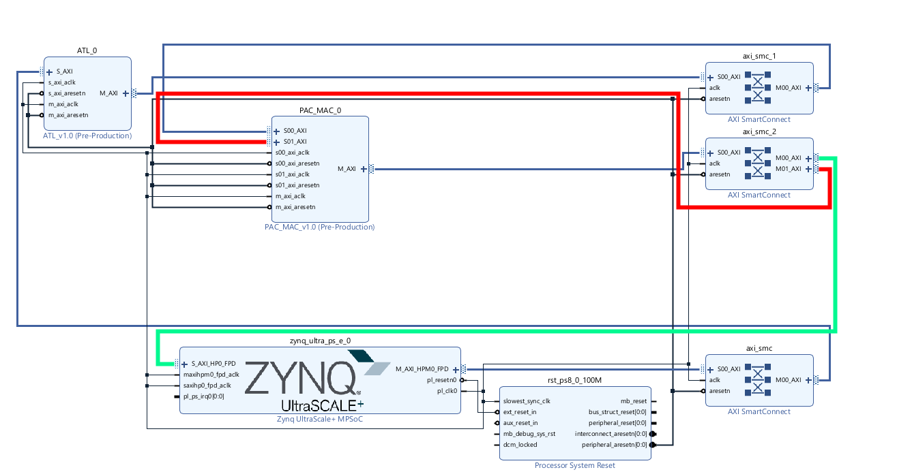
Block Design

Slide 19

Functional Analysis (1)
This is a piece of simulation of FILTER module with an AXI write transaction on port S00 of PAC_MAC module
N.B. Only a few signals were shown
As we see since it AWADDR is not in FILTER-range then the SINK is addressed by adding “11” and M_AXI_AWADDR becomes 0x1150AB0000

Slide 20
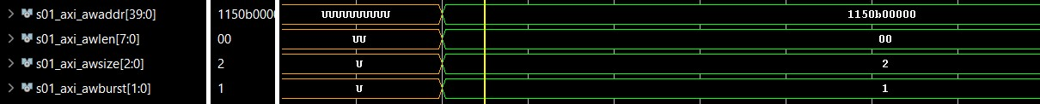
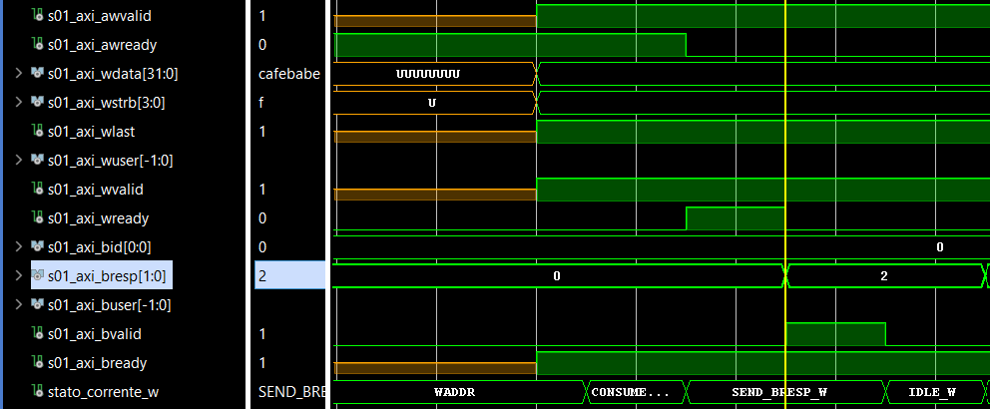
Functional Analysis (2)
This is a piece of simulation of SINK module with an AXI write transaction on port S01 of PAC_MAC module
As we see in SEND_BRESP_W state BRESP=10(=SLVERR)

Slide 21

Testing
ID | Operation | Input | Expected Output
T1 | Transfer DMA -> FPGA | scr address and dst address in range | DONE WITH NO ERROR
T2 | Transfer DMA -> FPGA | src address in range and dst address not | DONE WITH ERROR
T3 | Reading with CPU on FPGA page | Address in range | Destination updated with read value
T4 | Writing with CPU on FPGA page | Address in range | Destination updated with written value
T5 | Reading with CPU on FPGA page | Address not in range | --Sync Exception--
T6 | Writing with CPU on FPGA page | Address not in range | Kernel panic (or failure of non root cell in JAILHOUSE)

Slide 22

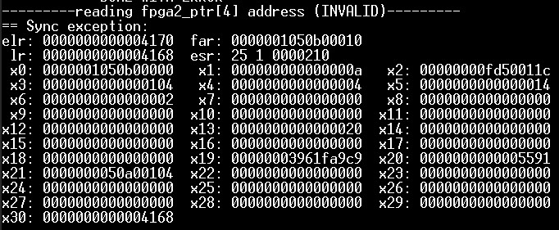
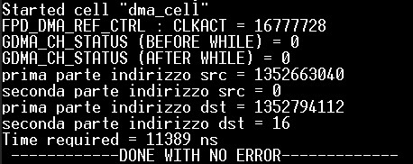


Test Cases(1)
T5
T1
T6
T2
T3 and T4

Slide 23
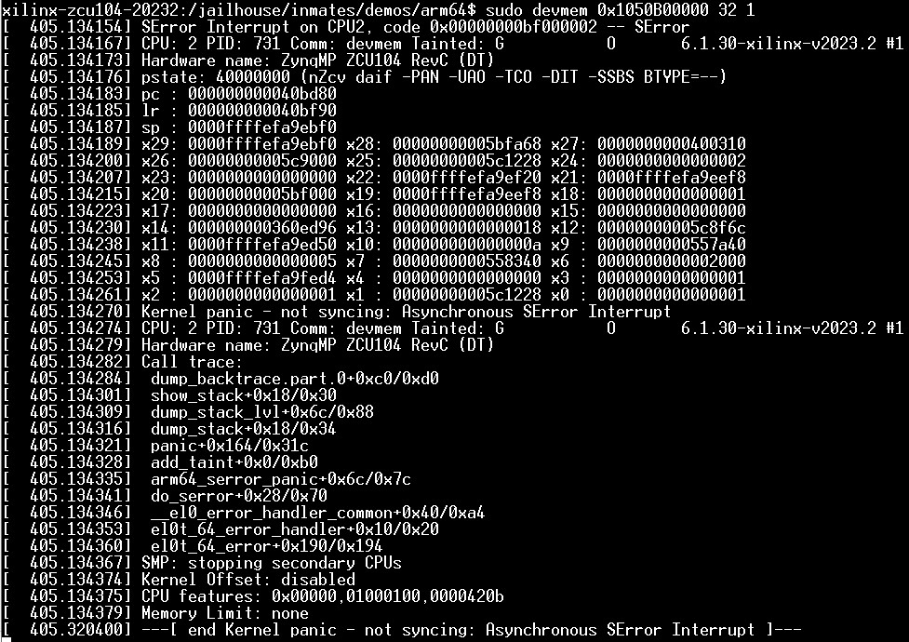
Test Cases (2)
It’s important to observe that AXI error like SLVERR and DECERR are seen by processor as failure on AXI bus, so if we were on Linux we would see a Kernel Panic (in JAILHOUSE the non root cell would fail).
In the case of DMA-master the situation is different and status registers capture the AXI error

Slide 24

System Analysis
Let’s start now to analyze the system to understand:
How the time of DMA transfer changes passing through FPGA or not
What are the significant factors which influence Transfer Time (Design of experiment)
Inter-cell interference
…

Slide 25
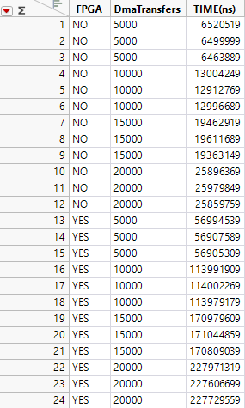
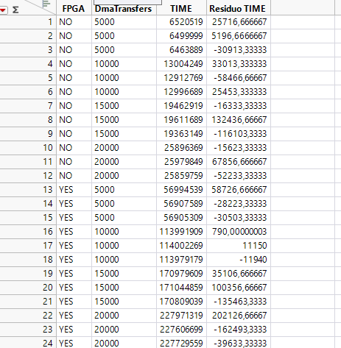
DOE (1)
This section tries to understand whether the two underlying factors are statistically significant for the transfer time.
  FPGA : signal if the DMA transfer is performed through FPGA or not
  DmaTransfers : define the number of DMA transfers, where every transfer is made of a burst of constant words (e.g 1000 words).
Full Factorial design is choosen with 3 repetitions for every factors combination, so we have 24 experiments in total.
Fpga
YES
NOT
DmaTransfers
5000
10000
15000
20000

Slide 26
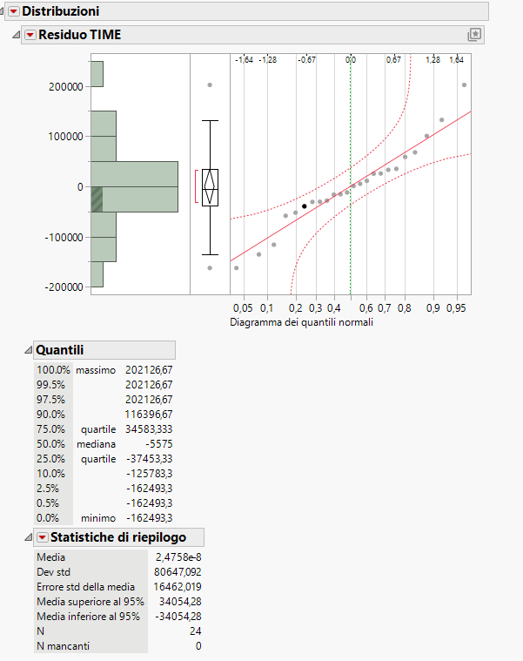
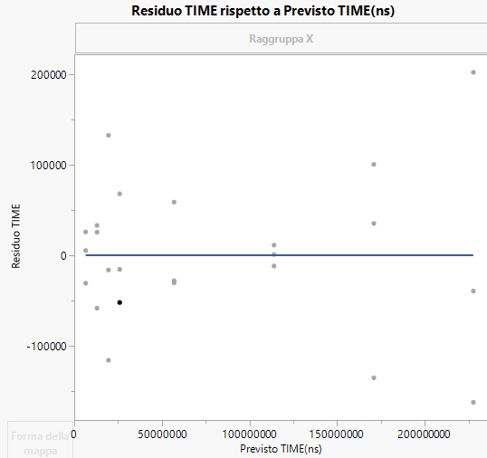

DOE (2)
The residuals are normal as shown by histogram and qq-plot
The residuals are eteroschedastic as shown by the visual test residuals vs predicted response, in fact it easy to see that the residuals increase as the predicted response increases
One-way analysis of Residuals Time(ns) for DmaTransfer factor shows low p-value with Levene and Bartlett tests

Slide 27
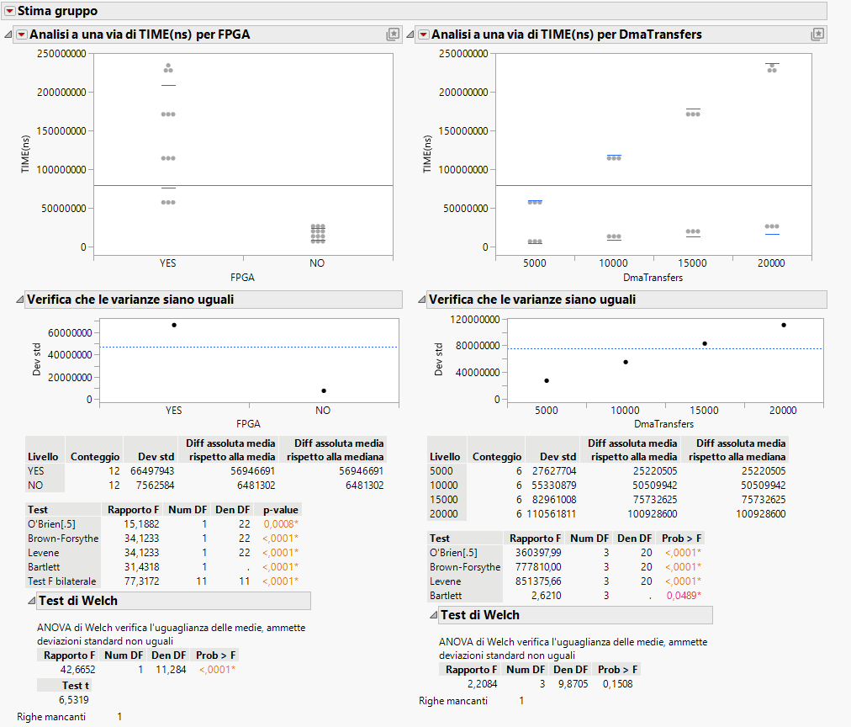
DOE (3)
The residuals properties suggest the use of Welch’s test which shows that :
  FPGA : is considered significant
  DmaTransfers : is considered not significant

Slide 28
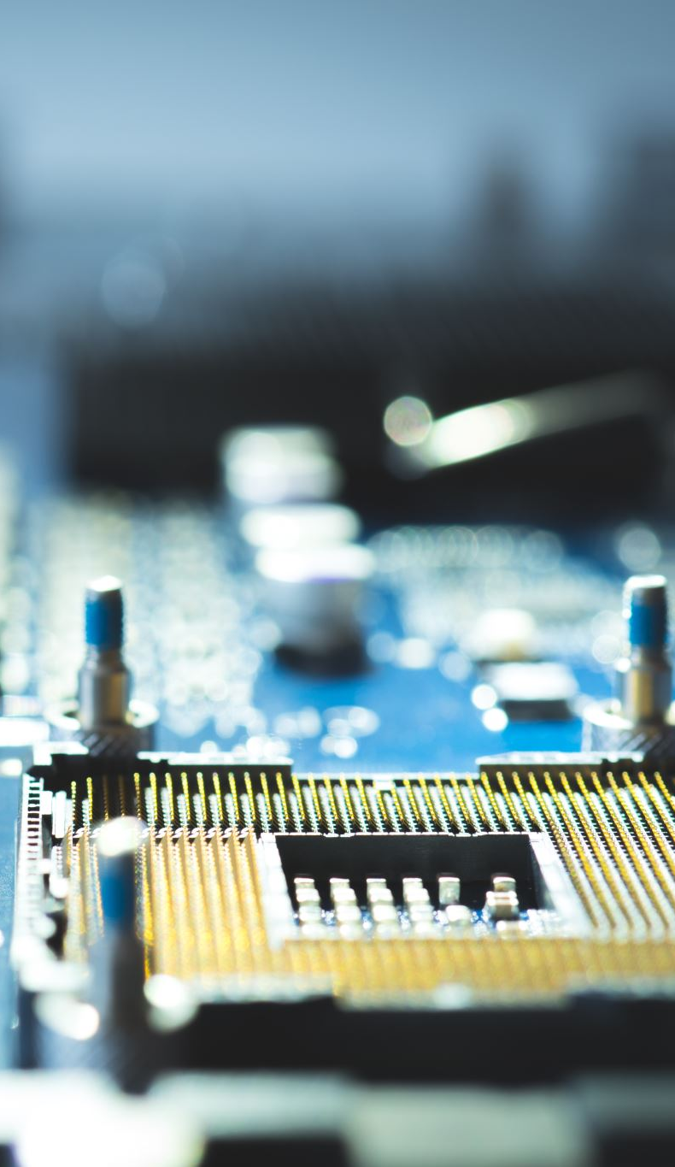
Time analysis
Showed that FPGA is a significant factor, this section tries to understand :
  How the transfer time changes if CPU passes through FPGA or directly in memory
  How the transfer time changes if DMA passes through FPGA or directly in memory
A stress test will be used to start a certain number of DMA transfers, each consisting of a constant number of word (e.g 1000), towards FPGA or Memory

Slide 29
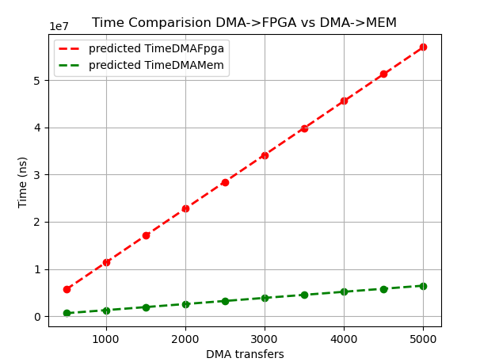
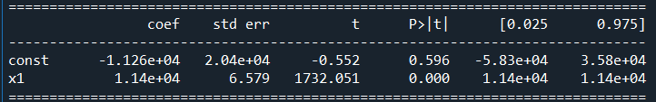
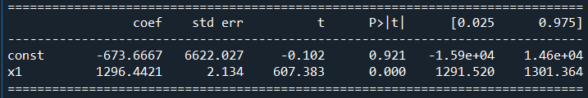
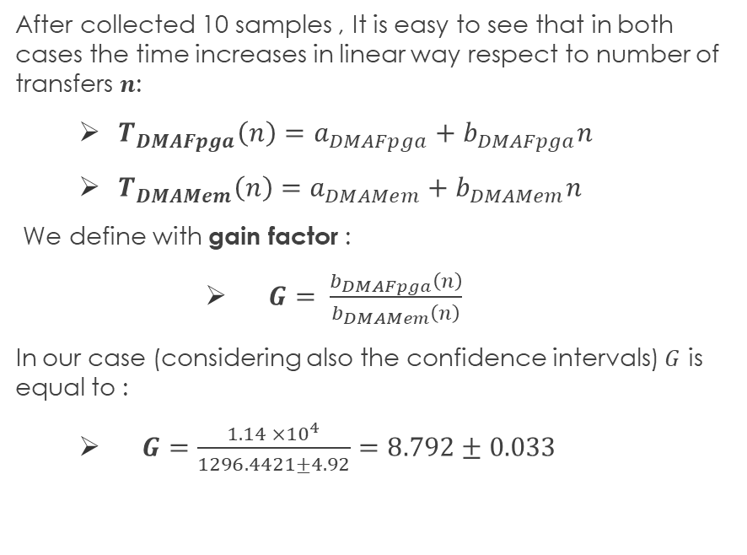
DMA->FPGA->MEM VS DMA->MEM
After collected 10 samples , It is easy to see that in both cases the time increases in linear way respect to number of transfers $n$:
  $T_{DMAFpga}\left(n\right)=a_{DMAFpga}+b_{DMAFpga}n$
  $T_{DMAMem}\left(n\right)=a_{DMAMem}+b_{DMAMem}n$
We define with gain factor :
      $G= \frac{b_{DMAFpga}\left(n\right)}{b_{DMAMem}\left(n\right)}$
In our case (considering also the confidence intervals) $G$ is equal to :
  $G=\frac{1.14 ×{10}^{4}}{1296.4421±4.92}=8.792±0.033$
Parameters of linear regression model TimeDMAFpga
Parameters of linear regression model TimeDMAMem

Slide 30
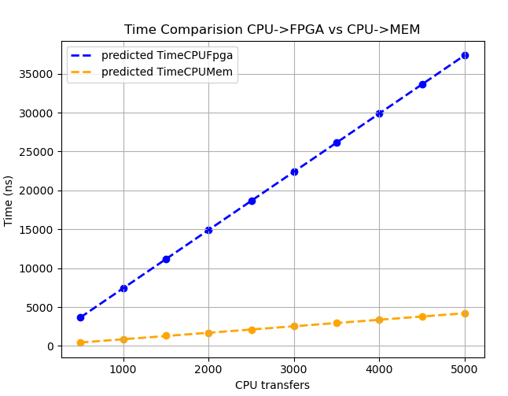
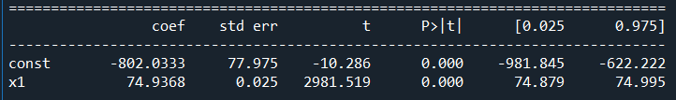
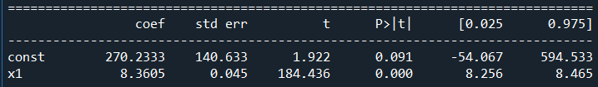
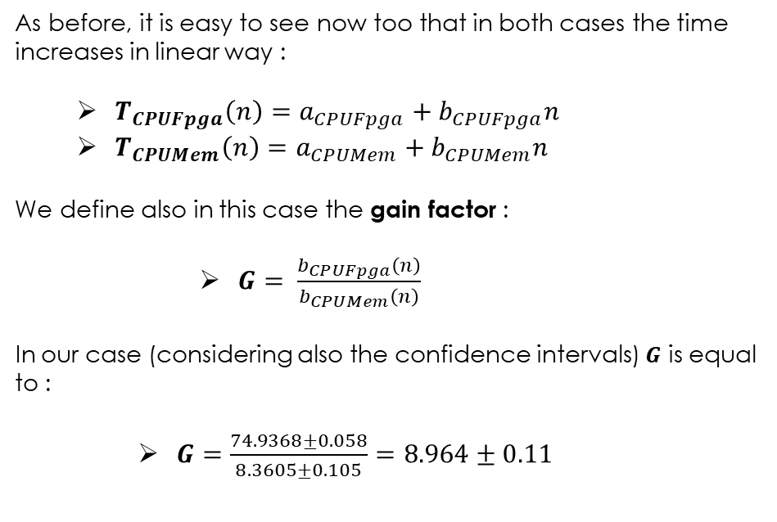
CPU->FPGA->MEM VS CPU->MEM
As before, it is easy to see now too that in both cases the time increases in linear way :
  $T_{CPUFpga}\left(n\right)=a_{CPUFpga}+b_{CPUFpga}n$
  $T_{CPUMem}\left(n\right)=a_{CPUMem}+b_{CPUMem}n$
We define also in this case the gain factor :
      $G= \frac{b_{CPUFpga}\left(n\right)}{b_{CPUMem}\left(n\right)}$
In our case (considering also the confidence intervals) $G$ is equal to :
    $G=\frac{74.9368±0.058}{8.3605±0.105}=8.964±0.11$
Parameters of linear regression model TimeCPUFpga
Parameters of linear regression model TimeCPUMem

Slide 31
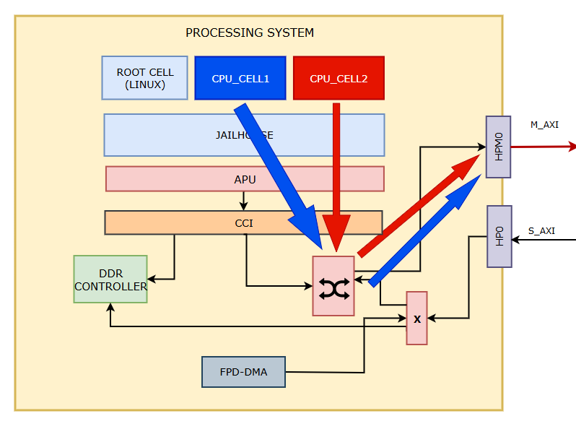
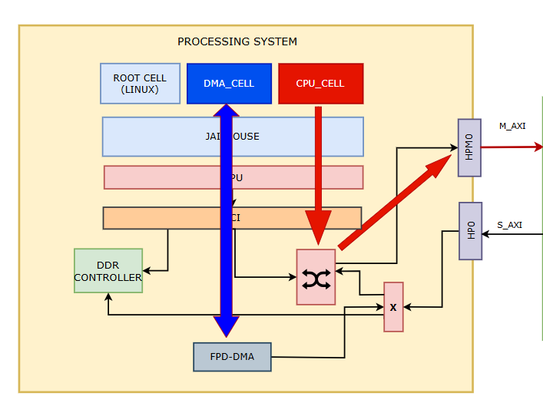
Inter-core interference
Assuming now to create an other bare metal non root cell which tries to engrave on FPGA, for example by performing consecutive writes with processor every T ms (e.g 5 ms)
Assuming we don’t worry about problems related to cuncurrent accesses…
How do the DMA->FPGA transfers time change???
How do the CPU->FPGA transfers time change???

Slide 32
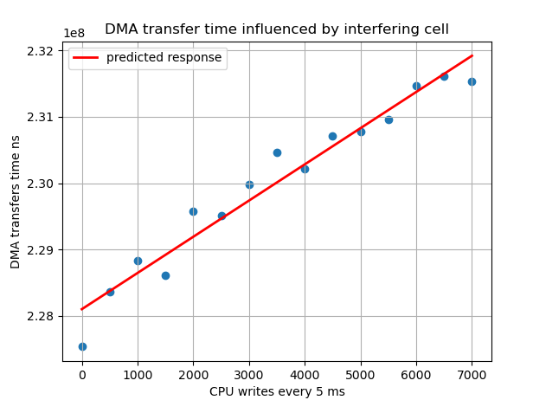

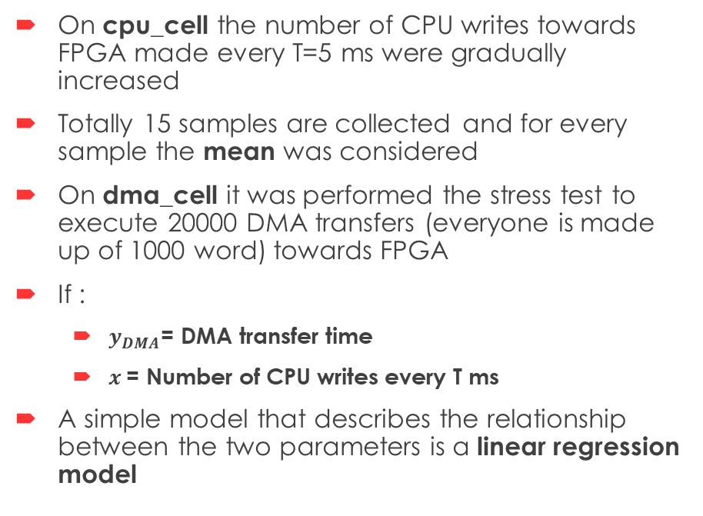
DMA transfer with interfering cell (1)
On cpu_cell the number of CPU writes towards FPGA made every T=5 ms were gradually increased
Totally 15 samples are collected and for every sample the mean was considered
On dma_cell it was performed the stress test to execute 20000 DMA transfers (everyone is made up of 1000 word) towards FPGA
If :
  $y_{DMA}$= DMA transfer time
  $x$= Number of CPU writes every T ms
A simple model that describes the relationship between the two parameters is a linear regression model
JAILHOUSE environment

Slide 33
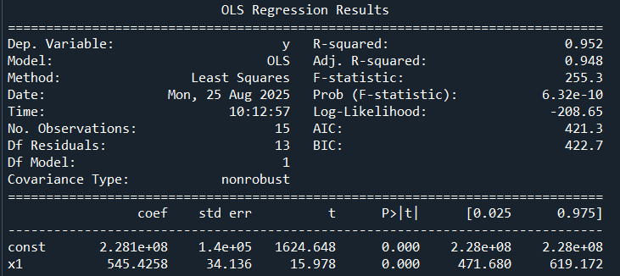
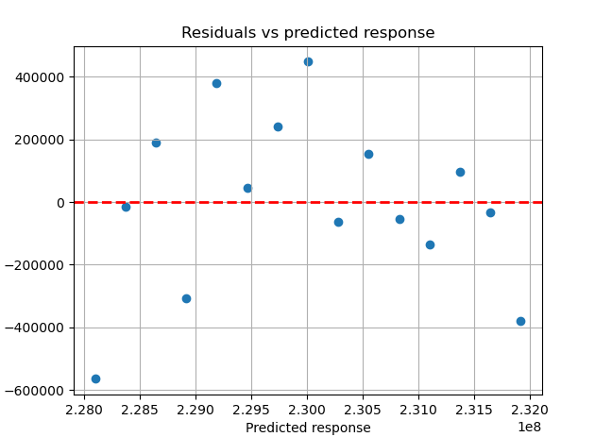
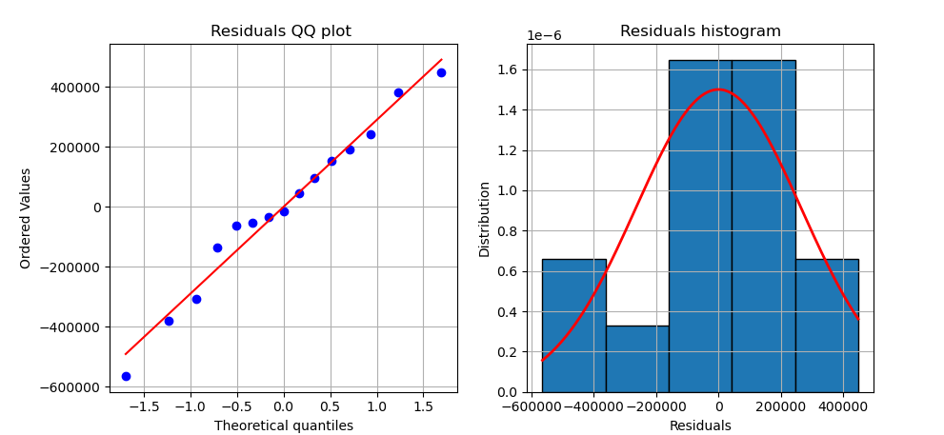
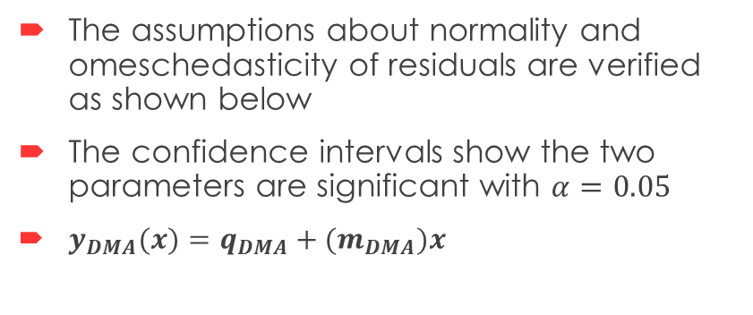

DMA transfer with interfering cell (2)
The assumptions about normality and omeschedasticity of residuals are verified as shown below
The confidence intervals show the two parameters are significant with $α=0.05$
$y_{DMA}(x)=q_{DMA}+(m_{DMA})x$
$q_{DMA} = const$and${ m}_{DMA}= x_{1}$

Slide 34
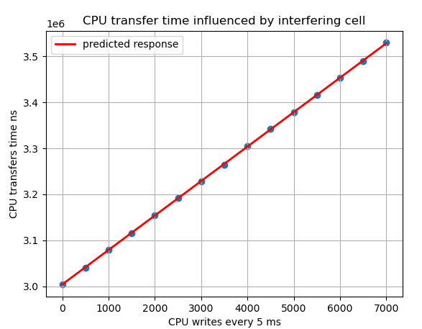
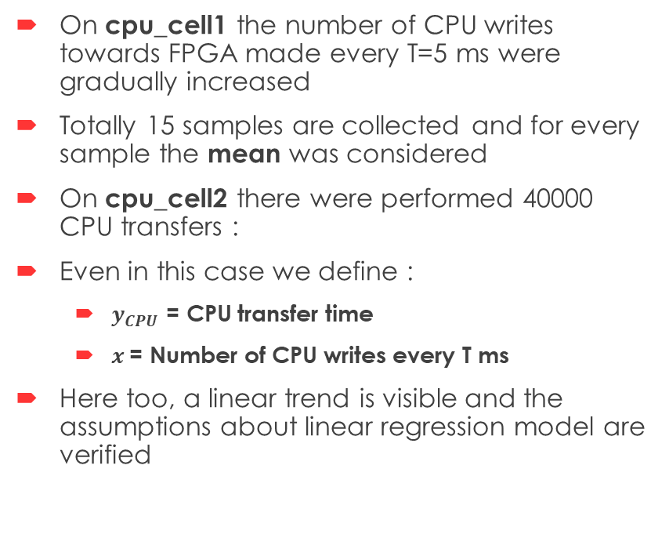
CPU transfer with interfering cell (1)
On cpu_cell1 the number of CPU writes towards FPGA made every T=5 ms were gradually increased
Totally 15 samples are collected and for every sample the mean was considered
On cpu_cell2 there were performed 40000 CPU transfers :
Even in this case we define :
  $y_{CPU}$ = CPU transfer time
  $x$= Number of CPU writes every T ms
Here too, a linear trend is visible and the assumptions about linear regression model are verified

Slide 35
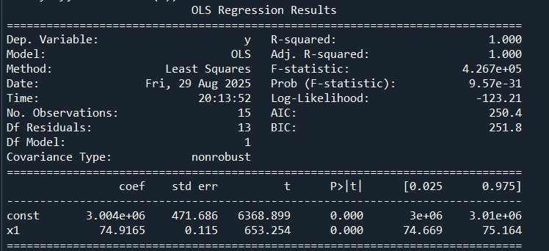
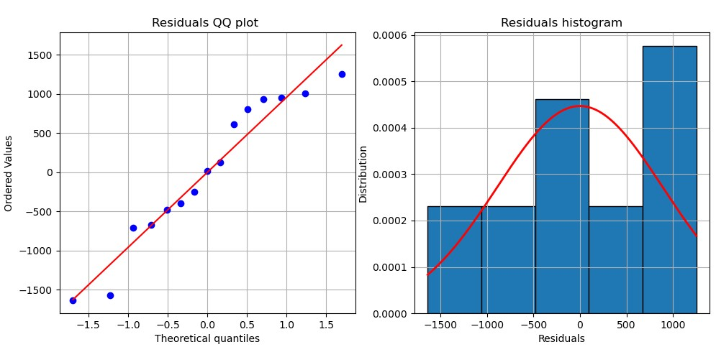
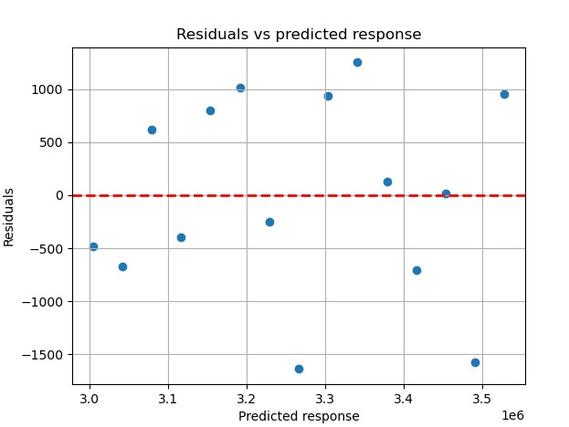
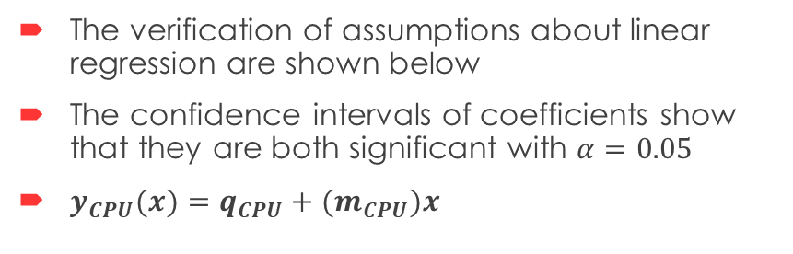
CPU transfer with interfering cell (2)
The verification of assumptions about linear regression are shown below
The confidence intervals of coefficients show that they are both significant with $α=0.05$
$y_{CPU}(x)=q_{CPU}+{(m}_{CPU})x$

Slide 36

Conclusions
The proposal described in this work should be considered a first implementation, susceptible to subsequent optimizations and improvements
From the previous analyses it can be seen that :
The Interference caused by an other cell doesn’t make the DMA/CPU transfer time much worse.
Going through FPGA instead of accessing directly in memory with DMA or Processor, causes the time to grow faster with a slope 9 times larger (in case of DMA this result is validated when each transfer consists of 1000 word).
  Reasons of this worsening are multiple:
    Longer path through FPGA
    PS Memory Optimizations are no longer valid on PL side
    Clock domain crossing latency

Slide 37

Future Developments
Some possible future works are :
Comparision with software solutions in terms of overhead
Extend PAC_MAC module with additional features
…
Happy to receive any suggestions for new ideas

Slide 38
References
Siemens, Github Repository, “Jailhouse Documentation”.
Xilinx, Inc., "Zynq UltraScale+ Device Technical Reference Manual (UG1085)", March 2025.
J. Peixoto, J. Martins, D. Cerdeira, S. Pinto, “BiRtIO: VirtIO for Real-Time Network Interface Sharing on the Bao Hypervisor”, Dec 2024.
Xilinx, Inc., "ZCU104 Board User Guide (UG1267)", October 2018.
F. Pizzo, "FPGA-Based Memory Traffic Analysis", June 2023.
F. Pizzo, Github, “Jailhouse on ZCU104”, Oct 2024.
ARM, “AXI protocol overview”.
ZDMA Module, https://docs.amd.com/r/en-US/ug1087-zynq-ultrascale-registers/ZDMA-Module

