Slide 2
Designing Account Systems
Peter Larsson-Green
Jönköping University
Autumn 2018

Slide 3


Authorization
POST /create-note Title: To Buy Content: Milk & Bread
Client
Server
Notes
Id | Title | Content
1 | To Buy | Milk & Bread
200 OK
GET /notes/1
Hmm... Is she authorized to request that?

Slide 4
Authentication & Authorization
Identity
Is the user really who he claims to be?
What is the user allowed to do?

Slide 5

Comparing to real life
Hi Peter!
Can you insert $100 from your account to my new account 123 456 78? Thanks!
Love, Mum

Slide 6
Implementing authentication
Users needs to be uniquely identified.
Use account resources.
Users needs to be able to prove ownership of an account.
Each user shares a secret with the server, e.g. a password.
Accounts
Id
1
2
3
4
Username
User A
User B
User C
User D
Password
Password A
Password B
Password C
Password D

Slide 7
Authorization with authentication
Accounts
POST /register Username: Alice Password: abc123
Id | Username | Password
Client
Server
1 | Alice | abc123
200 OK
Notes
POST /create-note Title: To Buy Content: Milk & Bread Account id: 1 Username: Alice Password: abc123
Id | AccountId | Title | Content
1 | 1 | To Buy | Milk & Bread
200 OK

Slide 8
Authorization with authentication
Accounts
GET /notes/1 Username: Alice Password: abc123
Id | Username | Password
Client
Server
1 | Alice | abc123
200 OK
Notes
Id | AccountId | Title | Content
1 | 1 | To Buy | Milk & Bread

Slide 9
Authorization with Sessions
Accounts
POST /login Username: Alice Password: abc123
Id | Username | Password
Client
Server
1 | Alice | abc123
Sessions
200 OK Create cookie: Name: SessionId Value: abcdefghij
Id | AccountId
POST /create-note Title: To Buy Content: Milk & Bread Account id: 1 Cookie: Name: SessionId Value: abcdefghij
abcdefghij | 1
Notes
Id | AccountId | Title | Content
1 | 1 | To Buy | Milk & Bread
200 OK

Slide 10
Authorization with Sessions
GET /notes/1 Cookie: Name: SessionId Value: abcdefghij
Accounts
Id | Username | Password
Client
Server
1 | Alice | abc123
Sessions
200 OK
Id | AccountId
abcdefghij | 1
Notes
Id | AccountId | Title | Content
1 | 1 | To Buy | Milk & Bread

Slide 11
Sign in as someone else
Accounts
Sign in
Username | Password
Lisa | jklSD$2Fk3
Bart | 123456
Homer | 1+4=8
Marge | ilovehs
Username:
Password:
Submit
What do the hacker do?
Keeps trying different passwords until he successfully logins.
What can we do?
Limit the number of login attempts.

Slide 12
If we are Hacked
Accounts
Username | Password
Lisa | jklSD$2Fk3
Bart | 123456
Homer | 1+4=8
Marge | ilovehs
What do the hacker do?
Logins as the users on other websites.
What can we do?
Don't store the passwords in plaintext.

Slide 13
Encryption
Caesar cipher
Key = 2
A
B
C
D
E
F
G
H
I
J
K
L
M
N
O
P
Q
R
S
T
U
V
W
X
Y
Z
C
D
E
F
G
H
I
J
K
L
M
N
O
P
Q
R
S
T
U
V
W
X
Y
Z
A
B
When the user signs up:
Store the password encrypted.
When the user signs in:
Decrypt the encrypted password and compare it with the provided one.
Username | Password
Stupid | SIMPLE
Username | Encrypted Password
Stupid | UKORNG

Slide 14
If we are hacked
The hacker can't read the passwords in plain text ☺
What do the hacker do?
Searches for the encryption function and decrypts the encrypted passwords.
What do we do?
Hash the passwords instead of encrypting them.

Slide 15
Hashing (mul + mod)
A
B
C
D
E
F
G
H
I
J
K
L
M
N
O
P
Q
R
S
T
U
V
W
X
Y
Z
65
66
67
68
69
70
71
72
73
74
75
76
77
78
79
80
81
82
83
84
85
86
87
88
89
90
When the user signs up:
Store the hash of the password.
When the user signs in:
Hash the provided password and compare it with the stored hash.
Username | Password
Stupid | SIMPLE
Username | Hashed Password
Stupid | 83*73*77*80*76*69 % 1000 = 360

Slide 16
If we are hacked
Rainbow Table
Username | Hashed Password
Stupid | 360
Plain text | Hashed
password | 746
123456 | 254
qwerty | 968
simple | 360
aaaaaa | 173
The hacker can't read the password in plaintext ☺
The hacker can't "unhash" the hashed passwords ☺
What do the hacker do?
Uses rainbow tables with common passwords to "unhash" the hash.
What do we do?
Add static salt to the password we hash.
hash("theSalt"+"thePassword")

Slide 17
If we are hacked
What do the hacker do?
Creates his own rainbow table with the same salt.
What do we do?
Use dynamic salt instead (each user has its own salt).
Rainbow Table
Plain text | Hashed
theSaltpassword | 245
theSalt123456 | 587
theSaltqwerty | 163
theSaltsimple | 93
theSaltaaaaaa | 974
Username | Salt | Hashed Password
Stupid | ksjktjf | 215
Member X | lkdyrar | 722
Member Y | jskdjtny | 859
The hacker needs to generate one rainbow table for each user → Takes time ☺

Slide 18
What more can we do?
Only short and common passwords are risky.
Use a minimum length for passwords.
Only accepts passwords containing both lower and upper case letters as well as symbols and digits.
But it's hard to remember long random passwords.
Humans choose simple ones (He||0W0r1d) ☹

Slide 19
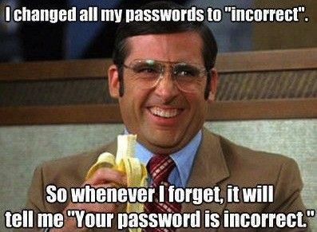
Fun of the day

Slide 20
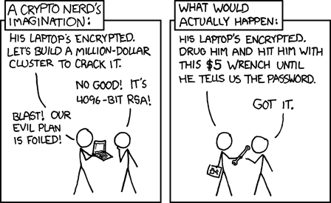
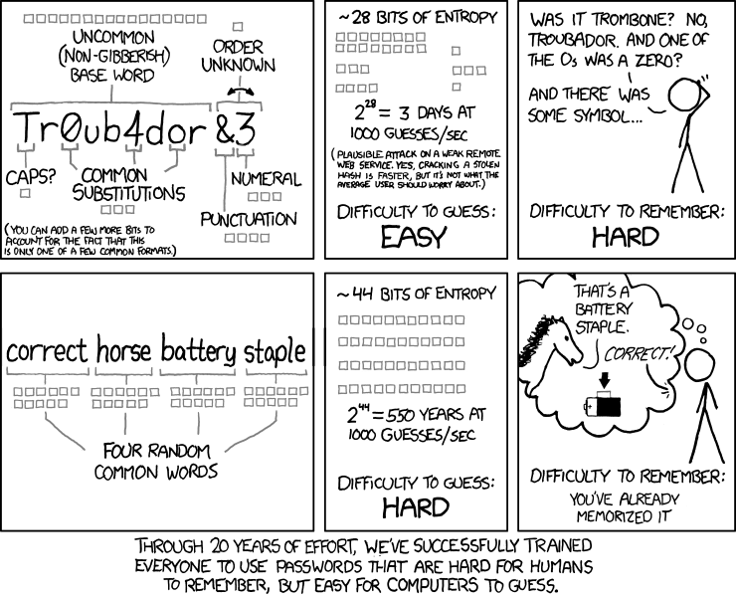
Fun of the day
https://xkcd.com/538/
https://xkcd.com/936/

