Slide 2
Android App Bar
Peter Larsson-Green
Jönköping University
Spring 2020

Slide 3
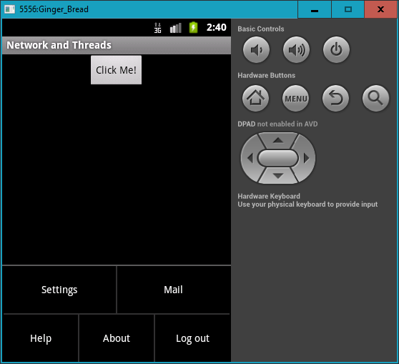
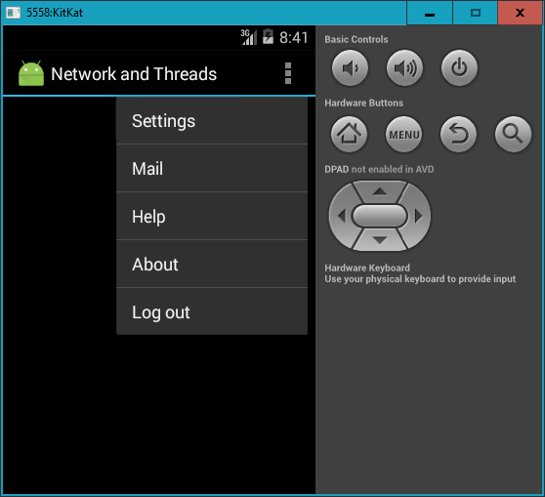
History
First Android applications had the title bar.
In Android 3, the title bar was replaced by the app bar.

Slide 4
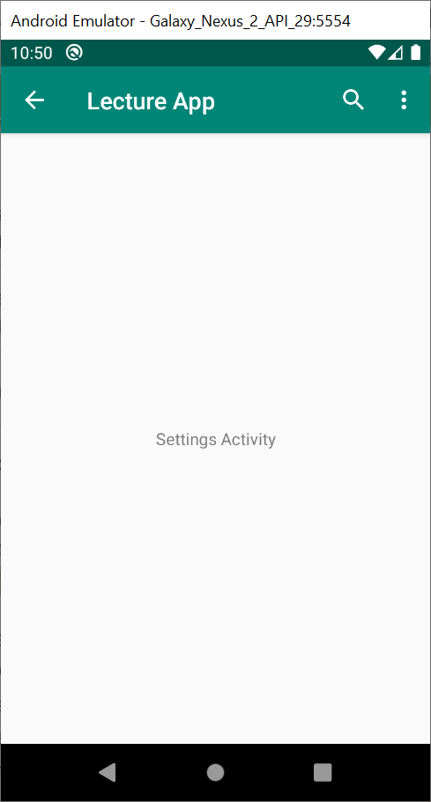
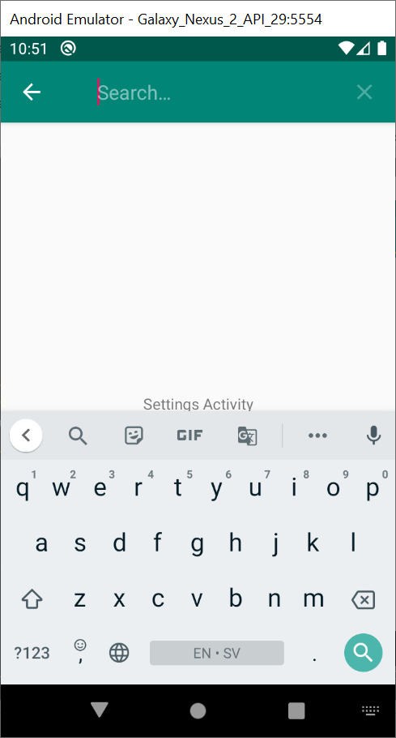
The app bar
Can contain:
The options menu:
Menu items as "buttons".
Menu items in the overflow menu.
The ← ("up") action.
Action Views, e.g.:
SearchView
Get reference to it:
anActivity.getActionBar()
anAppCompatActivity.getSupportActionBar()

Slide 5
The ← ("up") action
Should take the user to the "parent" activity.
Should not exist in the main activity.
Clicking on it repeatedly should take the user to the main activity.
Enable it in the activity's onCreate():
actionBar.setDisplayHomeAsUpEnabled(true)
Specify the parent activity in the Manifest file:
<activity android:name=".LifecycleActivity"
android:parentActivityName=".MainActivity">
</activity>
<meta-data
android:name="android.support.PARENT_ACTIVITY"
android:value=".MainActivity" />

Slide 6
The Search View
Convenient search widget for the user:
Enable it in a menu resource file:
<item
android:title="Search"
android:id="@+id/search"
app:icon="@drawable/ic_search_black_24dp"
app:showAsAction="ifRoom|collapseActionView"
app:actionViewClass="androidx.appcompat.widget.SearchView"/>

Slide 7
The Search View
Convenient search widget for the user:
Enable it in a menu resource file.
Configure it in onCreateOptionsMenu():
MenuItem searchItem = menu.findItem(R.id.search)
SearchView searchView = (SearchView) searchItem.actionView
searchView.setQueryHint("Search something")
searchView.setOnQueryTextListener(new SearchView.OnQueryTextListener{
boolean onQueryTextChange(String newText){ }
boolean onQueryTextSubmit(String query){
searchItem.collapseActionView()
}
})

