Slide 2
Android Async. Operations
Peter Larsson-Green
Jönköping University
Spring 2020

Slide 3
The Main application thread
By default, an Android application runs in a single thread.
Known as the main application thread.
Also known as the UI thread.
Should re-draw the GUI 60 times a second.
Needs to re-draw each 1 sec/60 = 16,67 millisecond.
Does by default everything else as well.
Such as handling clicks on buttons.
Draw GUI
Draw GUI
Handle button click
Draw GUI
Draw GUI
Draw GUI
Time [ms]
0
16.67
33.34
50
66.68
User clicks on button

Slide 4
The Main application thread
By default, an Android application runs in a single thread.
Known as the main application thread.
Also known as the UI thread.
Should re-draw the GUI 60 times a second.
Needs to re-draw each 1 sec/60 = 16,67 millisecond.
Does by default everything else as well.
Such as handling clicks on buttons.
Doesn't have time to re-draw the GUI → GUI unresponsive (freezes).
Draw GUI
Draw GUI
Handle button click
Draw GUI
Time [ms]
0
16.67
33.34
50
User clicks on button

Slide 5
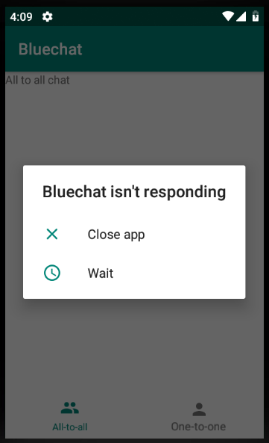
The Main application thread
By default, an Android application runs in a single thread.
Known as the main application thread.
Also known as the UI thread.
Should re-draw the GUI 60 times a second.
Needs to re-draw each 1 sec/60 = 16,67 millisecond.
Does by default everything else as well.
Such as handling clicks on buttons.
Doesn't have time to re-draw the GUI → GUI unresponsive (freezes).
Unresponsive for a few seconds → Android Not Responding dialog:

Slide 6
Handling long running operations
Anything that might take more than a few milliseconds to execute should not run on the main application thread, including:
Network communication.
Database communication.
Reading/Writing from/to files.
Instead:
Start new threads handling the long running operations.
Possible complication:
Only the main application thread may change the GUI.
Thread communication needed.

Slide 7
Handling long running operations
Draw GUI
Draw GUI
Handle button click
Draw GUI
Time [ms]
0
16.67
33.34
50
User clicks on button
Main Application Thread
Draw GUI
Draw GUI
Handle button click
Draw GUI
Draw GUI
Handle button click
Draw GUI
Time [ms]
0
16.67
33.34
50
66.68
User clicks on button
Starts
Sends back data
Handle button click
Time [ms]
Worker Thread
0

Slide 8
Creating threads
Runnable runnable = new Runnable(){
@Override
public void run(){
// Code to be executed in new the thread.
int result = computeSomethingThatTakesLongTime();
// How to send back result to the main app thread?
}
};
Thread thread = new Thread(runnable);
thread.start();

Slide 9
Thread Communication
final Handler handler = new Handler();
new Thread(new Runnable(){
public void run(){
final int result = compute();
handler.post(new Runnable(){
public void run(){
// Runs on the thread that
// created the handler.
}
});
}
}).start();
Handlers are used to communicate between threads.

Slide 10
Thread communication
Android provides two simple way to execute a Runnable on the main application thread.
Call runOnUiThread on an Activity:
anActivity.runOnUiThread(theRunnable);
Call post on a View:
aView.post(theRunnable);

Slide 11
Asynctask
Android's class AsyncTask makes thread handling even simpler.
AsyncTask t = new AsyncTask<Params, Progress, Result>(){
protected void onPreExecute(){
}
protected Result doInBackground(Params[] params){
}
protected void onProgressUpdate(Progress[] values){
}
protected void onPostExecute(Result result){
}
};
t.execute(new Params(), new Params());
Called by main thread.
publishProgress(new Progress())
Called by main thread.
Called by main thread.

