Slide 2
Android Broadcast receivers
Peter Larsson-Green
Jönköping University
Spring 2020

Slide 3
Fundamental app components
Activities
Services
Application
Broadcast Receivers
Content Providers

Slide 4
What's a broadcast?
An intent sent from one application component or the OS...
...and (possibly) received by broadcast receivers.

Slide 5
Broadcasts from Android
The action specifies the type of broadcast:
android.intent.action.NEW_OUTGOING_CALL
android.intent.action.HEADSET_PLUG
android.intent.action.BOOT_COMPLETED
android.bluetooth.adapter.action.STATE_CHANGED
...
Permissions may be required to send broadcasts.
Permissions may be required to receive broadcasts.

Slide 6
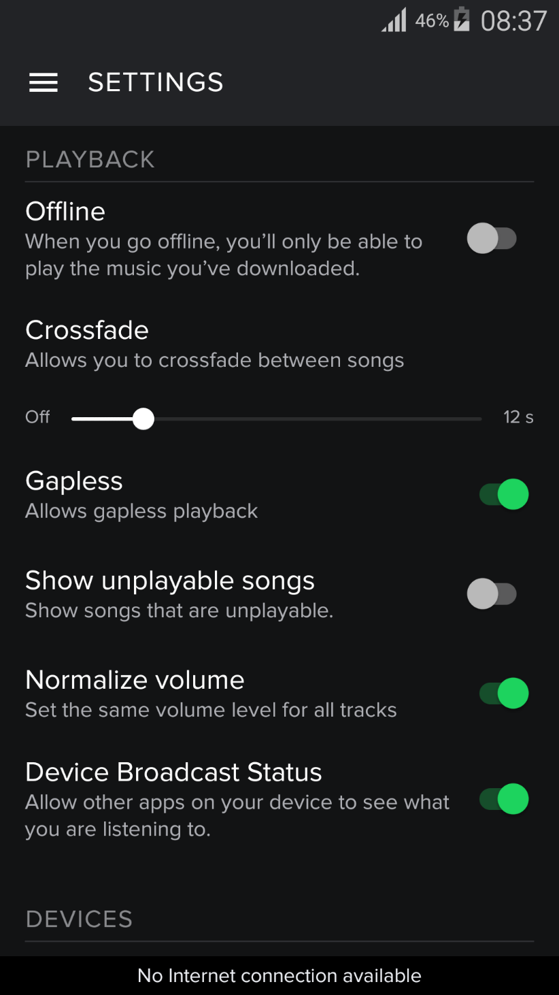
Spotify
Play/Pause or track position change:
Action: com.spotify.music.playbackstatechanged
Extras: playing, playbackPosition.
New track starts playing:
Action: com.spotify.music.metadatachanged
Extras: id, artist, album, track, length.
Play queue changed:
Action: com.spotify.music.queuechanged
https://developer.spotify.com/news-stories/2014/07/18/new-android-media-notifications-guide/

Slide 7
Application state
Only receivers whose app is in the Running state receives broadcasts.
Force stop
Stopped
Running
Install
Launch activity
Uninstall
Uninstall
More information: https://developer.android.com/about/versions/android-3.1.html#launchcontrols

Slide 8
Sending a broadcast
Intent intent = new Intent("action.to.be.handled");
intent.putExtra("name", "Herbert A. Simon");
aContext.sendBroadcast(intent);

Slide 9
Creating broadcast receivers
public class MyBroadcastReceiver extends BroadcastReceiver{
@Override
public void onReceive(Context context, Intent intent){
// Do your work!
}
}

Slide 10
Creating broadcast receivers
<manifest package="the.package" ...>
<application ...>
<receiver android:name=".MyBroadcastReceiver">
<intent-filter>
<action android:name="the.action.name" />
</intent-filter>
</receiver>
</application>
</manifest>

Slide 11
Important about receivers
Runs on the main application thread.
Is considered "done" when onReceive() returns.
Unless you call goAsync().
Global receivers must finish within 10 seconds.
Even if they call goAsync().
A receiver having a very long long running operation can simply start a service.

Slide 12
Going asynchronous
public void onReceive(Context context, Intent intent){
final PendingResult pendingResult = goAsync();
new Thread(new Runnable(){
@Override
public void run(){
// Do your work.
pendingResult.finish();
}
}).start();
}
Must be called within 10 seconds!

Slide 13
Dynamic broadcast receivers
Only interested in broadcast when an activity is running?
MyReceiver theReceiver = new MyReceiver();
IntentFilter theIntentFilter = new IntentFilter();
theIntentFilter.addAction("the.action.name");
aContext.registerReceiver(theReceiver, theIntentFilter);
aContext.unregisterReceiver(theReceiver);

Slide 14
Normal Broadcasts
Broadcast Receiver A
onReceive()
Application Component/OS
aContext.sendBroadcast()
Broadcast Receiver B
onReceive()

Slide 15
Ordered Broadcasts
Application Component/OS
aContext. sendOrderedBroadcast()
Broadcast Receiver A
onReceive()
Priority: 2
Broadcast Receiver X
onReceive()
Broadcast Receiver B
onReceive()
Priority: 1

Slide 16
Setting the priority
<manifest package="the.package" ...>
<application ...>
<receiver android:name=".MyBroadcastReceiver">
<intent-filter android:priority="37">
<action android:name="the.action.name" />
</intent-filter>
</receiver>
</application>
</manifest>

Slide 17
Handling ordered broadcast
Stop propagation:
theReceiver.abortBroadcast();
getResult*()
Set the result:
theReceiver.setResultData("The Data.");
theReceiver.setResultCode(Activity.RESULT_OK);
theReceiver.setResultCode(Activity.RESULT_CANCELED);
theReceiver.setResultExtras(aBundle);

Slide 18
Sending ordered broadcast
Can be null.
aContext.sendOrderedBroadcast(
theIntent,
"a.permission.the.receivers.must.have",
broadcastResultReceiver,
scheduler, // A Handler.
initialResultCode,
initialResultData,
initialResultExtras
);
Can be null.
Can be null.
Can be null.

Slide 19
Sending Local broadcasts
Global broadcasts
Send it to all applications.
Local broadcasts
Send it only to your application.
Not part of Android, but Support Library.
LocalBroadcastManager lbm =
LocalBroadcastManager.getInstance(aContext);
lbm.registerReceiver(theReceiver, intentFilter);
lbm.sendBroadcast(theIntent);
lbm.unregisterReceiver(theReceiver);

Slide 20
Custom permissions
<permission
android:name="my.package.THE_NAME"
android:protectionLevel="normal"
android:label="The label"
android:icon="@drawable/the_icon"
android:description="The description."
/>
normal
dangerous
signature

