Slide 2
Android Dialogs
Peter Larsson-Green
Jönköping University
Spring 2020

Slide 3
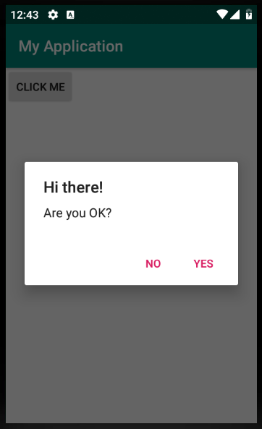
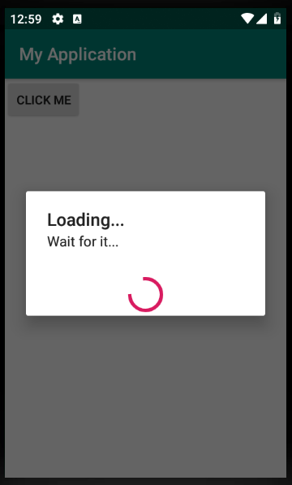
What is a dialog?
A dialog, not a monolog.

Slide 4
How to Create a dialog
A dialog is represented by the Dialog class.
Dialog dialog = new Dialog(aContext);
dialog.setTitle("The title");
dialog.setCancelable(true);
dialog.setContentView(R.layout.dialog_example);
dialog.show();

Slide 5
The alert dialog
new AlertDialog.Builder(aContext)
.setTitle("The title...")
.setMessage("The message...")
.setPositiveButton("Positive text", new DialogInterface.OnClickListener() {
@Override
public void onClick(DialogInterface dialog, int which) {
// Handle it...
}
})
.setNegativeButton("Negative text", new DialogInterface.OnClickListener() {
@Override
public void onClick(DialogInterface dialog, int which) {
// Handle it...
}
})
.create()
.show();

Slide 6
The Date Picker dialog
new DatePickerDialog(aContext, new DatePickerDialog.OnDateSetListener() {
@Override
public void onDateSet(DatePicker view, int year, int month, int dayOfMonth) {
// Handle it...
}
}, 2019, 2, 10).show();

Slide 7
The Time picker dialog
new TimePickerDialog(aContext, new TimePickerDialog.OnTimeSetListener() {
@Override
public void onTimeSet(TimePicker view, int hourOfDay, int minute) {
// Handle it...
}
}, 18, 55, true).show();
true: 24 hour format
false: AM/PM

Slide 8
Configuration changes...
public class MyDialogFragment extends DialogFragment{
@Override
public Dialog onCreateDialog(@Nullable Bundle savedInstanceState) {
// Build/Create the dialog instance and then:
return backTheDialogInstance;
}
}
new MyDialogFragment().show(
getSupportFragmentManager(),
"a-tag"
);

