Slide 2
Android File System
Peter Larsson-Green
Jönköping University
Spring 2021

Slide 3
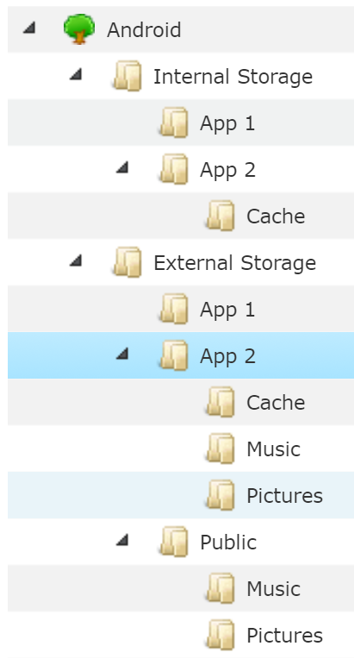
The file system
Consists of files and folders.

Slide 4
Internal storage
Where all apps are installed.
Each app has its own folder on internal storage.
An app can't access other apps' app folder.
Each app has its own cache folder on internal storage.
The OS can delete these files if low on memory.
(apps can be installed on external storage from API level 8)
https://developer.android.com/guide/topics/data/install-location.html
Typically used by large games.
If external storage not available, app can't run.
val folder: File = aContext.filesDir
val folder: File = aContext.cacheDir

Slide 5
External storage
Where apps can share files.
Is not always available.
For example, if it's on a removable SD card.
Each app has its own folder on external storage.
Each app has its own cache folder on external storage.
Each type of media has its own folder on external storage.
val folder: File = aContext.getExternalFilesDir(null)
val folder: File = aContext.getExternalFilesDir( Environment.DIRECTORY_MUSIC )
val folder: File = aContext.externalCacheDir
val folder: File = Environment.getExternalStoragePublicDirectory( Environment.DIRECTORY_DCIM )

Slide 6
Permissions
Internal Storage:
Each app has permission to access its own folder.
An app can't access another app's folder.
External Storage:
API level | READ_EXTERNAL_STORAGE | WRITE_EXTERNAL_STORAGE
1 | Didn't exist | Didn't exist
4 |  | Required for all external storage
16 | Introduced
19 | Enforced. Not required for own app folder | Not required for own app folder
29 | Scoped storage introduced = Can't read/write to other app folders | Can't write to other apps' own folders
30 | Scoped storage enforced | Scoped storage enforced
val folder: File = Environment.getExternalStoragePublicDirectory( Environment.DIRECTORY_DCIM )

Slide 7
Write to a file
val folder = aContext.filesDir
val file = File(folder, "my-file.txt")
file.writeText("The content.")

Slide 8
Read from a file
val folder = aContext.filesDir
val file = File(folder, "my-file.txt")
val content = file.readText()

Slide 9
Storing user files
Use the Media Store.
For media files (images, videos, audio, …)
Introduced in API level 1
Use the Storage Access Framework.
For other type of files
Introduced in API level 19

Slide 10
Media store
Provides a Content Provider with access to the files.
Contract: https://developer.android.com/reference/kotlin/android/provider/MediaStore
For Android <= 9:
READ_EXTERNAL_STORAGE for reading any file.
WRITE_EXTERNAL_STORAGE for writing any file.
For Android >= 10:
READ_EXTERNAL_STORAGE for reading files added by other apps.

Slide 11
Storage access framework
Your app needs no general read/write permission, the user selects file for us.
Ask the user to pick the place through the storage access framework.
Obtain a Content Provider URI with permission.

Slide 12
Secondary external storage
API level 19 started support for secondary external storage.
E.g., the device's main storage memory contains both internal and external storage, and then supports SD card too.
https://developer.android.com/about/versions/android-4.4#ExternalStorage
val folders: Array<File> = aContext.externalFilesDirs
val folders: Array<File> = aContext.externalCacheDirs

Slide 13
Shared Preferences
Key/value pairs of String/primitive data types stored in files.
Inside an activity (Activity specific):
SharedPreferences preferences = getPreferences(MODE_PRIVATE);
Inside an activity (Activity independent):
SharedPreferences preferences = getSharedPreferences(
"the-name",
MODE_PRIVATE
);
Older versions of Android supported different modes.

Slide 14
Shared preferences
Write:
SharedPreferences.Editor editor = preferences.edit();
editor.putInt("luckyNumber", 7);
editor.putString("name", "Hello");
editor.apply(); // Save changes asynchronously or...
editor.commit(); // ...save changes synchronously.
Read:
int luckyNumber = preferences.getInt("luckyNumber", -1);
String name = preferences.getString("name", "???");
Default value.
Default value.

