Slide 2
Android Menus
Peter Larsson-Green
Jönköping University
Spring 2020

Slide 3
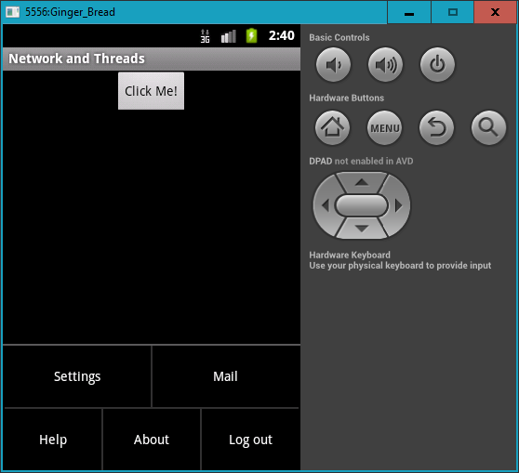
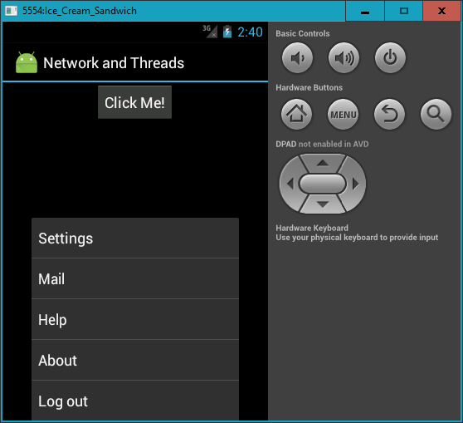
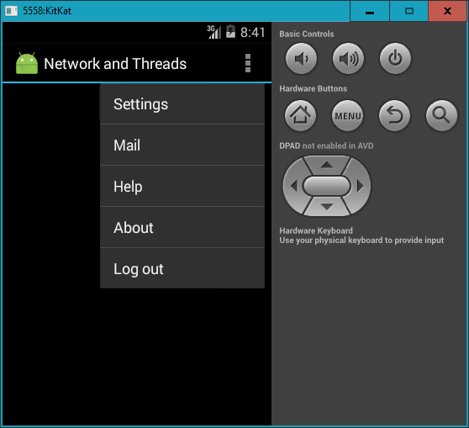
The options menu
Ginger Bread
Ice Cream Sandwich
KitKat

Slide 4
Adding the options menu
In activities:
@Override
public boolean onCreateOptionsMenu(Menu menu){
getMenuInflater().inflate(R.menu.the_menu, menu);
return super.onCreateOptionsMenu(menu);
}
<menu>
<item android:title="Settings" android:id="@+id/menu_item_settings" />
<item android:title="Reset" android:id="@+id/menu_item_reset" />
</menu>

Slide 5
Catching options menu clicks
In activities:
@Override
public boolean onOptionsItemSelected(MenuItem item){
switch(item.getItemId()){
case R.id.menu_settings:
// ...
return true;
default:
return super.onOptionsItemSelected(item);
}
}

Slide 6
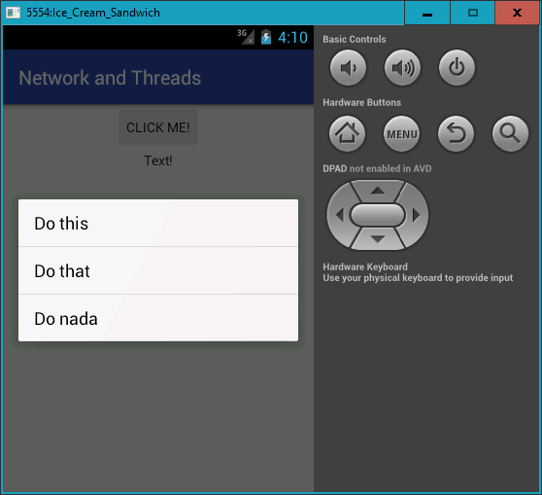
The floating context menu
anActivity.registerForContextMenu(theView);

Slide 7
Adding floating context menu
In activities:
@Override
public void onCreateContextMenu(
ContextMenu menu,
View v,
ContextMenu.ContextMenuInfo menuInfo){
super.onCreateContextMenu(menu, v, menuInfo);
getMenuInflater().inflate(R.menu.menu, menu);
}

Slide 8
Catching the clicks
In activities:
@Override
public boolean onContextItemSelected(MenuItem item){
switch(item.getItemId()){
case R.id.menu_settings:
// ...
return true;
default:
return super.onContextItemSelected(item);
}
}

