Slide 2
Android Notifications
Peter Larsson-Green
Jönköping University
Spring 2020

Slide 3
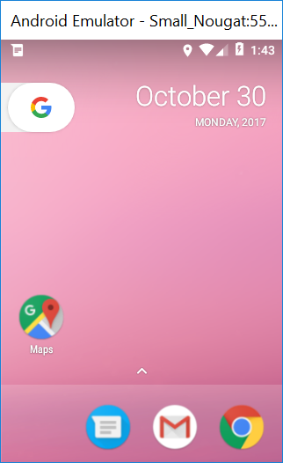
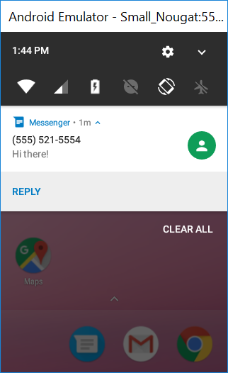
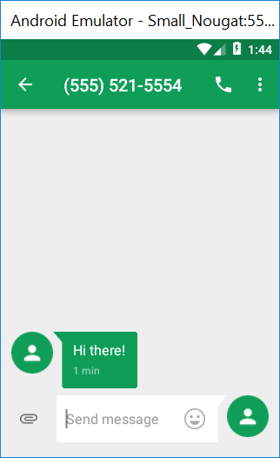
Notifications
Unlike activities, services have no graphical user interface.

Slide 4
Notification channels
Introduced in API level 26.
if(Build.VERSION_CODES.O <= Build.VERSION.SDK_INT){
NotificationChannel channel = new NotificationChannel(
"MESSAGE_FROM_CONTACT",
"New message from contact",
NotificationManager.IMPORTANCE_HIGH
);
channel.setDescription("Used when receiving a new message from a contact.");
NotificationManager notificationManager = aContext.getSystemService(
NotificationManager.class
);
notificationManager.createNotificationChannel(channel);
}
channel.enableLights(...);
channel.enableVibration(...);
channel.setSound(...);

Slide 5
Creating notifications
NotificationCompat.Builder builder = new NotificationCompat.Builder(
aContext,
"MESSAGE_FROM_CONTACT"
);
builder.setSmallIcon(R.drawable.the_icon);
builder.setContentTitle("New message!");
builder.setContentText("You've got a new message from Alice.");
Notification notification = builder.build();
NotificationManagerCompat nfManager = NotificationManagerCompat.from(aContext);
int notificationLocalId = 1;
nfManager.notify(notificationLocalId, notification);

Slide 6
Visibilities
channel.setVisibility(Notification.VISIBILITY_XXX);
VISIBILITY_PUBLIC
VISIBILITY_PRIVATE
VISIBILITY_SECRET

Slide 7
Intent VS Pending Intent
Intent = request to be handled by an application component.
You can always start your own applications components.
PendingIntent = request to be handled by an application component AND permissions to start that component.
You create a PendingIntent specifying the app component to be started.
You send the Pending Intent to another application.
The other application starts your app component using the PendingIntent.

Slide 8
notifications
FLAG_ONE_SHOT
FLAG_CANCEL_CURRENT
builder.setContentIntent(
PendingIntent.getActivity(aContext, theRequestCode,
theIntent, PendingIntent.FLAG_XXX)
);
builder.setAutoCancel(true);
builder.setDeleteIntent(
PendingIntent.getActivity(aContext, theRequestCode,
theIntent, PendingIntent.FLAG_XXX)
);

