Slide 2
Android Permissions
Peter Larsson-Green
Jönköping University
Spring 2020

Slide 3
Permissions
Some features are protected by permissions.
Before we can use the feature, we need the user's permission to use it.
Categories of permissions:
Normal permissions
Dangerous permissions
Permissions are grouped.
File System
GPS
Camera
Bluetooth
Internet

Slide 4

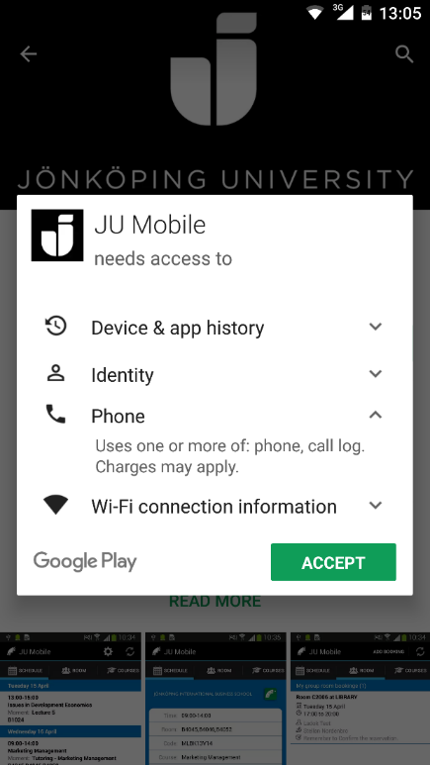
Obtaining permission
The old way:
List required permission in AndroidManifest.xml.
User grants the application these permission at installation time.
User needs to grant permission to use optional features ☹
<manifest
package="se.ju.larpet.myapplication"
xmlns:android="http://schemas.android.com/apk/res/android">
<uses-permission android:name="the.permission" />
<uses-permission android:name="the.other.permission" />
<application android:label="My Cool App">...</application>
</manifest>

Slide 5
Obtaining permission
The new way (Android 6, API level 23):
List required permission in AndroidManifest.xml.
User grants the application permissions at runtime.
We developers need to write extra code to make this happen...
We developers need to write extra code to handle the cases where we don't get the permissions...
User only needs to grant permission for optional features if she uses them ☺

Slide 6
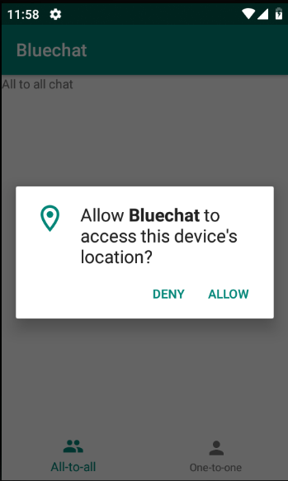
Obtaining permission at runtime
aFragment
anActivity.requestPermissions(
new String[]{"permission1", "permission2"},
123
);
ActivityCompat.requestPermissions(
theActivity,
new String[]{"permission1", "permission2"},
123
);
@Override
public void onRequestPermissionsResult(
int requestCode, String permissions[], int[] grantResults
){
// ...
}
PackageManager.PERMISSION_GRANTED
PackageManager.PERMISSION_DENIED

Slide 7
Checking permission at runtime
int permStat = aContext.checkSelfPermission("the.permission");
if(permStat == PackageManager.PERMISSION_GRANTED){
// We already have the permission ☺
}else{
// We need to ask for the permission.
}
int permStat = ContextCompat.checkSelfPermission(aContext, "the.permission");
if(permStat == PackageManager.PERMISSION_GRANTED){
// We already have the permission ☺
}else{
// We need to ask for the permission.
}

