Slide 2
Android Runtime configuration changes
Peter Larsson-Green
Jönköping University
Spring 2020

Slide 3
What are "configurations"?
Things about Android/the device we don't know in advance.
Screen size
Preferred language
Landscape/Portrait mode
Preferred font size
Pixel density
...

Slide 4
Runtime configuration change
Occurs when a Configuration setting changes.
Android will:
Destroy your activity instances:
onPause(), onStop() & onDestroy() are all called (in that order).
Create new instances:
onCreate(), onStart() & onResume() are all called (in that order).
Why?
To load the right resources (e.g. the string resources in a new language).
Consequence: the state of the activity is lost.
Needs to be retained.

Slide 5
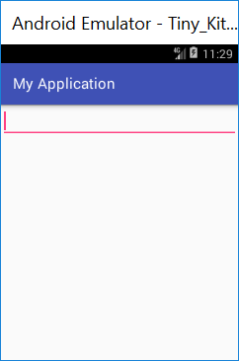
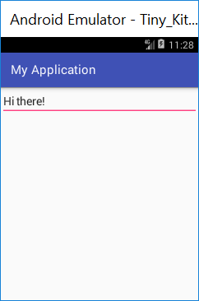
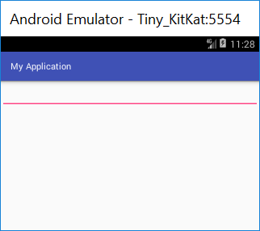
Example: Not retaining the state
public class MainActivity extends Activity{
@Override
protected void onCreate(Bundle savedInstanceState){
super.onCreate(savedInstanceState);
setContentView(R.layout.activity_main);
}
}
2. User enters text.
1. User starts activity.
3. User rotate screen.
<EditText
xmlns:android="http://schemas.android.com/apk/res/android"
android:layout_width="match_parent"
android:layout_height="wrap_content" />
4. Entered text gone.
res/layout/activity_main.xml

Slide 6
Remembering the state
The method onSaveInstanceState is called on configuration changes.
@Override
protected void onSaveInstanceState(Bundle outState){
super.onSaveInstanceState(outState);
EditText theEditText = (EditText) findViewById(R.id.theEditText);
String enteredText = theEditText.getText().toString();
outState.putString("enteredText", enteredText);
}

Slide 7
Restoring the state
Is null if not being re-created.
Restore the state in onCreate():
@Override
protected void onCreate(Bundle savedInstanceState){
super.onCreate(savedInstanceState);
setContentView(R.layout.activity_main);
if(savedInstanceState != null){
String enteredText = savedInstanceState.getString("enteredText");
EditText theEditText = (EditText) findViewById(R.id.theEditText);
theEditText.setText(enteredText);
}
}

Slide 8
Restoring the state
Or restore the state in onRestoreInstanceState():
Will be called after onCreate().
@Override
protected void onRestoreInstanceState(Bundle savedState){
super.onRestoreInstanceState(savedInstanceState);
String enteredText = savedInstanceState.getString("enteredText");
EditText theEditText = (EditText) findViewById(R.id.theEditText);
theEditText.setText(enteredText);
}

Slide 9
Actually...
The default implementation takes care of most of the UI per-instance state for you by calling onSaveInstanceState() on each view in the hierarchy that has an id, and by saving the id of the currently focused view (all of which is restored by the default implementation of onRestoreInstanceState(Bundle)).
https://developer.android.com/reference/android/app/Activity.html#onSaveInstanceState(android.os.Bundle)
Views with their own state are retained by default if you give them an id.
⇒
We only need to worry about the state of our data.

Slide 10
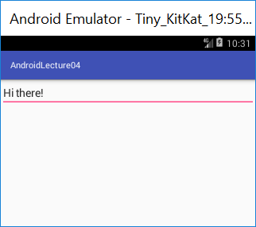
Example: retaining the state
public class MainActivity extends Activity{
@Override
protected void onCreate(Bundle savedInstanceState){
super.onCreate(savedInstanceState);
setContentView(R.layout.activity_main);
}
}
2. User enters text.
1. User starts activity.
3. User rotate device.
<EditText
xmlns:android="http://schemas.android.com/apk/res/android"
android:id="@+id/theEditText"
android:layout_width="match_parent"
android:layout_height="wrap_content" />
4. Entered text still there.
res/layout/activity_main.xml

Slide 11
Bad example
public class MainActivity extends Activity{
private int counter = 0;
@Override
protected void onCreate(Bundle savedInstanceState){
super.onCreate(savedInstanceState);
setContentView(R.layout.activity_main);
}
public void inc(View view){
counter += 1;
((Button)
findViewById(R.id.theButton)
).setText(""+counter);
}
}
In onCreate, this.counter needs to be restored, and we need to change the button text.
res/layout/activity_main.xml
<Button
xmlns:android="http://schemas.android.com/apk/res/android"
android:layout_width="wrap_parent"
android:layout_height="wrap_content"
android:text="0"
android:onClick="inc"
android:id="@+id/theButton" />

Slide 12
Remembering the state
Bundle can store most primitive data types.
Bundle can store objects implementing the interface Parcelable.
Many classes you will use do not implement Parcelable.
Old solution:
Return object from onRetainNonConfigurationInstance().
Called on the old activity being destroyed.
Receive object using getLastNonConfigurationInstance().
You call it in the activity.
Deprecated in API level 11 (Recommendation: use model fragments instead).
Re-introduced in API level 22, but named onRetainCustomNonConfigurationInstance() & getLastCustomNonConfigurationInstance().
Deprecated again when we got Android Architecture Components (ViewModel).

