Slide 2
Docker Basics
Peter Larsson-Green
Lecturer at Jönköping University
Spring 2019

Slide 3

Without Docker
Sharing source code.
Node.js 8
Node.js 9
App using Node.js 8
App using Node.js 9
App using Node.js 8

Slide 4
With Docker
Sharing source code + runtime environment.
Node.js 8
Node.js 9
App using Node.js 8
App using Node.js 9
Node.js 8
App using Node.js 8

Slide 5
Installing Docker
Available for Mac, Windows and Linux.
Windows:
Old version: Docker Toolbox
New version: Docker Desktop for Windows
Requires Hyper-V → Requires Windows 10 Pro/Education/Enterprise ☹

Slide 6
Images and Containers
The App
app.js
helpers.js
...
Dockerfile
Docker build
Docker run
App Image
App Image
Node.js version 11
Start command: node app.js
DB Image
X Image

Slide 7
Linux VS Windows
Linux containers run on Linux.
Docker on Windows can run Linux containers through virtual machines.
Windows containers run on Windows.

Slide 8
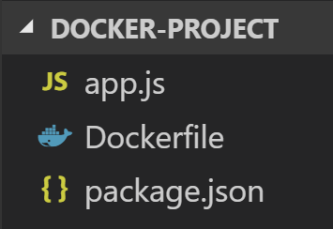
THE Dockerfile
Should contain:
The parent image:
Runtime
Docker Hub: https://hub.docker.com
The environment
Build instructions
The start command
FROM node:11.4.0
EXPOSE 8080
COPY package.json package.json
RUN npm install
COPY app.js app.js
CMD ["node", "app.js"]
Dockerfile

Slide 9
THE Dockerfile
Build the image:
docker build --tag=the-app .
Run the image:
docker run -p 3000:8080 the-app
docker run -v ./:./ the-app
The npm package nodemon can restart your app when files changes.
FROM node:11.4.0
EXPOSE 8080
COPY package.json package.json
RUN npm install
COPY app.js app.js
CMD ["node", "app.js"]
Dockerfile

Slide 10
Example

Slide 11
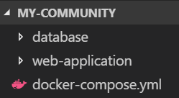
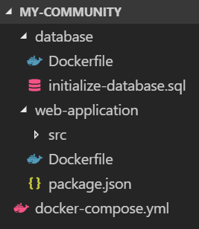
DOCKER COMPOSE
docker-compose.yml
version: '3'
services:
"web-application":
build: "./web-application"
ports:
- "3000:8080"
- "9229:9229"
volumes:
- "./web-application/src:/web-application/src"
depends_on:
- database
database:
build: ./database
ports:
- "3306:3306"
environment:
- MYSQL_ROOT_PASSWORD=theRootPassword
- MYSQL_DATABASE=webAppDatabase
A tool for building/running multiple images/containers.
App Image
DB Image
X Image
docker-compose up

