Slide 2
Introduction to computers and programming
Peter Larsson-Green
Jönköping University
Autumn 2018

Slide 3
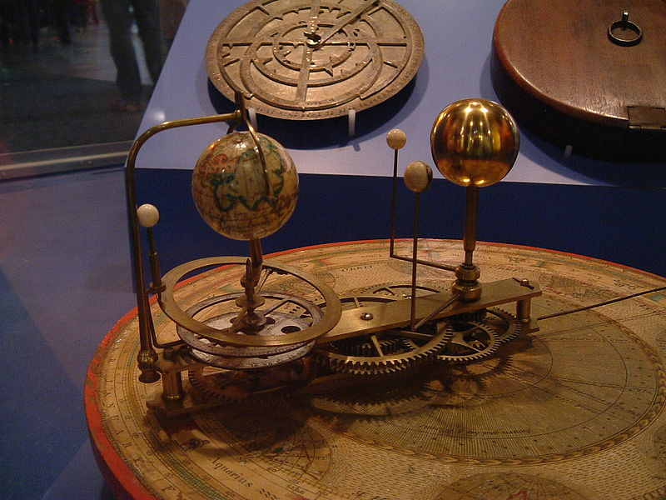
What is a computer?
Something that computes something.
E.g. an orrery:
https://www.youtube.com/watch?v=yKS7C0dC-bU
https://en.wikipedia.org/wiki/Orrery

Slide 4
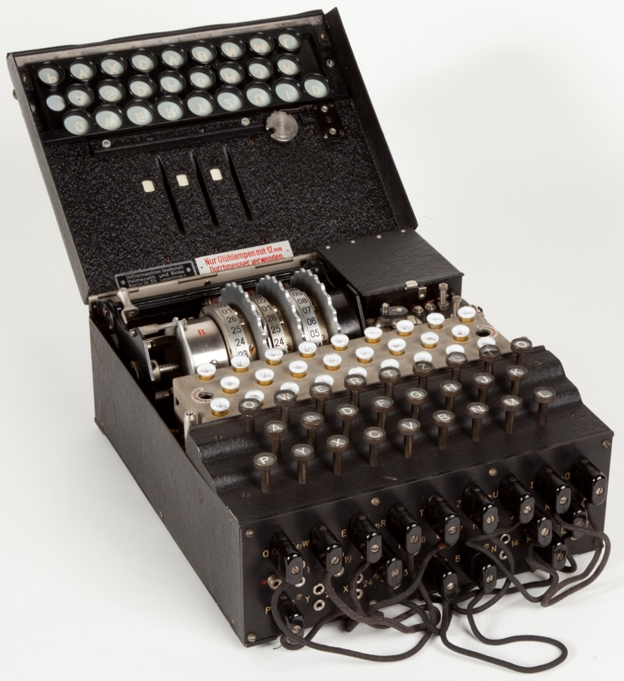
What is a computer?
Something that computes something.
E.g. the enigma machine:
https://www.youtube.com/watch?v=ASfAPOiq_eQ&feature=youtu.be&t=129
https://en.wikipedia.org/wiki/Enigma_machine

Slide 5
An abstract view of a computer
Computer
Input
Output
Orrery
Positions of planets
Time
Mode + message
Enigma
En-/decrypted message

Slide 6


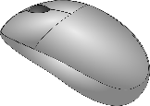
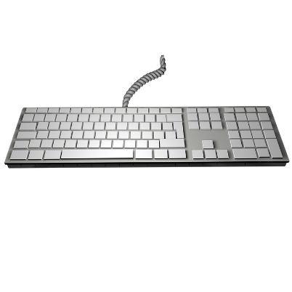

An abstract view of a computer
Computer
Input
Output
Does this view fit modern computers?

Slide 7

Modern computers
Modern computers are general-purpose computers.
The hardware in the computer can be used to compute things.
The program
The software (the program) tells the hardware what to compute.

Slide 8
Hardware ♥ software
A program (the software) consists of a sequence of instructions.
The hardware executes these instructions, one after another.
Many modern computers support a set of instructions called X86.
See all of the instructions at https://en.wikipedia.org/wiki/X86_instruction_listings.

Slide 9
Sample program
Checking if the sum of the integers between 0 and 2 is 3.
Instructions
Python
0: SET 0, #9 1: ADD 1, #9 2: ADD 2, #9 3: SUB 3, #9 4: JINZ #9, #7 5: SET 4, #10 6: JUMP #8 7: SET 5, #10 8: FINISH 9: 10:
sum = 0
sum += 1
sum += 2
if sum == 3:
answer = "Yes"
else:
answer = "No"
Hard to read & hard to write.
↓ Programming languages invented.
- 1
0
- 3
- 0
4

Slide 10
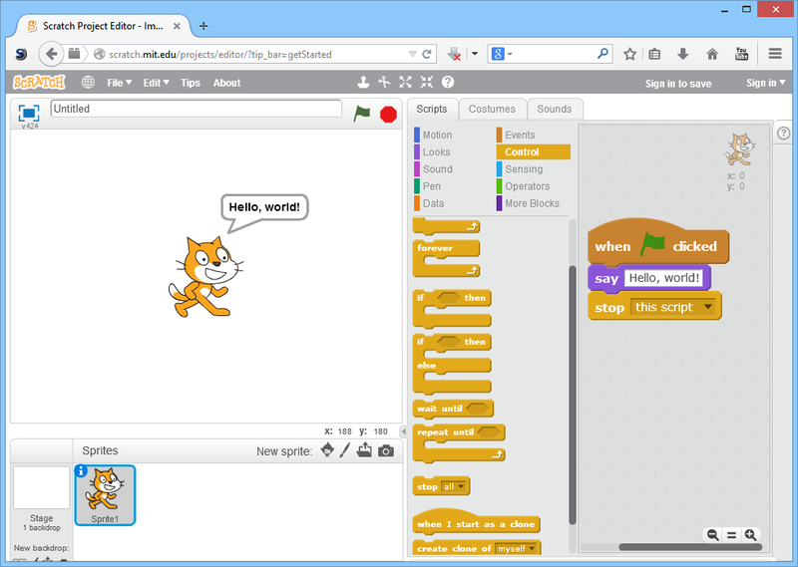
Programming in the future?
Visual programming?

Slide 11
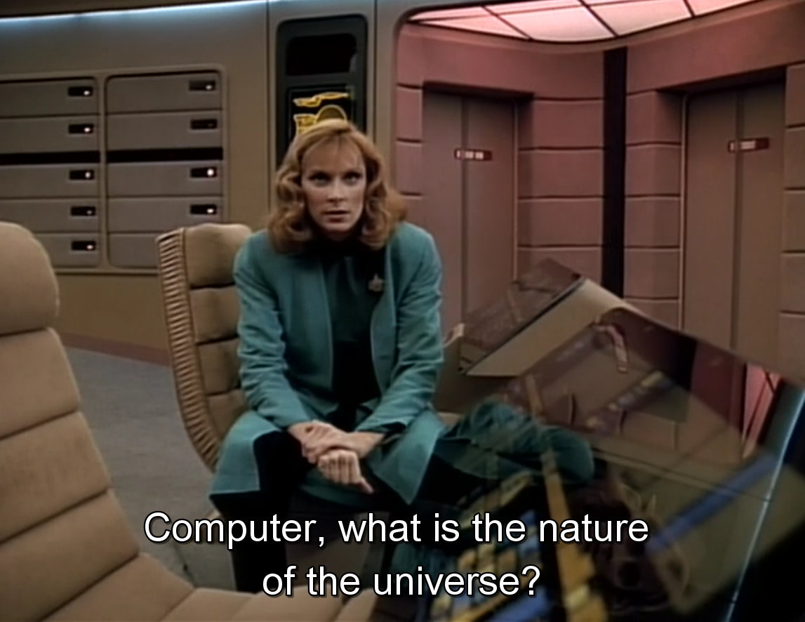
Programming in the future?
Just tell it what to do?

Slide 12
Programming paradigms
A programming paradigm is a special way to express how a program should work.
With C we primarily do imperative programming.
The program consists of statements to be executed.
Maps very well to how computers works internally.
int sum = 0;
sum += 1;
sum += 2;
sum += 3;

Slide 13
Programming paradigms
A programming paradigm is a special way to express how a program should work.
With C we primarily do imperative programming.
The program consists of statements to be executed.
Maps very well to how computers works internally.
With Java we primarily do object-oriented programming.
The program consists of objects that communicates with each other.
Maps very well to how the real world works.
Car petersCar = new Car("ABC123");
petersCar.increaseSpeed(10);
petersCar.break();

Slide 14
Programming paradigms
A programming paradigm is a special way to express how a program should work.
With C we primarily do imperative programming.
The program consists of statements to be executed.
Maps very well to how computers works internally.
With Java we primarily do object-oriented programming.
The program consists of objects that communicates with each other.
Maps very well to how the real world works.
With Haskell, we primarily do declarative programming.
The program consists of definitions.
Maps very well to recursively defined functions (math...).
factorial 3
3 * factorial 2
3 * 2 * factorial 1
3 * 2 * 1
6
factorial 1 = 1
factorial n = n * factorial (n - 1)

Slide 15
Operating systems
A computer can only run one program at a time.
⇒
Operating Systems invented
Users want to run multiple programs at the same time.

Slide 16
Operating systems
Computer
Program 1
Program 2
Program ...
Operating System
Hardware
OS starts
OS starts program 1
Program 1 runs
OS starts program 2
Program 2 runs
Program 1 runs
Program 2 runs
Program 1 runs
Program 2 runs
Time
0
The OS switches between the programs so fast that users don't notice.

Slide 17
Programming is hard!
Edsger W. Dijkstra:
Programming is one of the most difficult branches of applied mathematics; the poorer mathematicians had better remain pure mathematicians.

