Slide 2
Introduction to Python and IDEs
Peter Larsson-Green
Jönköping University
Autumn 2018

Slide 3
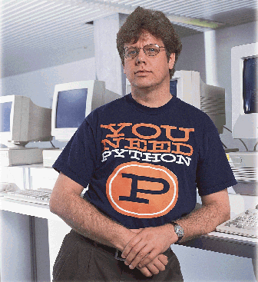
Python
Versions:
0.9 released 1991.
1.0 released 1994.
2.0 released 2000.
3.0 released 2008.
3.7 released 2018.
Python is quite popular:
https://www.tiobe.com/tiobe-index/
C released ~1972
C++ released ~1983
Java released ~1995.
C# released ~2000.
Guido van Rossum

Slide 4
Imperative programs
A program consists of:
A sequence of statements.
A statement consists of:
Other statements and expressions.
Expressions evaluate to:
Values.
Executed statements:
Alters the state of the program.
Program
if :
Expression 1
Statement 1
Statement 1
Statement 2
Statement 2
Statement 3
Statement 4
Name | Value
x | 12
y | 36
variable =
Variable table.
Expression 1

Slide 5
Sample program
Goal: to compute the sum of the integers between 0 and 3.
Program
a =
a = 0
a += 1
a += 2
a += 3
0
a +=
Name | Value
1
a
0
- 1
- 3
- 6
a +=
2
The variable table used while executing the program.
a +=
The code we write.
3
How the computer understands the code.

Slide 6
Python - Hello, World!
Python 3
Python 2
print("Hello, World!")
print "Hello, World!"
How to run the code?
An internet service: https://repl.it/languages/python3
On your own computer: https://www.python.org/downloads

Slide 7
writing and Running code
Demonstration

Slide 8
IDE
Integrated Development Environment
Code editor with useful programming features, such as:
Code highlighting.
Code completion.
Code hinting.
"Run code" button.
Debug capabilities.

Slide 9
Visual studio Code
An IDE from Microsoft.
Works on both Windows, Linux and Mac.
Has good support for Python through an extension.
Website: https://code.visualstudio.com

Slide 10
Visual studio Code
Demonstration

