Slide 2
Modelling in Python
Peter Larsson-Green
Jönköping University
Autumn 2018

Slide 3
What is modelling?
Representing data.
Represent the age of a human?
Use an integer.
age = 10
Represent the name of a human?
Use a string.
name = "Alice"
Represent whether a human is dead or alive?
Use a boolean.
alive = True

Slide 4
What is modelling?
Representing data.
Represent a circle?
Use an integer.
radius = 10
Represent a circle with a color?
Use multiple values.
circle_radius = 10
circle_color = "red"

Slide 5
Grouping data
Use dicts to group data together.
human = {
'name': "Alice",
'age': 10,
'city': "Atlanta"
}
print_human(human)
human_name = "Alice"
human_age = 10
human_city = "Atlanta"
print_human(human_name, human_age, human_city)

Slide 6
Grouping data
Use dicts to group data together.
date = {
'year': 2016,
'month': 3,
'day': 16
}
print_date(date)
date_year = 2016
date_month = 3
date_day = 16
print_date(date_year, date_month, date_day)

Slide 7
Dictionaries VS Lists
human = {
'name': "Alice",
'age': 10,
'city': "Atlanta"
}
human = [
"Alice",
10,
"Atlanta"
]
def print_human(human):
print(
human['name']+" comes from "+
human['city']+" and is "+
str(human['age'])+" years old."
)
def print_human(human):
print(
human[0]+" comes from "+
human[2]+" and is "+
str(human[1])+" years old."
)

Slide 8
General guidelines
Use a dict to represent a single entity.
human = {
'name': "Alice",
'age': 10,
'city': "Atlanta"
}
humans = [
{'name': "Alice", 'age': 10, 'city': "Atlanta"},
{'name': "Belle", 'age': 15, 'city': "Bilbao"},
{'name': "Clair", 'age': 20, 'city': "Chicago"}
]
Use a list to represent a collection of entities.

Slide 9
Program structure
The data
ages = [43, 47, 10, 7, 3]
Computations
def average(numbers):
return sum(numbers)/len(numbers)
User Interface
print("Average age: "+str(average(ages)))

Slide 10
Complex data
room = {
"name": "Living Room",
"side-length-1": 5,
"side-length-2": 10
}
house = {
"city": "Jönköping",
"color": "yellow"
}
house = {
"city": "Jönköping",
"color": "yellow",
"rooms": [
{"name": "Living Room", "side-length-1": 7, "side-length-2": 8},
{"name": "Kitchen", "side-length-1": 5, "side-length-2": 5}
]
}

Slide 11
Complex data
get_total_area(house)
def get_total_area(house):
area = 0
for room in house["rooms"]:
area += room["side-length-1"]*room["side-length-2"]
return area
house = {
"city": "Jönköping",
"color": "yellow",
"rooms": [
{"name": "Living Room", "side-length-1": 7, "side-length-2": 8},
{"name": "Kitchen", "side-length-1": 5, "side-length-2": 5}
]
}

Slide 12
Complex data
folder = {
"name": "images",
"files": [
{"name": "me.jpeg", "size": 2048},
{"name": "you.png", "size": 4096},
{"name": "dad.jpeg", "size": 4096}
]
}
folder = {
"name": "images"
}
file = {
"name": "me.jpeg",
"size": 2048
}

Slide 13
Complex data
get_files_with_extension(folder, ".jpeg")
folder = {
"name": "images",
"files": [
{"name": "me.jpeg", "size": 2048},
{"name": "you.png", "size": 4096},
{"name": "dad.jpeg", "size": 4096}
]
}
def get_files_with_extension(folder, ext):
files = []
for file in folder["files"]:
if file["name"].endswith(ext):
files.append(file)
return files

Slide 14
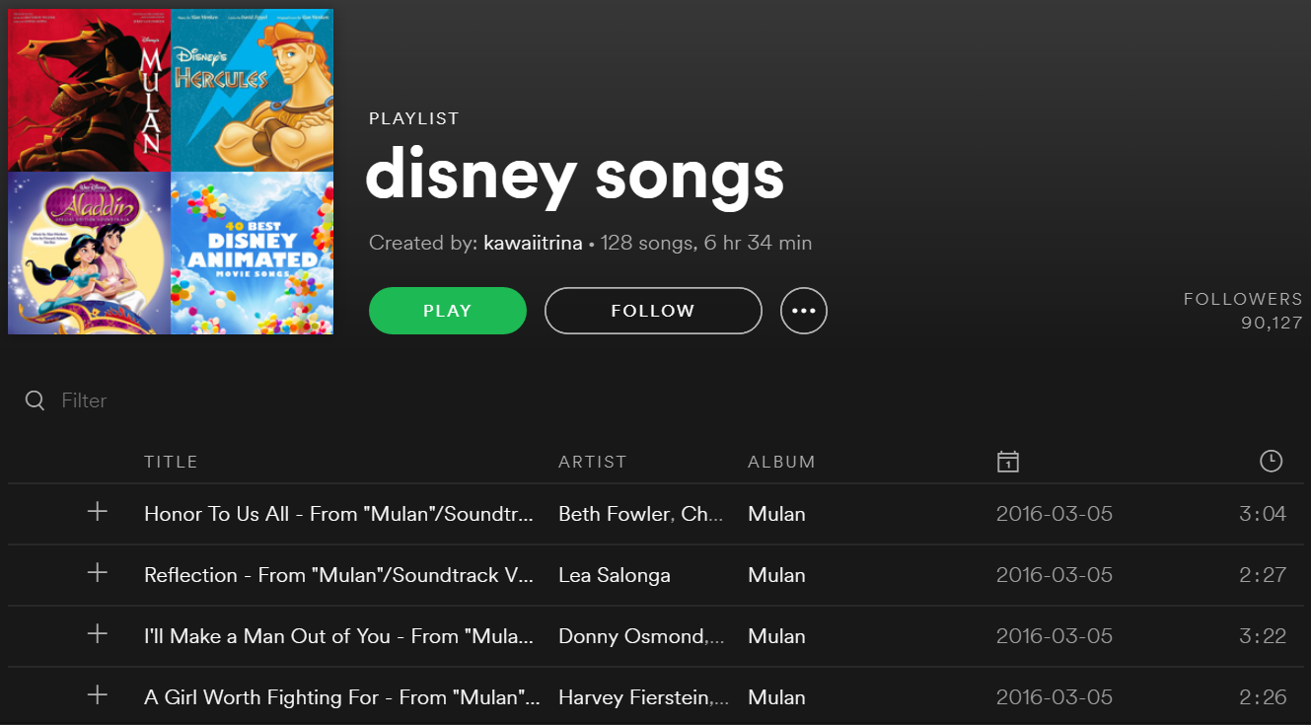
Modeling examples
A playlist on Spotify.
songs = [
{"title": "Honor To...",
"length": 184},
{"title": "Reflecti...",
"length": 147},
{"title": "I'll Mak...",
"length": 202},
{"title": "A Girl W...",
"length": 146},
# ...
]

Slide 15
Modeling examples
def get_in_units(seconds):
return {
"mins": seconds // 60
"secs": seconds % 60
}
A playlist on Spotify.
songs = [
{"title": "Honor To...",
"length": 184},
{"title": "Reflecti...",
"length": 147},
{"title": "I'll Mak...",
"length": 202},
{"title": "A Girl W...",
"length": 146},
# ...
]
def get_total_length(songs):
sum = 0
for song in songs:
sum += song["length"]
return sum

Slide 16
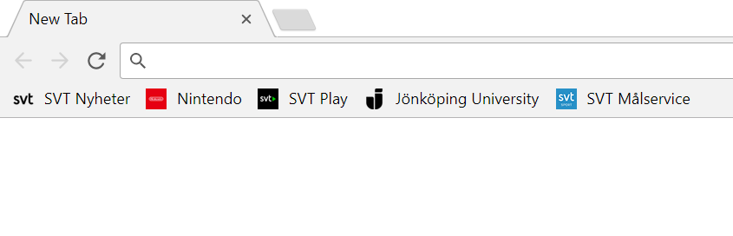
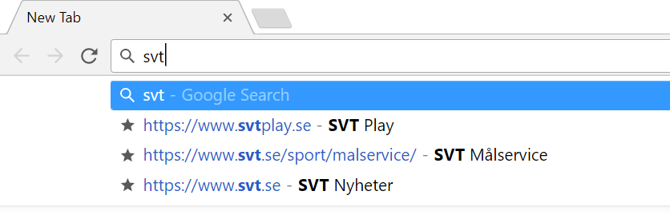
Modeling examples
Bookmarks in a web browser.
bookmarks = [
{"text": "SVT Nyhet..."
"url": "https://www..."},
{"text": "Nintendo",
"url": "https://nin..."},
{"text": "SVT Play",
"url": "https://www..."},
{"text": "Jönköping...",
"url": "https://ju.se"},
{"text": "SVT Målser...",
"url": "https://www..."}
]
def get_matches(bookmarks, text):
matches = []
for bookmark in bookmarks:
if text in bookmark["text"]:
matches.append(bookmark)
return matches

Slide 17
Modelling
5 in a row
X
X
O
X
X
O
O

Slide 18
Modelling
game = {
'width': 8,
'height': 6,
'moves': [
{'x': 1, 'y': 4, 'player': 'X'},
{'x': 2, 'y': 3, 'player': 'O'},
{'x': 2, 'y': 4, 'player': 'X'},
{'x': 2, 'y': 2, 'player': 'O'},
{'x': 3, 'y': 3, 'player': 'X'},
{'x': 3, 'y': 2, 'player': 'O'},
{'x': 4, 'y': 3, 'player': 'X'}
]
}
y
5 in a row
5
4
X
X
3
O
X
X
2
O
O
1
0
x
0
1
2
3
4
5
6
7

Slide 19
Modelling
game = {
'width': 8,
'height': 6,
'x-moves': [
{'x': 1, 'y': 4},
{'x': 2, 'y': 4},
{'x': 3, 'y': 3},
{'x': 4, 'y': 3}
],
'o-moves': [
{'x': 2, 'y': 3},
{'x': 2, 'y': 2},
{'x': 3, 'y': 2}
]
}
y
5 in a row
5
4
X
X
3
O
X
X
2
O
O
1
0
x
0
1
2
3
4
5
6
7

Slide 20
Modelling
y
5 in a row
game = {
'width': 8,
'height': 6,
'board': [
[' ', ' ', ' ', ' ', ' ', ' ', ' ', ' '],
[' ', 'X', 'X', ' ', ' ', ' ', ' ', ' '],
[' ', ' ', 'O', 'X', 'X', ' ', ' ', ' '],
[' ', ' ', 'O', 'O', ' ', ' ', ' ', ' '],
[' ', ' ', ' ', ' ', ' ', ' ', ' ', ' '],
[' ', ' ', ' ', ' ', ' ', ' ', ' ', ' ']
]
}
5
4
X
X
3
O
X
X
2
O
O
1
0
x
0
1
2
3
4
5
6
7

Slide 21
Modelling
game = {
'width': 8,
'height': 6,
'board': {
(1, 4): 'X',
(2, 3): 'O',
(2, 4): 'X',
(2, 2): 'O',
(3, 3): 'X',
(3, 2): 'O',
(4, 3): 'X'
}
}
y
5 in a row
5
4
X
X
3
O
X
X
2
O
O
1
0
x
0
1
2
3
4
5
6
7

