Slide 1
Subi: A location-based pick-up game coordinator
Yue Zeng yzk4v@mail.umkc.edu
Anh Nguyen lndhf@mail.umkc.edu
Khalid kmdk2t@mail.umkc.edu

Slide 2
Goal
Our goal is to create an application for android and iOS devices.
In this App, the users can do the following:
- Sign up a new account and login using the same account.
- The user can rest their password if they forget it.
- The user can surf the games available in the app.
- They can also create a new game and other users can register for it.

Slide 3
Technologies
We used for the frontend the following technologies:
- Ionic.
- Angular.
We also used bootstrap.
For the Backend, we have used Firebase.

Slide 4
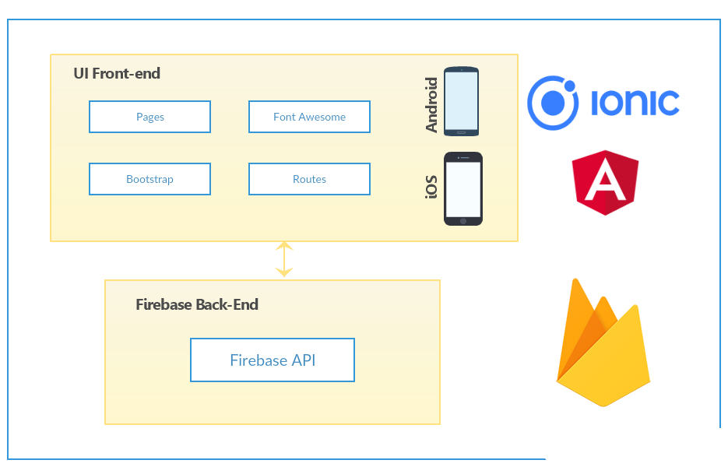
Architecture

Slide 5
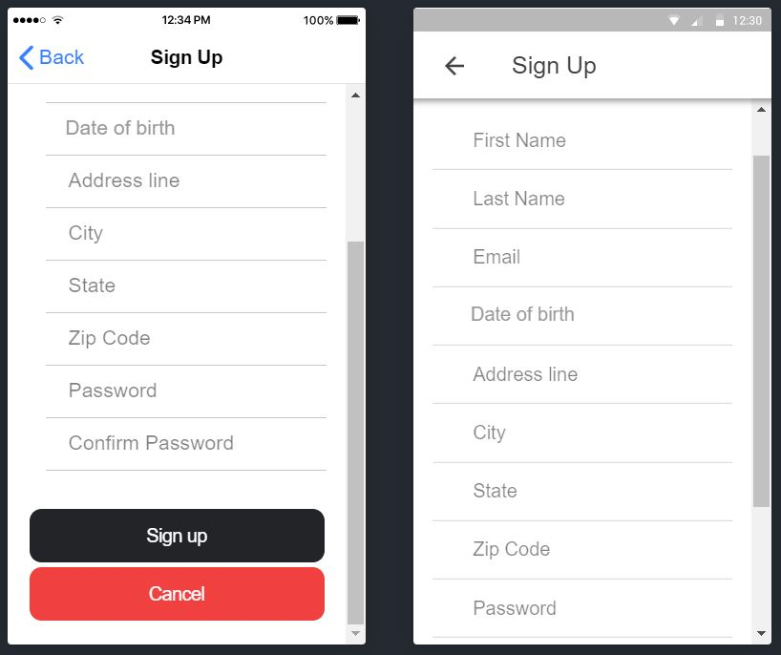
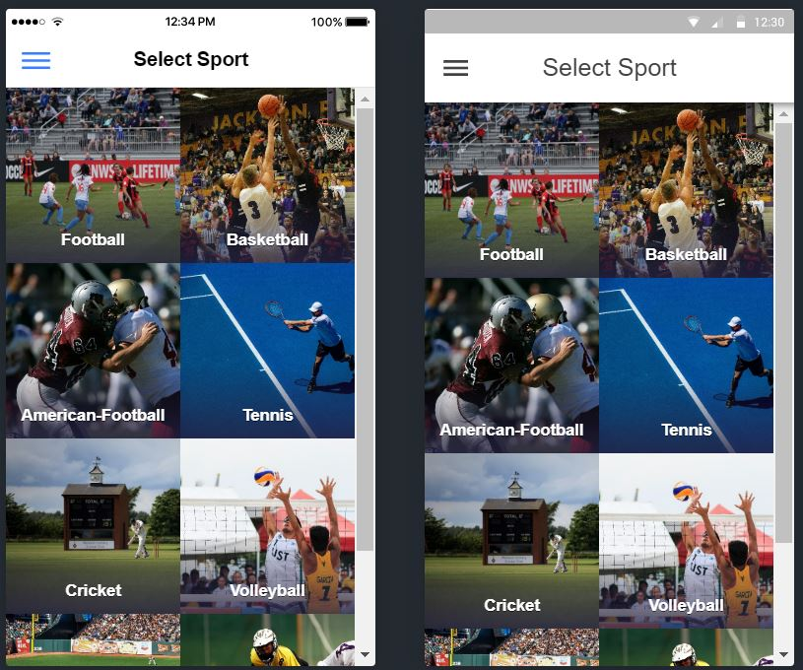

Slide 6
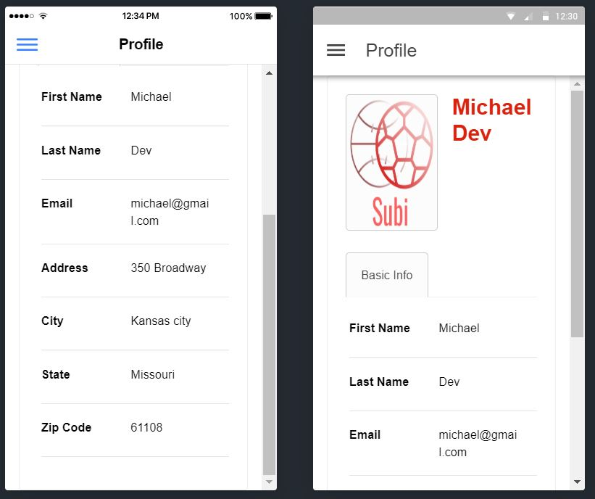
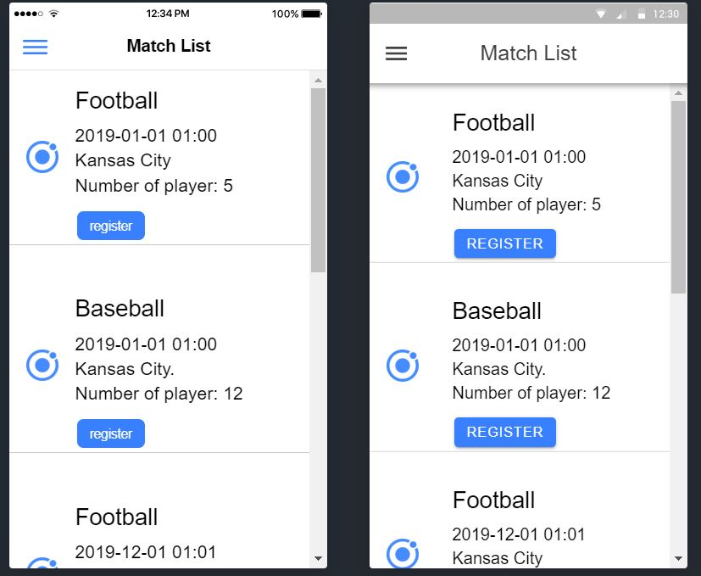

Slide 7
Thank You !

