Slide 1

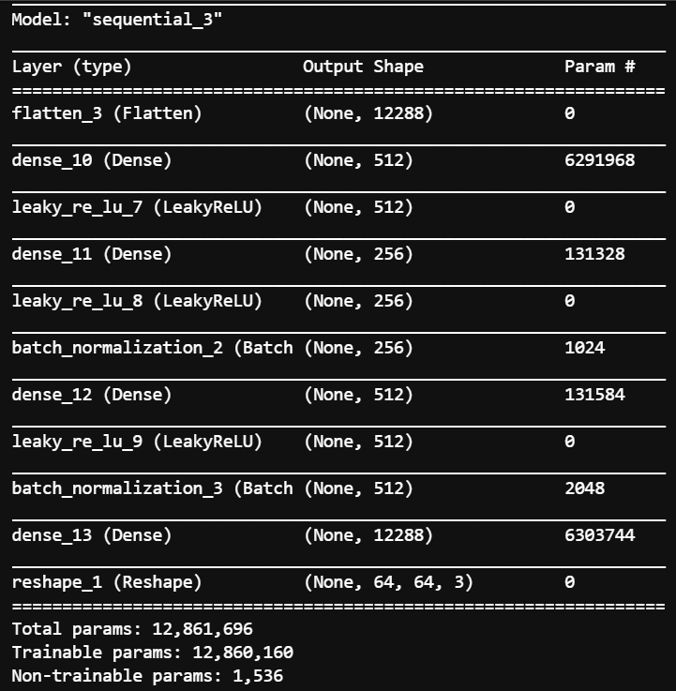
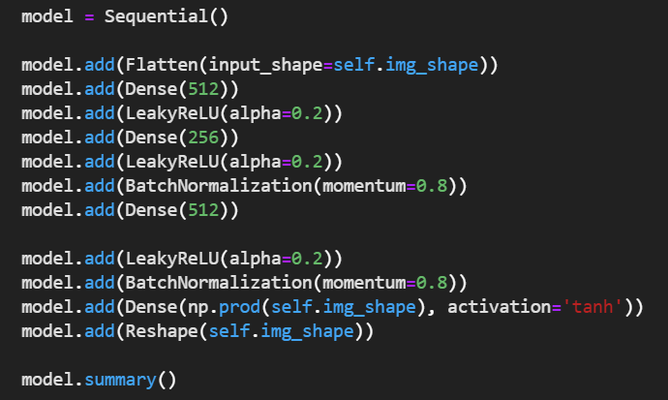
Basic generator
Input dimension: (samples, rows, cols, channels)
Loss functions for combined training:
Structure of G: untrained; structure of D: trained.
Network architecture

Slide 2
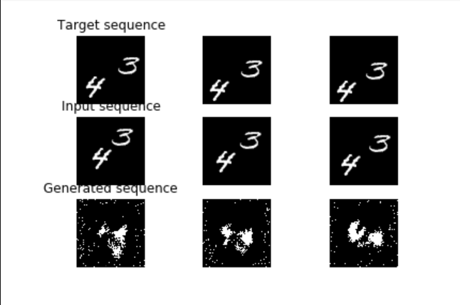
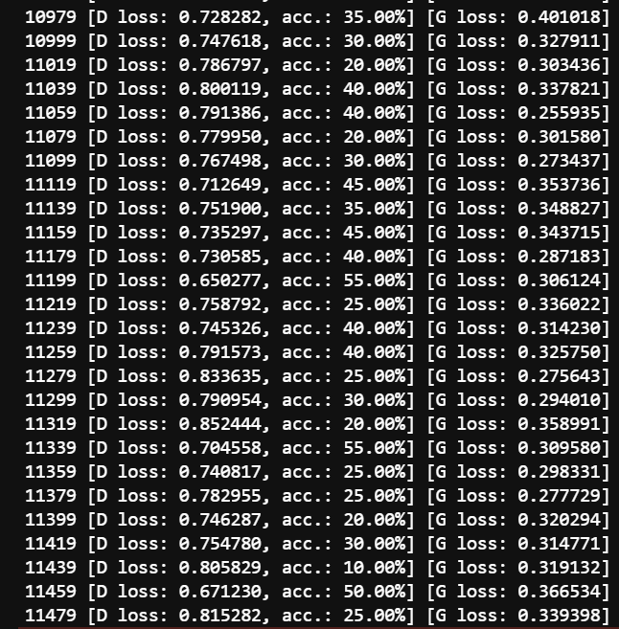
Basic generator
Result:
Discriminator loss and accuracy. G loss.
Problem: blurry, can not predict even after 50000 epoch of training.

Slide 3

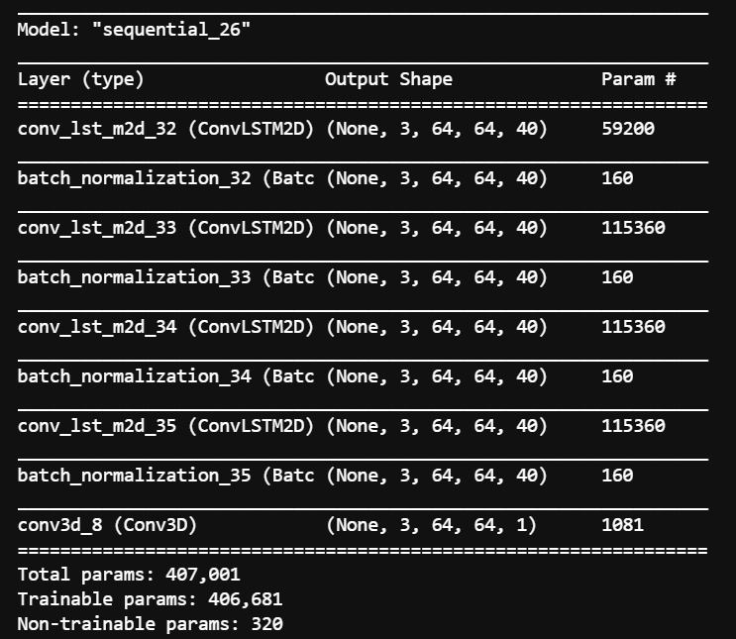
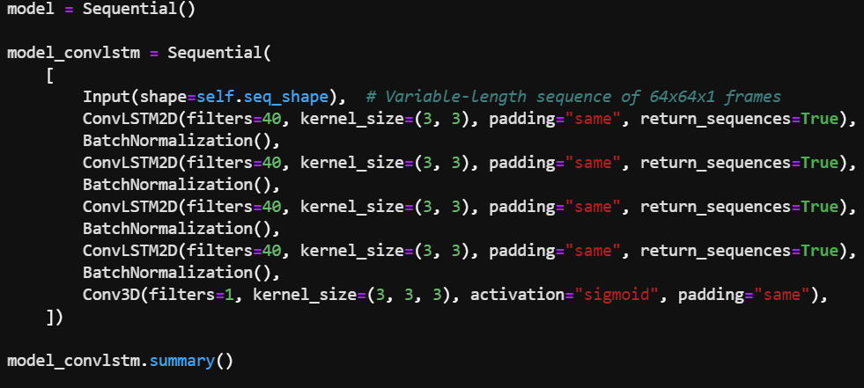
ConvLSTM generator
Input dimension: (samples, time, rows, cols, channels)
Loss functions for combined training:
Network architecture

Slide 4
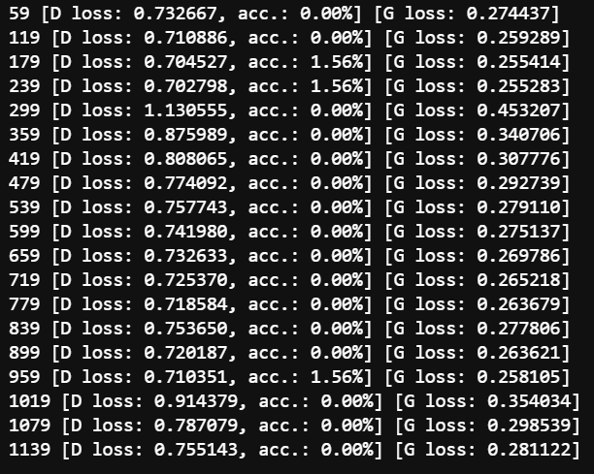
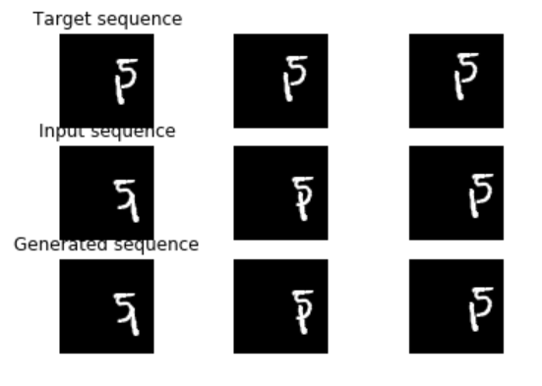
ConvLSTM generator
Discriminator loss and accuracy. G loss.
Result
Problem: G generates same as input sequence, the discriminator (too weak) can not tell the difference between target and generated.
Possible solution: 1. combine neuro structure of Convlstm with Basic one. 2. Use stronger D (pretrained or use better loss functions) to tell the slight difference between target and generated clips.

