Slide 1
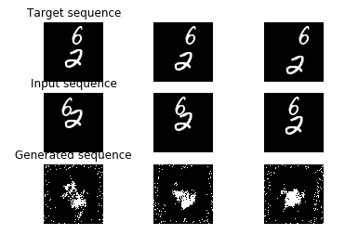
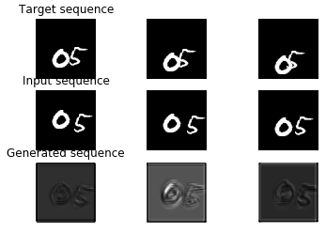
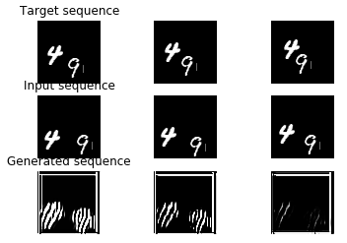
basic G + basic D
convlstm G + basic D
convlstm G + convlstm D
 | Basic G Basic D | Convlstm G Basic D | Convlstm G Convlstm D
MSE loss | 0.308259342619746 | 0.9732511286446791 | 1.3893313126076463

