Slide 1
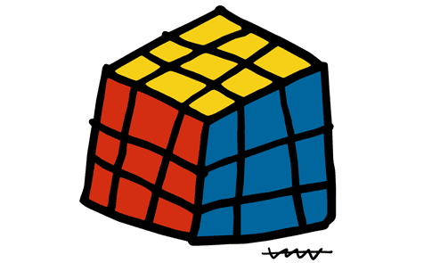
Solving Rubik's cube using group theory
  Sheldon Joyner
  09/29/2009

Slide 2
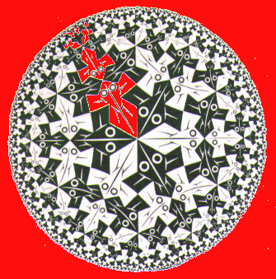
  Groups are used to measure symmetry
  (Escher, Circle limit I)
  Groups act upon sets of objects

Slide 3
Third thing to take away today:
Rubik's cube is fun ... and group theory provides tools that help understand how it works!

Slide 4
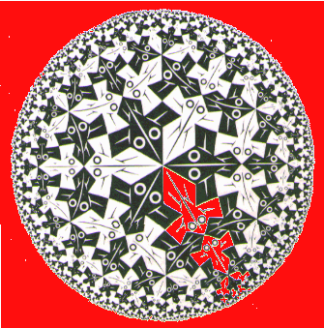
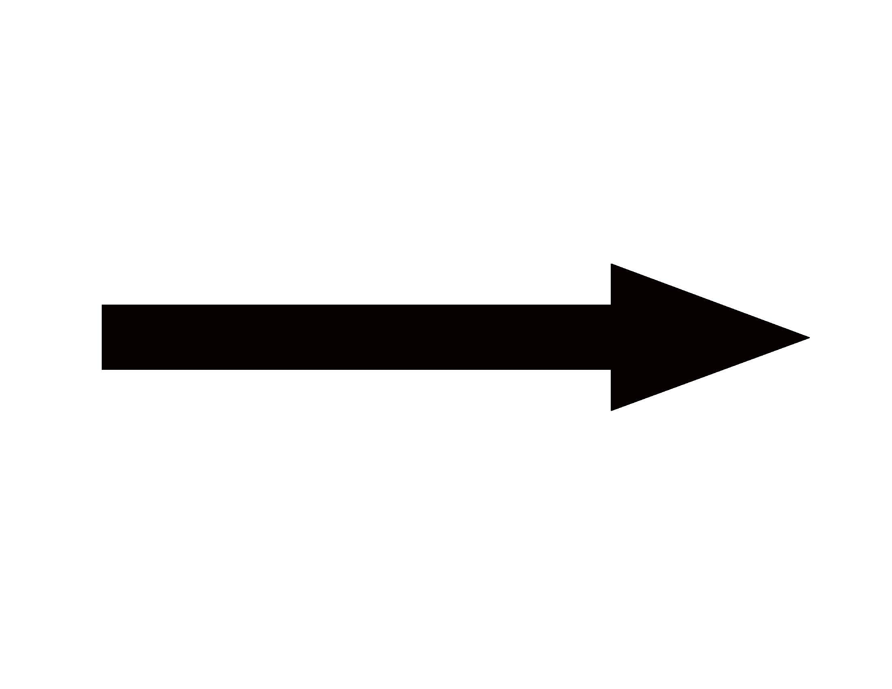

Slide 5
Rotation of the plane...
is a group transformation
Even number of rotations: no effect ''0''
Odd number of rotations: same effect as1 rotation ''1''

Slide 6
Group of rotations of plane through pi radians has group law:
0+0=0
1+0=1
0+1=1
1+1=0

Slide 7
Relation to usual addition law of integers:
we say two integers are equivalent if their difference is even.
Equivalent number of rotations produces same effect on the plane.
We discard all information but the parity of the number, and indicate odd by 1 and even by 0.

Slide 8
Our group law says:
Even + even = even
Odd+ even = odd
Even + odd = odd
Odd + odd = even
0+0=0
1+0=1
0+1=1
1+1=0

Slide 9
This is the group Z/2Z
Where did the 2 come from?

Slide 10
This is the group Z/2Z
Where did the 2 come from?
2 rotations get us back where we started

Slide 11
A more familiar example:
what time is 4 hours after 11pm?

Slide 12
A more familiar example:
what time is 4 hours after 11pm?
11+4 = 3...

Slide 13
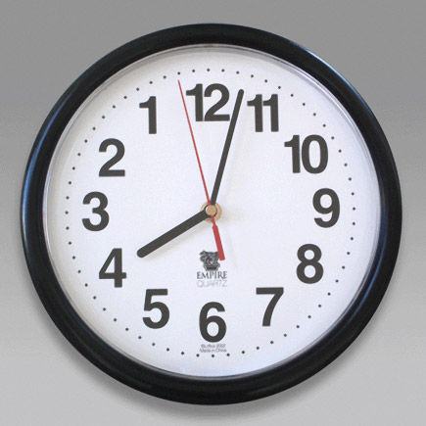
A more familiar example:
rotations of the plane through 2 pi / 12
12 = 0

Slide 14
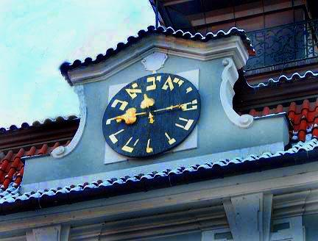
(Clock in Jewish Quarter of Prague)
Z/12Z: group law is
determined by 12=0 (i.e. integers which differ by 12 are equivalent) Example:
11+4=15 = 12+3 = 3

Slide 15
Generally, Z/NZ is the cyclic group of order N.
N = number of elements,
(also number of times 1 added to itself is 0).
All elements are of the form 1+1+...+1 for some number of additions. 1 is called a generator of the group.

Slide 16
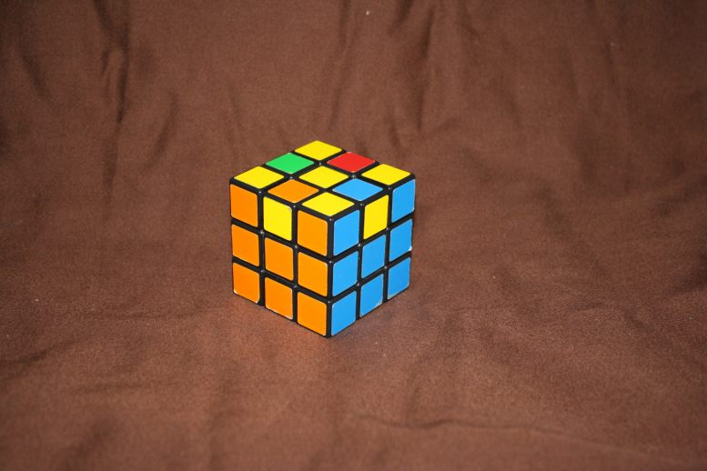
Some of the groups Z/NZ act on Rubik's cube!

Slide 17
What is one way that Z/4Z acts on the cube?

Slide 18
0 1 2 3 4 5 6 7

Slide 19
0 1 2 3 4 5 6 7
4 5 0 1 6 3 2 7

Slide 20
Permutation on 8 letters (symbols)
Group comprises the actual permutations
acting on some ordered list of objects

Slide 21
0 1 2 3 4 5 6 7
4 5 0 1 6 3 2 7
Three cycles: 0,4,6,2,0
and 1,5,3,1
and 7,7

Slide 22
0 1 2 3 4 5 6 7
4 5 0 1 6 3 2 7
(0 4)(0 6)(0 2) odd parity
(1 5)(1 3) even parity
(7 7) = e even parity

Slide 23
0 1 2 3 4 5 6 7
4 5 0 1 6 3 2 7
0 1 2 3 4 5 6 7

Slide 24
Group operation / multiplication
is succession of permutations:
0 1 2 3 4 5 6 7
4 5 0 1 6 3 2 7
2 5 6 3 0 7 1 4
(0 4)(0 6)(0 2)(1 5)(1 3)*(0 6)(1 3 7 4 2)

Slide 25
Group S_{8} of permutations on 8 letters (symbols).
What is one way that S_{8} acts on the cube?

Slide 26
Notice that Z/4Z sits inside S_{8}!
We say that Z/4Z is a subgroup of S_{8}.

Slide 27
Group:
Set G with map m: G x G G:
associative: m(m(g,h),k) = m(g,m(h,k))
for any g,h,k in G;
admits an identity element e in G:
m(g,e) = m(e,g) = g for any g in G
each element has an inverse:
for any g in G, there exists g' in G so that
m(g,g') = m(g',g)=e

Slide 28
Group action:
Group G acts on set X if there is a map T of G x X into X with nice properties:
associativity: T(h,T(g,x)) = T(hg, x)
for any g,h in G and x in X;
action of identity element e in G:
T(e,x) = x for any x in X

Slide 29
Symmetry group G of the cube:
R,L,U,D,F,B
R',L',U',D',F',B'
R'=RRR=R^3; L'=LLL=L^3; ...

Slide 30
Does order matter?
Does RUR'U' = RR'UU' ?

Slide 31
RL'F^2B^2RL' U LR'B^2F^2LR' = D!!!

Slide 32
RL'F^2B^2RL' U LR'B^2F^2LR' = D!!!
same as:
(RL'F^2B^2RL') U (RL'F^2B^2RL')'
= W U W'

Slide 33
W U W' is “Conjugation” of U by W:
group theoretic change of coordinates.
Real change is effected by “U” - other stuff just sets up the move.

Slide 34
Generators for G:
UBLUL'U'B'
R^2FLD'R'

Slide 35
Subgroups:
Z/NZ may be realized on the cube for N=2,3,4,...,12
These groups are subgroups of G

Slide 36
Z/1260Z
is largest cyclic subgroup of G...
and any move (group element) repeated enough times returns cube to starting position.
(RU^2D'BD' has order 1260)

Slide 37
Subgroup R of all permutations of cubie positions:
(S_{8} x S_{12})intersect A_{20}.
R=G/P
where P comprises moves which change orientation of cubies

Slide 38
P=P(corners) x P(edges)
=[subgroup of (Z/3Z)^8]
x [subgroup of (Z/2Z)^12]
|P|=3^7 * 2^11

Slide 39
G same as R*P, so has order
(1/2)12!8!(2^11)(3^7)

Slide 40
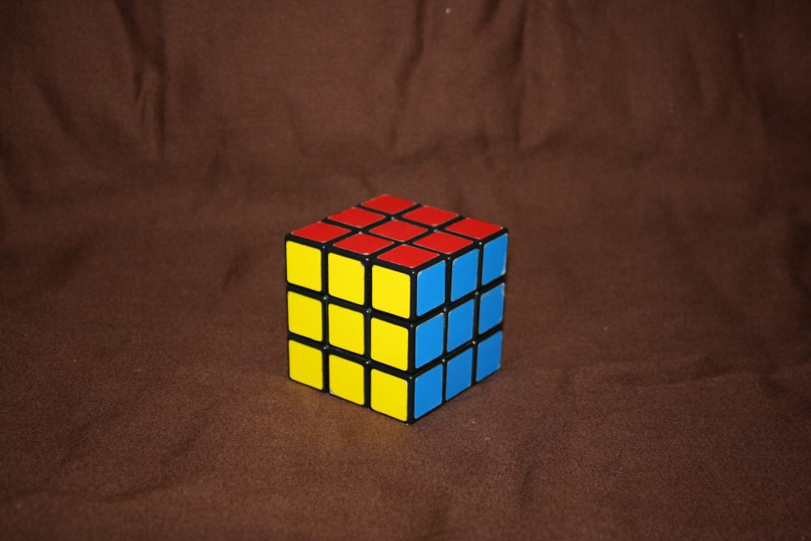
Symmetries of this position:
(i.e. moves that leave it unchanged)
all moves equivalent to “e”, identity.

Slide 41
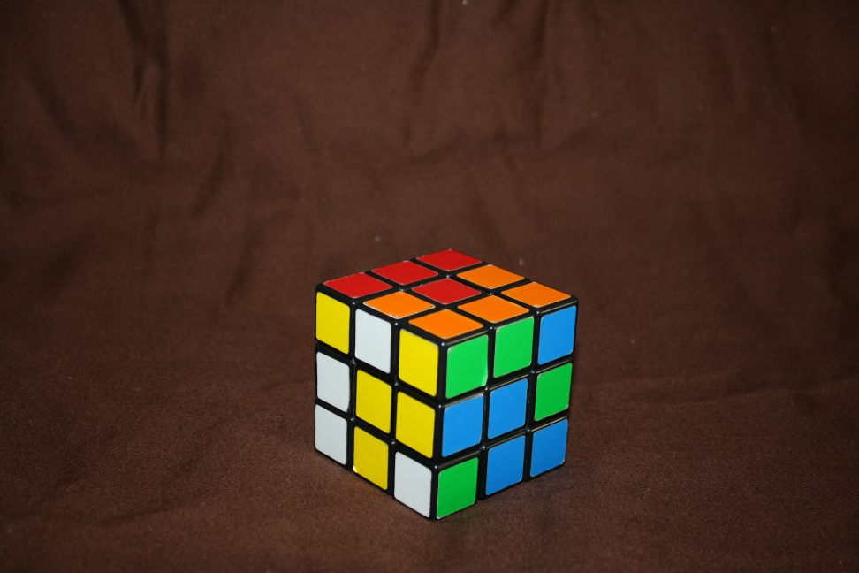
Thought experiment: scramble cube in a very specific way
R^2,L^2,U^2,D^2,F^2,B^2

Slide 42
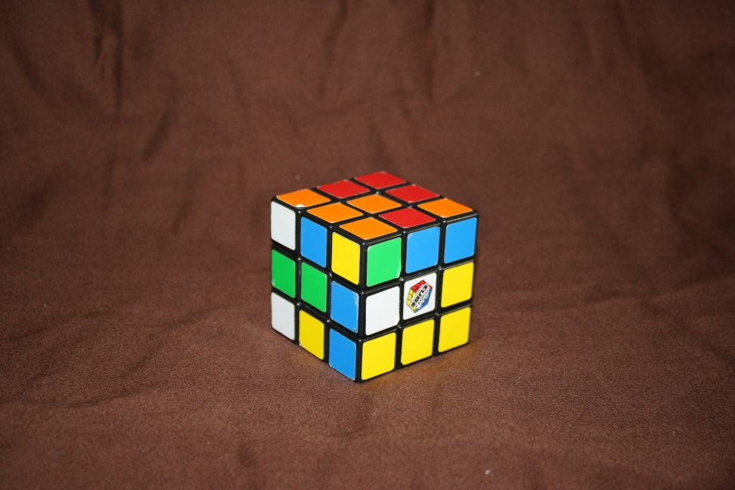
Next allow also U,D:
R^2,L^2,U,D,F^2,B^2

Slide 43
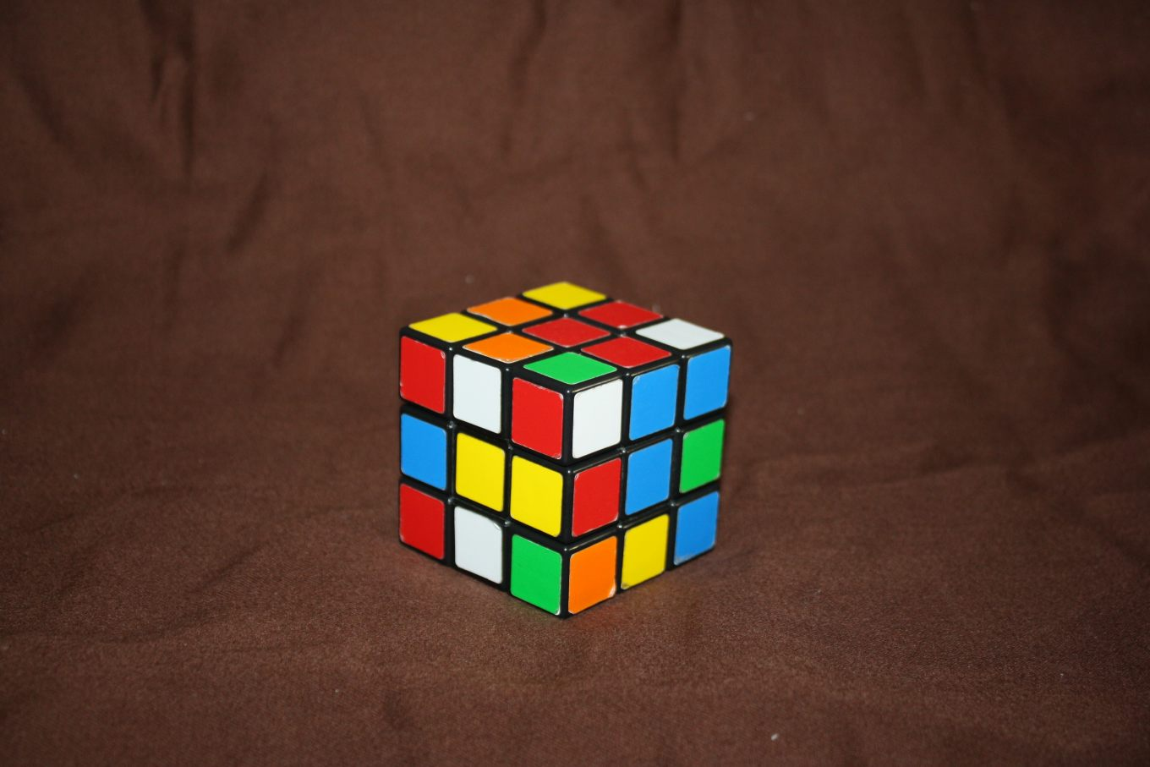
Next: R^2,L^2,U,D,F,B

Slide 44
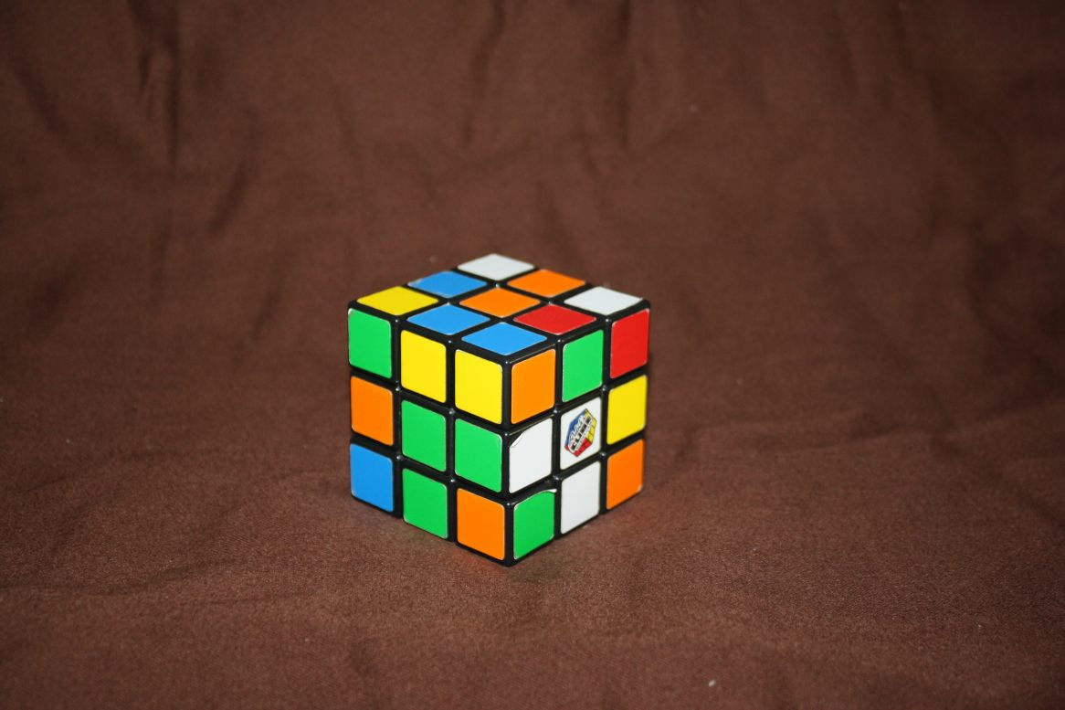
Now scramble completely

Slide 45
This was the Thistlethwaite algorithm in reverse!
G = G_{0}
Step 1:From scrambled position, perform moves that bring the cube into a position where moves from G_{1} = <R^2,L^2,U,D,F,B>
will solve it.

Slide 46
Step 2:
Using only moves from G_{1}, get cube into a position so that moves from G_{2}=<R^2,L^2,U,D,F^2,B^2>
suffice.

Slide 47
Step 3:
Get to position so that action of the “squares group”
G_{3}=<R^2,L^2,U^2,D^2,F^2,B^2>
can solve the cube.

Slide 48
G=G_{0}
G_{1}=<R^2,L^2,U,D,F,B>
G_{2}=<R^2,L^2,U,D,F^2,B^2>
G_{3}=<R^2,L^2,U^2,D^2,F^2,B^2>
G_{4}={e}

Slide 49
Human version!

Slide 50
Computer improvements
God's algorithm?
Cayley length of the cube group?

Slide 51
END
Thank you for coming!

