Slide 1
Microservices-Based E-Commerce Application
Master’s in Computer Engineering - Mobile Computing
Student: Pedro Henrique Fernandes (2240198)

Slide 2
Project Overview
Transform a monolithic e-commerce app into a microservices system.
Goals:
Modularity
Scalability
Maintainability
Features:
Browse products
Manage accounts
Place orders
PayPal integration
Real Time Notifications

Slide 3
Architecture Concept
Independent services
Communication:
REST APIs
Asynchronous messaging (Events)
Single entry point:
API Gateway (nginx)

Slide 4
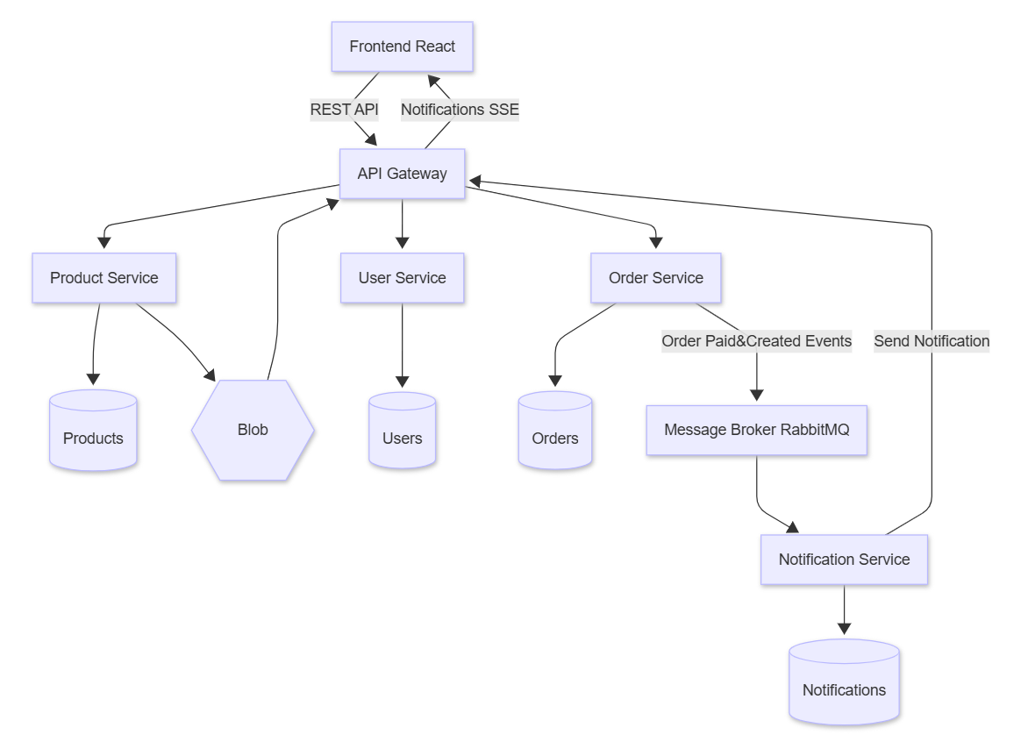
Architecture Overview

Slide 5
Microservices Breakdown
User Service: authentication & users
Product Service: catalog & images
Order Service: order processing
Notification Service: real-time updates

Slide 6
Frontend
Built with React
Enhancements:
PayPal integration
Notifications module
Image retrieval via API Gateway

Slide 7
Backend Infrastructure
MongoDB (shared)
nginx API Gateway
Azurite (Blob storage emulator)
RabbitMQ (messaging)

Slide 8
Notifications System
Uses Server-Sent Events (SSE)
Flow:
1. Order created
2. Event sent to RabbitMQ
3. Notification service processes
4. Frontend receives update

Slide 9
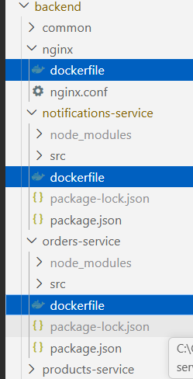
Deployment with Docker
Each service runs in containers and has its own dockerfile.
Backend, shares common project reused by services.
Configs:
Production
docker compose -f docker.compose.yml up --build -d
Development
docker compose -f docker.compose.yml -f docker.compose.dev.yml up --build

Slide 10
System Orchestration
Containers:
MongoDB
Services
RabbitMQ
API Gateway
Frontend

Slide 11
Challenges
Service startup timing
Reuse app common code without proper packing
Container networking
Blob storage access
SSE implementation

Slide 12
Possible Improvements
Add health checks
Use dedicated API Gateway
Use real cloud storage
Use npm packages to reduce dockerfile complexity.
Improve logging & monitoring

Slide 13
Conclusion
Microservices improve scalability and structure
Docker simplifies deployment
Practical experience with distributed systems

Slide 14
Final Note
A practical project focused on understanding microservices concepts and real-world challenges

