Slide 1
Stock Behavioral Clustering
& Return Prediction
Do data-driven behavioral groupings reveal market structure that GICS sectors miss?
Vishnu Peram
DATA 255 · Data Mining · Final Project
San José State University · Spring 2026

Slide 2
AGENDA
Roadmap of this presentation
12 steps from problem definition to deployment, mapped to the rubric
1
Problem statement & research question
Slides 3–5
2
Data sources & warehouse design
Slides 6–7
3
Pipeline architecture
Slide 8
4
Preprocessing
Slide 9
5
Feature engineering
Slides 10–11
6
EDA & visualization
Slides 12–14
7
Clustering — Part 1
Slides 15–19
8
Classification — Part 2
Slides 20–22
9
Results & evaluation
Slide 23
10
Conclusions
Slide 24
11
Future work
Slide 25
Vishnu Peram · DATA 255 · SJSU
2 / 25

Slide 3
01 · PROBLEM STATEMENT
Why GICS sectors may not capture how stocks behave
The official taxonomy classifies by business activity — not by trading character
The gap
The opportunity
• GICS labels are assigned by primary business activity (what a company does)
• Stock prices are driven by market dynamics, factor exposure, and sentiment
• These two views can disagree — e.g. NVDA (Tech) and CEG (Utilities) both rallied on AI
• During macro narratives, otherwise unrelated stocks move together
• Cluster stocks by their actual price behavior over 5 years
• Compare data-driven groupings to official GICS sectors
• Test whether knowing the behavioral cluster improves prediction
• Reveal hidden risk archetypes that cross sector lines
Vishnu Peram · DATA 255 · SJSU
3 / 25

Slide 4
01 · RESEARCH QUESTION
Formal statement
Two coupled sub-questions tested on 5 years of daily price data
Do S&P 500 stocks form distinct behavioral clusters that diverge from their official GICS sector classifications when grouped by market-adjusted price behavior and risk profile — and can technical indicators, enriched by behavioral cluster membership, predict short-term return direction?
RQ1 — Clustering
RQ2 — Prediction
When clustered using market-adjusted returns, volatility, momentum, and risk features, do the resulting groups align with or diverge from the 11 official GICS sectors?
Do technical indicators, augmented with behavioral cluster labels from RQ1, improve classification performance — specifically ROC-AUC — for predicting whether a stock's 5-day forward return is positive?
Vishnu Peram · DATA 255 · SJSU
4 / 25

Slide 5
01 · MOTIVATION
The AI boom — a real-world example of the cross-sector gap
When a single narrative dominates, sectors stop describing behavior
Three stocks that moved together for the same AI-infrastructure reason — across IT and Utilities sectors:
NVDA (Nvidia)
Theme: AI compute & power demand
+239%
Information Technology
2023 calendar return
CEG (Constellation Energy)
Theme: AI compute & power demand
~+91%
Utilities
2024 calendar return
VST (Vistra)
Theme: AI compute & power demand
~+258%
Utilities
2024 calendar return
Different GICS sectors (IT vs Utilities) — but their stocks rallied on the same macro narrative.
Vishnu Peram · DATA 255 · SJSU
5 / 25

Slide 6
02 · DATA SOURCES
Three free, programmatically-accessible sources
All data is public, reproducible, and requires no paid APIs
Source
What it provides
Access method
Volume
Yahoo Finance (yfinance)
Daily OHLCV for all S&P 500 tickers + index
yfinance.download()
~743,837 stock-days
Wikipedia constituent list
Tickers, GICS sectors, sub-industries
pd.read_html()
503 tickers
^GSPC index
S&P 500 market benchmark — for excess returns
yfinance.download()
1,509 trading days
Why 2019–2024?
• Pre-COVID bull (2019) → COVID crash (Mar 2020) → V-shaped recovery (2020–21)
• Inflation + Fed hiking cycle (2022 bear market) → AI-driven bull (2023–24)
• 5 distinct market regimes in one panel — clusters reflect a stock's character across all conditions, not just one environment
Vishnu Peram · DATA 255 · SJSU
6 / 25

Slide 7
02 · DATA WAREHOUSE
Star schema design
One central fact table joined to three dimensions
stock_dim
time_dim
ticker · company GICS sector · sub-industry
date · year · quarter macro_regime
daily_returns_fact
OHLCV · returns · excess return 5-day forward target
technical_features
743,837
501
RSI · MACD · ATR · OBV beta · volatility · MAs
19
11
fact rows
tickers
feature cols
GICS sectors
Vishnu Peram · DATA 255 · SJSU
7 / 25

Slide 8
03 · PIPELINE
End-to-end data + ML workflow
Modular, cached, fully reproducible from source
Ingest
Engineer
Cluster
Classify
Visualize
Wikipedia + yfinance
Technical indicators Behavioral fingerprints
K-Means + Hierarchical + DBSCAN + PCA
LogReg / Tree / RF / XGB with vs without cluster
Streamlit dashboard 5 interactive pages
→
→
→
→
↓
↓
↓
↓
↓
fact_table.parquet
technicals + fingerprints
cluster_assignments
classification_metrics
live URL
Each stage caches its outputs as parquet. Re-running is incremental — only invalidated stages recompute.
First full run: 5–10 min · Cached re-runs: <5 sec · Pipeline command: python pipeline.py
Vishnu Peram · DATA 255 · SJSU
8 / 25

Slide 9
04 · PREPROCESSING
From raw prices to model-ready features
Five preprocessing passes ensure the data is statistically clean
Returns honesty
pct_change(fill_method=None) — gaps stay as NaN instead of being silently filled with zeros
Market adjustment
excess_return = stock_return − S&P 500 return — strips out the systematic market tide
Missing data
Drop rows missing core fields (adj_close, raw_return); technical indicators have warm-up NaNs that are dropped at modeling time
Outlier control
Behavioral fingerprint features winsorized at 1st/99th percentile; daily-return outliers retained as genuine signal
Feature scaling
StandardScaler for clustering; price-relative ratios (MA / close) and log-volume to prevent magnitude domination
Vishnu Peram · DATA 255 · SJSU
9 / 25

Slide 10
05 · FEATURE ENGINEERING — PART 1
Technical indicators (per stock-day)
8 indicators across 4 families — the standard quant-finance feature set
Trend
Momentum
Volatility
Risk / Volume
MA(20), MA(50)
RSI(14)
Bollinger(20, 2σ)
Beta(60d)
Rolling mean of close — trend direction
EMA(gains)/EMA(losses) → 0..100 — overbought/oversold
MA ± 2σ; band width = vol regime
Cov(stock, market) / Var(market) — market sensitivity
MACD(12,26,9)
ATR(14)
OBV
EMA(12) − EMA(26) and signal — momentum shifts
Average true daily range
Cumulative signed volume — accumulation
Volatility(20d)
Rolling std of returns
Vishnu Peram · DATA 255 · SJSU
10 / 25

Slide 11
05 · FEATURE ENGINEERING — PART 2
Behavioral fingerprint (per stock)
Each stock collapses its 2019–2022 training window into a single 7-feature vector (leakage-free for downstream classification)
mean_excess_return
Average alpha — outperformance vs market
Each stock → 1 row × 7 features
volatility
Std dev of daily excess returns
Aggregation pipeline:
mean_beta
Average 60-day rolling beta
1. ~1,000 train days × 8 indicators per stock
2. Aggregate to means / std / max
mean_rsi
Average RSI level — momentum tendency
3. Winsorize 1st / 99th percentile
mean_bollinger_width
Average band width — vol regime
4. StandardScaler normalize
5. Cluster on this 7-D vector (leakage-free)
max_drawdown
Worst peak-to-trough loss
momentum_score
Average rolling 12-month return
495
stocks fingerprinted
Vishnu Peram · DATA 255 · SJSU
11 / 25

Slide 12
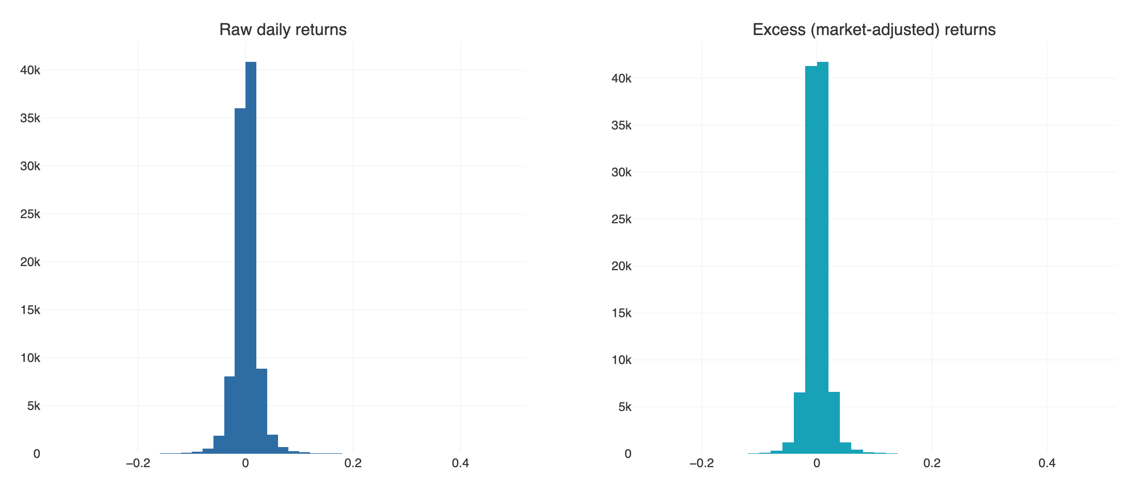
06 · EDA
Daily return distributions — raw vs market-adjusted
Market adjustment removes the common tide and reveals stock-specific behavior
Reading the chart
• Both have fat tails (extreme moves more frequent than normal distribution)
• Excess returns are tighter — the market component contributes substantial variance
• Negative skew in both — crashes are sharper than rallies
0.0229
0.0191
47.0%
53.0%
Raw std
Excess std
Down days
Up days
Vishnu Peram · DATA 255 · SJSU
12 / 25

Slide 13
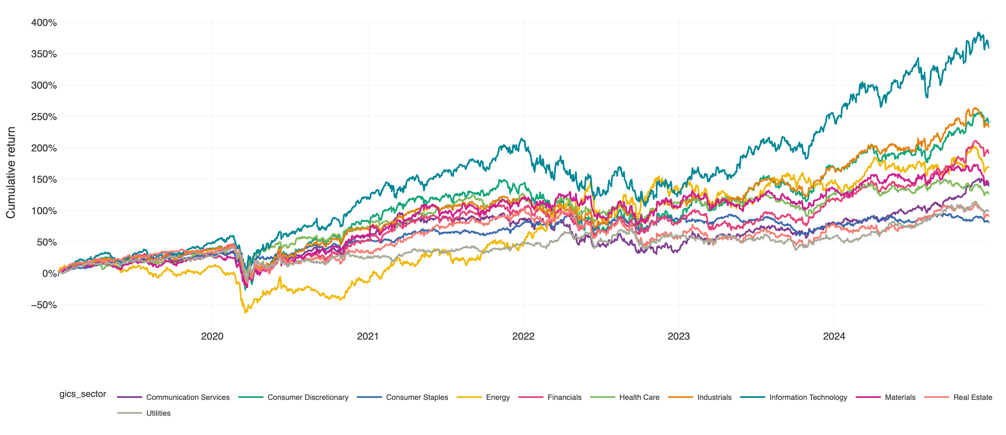
06 · EDA
Cumulative sector returns 2019 → 2024
Each sector's path through five distinct market regimes
Tech and Communication Services led the period; Energy whip-sawed; defensives lagged.
Vishnu Peram · DATA 255 · SJSU
13 / 25

Slide 14
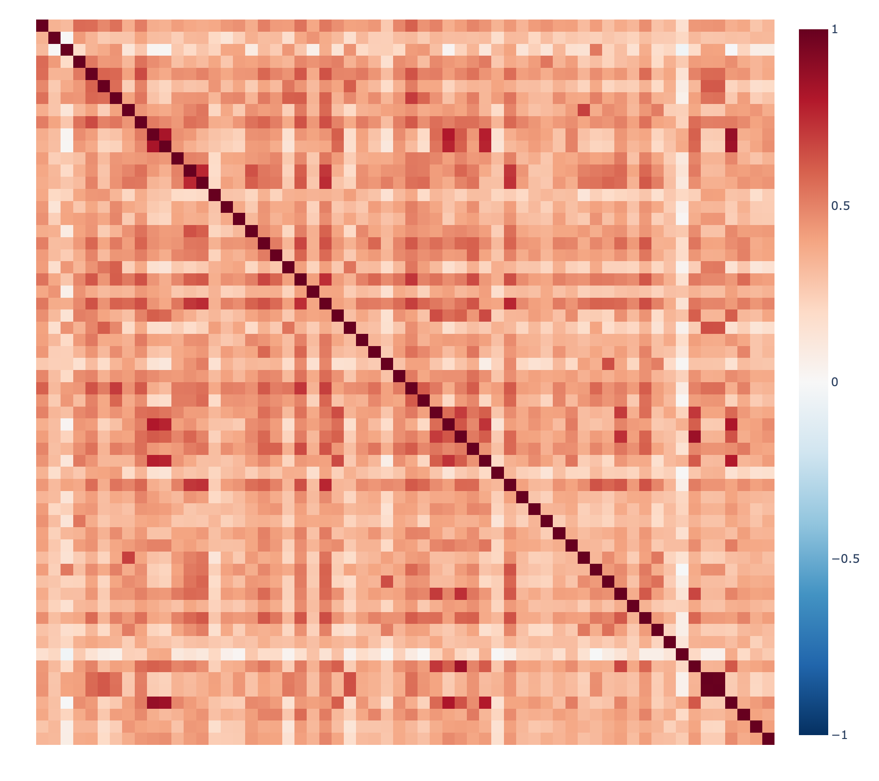
06 · EDA
Cross-stock correlation — the sector-vs-behavior gap
Even within the same period, stocks group by macro factor, not just sector
What the heatmap shows
60 stocks (~5 per sector). Red = positive correlation, blue = negative. If sectors fully explained behavior, we'd see clean diagonal blocks.
0.492
Avg within-sector corr
0.369
Avg cross-sector corr
Vishnu Peram · DATA 255 · SJSU
14 / 25

Slide 15
07 · CLUSTERING — PART 1
Three algorithms, one feature space
Same 7-D fingerprint → three different ways of finding structure
K-Means
Hierarchical (Ward)
DBSCAN
• Partition into k spherical clusters
• Pick K via elbow + silhouette
• Random_state=42 for reproducibility
• Final K = 5
• Builds a nested cluster tree
• No need to pre-specify K
• Dendrogram shows merge structure
• Cut tree at K = 5 for comparison
• Density-based — finds non-spherical clusters
• Identifies outliers as noise (label = -1)
• Useful for detecting idiosyncratic stocks
• eps = 0.9, min_samples = 5
Evaluation: silhouette (cluster quality) + ARI vs GICS sectors (do they match official labels?)
Vishnu Peram · DATA 255 · SJSU
15 / 25

Slide 16
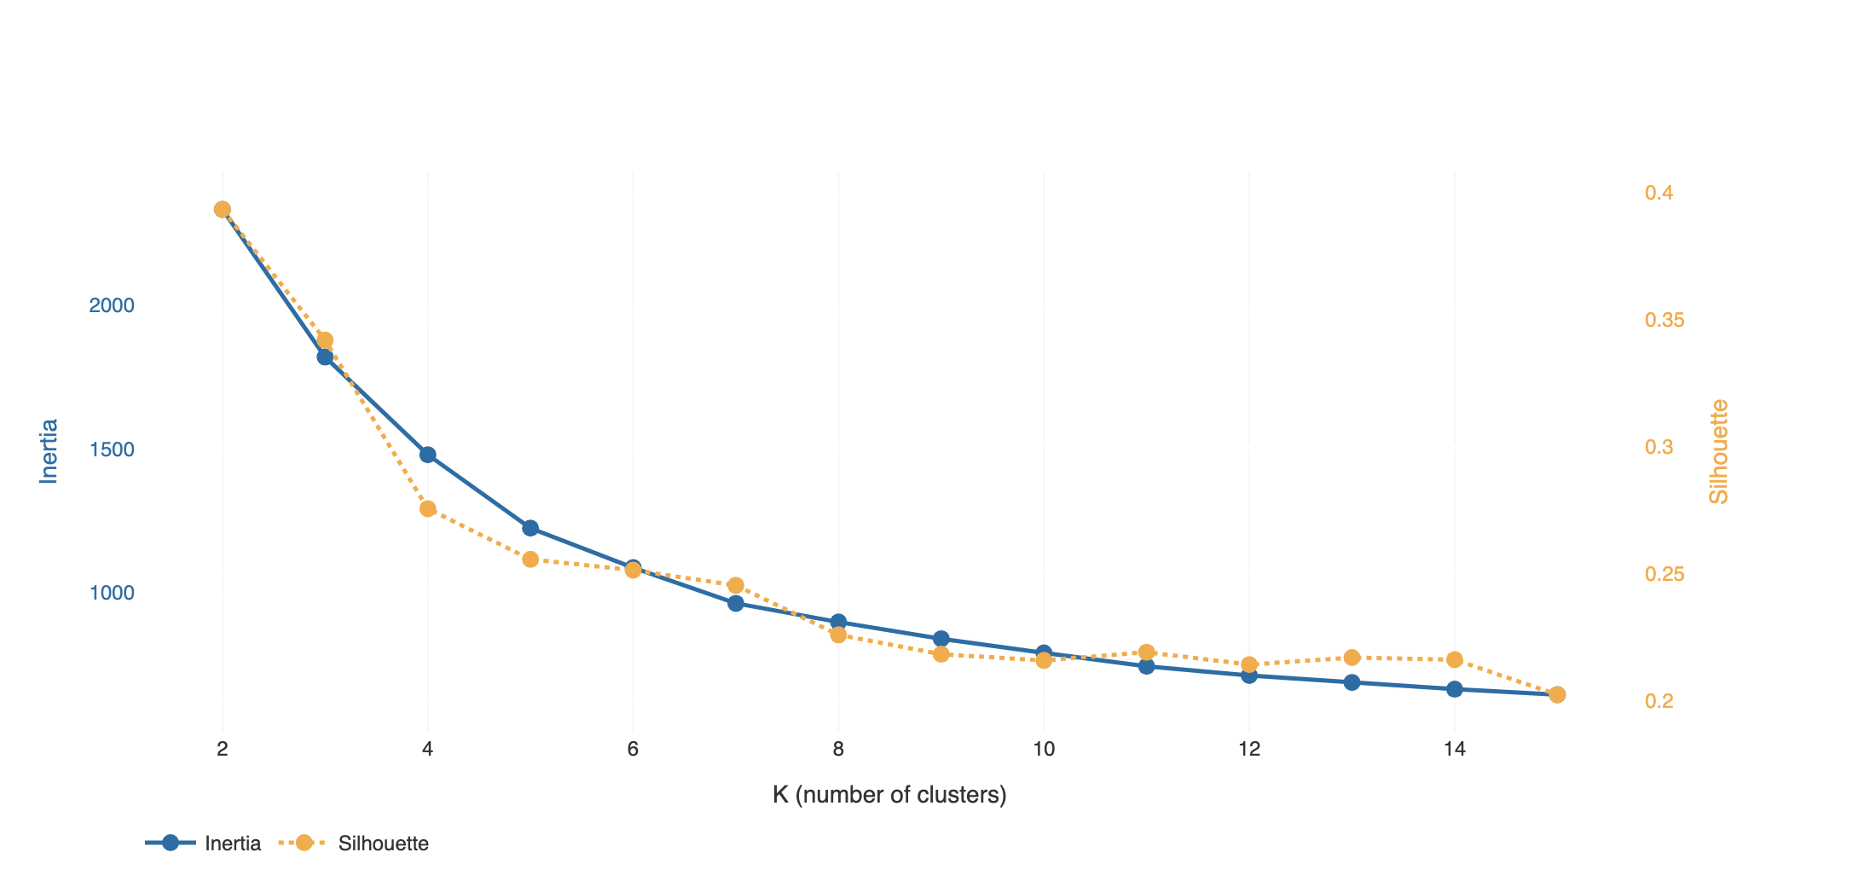
07 · CLUSTERING
Choosing K — elbow + silhouette
Silhouette peaks at K=2; we chose K=5 as an interpretability-driven compromise near the elbow
Diagnostics
K = 2
Silhouette peak (0.393)
K = 5
Chosen (silhouette 0.256)
K=2 maximizes silhouette but produces clusters too coarse for the 11-sector comparison. K=5 trades silhouette for interpretability.
Vishnu Peram · DATA 255 · SJSU
16 / 25

Slide 17
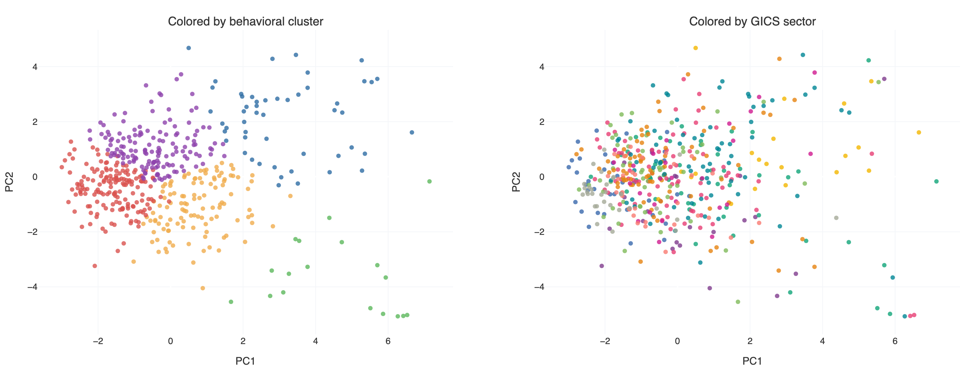
07 · CLUSTERING
PCA projection — clusters vs GICS sectors
Same 2D space, two color schemes — visual evidence of structural mismatch
PC1 explains 50.8% · PC2 explains 34.5% · combined 85.3% of variance. Clusters are clean blobs; sectors overlap substantially in this space.
Vishnu Peram · DATA 255 · SJSU
17 / 25

Slide 18
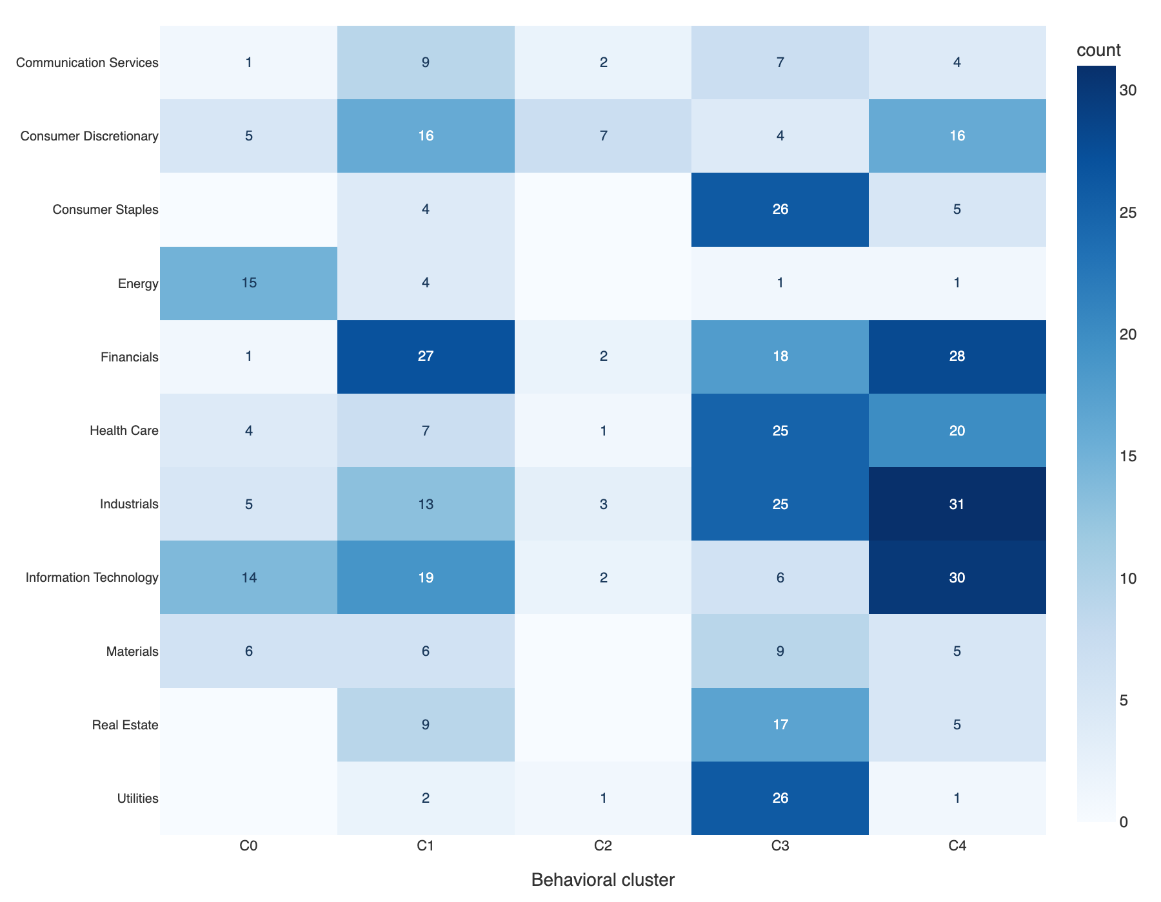
07 · CLUSTERING — KEY RESULT
Behavioral clusters do not equal GICS sectors
Adjusted Rand Index quantifies the disagreement
Adjusted Rand Index
0.045
K-Means ARI vs GICS
0.026
Hierarchical ARI
0.256
K-Means silhouette
ARI near 0 = close to random agreement · 1 = identical · can be negative for highly discordant
Vishnu Peram · DATA 255 · SJSU
18 / 25

Slide 19
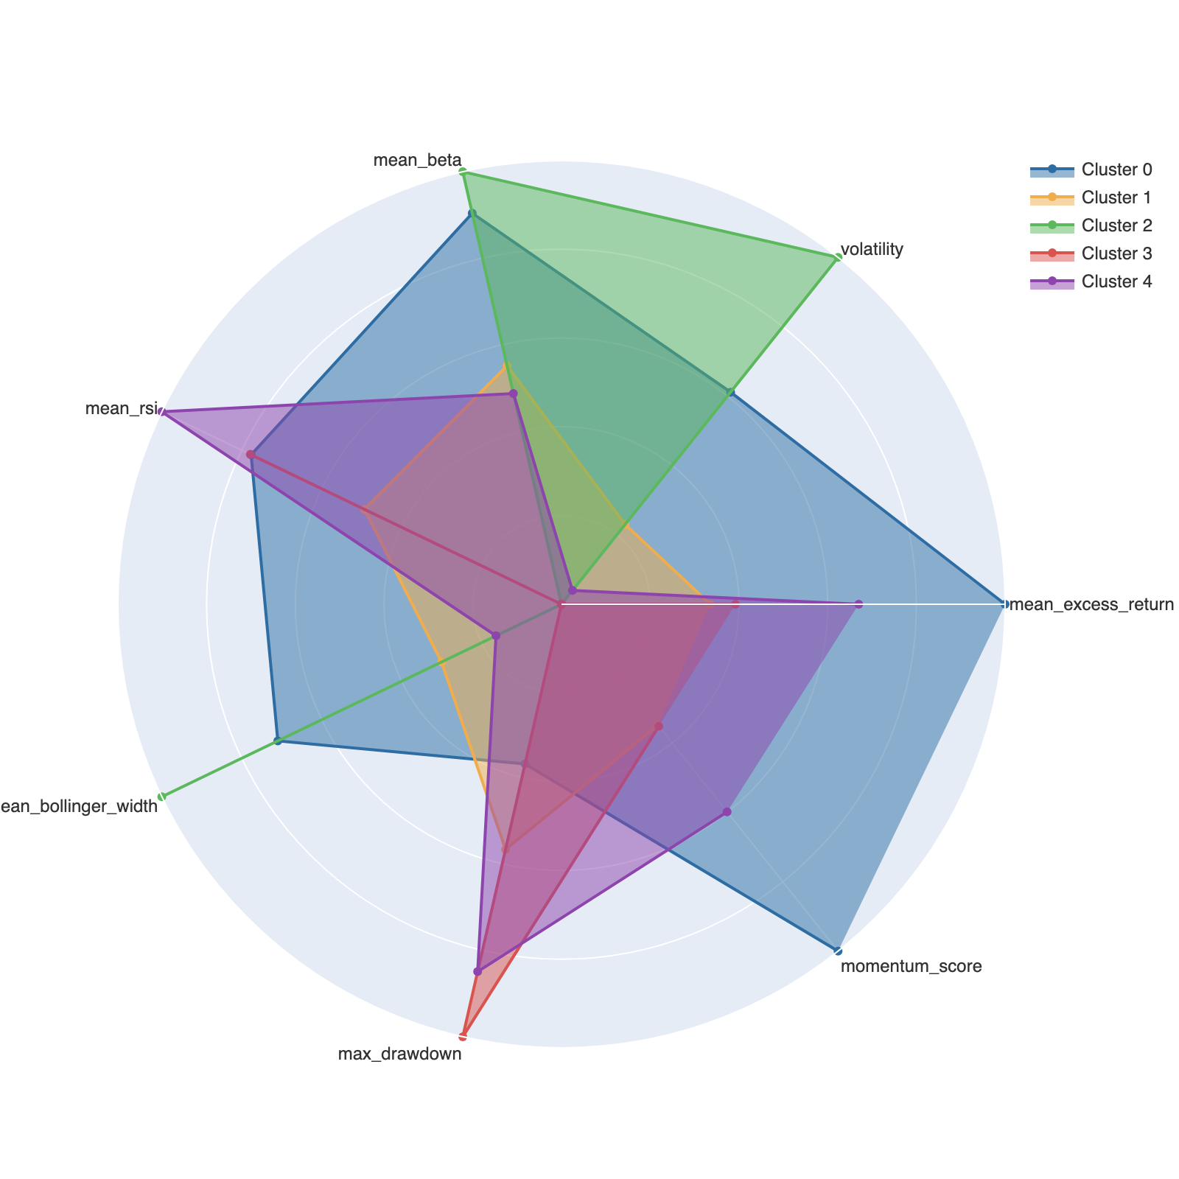
07 · CLUSTERING
What does each cluster look like?
Centroid profile reveals the behavioral archetype
Cluster sizes
C0
51 stocks
C1
116 stocks
C2
18 stocks
C3
164 stocks
C4
146 stocks
Each cluster is a risk archetype — distinct combinations of return, volatility, and trend behavior.
Vishnu Peram · DATA 255 · SJSU
19 / 25

Slide 20
08 · CLASSIFICATION — PART 2
Setup
Predict 5-day forward direction; test whether cluster label adds signal
Target
forward_5day_direction (binary)
Models
Features w/o cluster
14 technical indicators
Logistic Regression
Linear baseline — sets the predictability floor
Features w/ cluster
14 technicals + behavioral cluster label
Decision Tree (depth=8)
Interpretable non-linear model
Train
Years < 2023
Random Forest (200 trees)
Test
2023–2024 (held-out future)
Primary model — handles interactions
Split type
Temporal (no random shuffling on time series)
XGBoost (300 rounds)
Strongest model — boosted gradient trees
Naive 'always-up' baseline accuracy: 0.538 — any model must beat this meaningfully.
Vishnu Peram · DATA 255 · SJSU
20 / 25

Slide 21
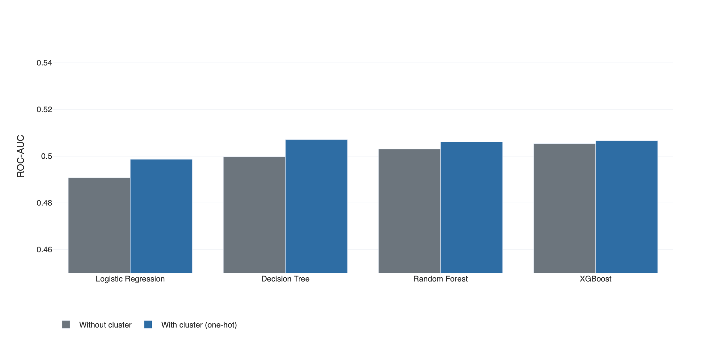
08 · CLASSIFICATION — RESULT
Model comparison: ROC-AUC with vs without cluster
Cluster label adds a small but consistent AUC lift across all 4 models
Best ROC-AUC
0.507
Decision Tree
AUC delta (avg)
+0.0049
4/4 models improved
AUC barely above 0.5 — weak ranking signal, consistent with weak-form market efficiency.
Vishnu Peram · DATA 255 · SJSU
21 / 25

Slide 22
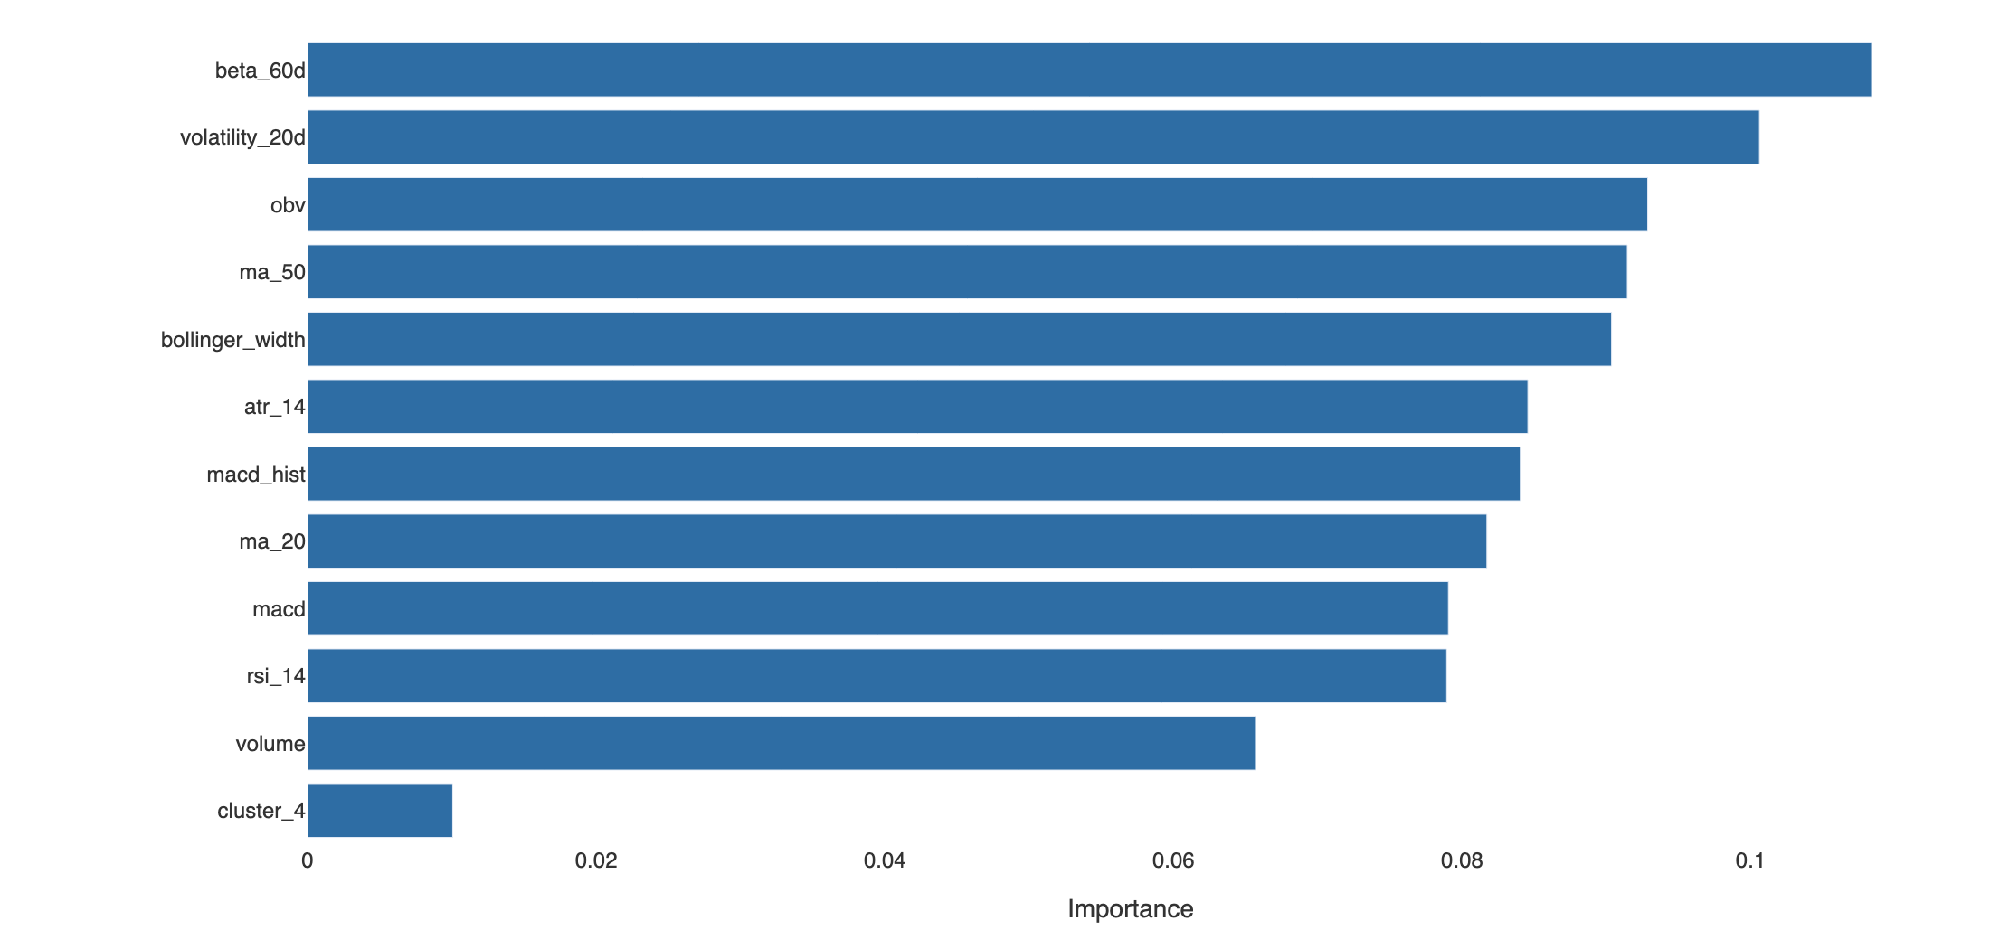
08 · CLASSIFICATION
What features drive the prediction?
Random Forest feature importance — risk, volatility, and volume dominate
Top 3 features
#1
beta_60d
importance: 0.108
#2
volatility_20d
importance: 0.101
#3
obv
importance: 0.093
Vishnu Peram · DATA 255 · SJSU
22 / 25

Slide 23
09 · RESULTS & EVALUATION
Headline numbers
What the analysis ultimately demonstrates
501
743,837
0.045
Tickers analyzed
Stock-day rows
ARI (clusters vs GICS)
0.507
0.533
0.538
Best ROC-AUC (Decision Tree)
Best accuracy
Test baseline (always-up)
Take-home
Behavioral clusters show weak alignment with GICS sectors (ARI = 0.045). Best ROC-AUC of 0.507 is slightly above random ranking, but best accuracy (0.533) is below the test baseline (0.538) — models do NOT beat the directional baseline. Consistent with weak-form market efficiency. Cluster label gives a small AUC lift.
Vishnu Peram · DATA 255 · SJSU
23 / 25

Slide 24
10 · CONCLUSIONS
Three findings that answer the research question
Finding 1
Behavioral clusters show weak alignment with GICS sectors
ARI = 0.045 (near 0 = random alignment). Clusters group stocks by risk profile (growth, defensive, cyclical) rather than industry. The official taxonomy does not capture this structural lens. RQ1 supported.
Finding 2
Models do NOT beat the naive baseline on accuracy
Best ROC-AUC = 0.507 — slightly above random ranking. Best accuracy = 0.533, BELOW the test-set always-up baseline of 0.538. Weak ranking signal exists but cannot translate into directional accuracy. Consistent with weak-form market efficiency.
Finding 3
Cluster label adds a small AUC lift
Adding one-hot encoded cluster labels changed average ROC-AUC by +0.0049. Lift is consistent but small; warrants statistical significance testing in future work before any operational use.
Vishnu Peram · DATA 255 · SJSU
24 / 25

Slide 25
11 · FUTURE WORK & 12 · DEPLOYMENT
Where next, and how it's deployed
Honest limitations + the live dashboard
Future work
Deployment
• Survivorship bias: include delisted stocks via CRSP
• Rolling-window clustering — capture regime-shifting behavior
• Multi-horizon prediction (1-day, 20-day, 60-day)
• Transaction costs + position sizing → economic Sharpe ratio
• Add fundamentals (P/E, earnings surprise) and news sentiment
• Deep models (LSTM, transformer) on raw OHLCV sequences
Streamlit Community Cloud (free tier)
Repo:
github.com/PeramVishnuSree/Stock-Behavioral-Clustering-and-Return-Prediction
Live dashboard pages:
• 📊 Data Overview
• 📈 EDA
• 🎯 Clustering
• 🔮 Prediction
• 📋 Methodology
Thank you — questions?
Vishnu Peram · DATA 255 · SJSU
25 / 25

