Slide 1

HCL TECHNOLOGIES
ATTRITION ANALYSIS AND PREDICTION IN AN IT ORGANISATION
Project Supervisor : Mr.Rajasekar.P
Name of the Student: Peravali Deepesh
Registration Number : 39110770
Branch : Computer Science and Engineering

Slide 2
Presentation Outline
Course Certificate
Introduction
Objectives
System Architecture / Ideation Map
Module / Project Implementation
Application Snapshots
Results and Discussions
Conclusions
References

Slide 3
Course Certificate

Slide 4
Introduction
This project is related to Machine learning.It mainly deals about analyzing the data and predicting.
The project we are dealing is about Attriton analysis and Prediction in an IT organization.
Employee attrition is specifically focussed on identifying why employees voluntarily leave,what might have prevented them from leaving,and how we can use data to predict attrition risk.
Most importantly,this type of employee predictive analytics can be used to help organizations understand and design interventions that will be most effective in reducing unwanted risk.

Slide 5
Objectives
The scope of the project is to analyze the attrition and prediction using Machine Learning algorithms.
From this project we can gain maximum knowledge on Machine Learning models and we can increase accuracy of regression models.
To gain complete knowledge on Python libraries and be able to use Jupiter notebook.

Slide 6
Ideation map
Importing Libraries
Loading Data
Elementary Data Analysis(EDA)
Checking Missing and Null Values
Dropping Useless Columns
Correlation
Encoding and Scaling
Data Preprocessing
Splitting into Training Set and Testing Set
Implementing Machine Algorithms
Model Evaluation
Fitting The Training Data into model
Model Deployment

Slide 7
Project Implementation
Import required Libraries and packages.
Elementary Data Analysis(EDA)
Loading the data
Displaying Head of the data
Getting the shape of the dataset
Checking missing values or null values
Finding corelation of attrition with some important attributes in the data using countplot.
Data Preprocessing
Dropping single values or useless coloumns and id values.

Slide 8
Project Implementation
Creating dummy variables and concatenating
Using binary encoding converting categorical data into numerical data like gender and attrition.
Using ordinal encoding converting the categorical data of BusinessTravel into numerical data.
Using OneHotEncoding converting categorical data which are having more than three object data into numerical data.
Splitting the data into x and y.
Y as Attrition and X as other than Attrition coloumn.
And training and testing the splitted data.
Scaling the trained and tested data to check maginitude of the data.

Slide 9
Project Implementation
Model Evaluation
Implementing Machine Learning Models.
Fitting the trained data into the model and checking whether the model is trained.
Model Deployment
Getting the model scores.

Slide 10
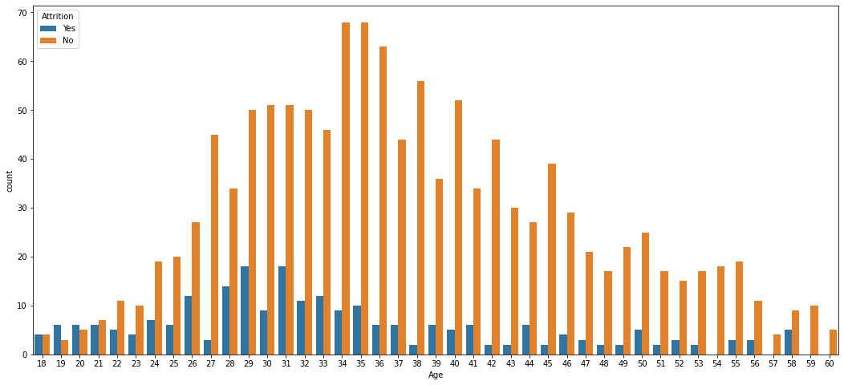
Application snapshots
Attrition vs Age

Slide 11
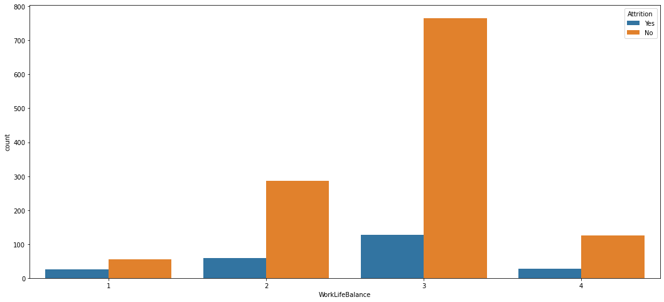
Attrition vs WorkLife

Slide 12
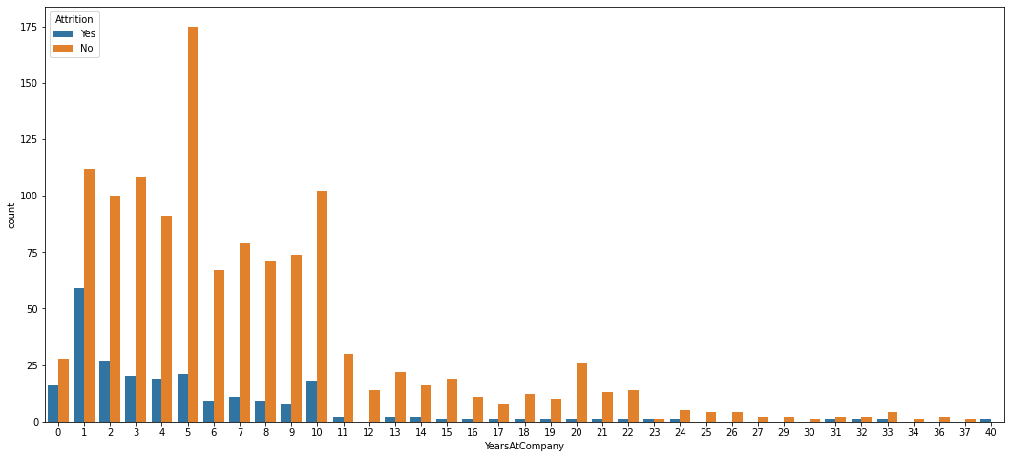
Attriton vs Years At Company

Slide 13
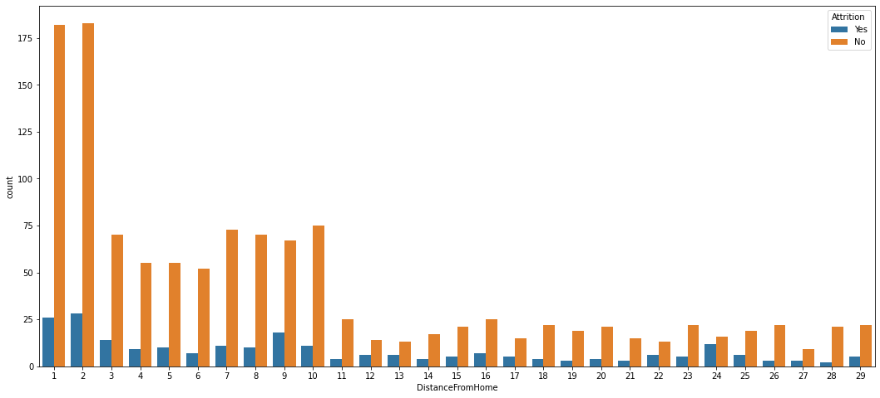
Attrition vs distancefromhome

Slide 14
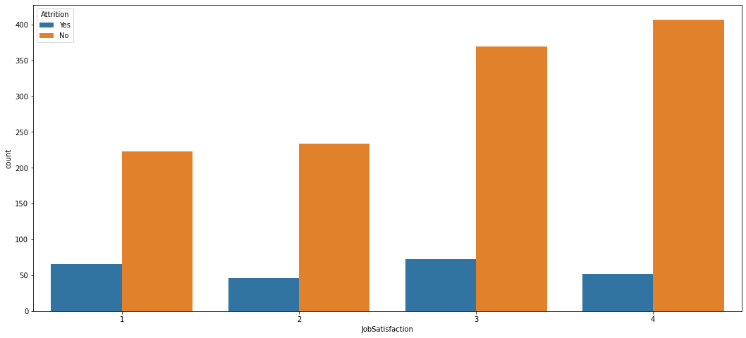
Attrition vs JobSatisfaction

Slide 15
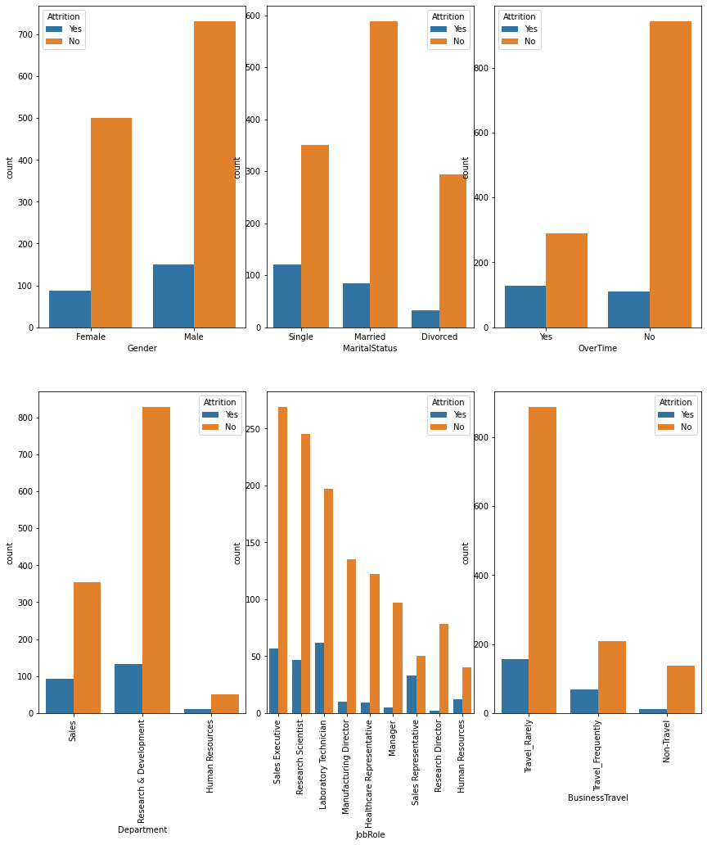
Attrition vs Categorical Data

Slide 16
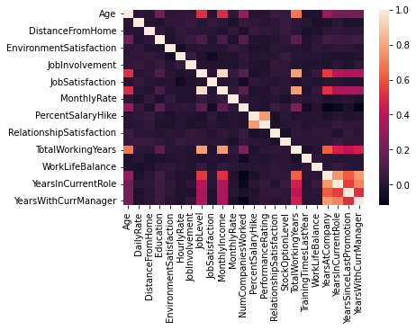
Corelation between Attributes

Slide 17
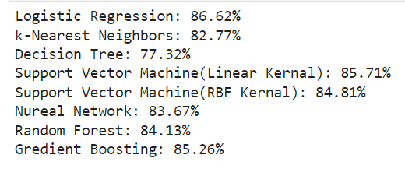
Results

Slide 18
Conclusion
In conclusion,we’ve done the analysis of attrition and prediction using several Machine Learning Algorithms.And we got the scores of the models.The highest score is the better model to predict.

Slide 19
References
Qiao, Zihan. (2020).Attrition analysis and prediction on machine learining algorithms. 76-79. 10.1109/MLBDBI51377.2020.00020
Xie, Han & Li, Chaoyi & Ding, Ning & Gong, Changrui. (2021). Attrition analysis Based On Machine Learning model. 366-369. 10.1109/ICEKIM52309.2021.00087
Saraswathi, K. & Renukadevi, N. & Nandhinidevi, S. & Gayathridevi, S. & Naveen, P.. (2021). Attrition prediction using machine learning approaches. AIP Conference Proceedings. 2387. 140038. 10.1063/5.0068655.
https://www.kaggle.com/search?q=Attrition+Analysis+prediction

