Slide 1
Imitator: Direct Prediction of Gemma Token IDs for Language-Model-Assisted Sign Transcription
Christian Velasquez Borasino, Giorgio Mancusi Barreda, Rody Vilchez Marin
Universidad Peruana de Ciencias Aplicadas (UPC), Lima, Peru
Oral Session 10 · Paper ID 58
Notes:
Good morning. I am Christian Velasquez, from UPC, presenting joint work with Giorgio Mancusi and Rody Vilchez. The question behind this paper is simple: how should a small sign-language model talk to a large language model? Let me start with why that is the hard part.

Slide 2
Sign-to-text needs a bridge between vision and language
See the signs
motion → linguistic evidence
(video → 2D keypoints)
Interface ?
what should the visual model
hand to the language model?
Write the language
pretrained LLMs already
turn tokens into fluent text
Sign-to-text needs a bridge between vision and language
Bridges explored so far
Pseudo-gloss pretraining (Sign2GPT) · hierarchical sign tokens (SignLLM)
Separate visual and language learning (FLa-LLM)
In speech: continuous prompts and CTC token embeddings (Wav2Prompt, LegoSLM)
Notes:
Turning signing into text needs two skills. First, seeing: extracting linguistic evidence from motion. Second, writing: turning that evidence into language. Large language models are already very good at the second part. The open question is the bridge: what exactly should a visual model hand to the language model? Several answers exist: pseudo-glosses as in Sign2GPT, hierarchical sign tokens as in SignLLM, or keeping visual and language learning separate. In speech, systems pass continuous prompts or token embeddings. [pause] Our own first answer was this.

Slide 3
Our first Imitator imitated the LLM's input embeddings
2D keypoints
sign video
Small visual model
lightweight
ST-GCN encoder
Vectors ≈ embeddings
close to the frozen
LLM's embeddings
Frozen LLM
reads the vectors
as its input
Our first Imitator imitated the LLM's input embeddings
Premise: a compact model learns the input language of a frozen LLM
Trained with MSE + cosine distance; reported loss ≈ 8×10⁻⁴ (preliminary)
Open question: does the LLM read those vectors as the intended words?
Notes:
In our earlier, published Imitator, a small visual model read 2D keypoints and produced continuous vectors meant to sit close to the frozen LLM's own input embeddings. The idea is that a compact model can learn the input language of a large one. Training used mean-squared and cosine distance, and the preliminary loss was very low, about 8 times 10 to the minus 4. But a low loss leaves one question open: does the LLM actually read those vectors as the intended words?

Slide 4
Close to the right embedding is not the right token
Limits of embedding imitation
A nearby vector may not be the intended token, especially in anisotropic spaces
No exact way to check what the LLM receives
Splits were not signer-exclusive
This work: predict the token IDs
Keypoints → exact Gemma tokenizer IDs + EOS
Correct only if every ID matches: measurable, falsifiable
Gemma 3n receives ordinary text tokens
Notes:
And the answer is: not necessarily. Being geometrically close does not guarantee the intended token, especially because these embedding spaces are anisotropic. There was also no exact way to check what the LLM received, and the splits were not signer-exclusive. So in this work we keep the premise, but we predict the exact Gemma token IDs. A prediction is right only if every ID matches, and Gemma receives ordinary text. [pause] Let me show the pipeline.

Slide 5
Imitator writes exact Gemma IDs; Gemma only reads text
Imitator · scored on its own: strict accuracy, edit similarity
Audited separately
2D keypoints
111 per frame
(pose, face, hands)
Visual encoder
ST-GCN + temporal conv
+ Transformer
+ positional encoding
Token decoder
2-layer causal
Transformer
121-row softmax
Exact Gemma IDs
content IDs
+ EOS
Gemma 3n
E2B, frozen;
reads IDs as text
Imitator writes exact Gemma IDs; Gemma only reads text
No 64-class gloss classifier at inference (targets still come from LSA64 labels)
121 output rows map one-to-one back to the original Gemma IDs
Transcription is scored before the LLM, so fluent output cannot hide visual errors
Notes:
From 2D keypoints, 111 per frame, a spatial-temporal graph encoder with positional encoding builds visual memory. A small causal Transformer decoder emits Gemma IDs until end-of-sequence. The task uses 118 Gemma content IDs, so the output layer has 121 rows that map one-to-one back to the real IDs. Important: we score this transcription on its own, before Gemma, so a fluent LLM cannot hide a visual error. Gemma 3n is frozen and audited separately. Next, how we evaluated it.

Slide 6
Test signers are unseen; confirmation was preregistered
Data: LSA64
3,200 videos · 64 signs · 10 signers
Streams of 2–8 isolated clips, random order
Target: Gemma tokens of the Spanish labels
Random order blocks a language shortcut — but there is no syntax to exploit either
Leave-one-signer-out folds
1
2
3
4
5
6
7
8
9
10
development
confirmation
reserved
Preregistered, on each confirmation signer:
H1 beat historical CIF (sign test p < .01)
H2 strict accuracy ≥ 11.9%
H3 label order ≥ .90 and permutation drop ≥ .15
Notes:
We use LSA64: 64 Argentinian signs, ten signers. We build streams of two to eight clips in random order, and the target is the Gemma tokenization of their Spanish labels. Random order prevents a language shortcut, but it also means there is no syntax. Every fold leaves one signer out. Folds 1 to 6 were for development, 7 and 8 were held back for confirmation, and before testing them we registered three criteria: beat the historical CIF model, reach 11.9 percent strict accuracy, and show that output order follows the video. First, development.

Slide 7
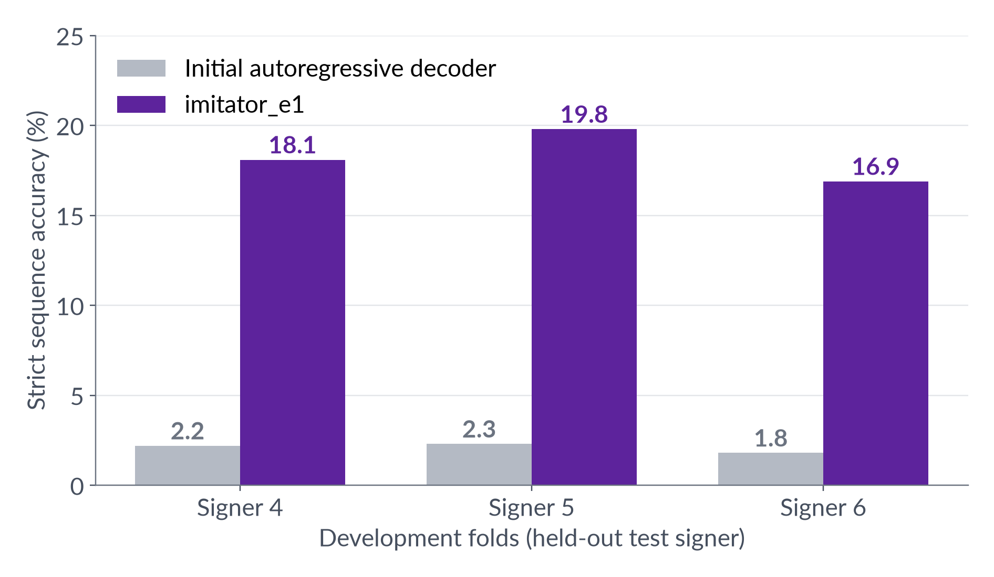
Token IDs raise strict accuracy ~10× on development signers
Key result
16.9–19.8%
strict accuracy
(initial decoder: 1.8–2.3%)
Positional encoding: label order goes from chance to ≈ 0.99
Viable, not solved: most sequences still contain ≥ 1 error
Notes:
On the development signers, strict accuracy, meaning the whole sequence exactly right, goes from about 2 percent with our initial autoregressive decoder to 17 to 20 percent. Roughly ten times. Adding positional encoding moved pairwise label order from chance to about 0.99. But to be clear: most sequences still have at least one error. It is viable, not solved. [pause] Does it hold on new signers?

Slide 8
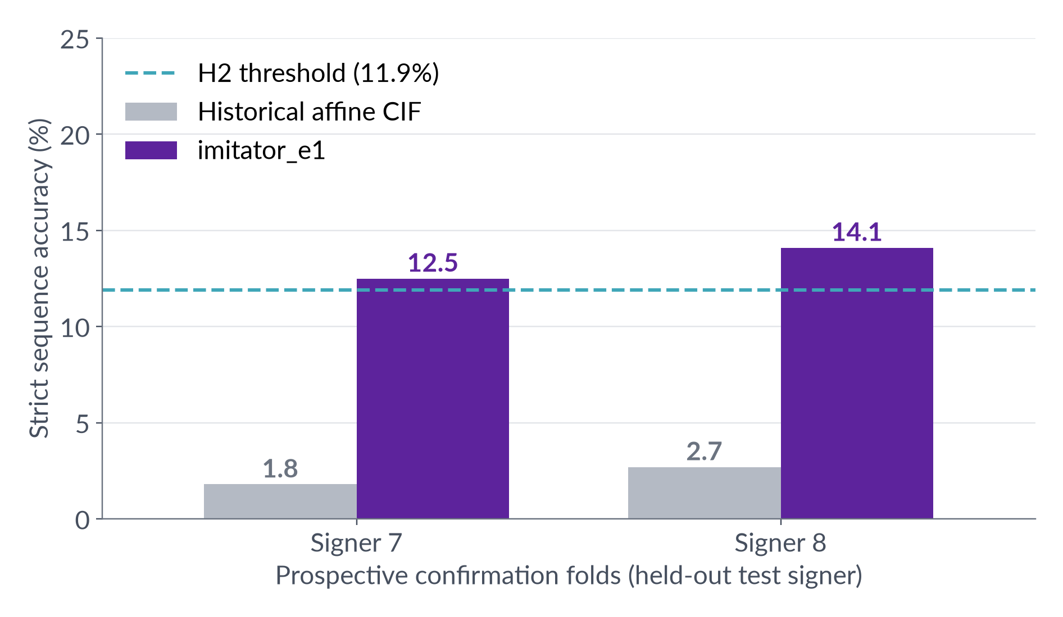
Both held-out signers pass all three preregistered criteria
H1 ✓ beats CIF
wins/losses 99/3 and 108/6
H2 ✓ ≥ 11.9%
12.5% and 14.1% strict accuracy
H3 ✓ visually ordered
label order 0.98–0.99; shuffling segments drops edit similarity by 0.34–0.38
Notes:
On the two signers we had never touched, imitator_e1 reaches 12.5 and 14.1 percent, above the pre-registered 11.9 threshold, against 1.8 and 2.7 for CIF. Paired, it wins 99 times and loses 3 on signer 7, and 108 to 6 on signer 8. Edit similarity is 53 and 59 percent. And if we shuffle the sign segments while keeping the target, edit similarity drops by about 0.35: the order really comes from the video. All three criteria pass. Now the second half: can Gemma fix the remaining errors?

Slide 9
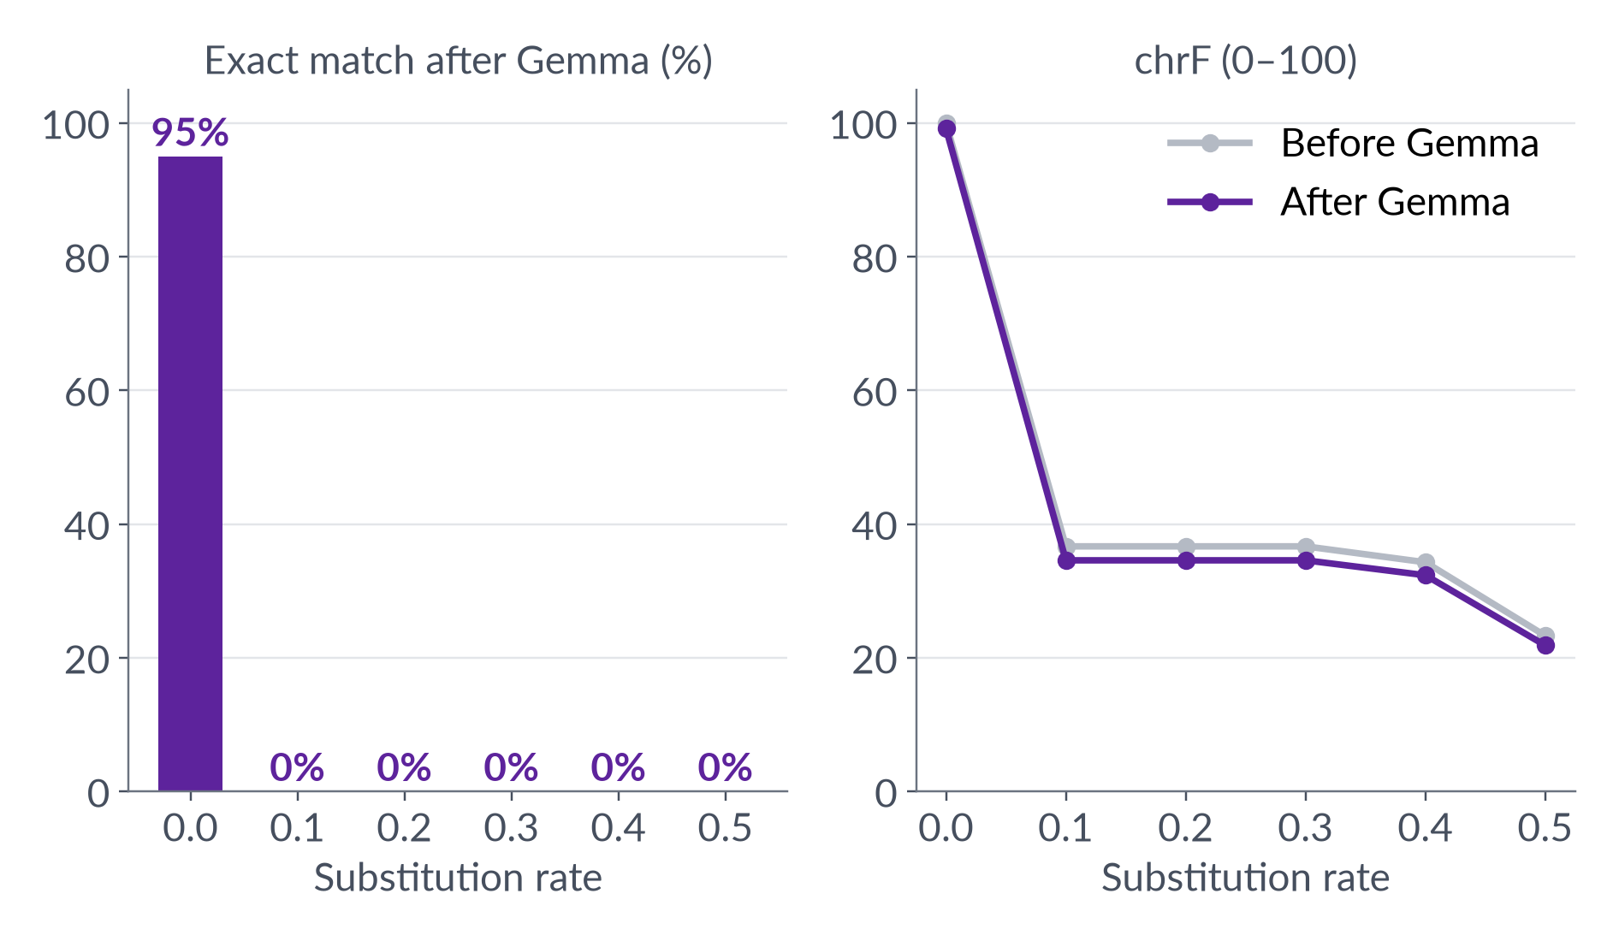
Without sentence context, Gemma cannot repair substitutions
Negative result
Clean input: 95% kept exact
Any substitution: 0% exact, before and after Gemma
chrF drops 0.8–2.1 points
“photo” → “green”: isolated labels leave nothing to infer from
Notes:
We corrupted gold token sequences by replacing whole labels and asked Gemma 3n to correct them, 120 rows per rate. With clean input Gemma keeps 95 percent exact. With any substitution, exact match is zero before and zero after, and chrF actually goes down slightly. The reason is structural: if 'photo' became 'green' in a list of random signs, nothing tells you it was 'photo'. So this is not evidence that LLMs cannot correct signs; it shows our data has no context to correct with.

Slide 10
Exact IDs make the bridge measurable; correction needs context
What we showed
Exact Gemma IDs replace approximate embeddings with a checkable contract
Unseen signers: 12.5–14.1% strict accuracy, ordered by the video
Isolated labels give Gemma nothing to correct
Limits → next step
One seed (23), synthetic LSA64 streams, two confirmation signers
Next: preregistered sentence corpus with real context
Pass top-k / posterior alternatives, still scoring the transcript
Notes:
To summarise: predicting exact token IDs turns the bridge into something we can measure. On unseen signers it gives 12 to 14 percent fully correct, visually ordered sequences. And correction needs context that isolated labels do not have. Limits: one training seed, synthetic streams and two confirmation signers. Next, we want a pre-registered sentence corpus, and passing top-k alternatives to the LLM while still scoring the transcript.

Slide 11
Thank you · Questions?
Christian Velasquez Borasino
Universidad Peruana de Ciencias Aplicadas (UPC) · Paper ID 58
Notes:
Thank you. I am happy to take questions.

Slide 12
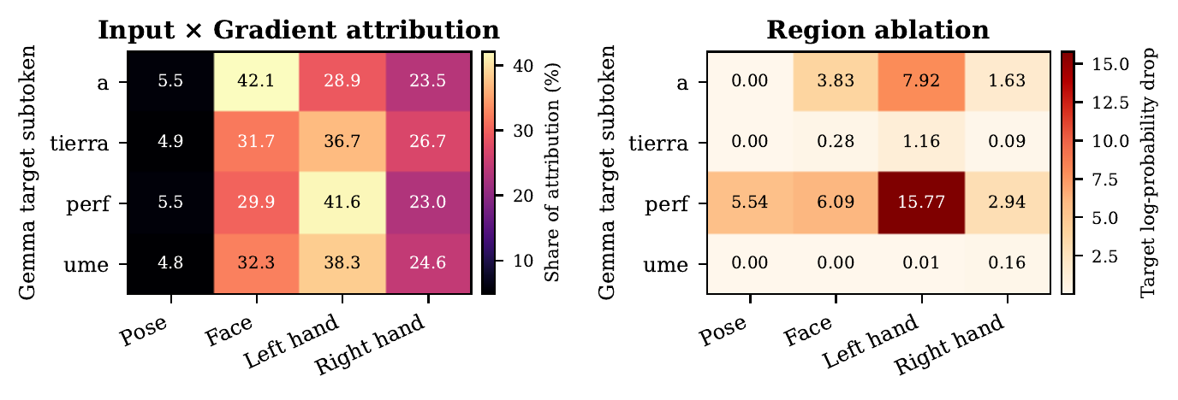
Backup · Left hand drives the central subtokens (one example)
Signer 7, “A tierra / Perfume”
Left hand: 28.9–41.6% of attribution
Largest ablation loss for “a” and “perf” (7.92, 15.77 log-prob)
One example: descriptive, not population-level
Notes:
Backup for questions on interpretability. For one unseen-signer sequence, input-times-gradient and region ablation both point to the left hand for the central subtokens. It is a single example, so it is descriptive, not a dataset-wide claim.

