Slide 1
Perception
A game based on using what you perceive to overcome challenges
Stephen MacDonald
Zach Curll
Laura Amoroso
Zack Reynolds

Slide 2
What is Perception?
Perception is a game based on a simple concept: What if the way you perceived an object had an effect on its size?
With this logic, you could hold a far off car between your fingers or resize a nearby piece of cake to be triple the size!
This is the concept that inspired this game.

Slide 3
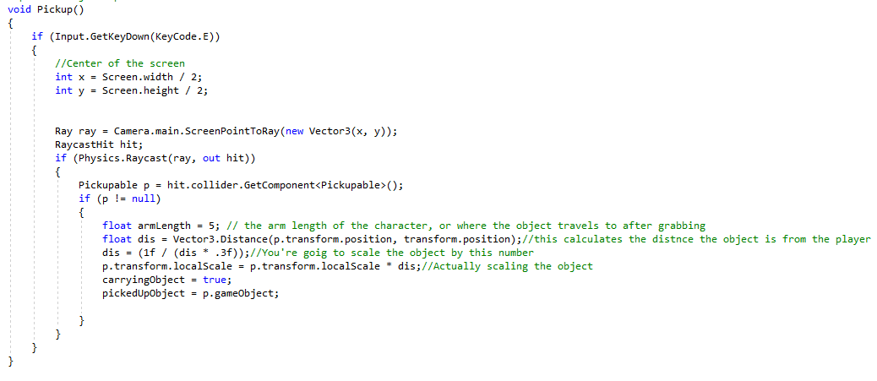
Algorithm for picking up Objects

Slide 4
Controls
W, A, S, D or arrow keys: to move forward, left, right, and backwards
E: to pick up and drop objects
Space: jump
Shift: run
P: pause

Slide 5
Video
https://www.youtube.com/watch?v=qjLbULsqy-U&t=3s

Slide 6
Biggest Issues
Unity compatibility with Github: It took many trials and errors to learn how to push unity game files to Github. We overcame this by using a gitignore file.
Player picking up objects: This aspect of the game had many factors. Not only did we struggle getting the objects to rescale properly, we consistently had to improve the code. For instance, we went back to this code to disable gravity on an affected object to stop it from clipping downwards.

