Slide 1


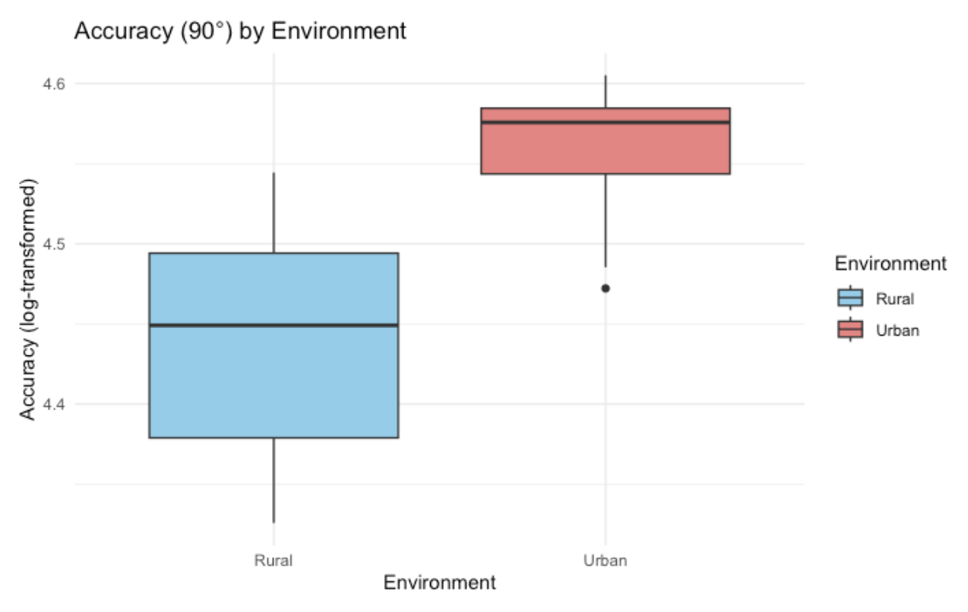
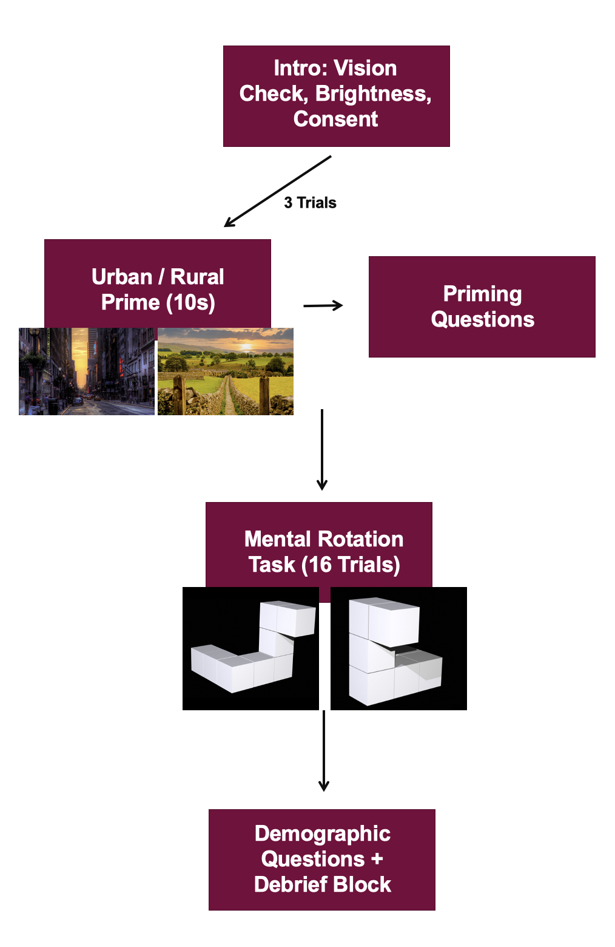


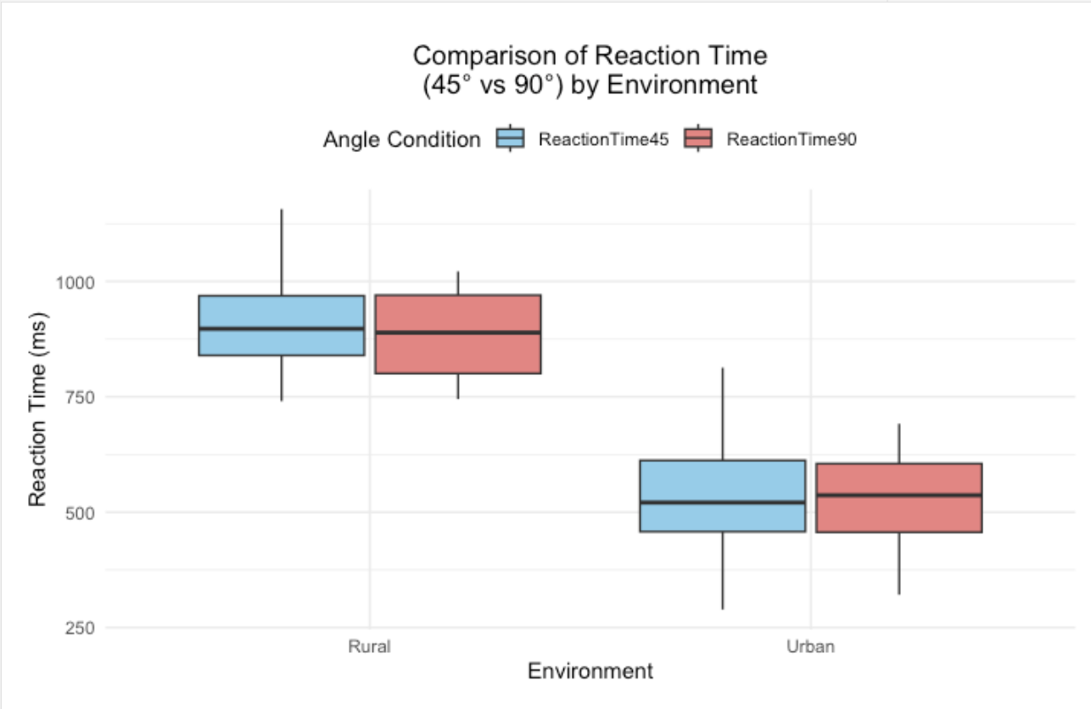

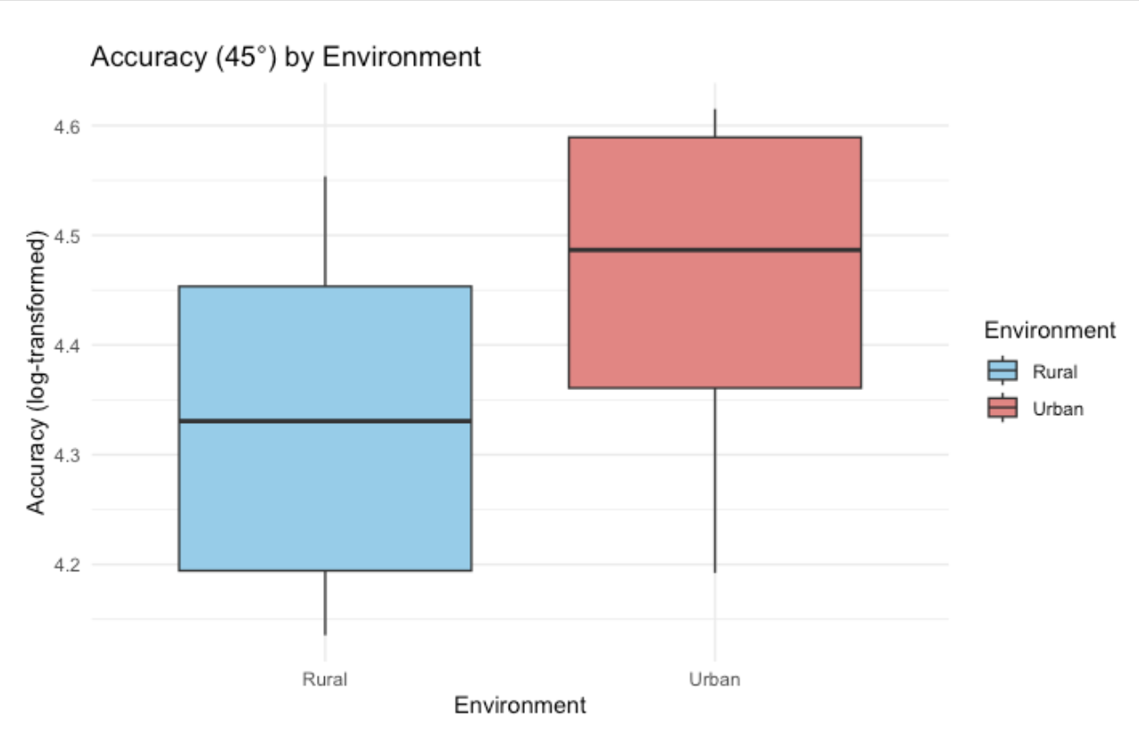

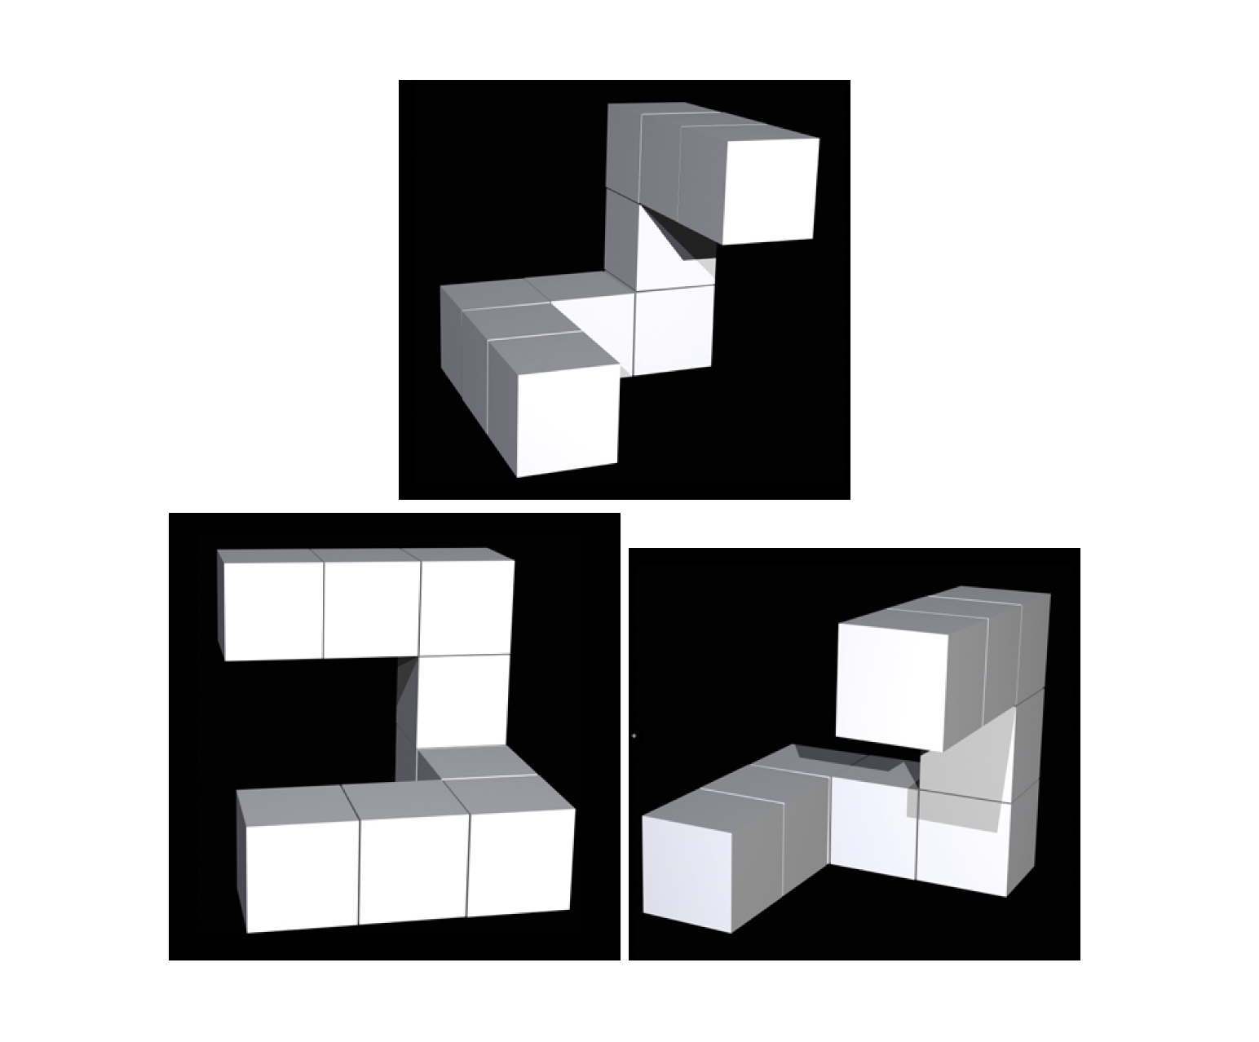


Effects of Urban and Rural Environments on Mental Rotation
Fatema Mala
Background
Methods
Results
Perception and spatial cognition are influenced by environmental experiences.
Urban and rural environments shape visual perception differently:
Rural individuals are more susceptible to perspective illusions.
Urban individuals are more affected by horizontal-vertical illusions (Hagen, 1977).
Environmental context affects spatial processing and cognitive abilities across the lifespan (Hirst et al., 2022; Saenz et al., 2022).
Reaction Time: Urban-primed participants responded significantly faster than rural-primed participants across both 45° and 90° angles.
Accuracy: Significant differences in accuracy were found between Urban and Rural environments at both angles.
Rotation Angle Effect:
No significant interaction between rotation angle and environment, but Urban participants showed higher accuracy and reaction time overall.
Figure 5: Accuracy (90°) by Environment: Boxplot with error bars demonstrating a highly significant accuracy difference at 90°, with urban-primed participants outperforming rural-primed participants
Conclusions
Hypothesis supported: Urban-primed participants responded faster than rural-primed participants.
Unexpected finding: Urban-primed participants also showed higher accuracy
Maybe due to urban environemnts being visually dense → need to recognize patterns and align objects correctly
Environmental context affected performance regardless of rotation angle.
Implications: Exposure to urban environments enhances spatial perception and cognition → can have implications on navigation and wayfinding
Research Gap + Objective
Figure 1: Study Methods Flow Chart
Limited research explores how environmental context influences mental rotation.
This study investigates whether priming with urban vs. rural imagery affects reaction time and accuracy in 45° and 90° rotations.
Hypothesis: Urban-primed participants will respond faster than rural-primed participants, but accuracy will not significantly differ between groups.
34 participants
Participants were primed with images of either urban or rural environments.
They completed a mental rotation task (judging if two rotated images were the same)
Rotations tested at 45° and 90°.
Reaction time (ms) and accuracy (%) recorded.
Figure 3: Reaction Time (45° vs 90°) by Environment: Boxplot with error bars showing reaction times for 45° and 90° rotations across environments. Urban-primed participants responded significantly faster.
Limitations & Future Studies
Figure 2: Mental Rotation Trial Example Top image is the reference image. Bottom left is the incorrect image rotation. Bottom right is the correct 45° rotation.
Developmental environment could have impacted study
Priming strength: more immersive priming methods (e.g., VR simulations) could enhance effects.
Exploring other spatial tasks such as navigation and depth perception.
Figure 4: Accuracy (45°) by Environment: Boxplot with error bars illustrating significantly higher accuracy at 45° in the urban environment compared to the rural environment.

