Slide 1
Team #44: Object Segmentation
3 March 2016 Presentation

Slide 2
NUC PCL Performance Problems

Slide 3
Voxel Filter Data

Slide 4
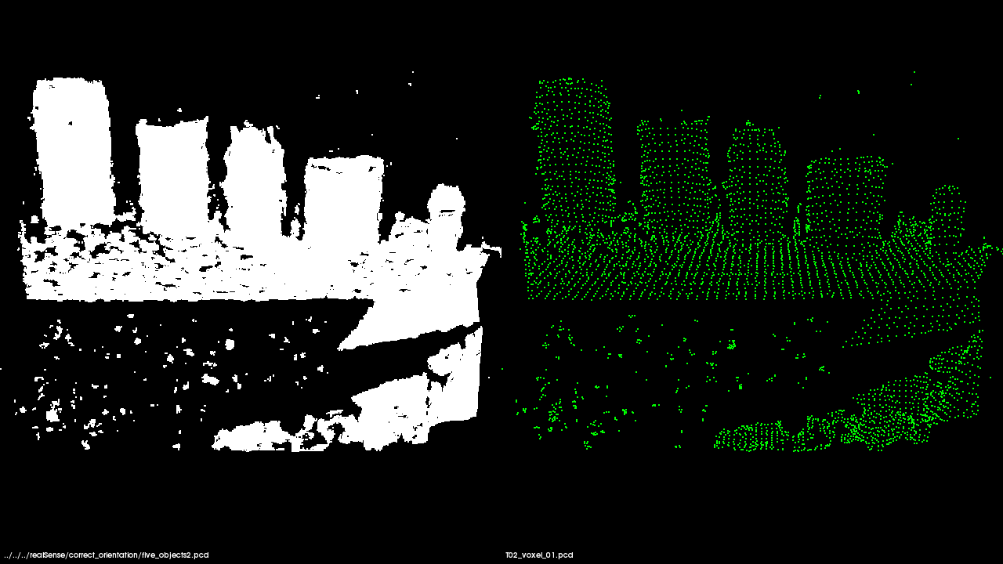
Voxel Filter Output
172800 data points 4620 data points
Leaf Size = 1 cm
Time = 34 ms

Slide 5
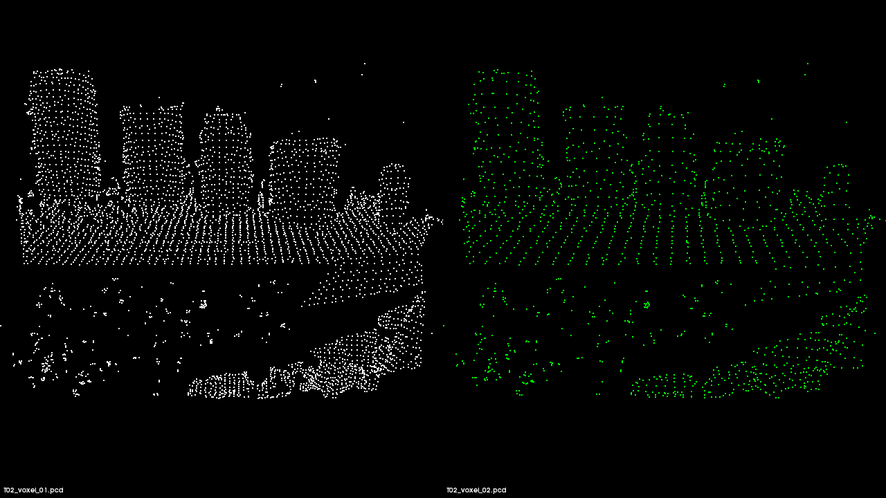
Voxel Filter Output
4620 data points 1153 data points
Leaf Size = 2 cm
Time = 7 ms

Slide 6
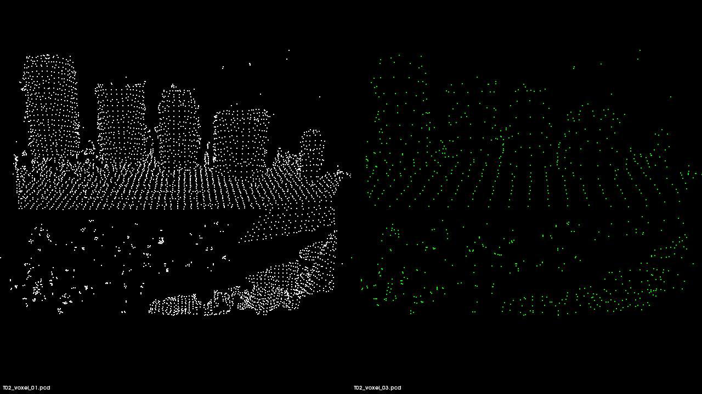
Voxel Filter Output
4620 data points 823 data points
Leaf Size = 3 cm
Time = 7 ms

Slide 7
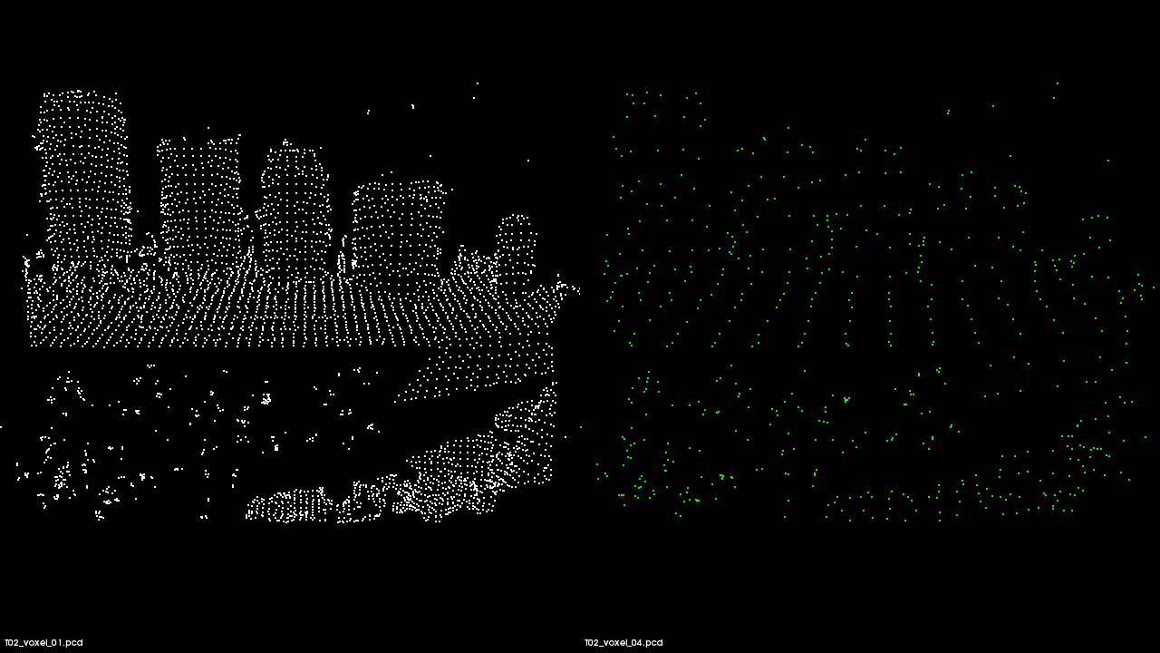
Voxel Filter Output
4620 data points 591 data points
Leaf Size = 4 cm
Time = 7 ms

Slide 8
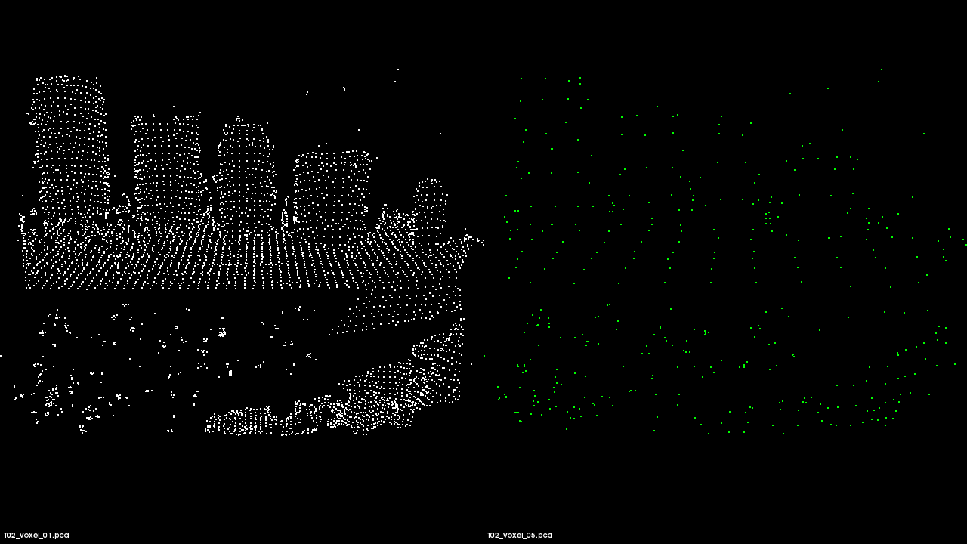
Voxel Filter Output
4620 data points 407 data points
Leaf Size = 5 cm
Time = 7 ms

Slide 9
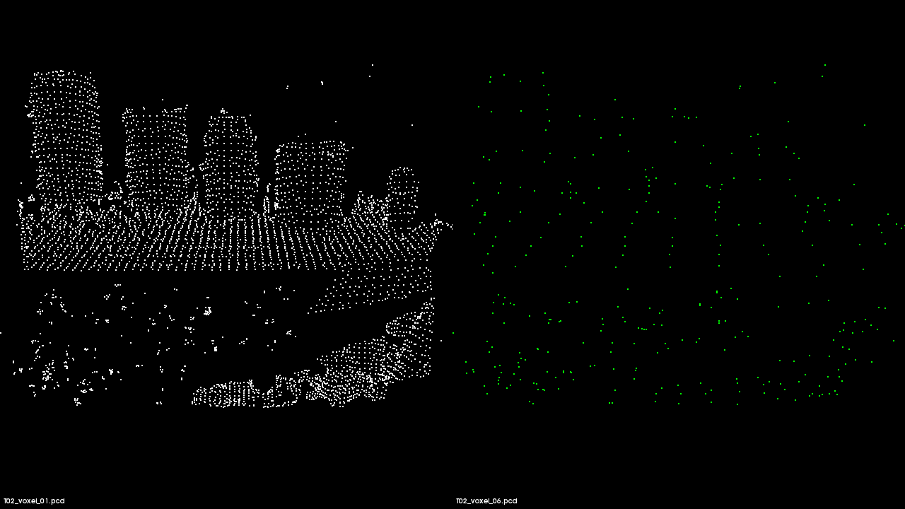
Voxel Filter Output
4620 data points 331 data points
Leaf Size = 6 cm
Time = 7 ms

Slide 10
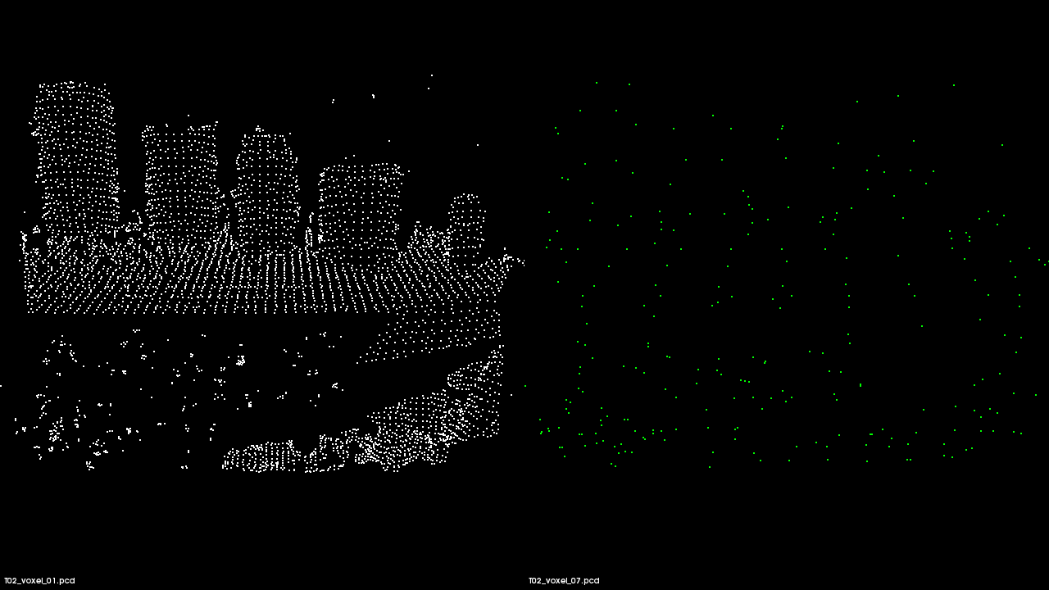
Voxel Filter Output
4620 data points 264 data points
Leaf Size = 7 cm
Time = 3 ms

Slide 11
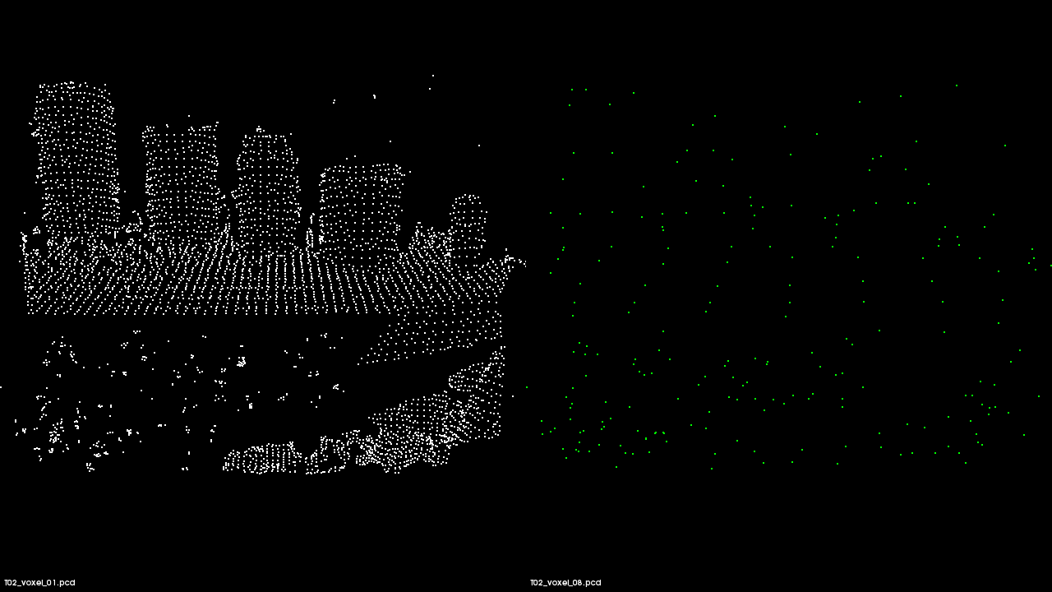
Voxel Filter Output
4620 data points 226 data points
Leaf Size = 8 cm
Time = 2 ms

Slide 12
Noise Removal Data: Nearest Neighbors
Standard Deviation = 1.0

Slide 13

Noise Removal Filter: Nearest Neighbors
828 data points removed
Std. Deviation = 1.0
Neighbors = 10
Time = 259 ms
This test altered the number of nearest neighbors to be analyzed while keeping standard deviation constant.
Red shows outliers
Function:
c44::removeNoise()

Slide 14
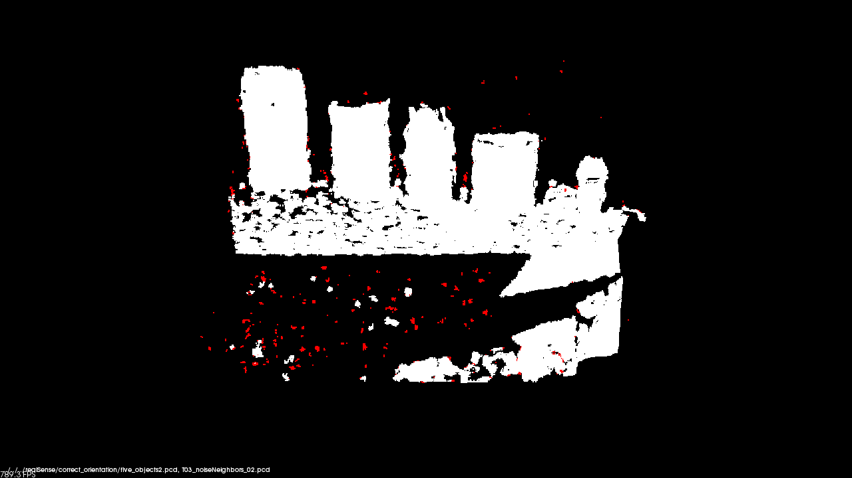
Noise Removal Filter: Nearest Neighbors
1016 data points removed
Std. Deviation = 1.0
Neighbors = 20
Time = 253 ms
This test altered the number of nearest neighbors to be analyzed while keeping standard deviation constant.
Red shows outliers
Function:
c44::removeNoise()

Slide 15

Noise Removal Filter: Nearest Neighbors
1209 data points removed
Std. Deviation = 1.0
Neighbors = 30
Time = 266 ms
This test altered the number of nearest neighbors to be analyzed while keeping standard deviation constant.
Red shows outliers
Function:
c44::removeNoise()

Slide 16

Noise Removal Filter: Nearest Neighbors
1336 data points removed
Std. Deviation = 1.0
Neighbors = 40
Time = 375 ms
This test altered the number of nearest neighbors to be analyzed while keeping standard deviation constant.
Red shows outliers
Function:
c44::removeNoise()

Slide 17

Noise Removal Filter: Nearest Neighbors
1386 data points removed
Std. Deviation = 1.0
Neighbors = 50
Time = 427 ms
This test altered the number of nearest neighbors to be analyzed while keeping standard deviation constant.
Red shows outliers
Function:
c44::removeNoise()

Slide 18

Noise Removal Filter: Nearest Neighbors
1573 data points removed
Std. Deviation = 1.0
Neighbors = 100
Time = 837 ms
This test altered the number of nearest neighbors to be analyzed while keeping standard deviation constant.
Red shows outliers
Function:
c44::removeNoise()

Slide 19
Noise Removal Data: Standard Deviation
Nearest Neighbors = 50

Slide 20
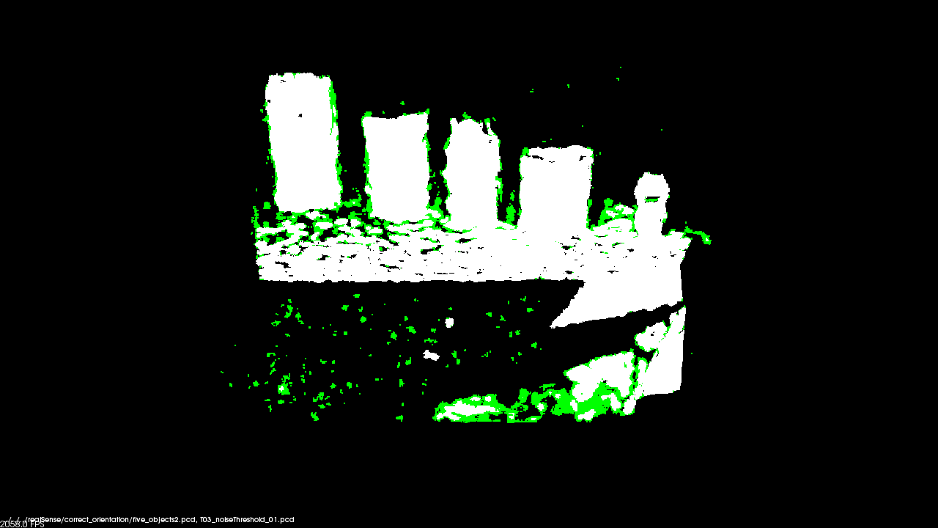
Noise Removal Filter: Standard Deviation
8341 data points removed
Std. Deviation = 0.1
Neighbors = 50
Time = 430 ms
This test altered the standard deviation while keeping the number of neighbors to be analyzed deviation constant.
Green shows outliers
Function:
c44::removeNoise()

Slide 21
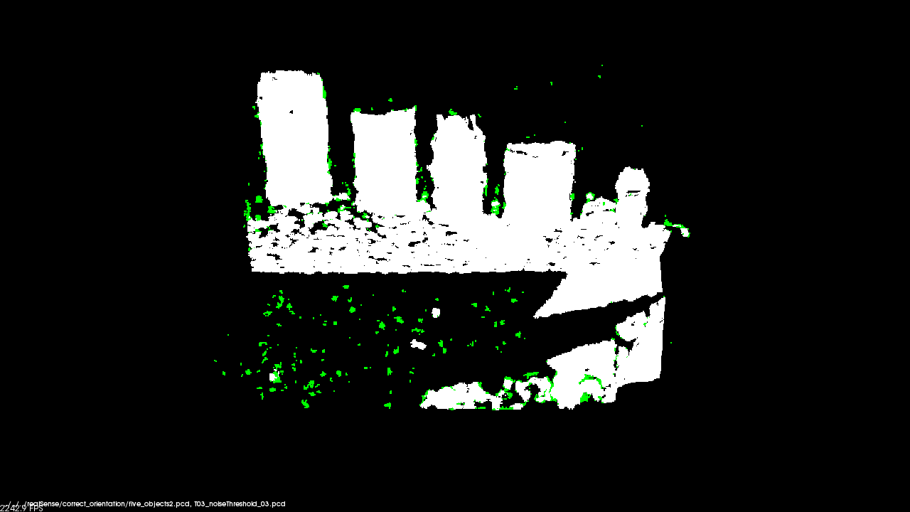
Noise Removal Filter: Standard Deviation
2598 data points removed
Std. Deviation = 0.5
Neighbors = 50
Time = 426 ms
This test altered the standard deviation while keeping the number of neighbors to be analyzed deviation constant.
Green shows outliers
Function:
c44::removeNoise()

Slide 22
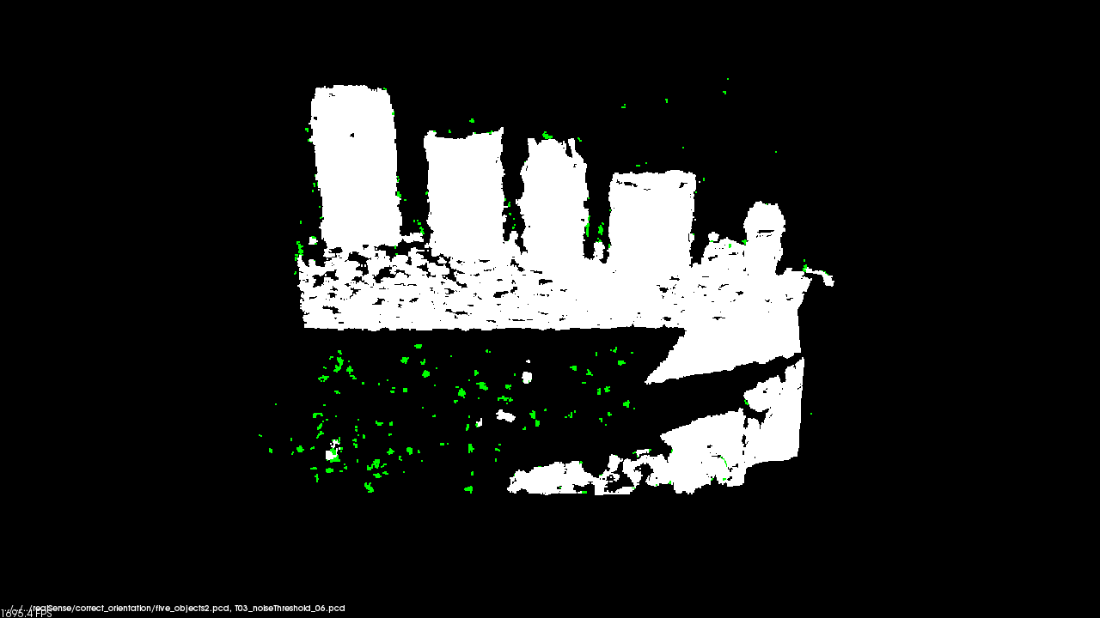
Noise Removal Filter: Standard Deviation
1352 data points removed
Std. Deviation = 1.1
Neighbors = 50
Time = 436 ms
This test altered the standard deviation while keeping the number of neighbors to be analyzed deviation constant.
Green shows outliers
Function:
c44::removeNoise()

Slide 23

Noise Removal Filter: Standard Deviation
907 data points removed
Std. Deviation = 2.1
Neighbors = 50
Time = 428 ms
This test altered the standard deviation while keeping the number of neighbors to be analyzed deviation constant.
Green shows outliers
Function:
c44::removeNoise()

Slide 24
Extract Prism Data: RANSAC
Threshold = 1 cm

Slide 25
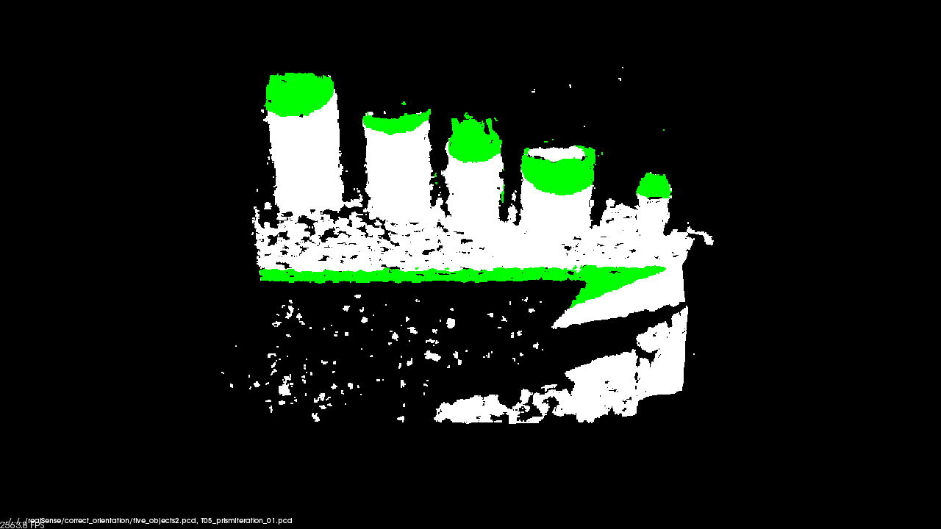
Extract Prism Data: RANSAC Iterations
original data: 172800 points after extraction: 12930 points
Iterations = 200
Threshold = 1 cm
Time = 692 ms
This test altered number of iterations RANSAC can go through to find a planar surface.
Green shows inliers of extraction
Function:
c44::getPrism()

Slide 26
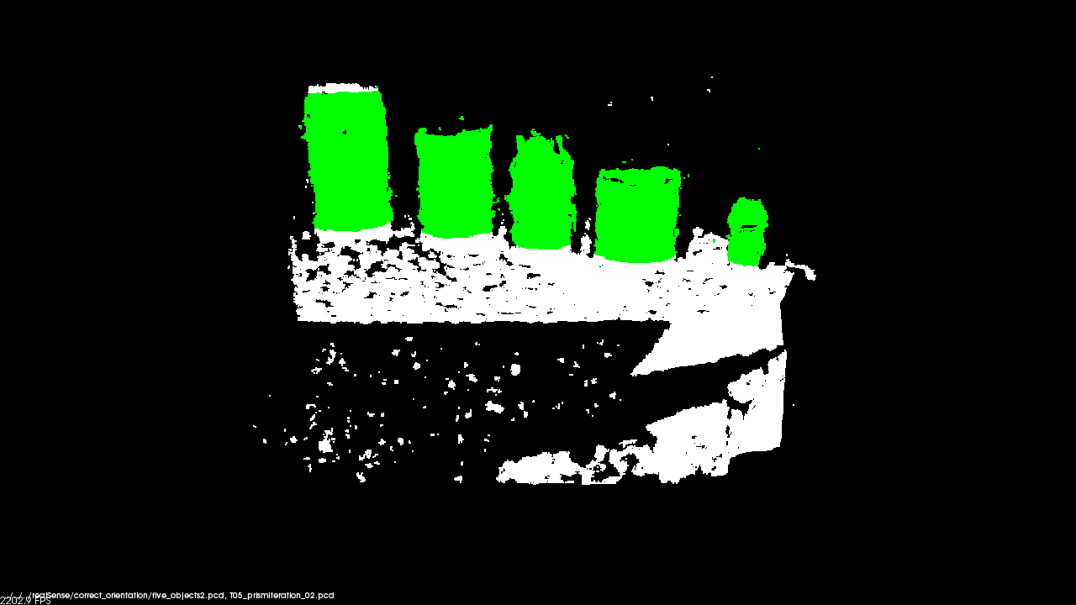
Extract Prism Data: RANSAC Iterations
original data: 172800 points after extraction: 22938 points
Iterations = 400
Threshold = 1 cm
Time = 915 ms
This test altered number of iterations RANSAC can go through to find a planar surface.
Green shows inliers of extraction
Function:
c44::getPrism()

Slide 27

Extract Prism Data: RANSAC Iterations
original data: 172800 points after extraction: 22938 points
Iterations = 800
Threshold = 1 cm
Time = 1376 ms
This test altered number of iterations RANSAC can go through to find a planar surface.
Green shows inliers of extraction
Function:
c44::getPrism()

Slide 28
Extract Prism Data: Threshold Distance
RANSAC Iterations = 1000

Slide 29
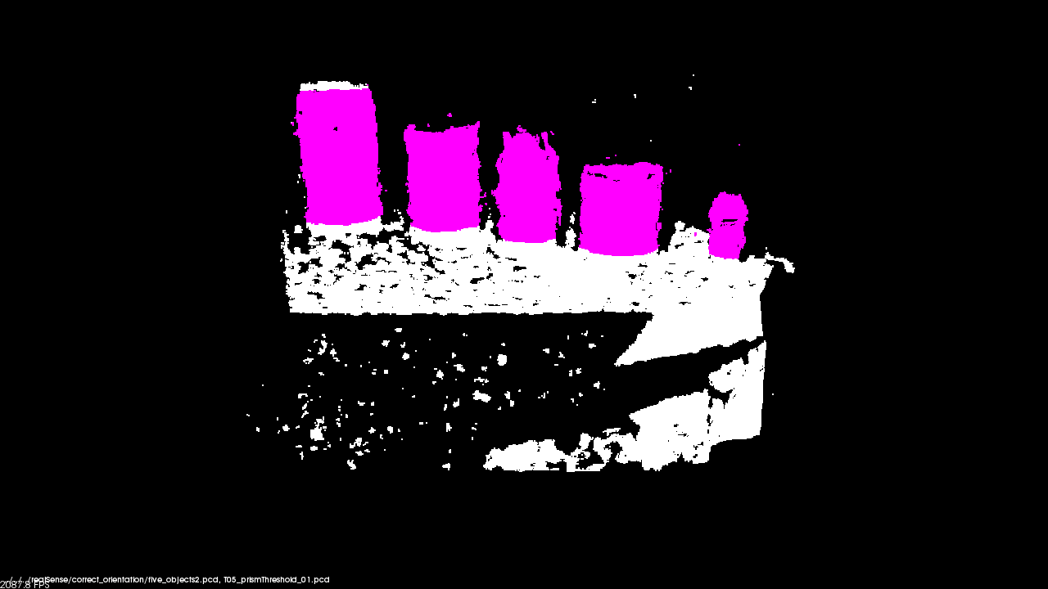
Extract Prism Data: Threshold Distance
original data: 172800 points after extraction: 22938 points
Iterations = 1000
Threshold = 1 cm
Time = 2269 ms
This test altered the threshold distance used by the RANSAC algorithm
Violet shows inliers of extraction
Function:
c44::getPrism()

Slide 30

Extract Prism Data: Threshold Distance
original data: 172800 points after extraction: 46296 points
Iterations = 1000
Threshold = 2 cm
Time = 2124 ms
This test altered the threshold distance used by the RANSAC algorithm
Violet shows inliers of extraction
Function:
c44::getPrism()

Slide 31
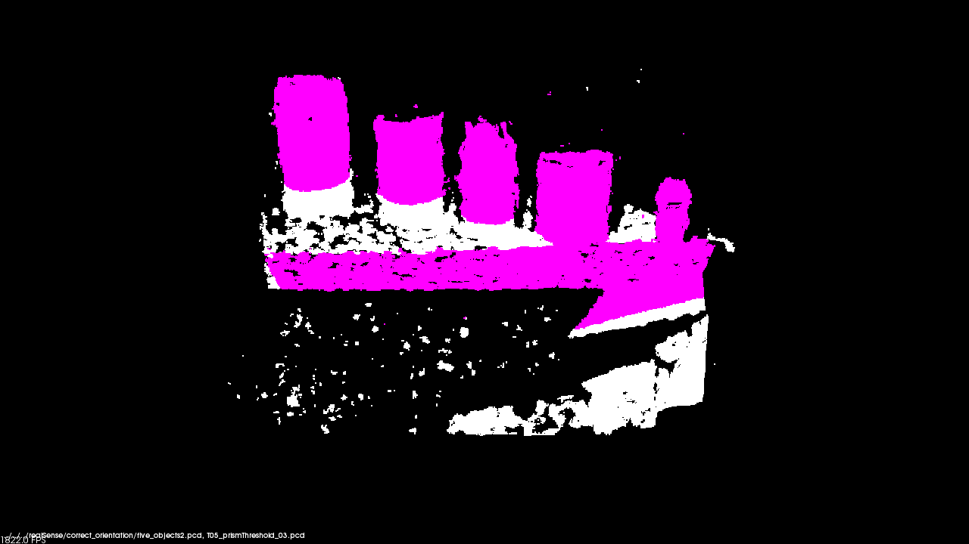
Extract Prism Data: Threshold Distance
original data: 172800 points after extraction: 42369 points
Iterations = 1000
Threshold = 3 cm
Time = 1297 ms
This test altered the threshold distance used by the RANSAC algorithm
Violet shows inliers of extraction
Function:
c44::getPrism()

Slide 32
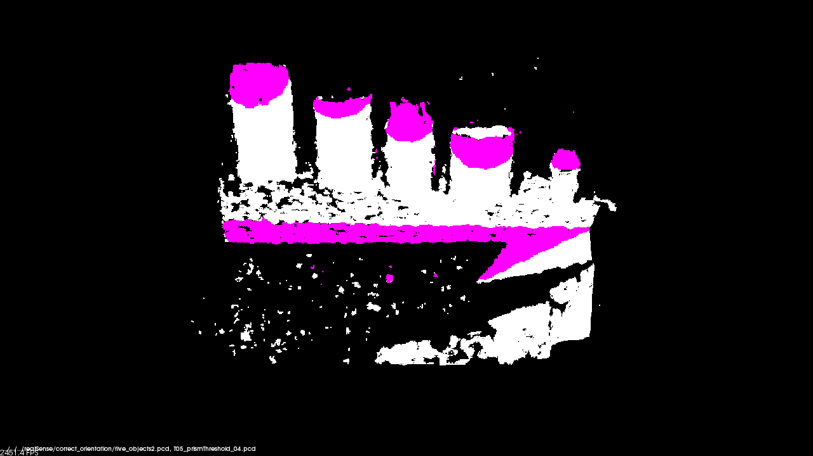
Extract Prism Data: Threshold Distance
original data: 172800 points after extraction: 18366 points
Iterations = 1000
Threshold = 4 cm
Time = 909 ms
This test altered the threshold distance used by the RANSAC algorithm
Violet shows inliers of extraction
Function:
c44::getPrism()

Slide 33
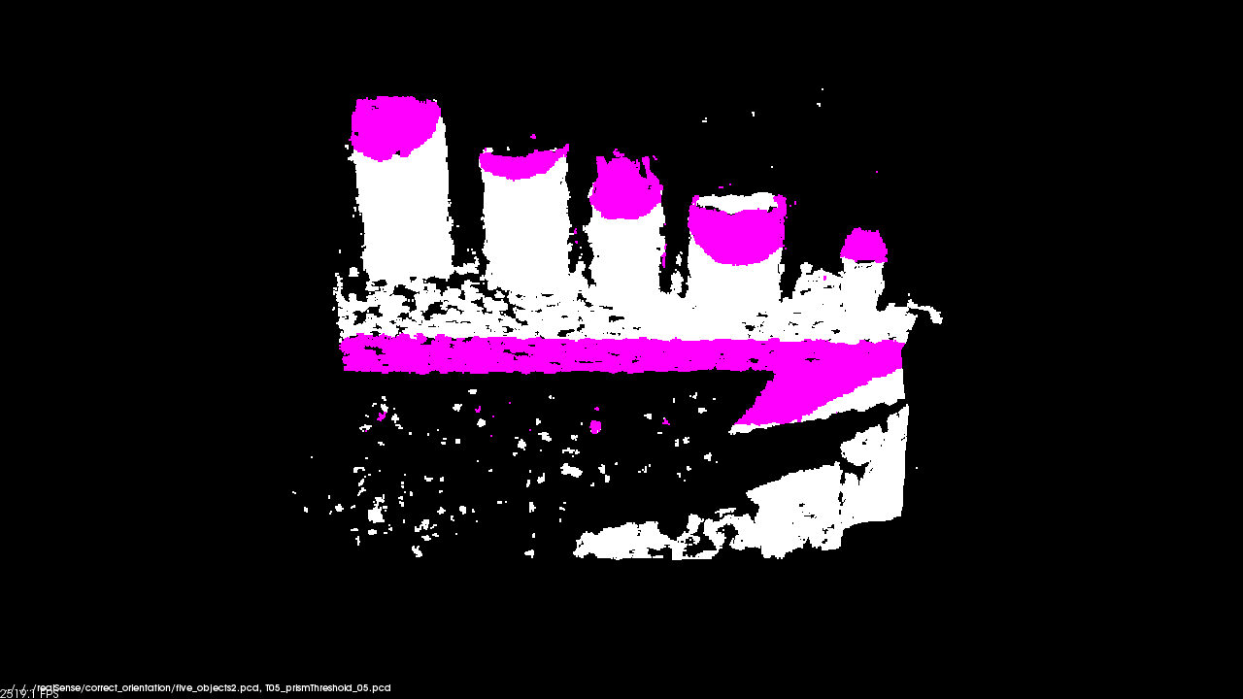
Extract Prism Data: Threshold Distance
original data: 172800 points after extraction: 21527 points
Iterations = 1000
Threshold = 5 cm
Time = 669 ms
This test altered the threshold distance used by the RANSAC algorithm
Violet shows inliers of extraction
Function:
c44::getPrism()

Slide 34
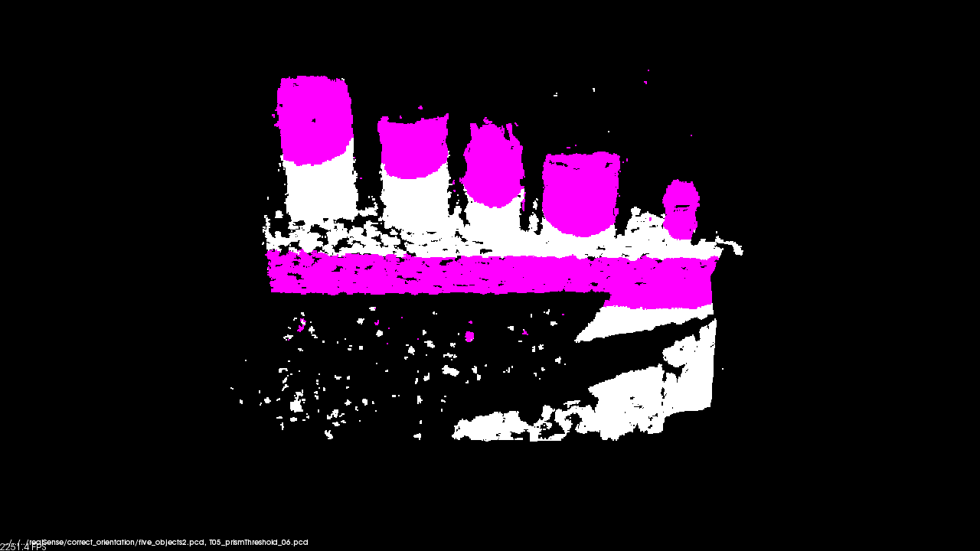
Extract Prism Data: Threshold Distance
original data: 172800 points after extraction: 34242 points
Iterations = 1000
Threshold = 6 cm
Time = 517 ms
This test altered the threshold distance used by the RANSAC algorithm
Violet shows inliers of extraction
Function:
c44::getPrism()

