Slide 1
Team #44: Object Segmentation
3 March 2016 Presentation

Slide 2
NUC PCL Performance Problems
PCL 1.7.2 Setup PCL 1.8 Setup

Slide 3
Voxel Filter Data
PCL 1.7.2 Desktop Results
PCL 1.7.2 NUC Results

Slide 4
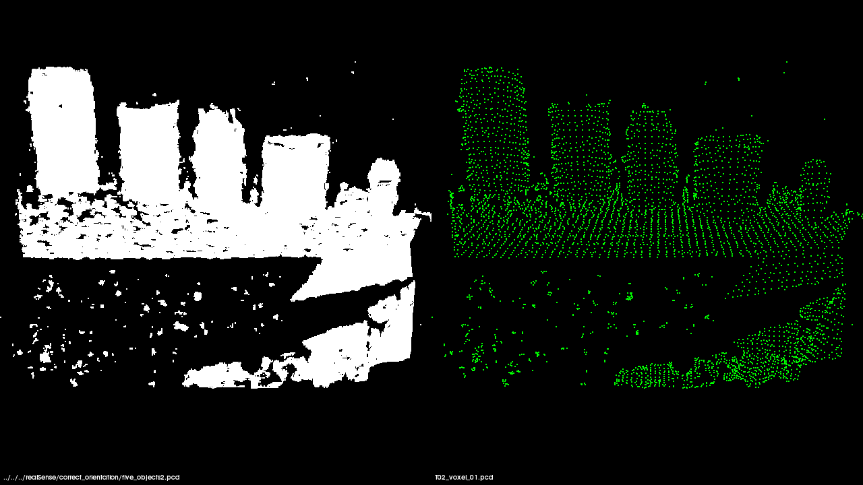
Voxel Filter Output
172800 data points 4620 data points
Leaf Size = 1 cm
Time = 4 ms

Slide 5
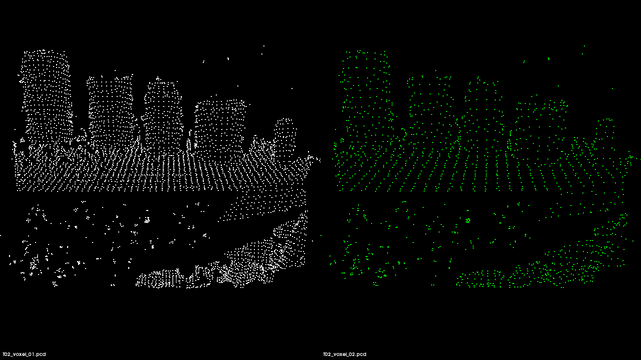
Voxel Filter Output
4620 data points 1553 data points
Leaf Size = 2 cm
Time = 4 ms

Slide 6
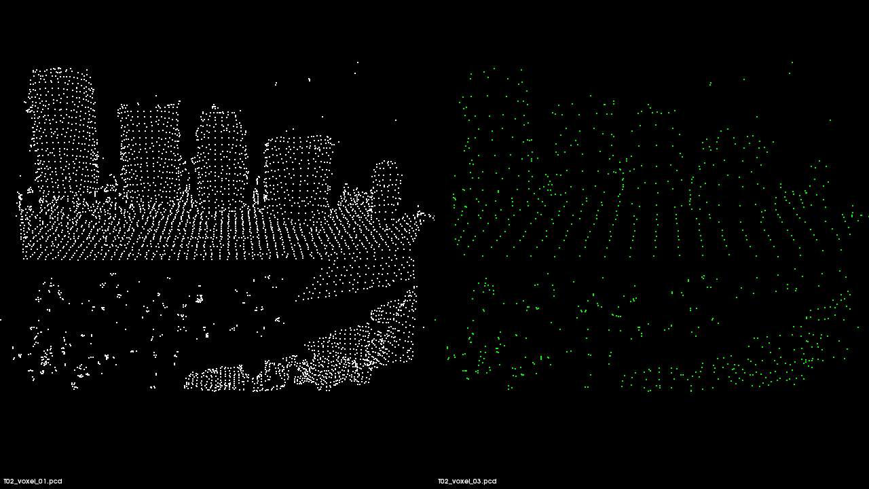
Voxel Filter Output
4620 data points 823 data points
Leaf Size = 3 cm
Time = 3 ms

Slide 7
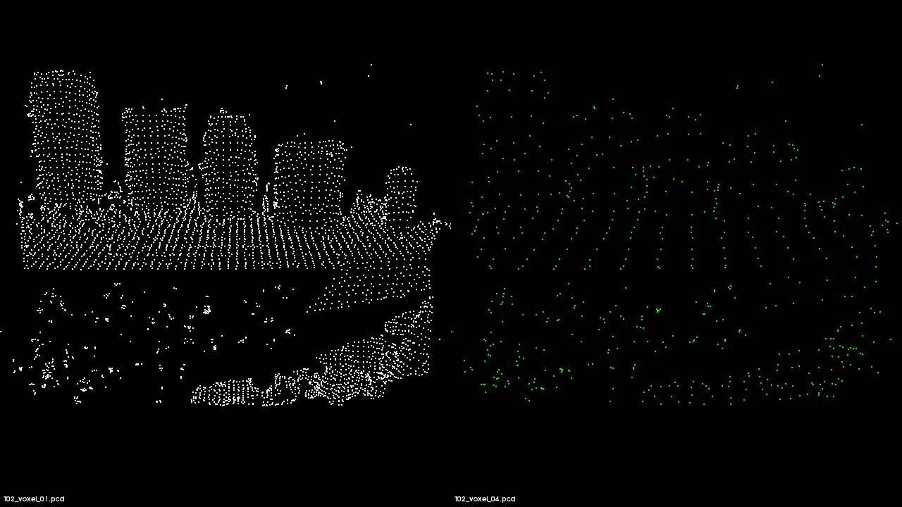
Voxel Filter Output
4620 data points 591 data points
Leaf Size = 4 cm
Time = 4 ms

Slide 8
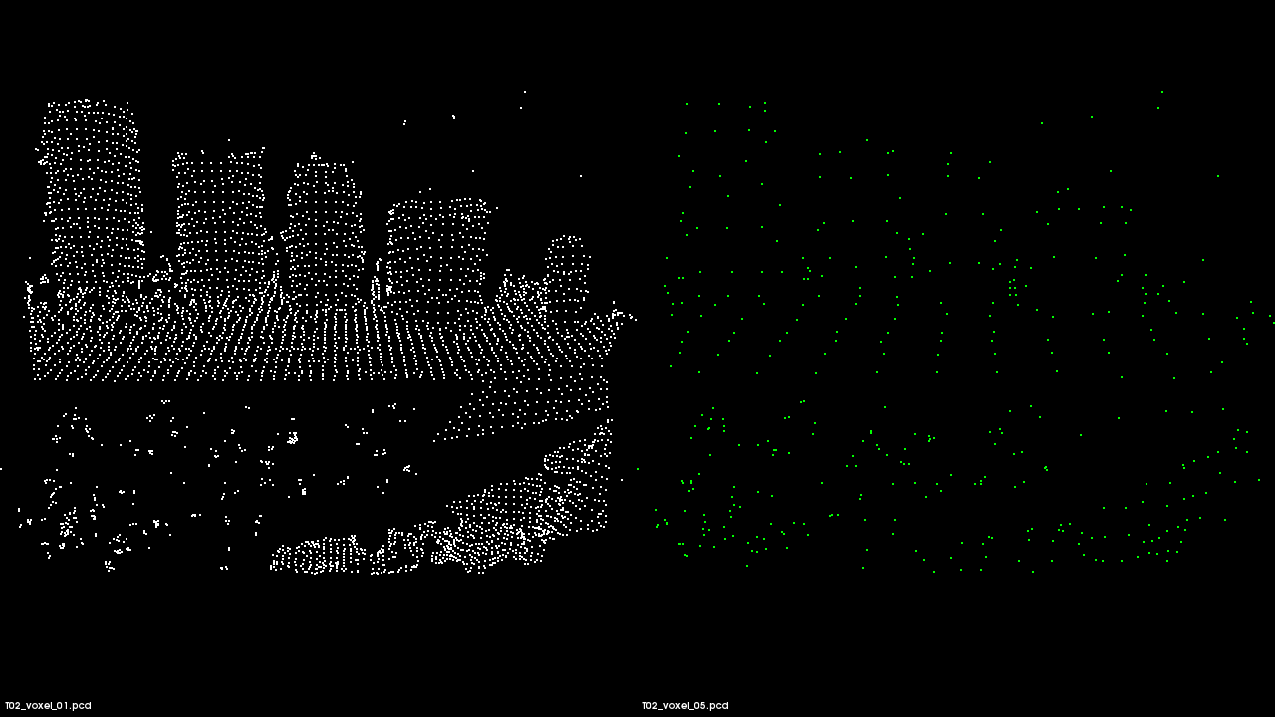
Voxel Filter Output
4620 data points 407 data points
Leaf Size = 5 cm
Time = 3 ms

Slide 9
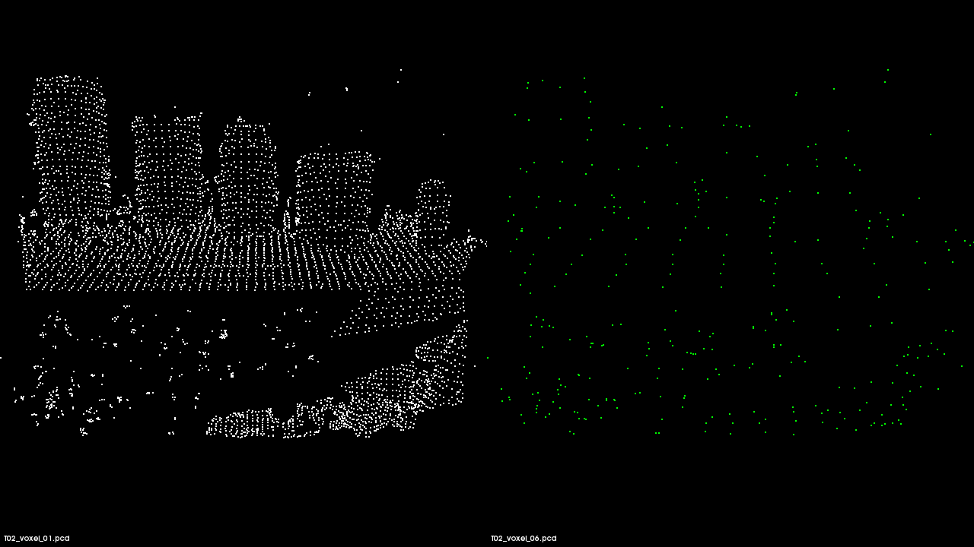
Voxel Filter Output
4620 data points 331 data points
Leaf Size = 6 cm
Time = 3 ms

Slide 10
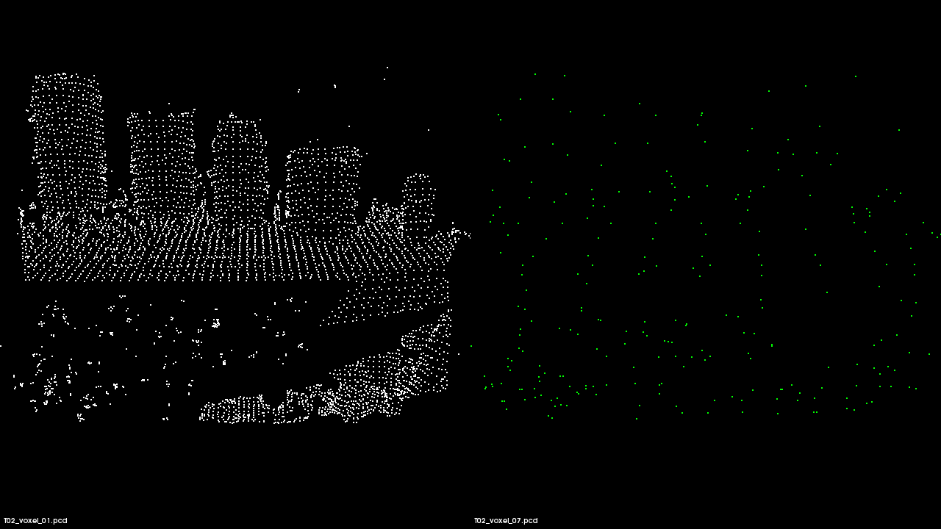
Voxel Filter Output
4620 data points 264 data points
Leaf Size = 7 cm
Time = 3 ms

Slide 11
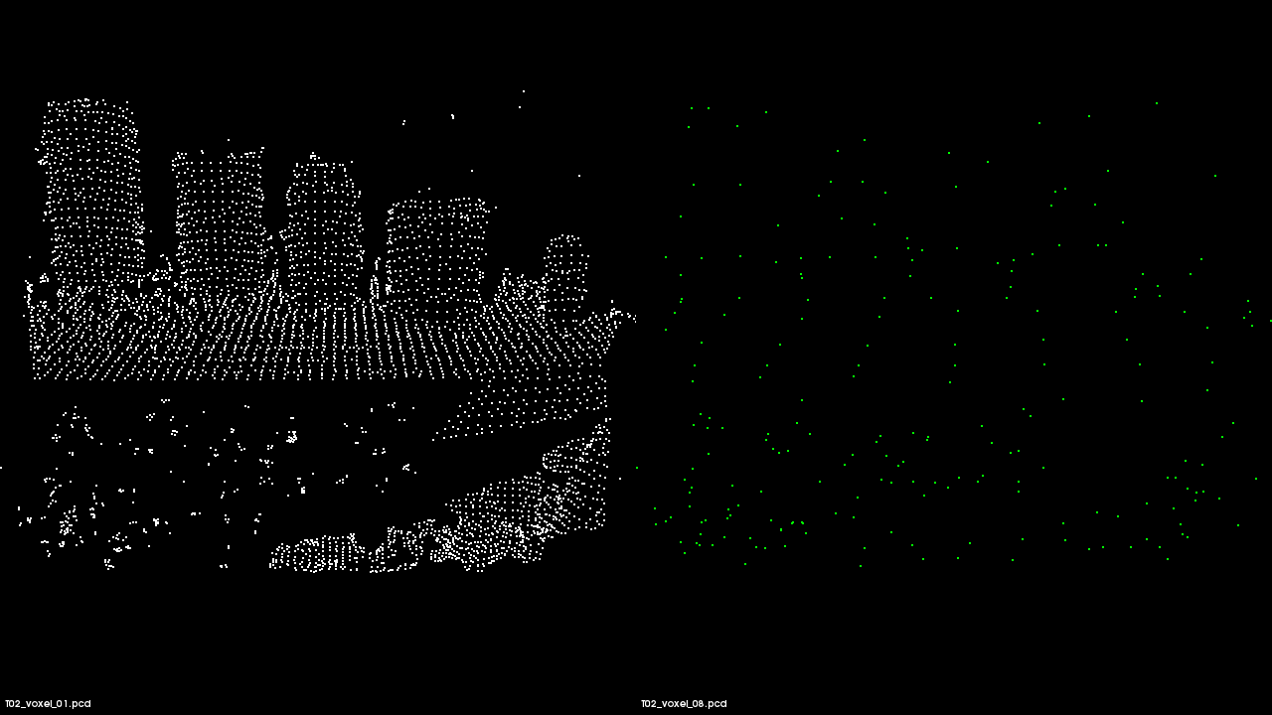
Voxel Filter Output
4620 data points 226 data points
Leaf Size = 8 cm
Time = 3 ms

Slide 12
Noise Removal Data: Nearest Neighbors
Standard Deviation = 1.0

Slide 13
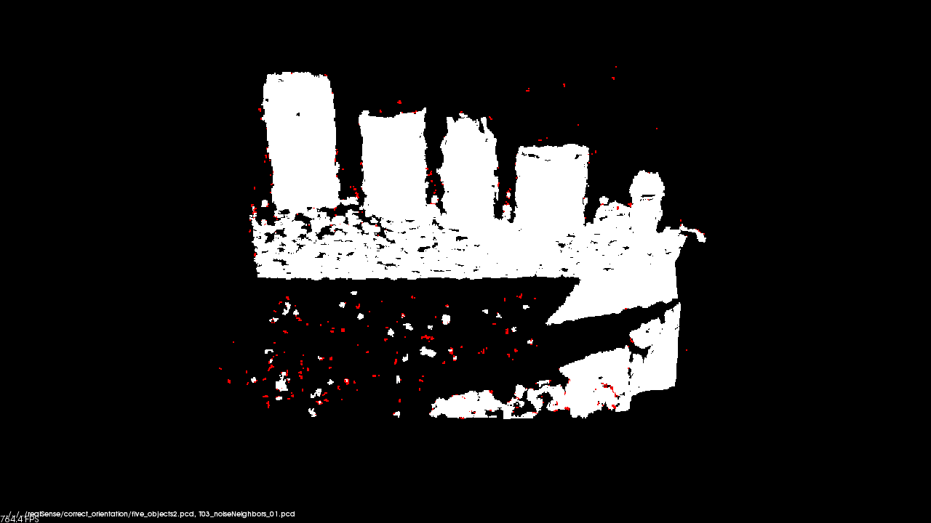
Noise Removal Filter: Nearest Neighbors
828 data points removed
Std. Deviation = 1.0
Neighbors = 10
Time = 269 ms
This test altered the number of nearest neighbors to be analyzed while keeping standard deviation constant.
Red shows outliers
Function:
c44::removeNoise()

Slide 14
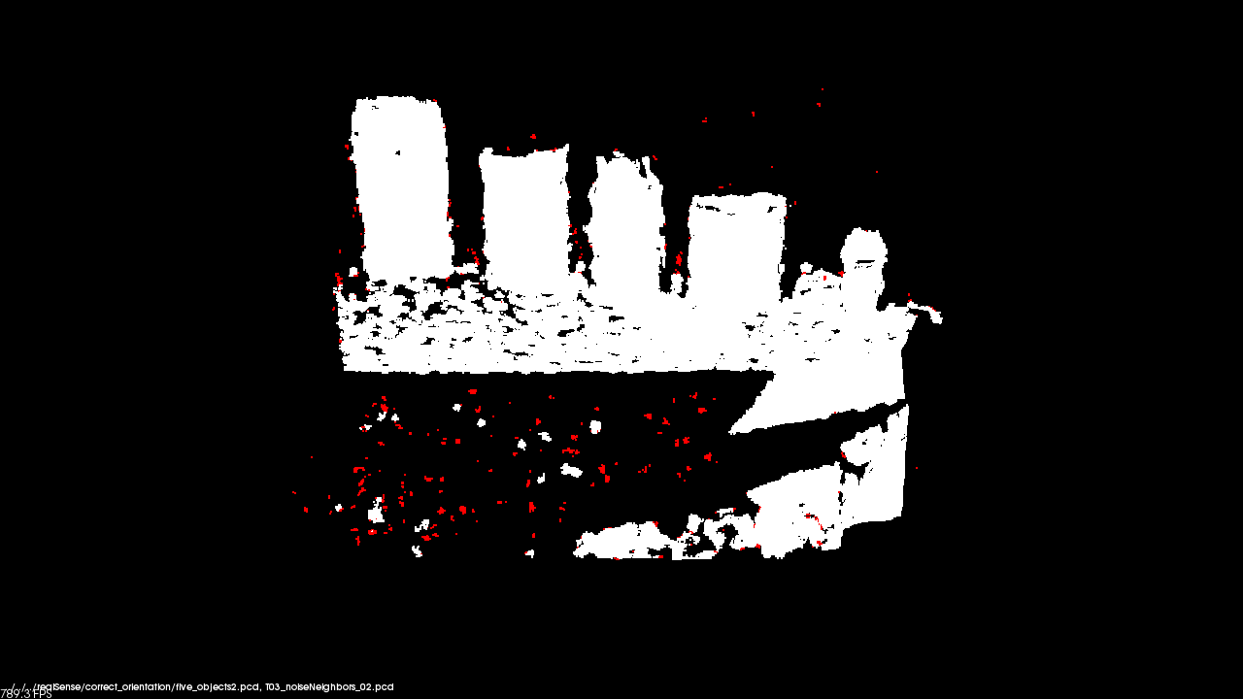
Noise Removal Filter: Nearest Neighbors
1016 data points removed
Std. Deviation = 1.0
Neighbors = 20
Time = 278 ms
This test altered the number of nearest neighbors to be analyzed while keeping standard deviation constant.
Red shows outliers
Function:
c44::removeNoise()

Slide 15

Noise Removal Filter: Nearest Neighbors
1209 data points removed
Std. Deviation = 1.0
Neighbors = 30
Time = 301 ms
This test altered the number of nearest neighbors to be analyzed while keeping standard deviation constant.
Red shows outliers
Function:
c44::removeNoise()

Slide 16

Noise Removal Filter: Nearest Neighbors
1336 data points removed
Std. Deviation = 1.0
Neighbors = 40
Time = 424 ms
This test altered the number of nearest neighbors to be analyzed while keeping standard deviation constant.
Red shows outliers
Function:
c44::removeNoise()

Slide 17

Noise Removal Filter: Nearest Neighbors
1386 data points removed
Std. Deviation = 1.0
Neighbors = 50
Time = 490 ms
This test altered the number of nearest neighbors to be analyzed while keeping standard deviation constant.
Red shows outliers
Function:
c44::removeNoise()

Slide 18

Noise Removal Filter: Nearest Neighbors
1573 data points removed
Std. Deviation = 1.0
Neighbors = 100
Time = 967 ms
This test altered the number of nearest neighbors to be analyzed while keeping standard deviation constant.
Red shows outliers
Function:
c44::removeNoise()

Slide 19
Noise Removal Data: Standard Deviation
Nearest Neighbors = 50

Slide 20
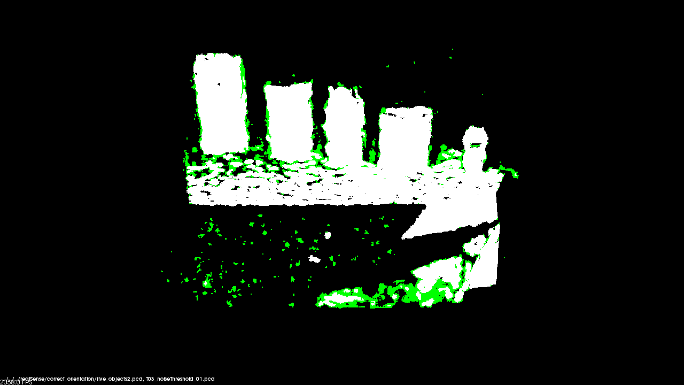
Noise Removal Filter: Standard Deviation
8341 data points removed
Std. Deviation = 0.1
Neighbors = 50
Time = 489 ms
This test altered the standard deviation while keeping the number of neighbors to be analyzed deviation constant.
Green shows outliers
Function:
c44::removeNoise()

Slide 21
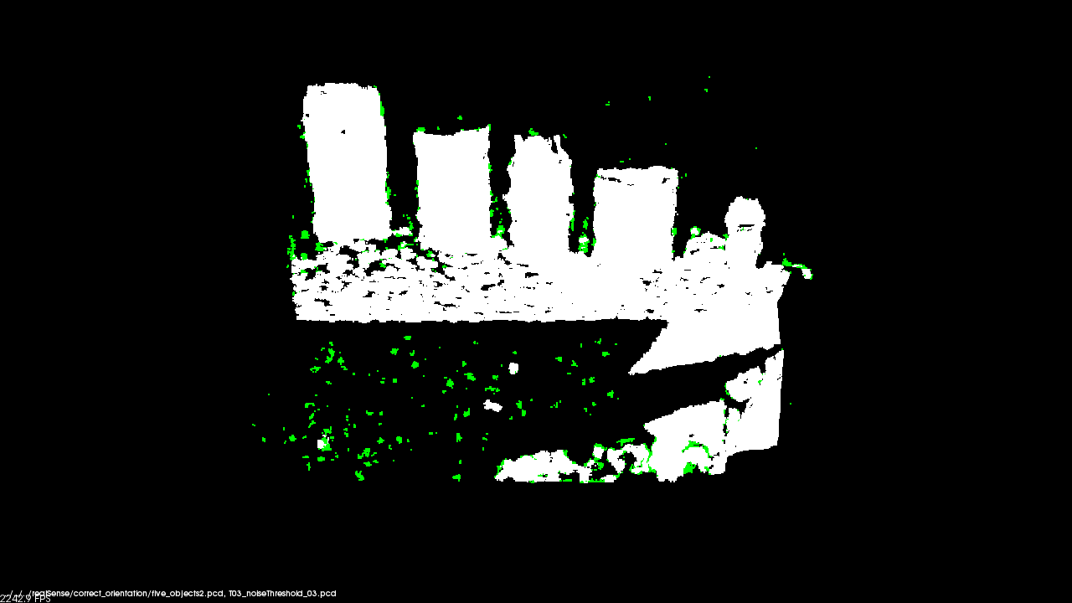
Noise Removal Filter: Standard Deviation
2598 data points removed
Std. Deviation = 0.5
Neighbors = 50
Time = 488 ms
This test altered the standard deviation while keeping the number of neighbors to be analyzed deviation constant.
Green shows outliers
Function:
c44::removeNoise()

Slide 22
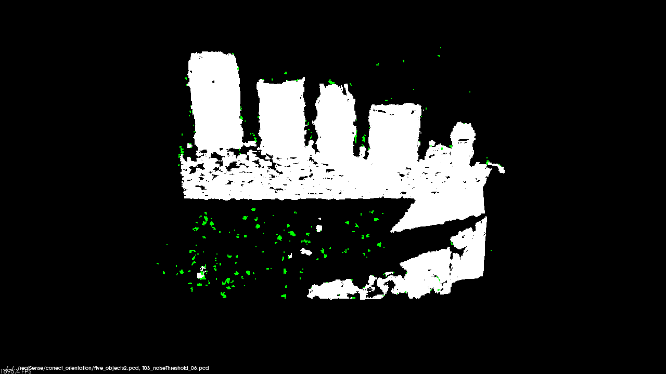
Noise Removal Filter: Standard Deviation
1352 data points removed
Std. Deviation = 1.1
Neighbors = 50
Time = 488 ms
This test altered the standard deviation while keeping the number of neighbors to be analyzed deviation constant.
Green shows outliers
Function:
c44::removeNoise()

Slide 23

Noise Removal Filter: Standard Deviation
907 data points removed
Std. Deviation = 2.1
Neighbors = 50
Time = 488 ms
This test altered the standard deviation while keeping the number of neighbors to be analyzed deviation constant.
Green shows outliers
Function:
c44::removeNoise()

Slide 24
Extract Prism Data: RANSAC
Threshold = 1 cm

Slide 25
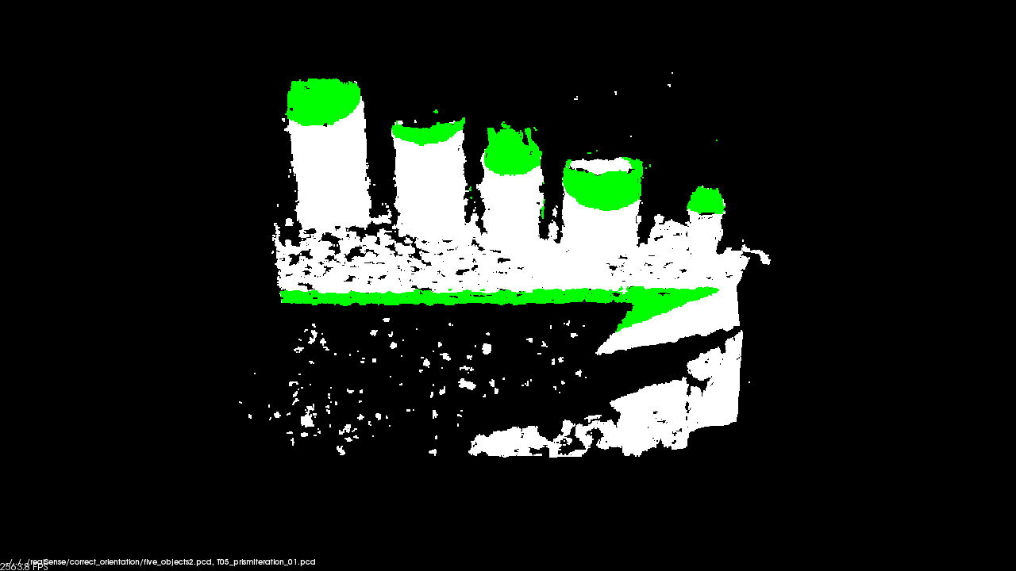
Extract Prism Data: RANSAC Iterations
original data: 172800 points after extraction: 12930 points
Iterations = 200
Threshold = 1 cm
Time = 570 ms
This test altered number of iterations RANSAC can go through to find a planar surface.
Green shows inliers of extraction
Function:
c44::getPrism()

Slide 26
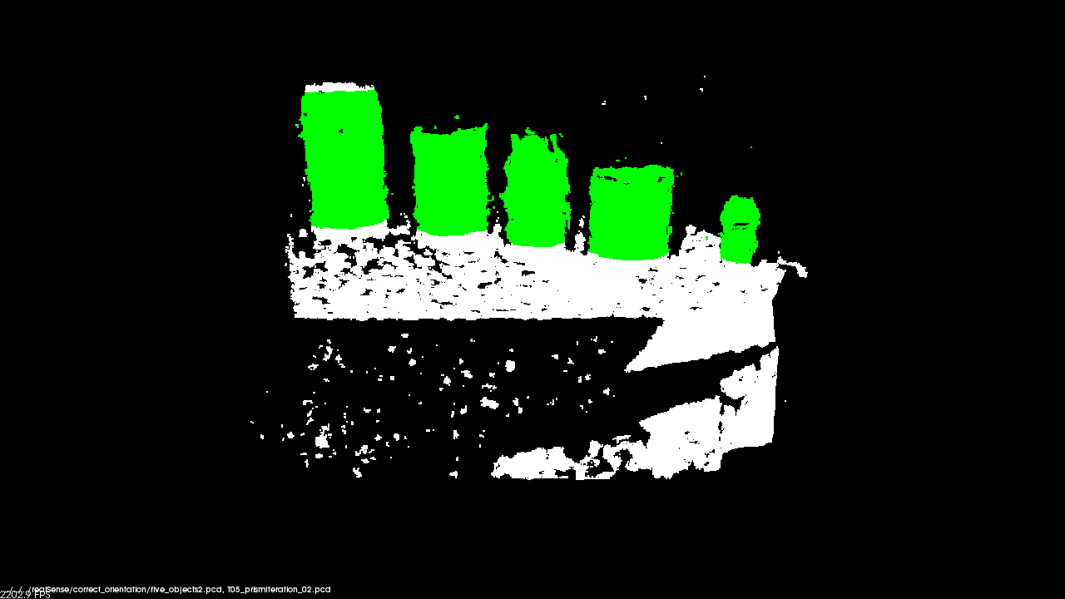
Extract Prism Data: RANSAC Iterations
original data: 172800 points after extraction: 22938 points
Iterations = 400
Threshold = 1 cm
Time = 1117 ms
This test altered number of iterations RANSAC can go through to find a planar surface.
Green shows inliers of extraction
Function:
c44::getPrism()

Slide 27

Extract Prism Data: RANSAC Iterations
original data: 172800 points after extraction: 22938 points
Iterations = 800
Threshold = 1 cm
Time = 2205 ms
This test altered number of iterations RANSAC can go through to find a planar surface.
Green shows inliers of extraction
Function:
c44::getPrism()

Slide 28
Extract Prism Data: Threshold Distance
RANSAC Iterations = 1000

Slide 29
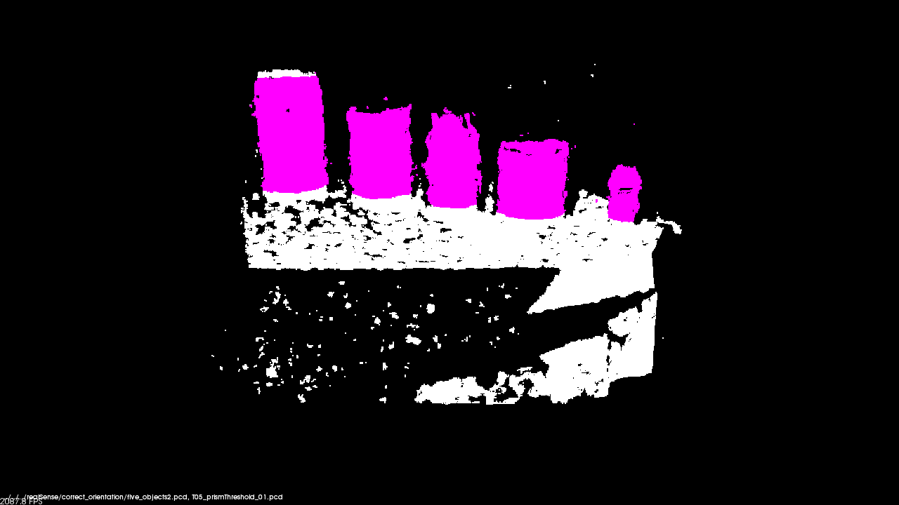
Extract Prism Data: Threshold Distance
original data: 172800 points after extraction: 22938 points
Iterations = 1000
Threshold = 1 cm
Time = 2748 ms
This test altered the threshold distance used by the RANSAC algorithm
Violet shows inliers of extraction
Function:
c44::getPrism()

Slide 30
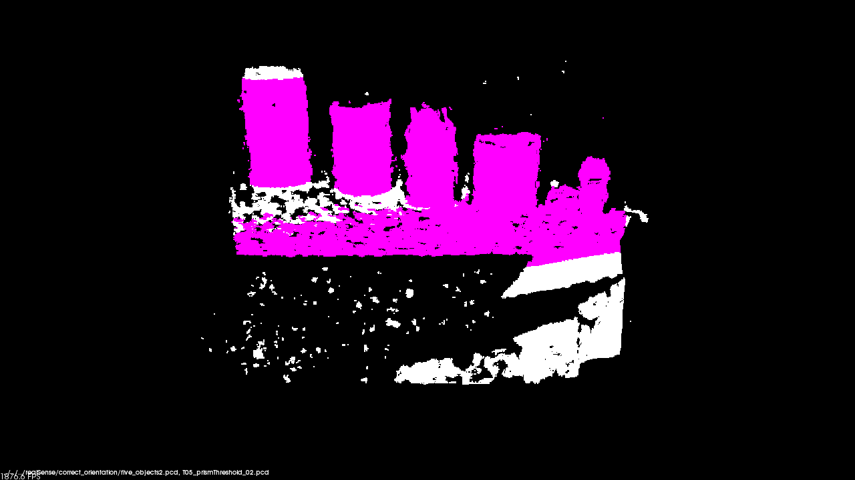
Extract Prism Data: Threshold Distance
original data: 172800 points after extraction: 46296 points
Iterations = 1000
Threshold = 2 cm
Time = 2574 ms
This test altered the threshold distance used by the RANSAC algorithm
Violet shows inliers of extraction
Function:
c44::getPrism()

Slide 31
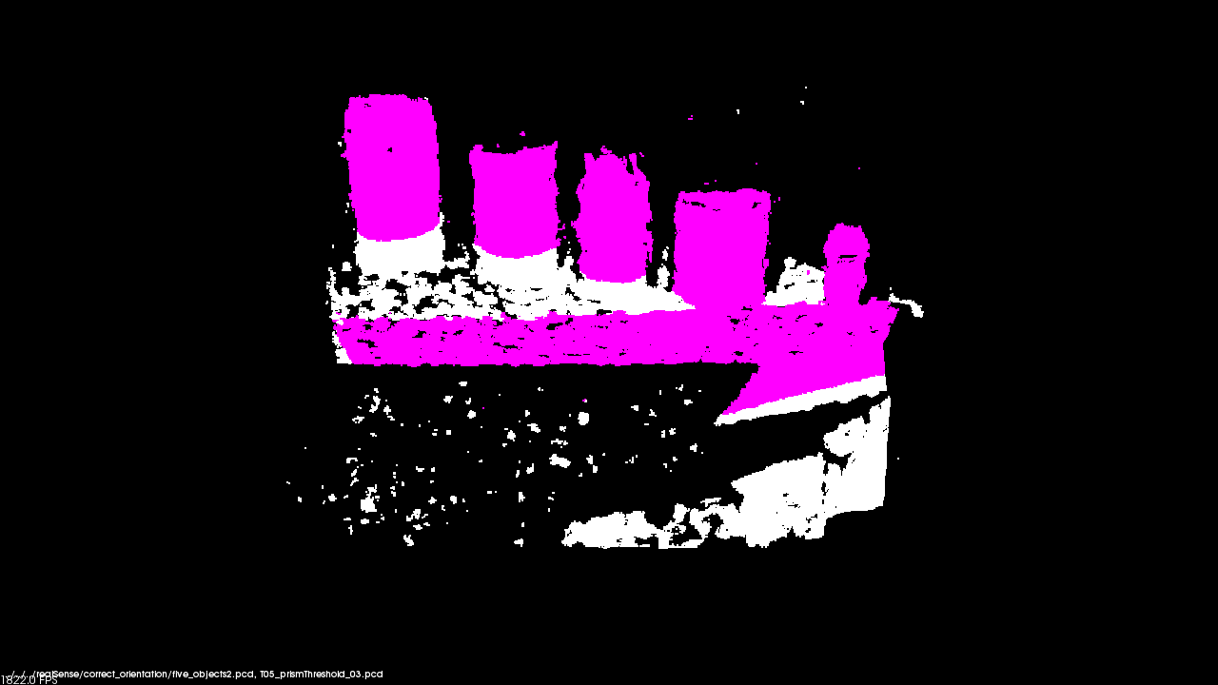
Extract Prism Data: Threshold Distance
original data: 172800 points after extraction: 42369 points
Iterations = 1000
Threshold = 3 cm
Time = 1540 ms
This test altered the threshold distance used by the RANSAC algorithm
Violet shows inliers of extraction
Function:
c44::getPrism()

Slide 32
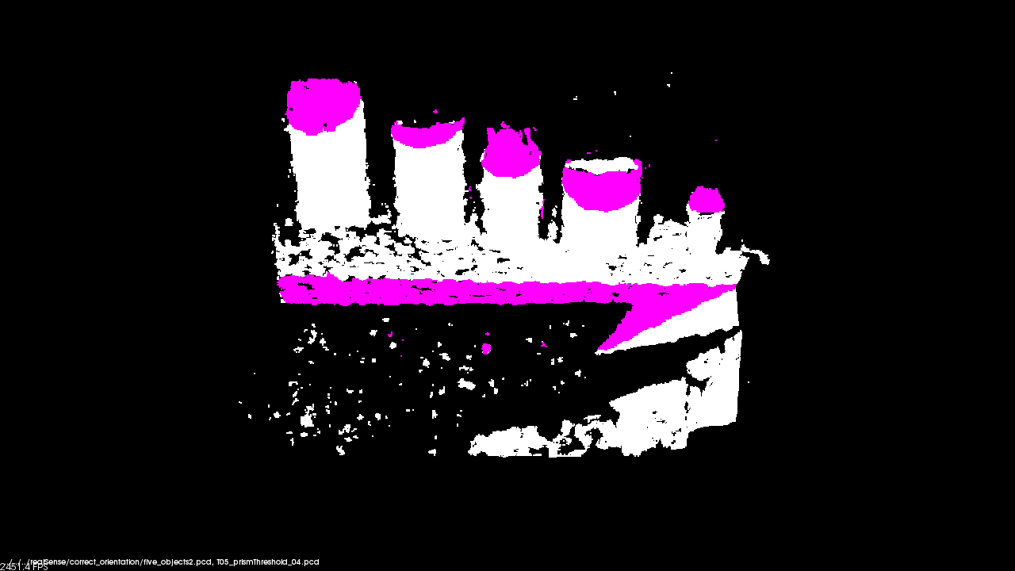
Extract Prism Data: Threshold Distance
original data: 172800 points after extraction: 18366 points
Iterations = 1000
Threshold = 4 cm
Time = 1095 ms
This test altered the threshold distance used by the RANSAC algorithm
Violet shows inliers of extraction
Function:
c44::getPrism()

Slide 33
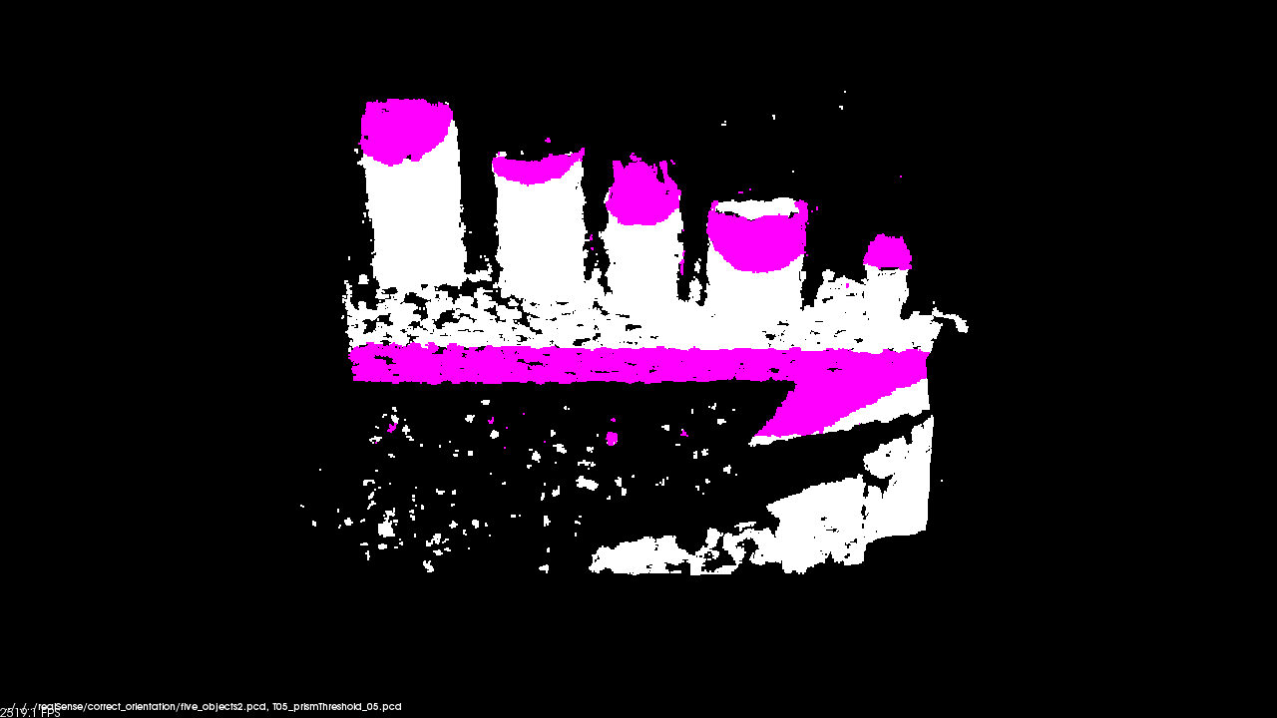
Extract Prism Data: Threshold Distance
original data: 172800 points after extraction: 21527 points
Iterations = 1000
Threshold = 5 cm
Time = 805 ms
This test altered the threshold distance used by the RANSAC algorithm
Violet shows inliers of extraction
Function:
c44::getPrism()

Slide 34
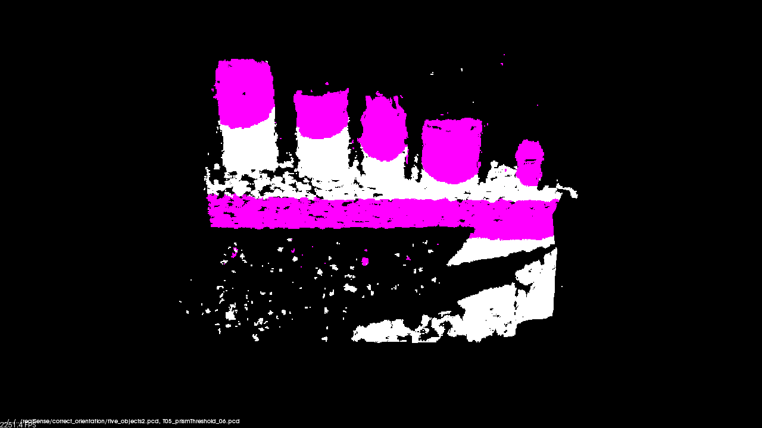
Extract Prism Data: Threshold Distance
original data: 172800 points after extraction: 34242 points
Iterations = 1000
Threshold = 6 cm
Time = 620 ms
This test altered the threshold distance used by the RANSAC algorithm
Violet shows inliers of extraction
Function:
c44::getPrism()

Slide 35
New Object Segmentation Dataflow
PCD Files
Voxel Filter (down sample)
Segmented PCD File
Plane Segmentation (RANSAC)
Extract Prism (convex hull)
Noise Removal (Gaussian)

Slide 36
Object Segmentation: Manipulating RANSAC
All variables are held constant except for RANSAC Iterations

Slide 37
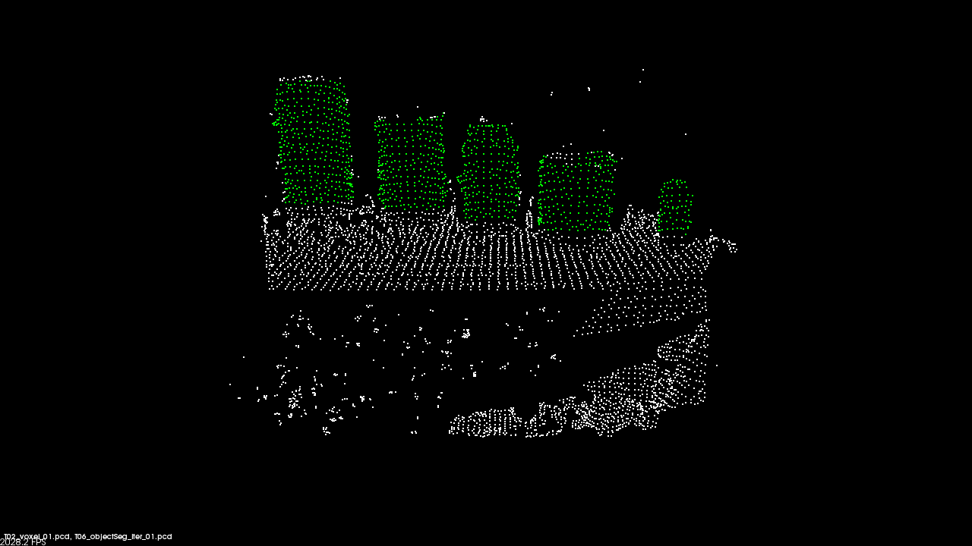
Object Segmentation: Manipulating RANSAC
original data: 172800 points after extraction: 1172 points
Iterations = 200
Threshold = 1.0
Time = 18 ms
Green points show objects above plane
White points show original PCD file after being down sampled
Function:
c44::segObjects()

Slide 38

Object Segmentation: Manipulating RANSAC
original data: 172800 points after extraction: 1172 points
Iterations = 400
Threshold = 1.0
Time = 18 ms
Green points show objects above plane
White points show original PCD file after being down sampled
Function:
c44::segObjects()

Slide 39

Object Segmentation: Manipulating RANSAC
original data: 172800 points after extraction: 1172 points
Iterations = 600
Threshold = 1.0
Time = 17 ms
Green points show objects above plane
White points show original PCD file after being down sampled
Function:
c44::segObjects()

Slide 40

Object Segmentation: Manipulating RANSAC
original data: 172800 points after extraction: 1172 points
Iterations = 800
Threshold = 1.0
Time = 18 ms
Green points show objects above plane
White points show original PCD file after being down sampled
Function:
c44::segObjects()

Slide 41
Object Segmentation: Voxel Filter Leaf Size
All variables are held constant except for the voxel filter’s leaf size variable

Slide 42
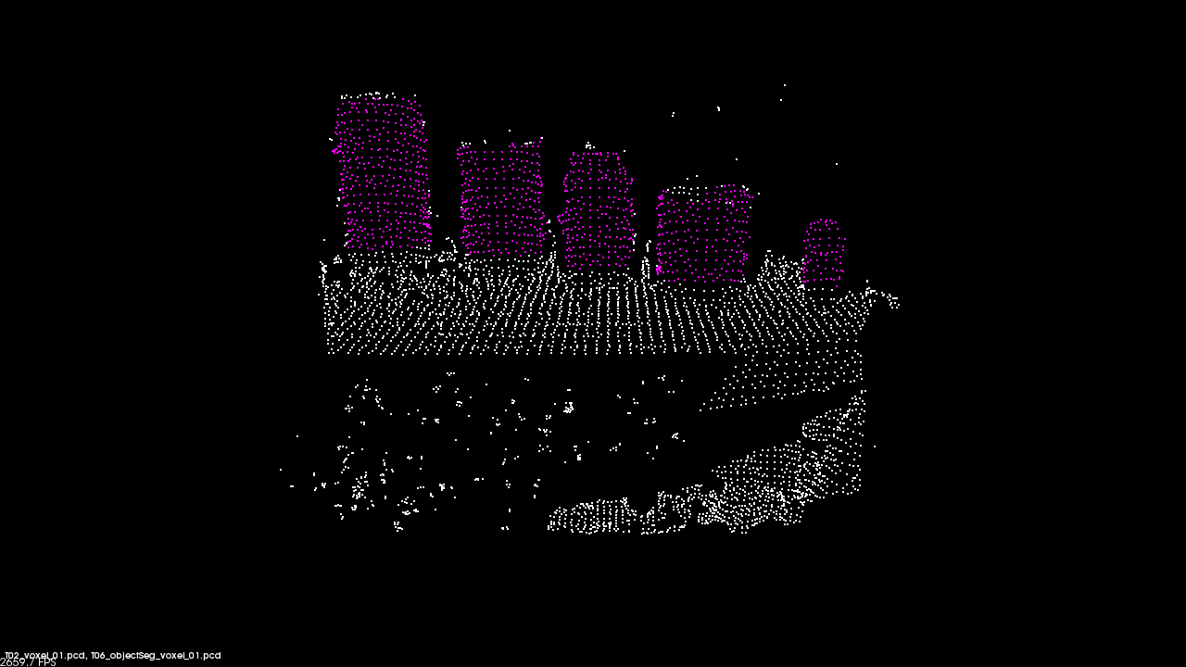
Object Segmentation: Voxel Filter Leaf Size
original data: 172800 points after extraction: 1172 points
Leaf Size = 1 cm
Time = 18 ms
Violet points show objects above plane
White points show original PCD file after being down sampled
Function:
c44::segObjects()

Slide 43
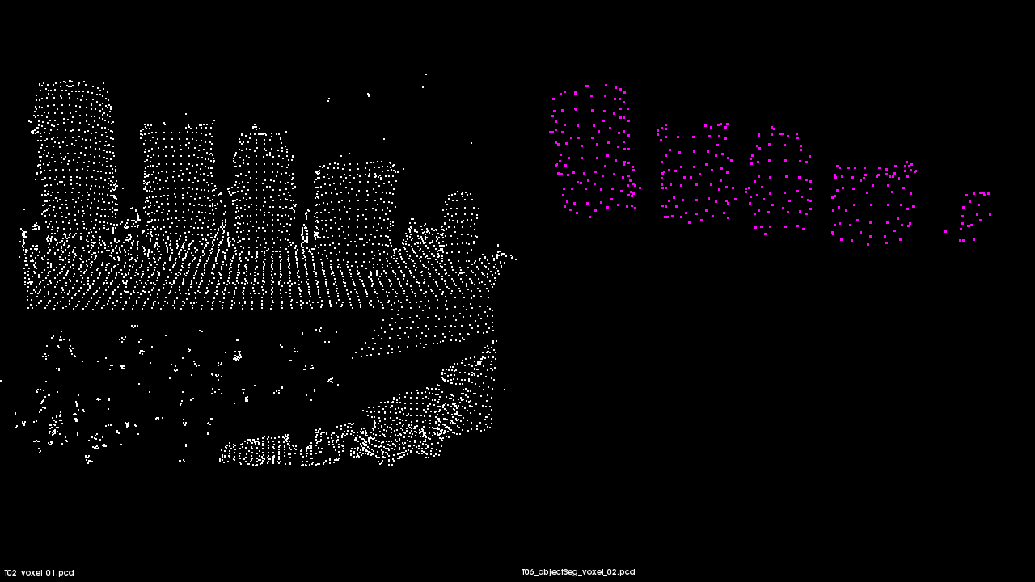
Object Segmentation: Voxel Filter Leaf Size
original data: 172800 points after extraction: 353 points
Leaf Size = 2 cm
Time = 9 ms
Violet points show objects above plane
White points show original PCD file after being down sampled
Function:
c44::segObjects()

Slide 44
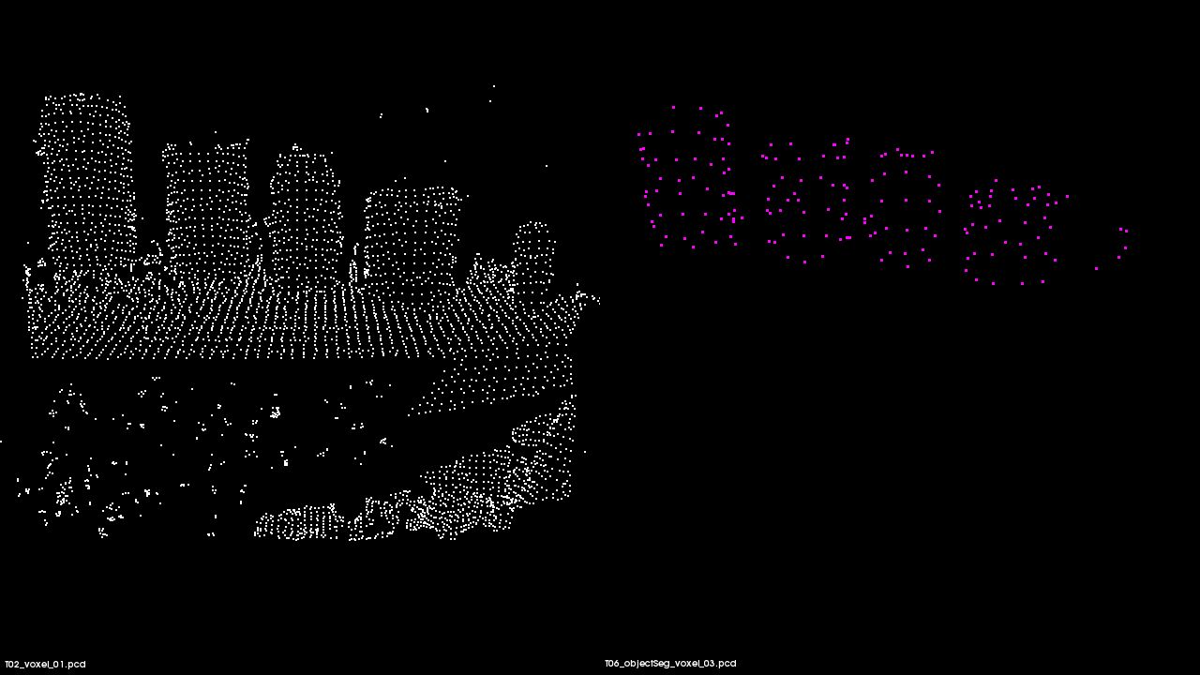
Object Segmentation: Voxel Filter Leaf Size
original data: 172800 points after extraction: 176 points
Leaf Size = 3 cm
Time = 7 ms
Violet points show objects above plane
White points show original PCD file after being down sampled
Function:
c44::segObjects()

Slide 45
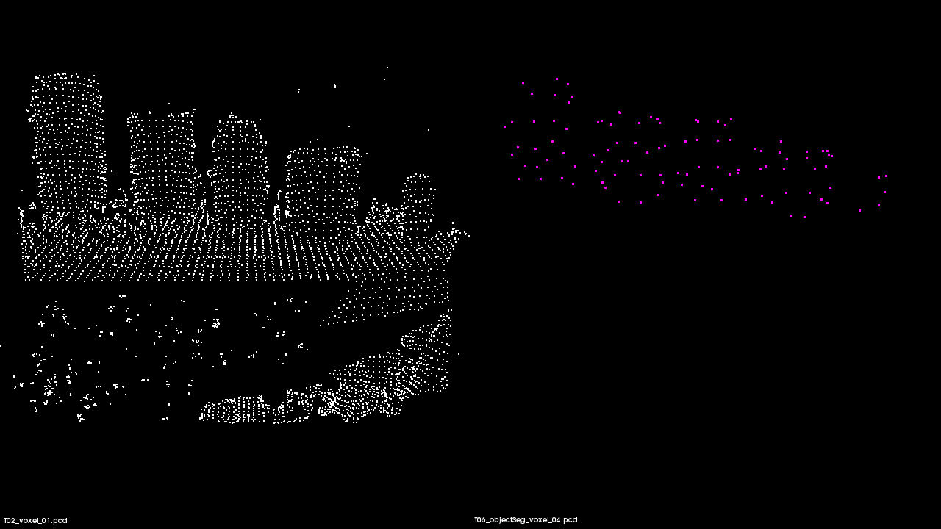
Object Segmentation: Voxel Filter Leaf Size
original data: 172800 points after extraction: 106 points
Leaf Size = 4 cm
Time = 7 ms
Violet points show objects above plane
White points show original PCD file after being down sampled
Function:
c44::segObjects()

Slide 46
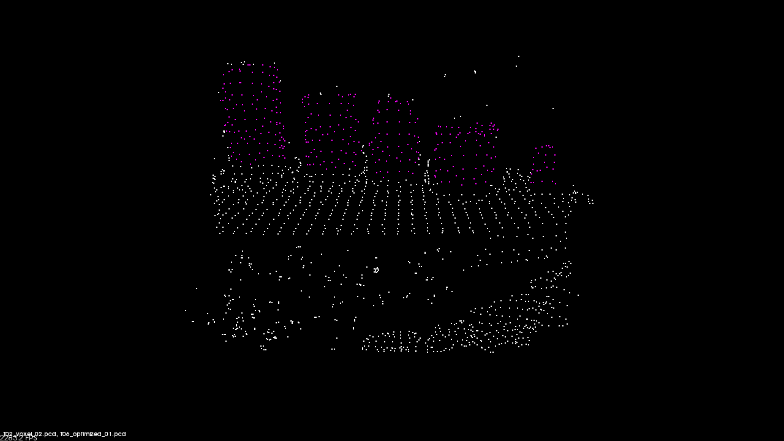
Object Segmentation: Optimized Image
original data: 172800 points after extraction: 355 points
Execution Time = 9 ms
Leaf Size = 2 cm
Number of Nearest Neighbors Analyzed = 20
Standard Deviation = 1.0
Minimum Radius = 0 deg
Maximum Radius = 90 deg
RANSAC Iterations = 500
Threshold Distance = 1 cm
Minimum Distance above Plane = 2 cm
Maximum Distance Above Plane = 20 cm
Function:
c44::segObjects()

Slide 47
Project Files Structure
Project Root Directory
build/
include/
CMakeLists.txt
log/
pictures/
src/
Contains build files
Contains header files (.h)
Contains data logging information (e.g. script)
Contains images (e.g. PCD or JPEG)
Contains source files (.cpp)
Project build settings

