Slide 1
Object Segmentation Parameters
Below are the default parameters used for the following images
Leaf Size = 1 cm
Number of Nearest Neighbors = 50
Standard Deviation = 1.0
Minimum Radius = 20 degrees
Maximum Radius = 70 degrees
RANSAC Iterations = 1000
Threshold Distance = 1 cm
Minimum Inlier Distance above Plane = 2 cm
Maximum Inlier Distance above Plane = 20 cm

Slide 2
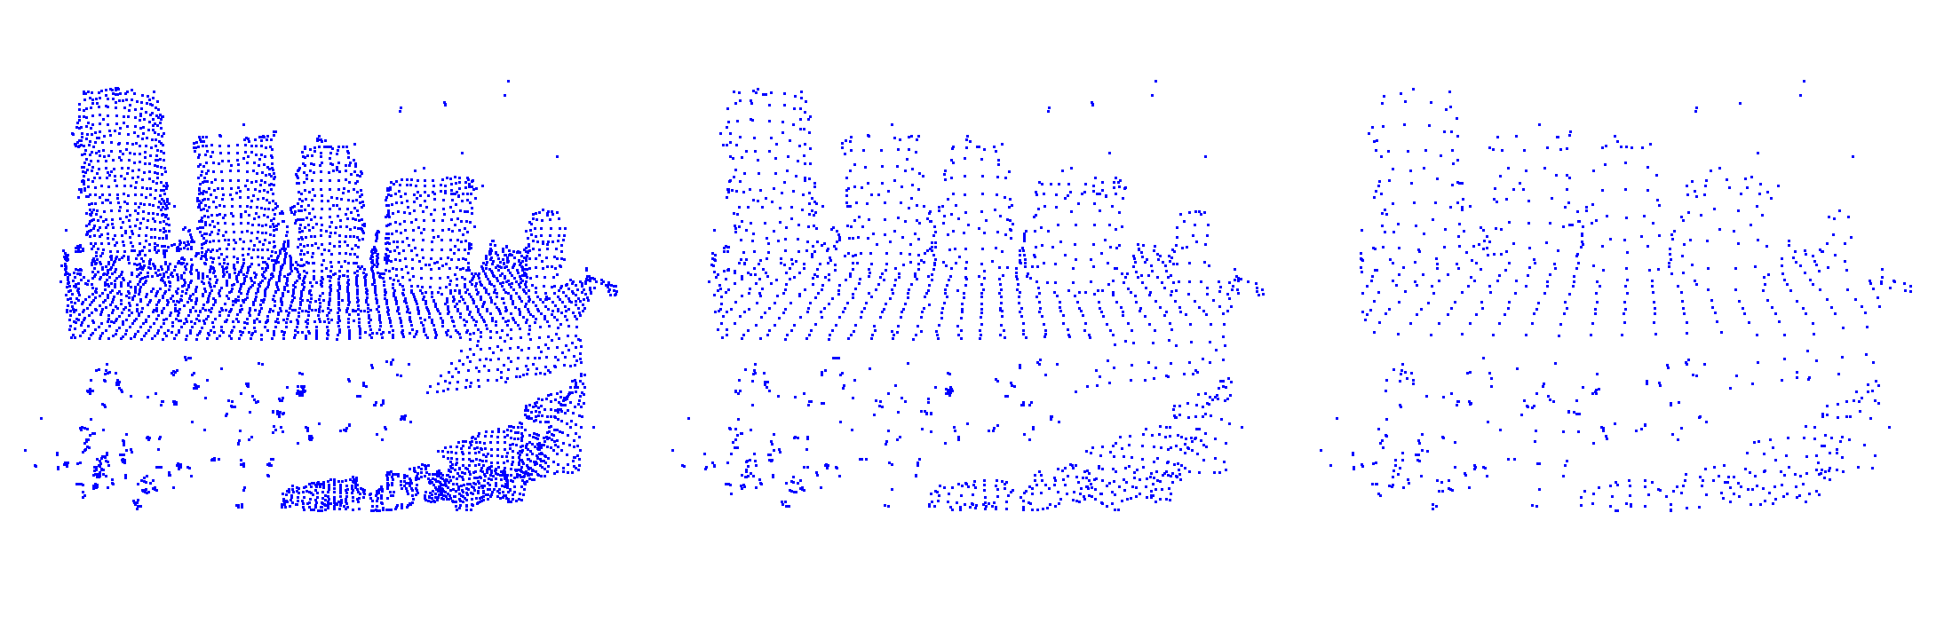
Voxel Filter
Leaf Size = 1 cm
Leaf Size = 2 cm
Leaf Size = 3 cm

Slide 3
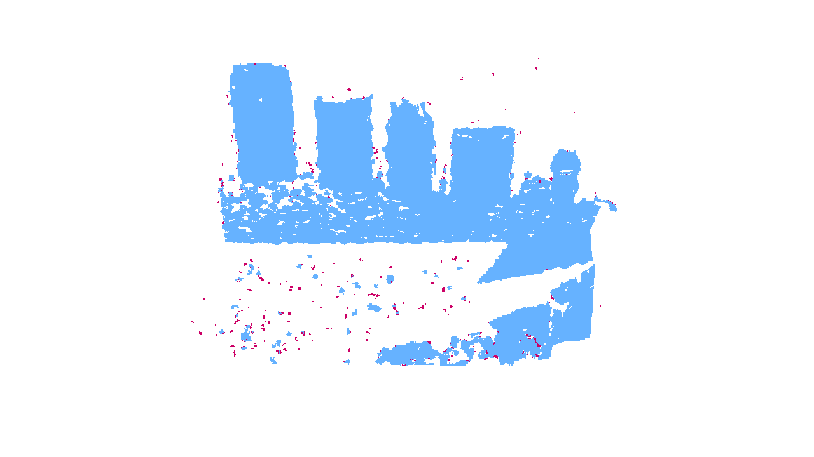

Noise Removal Filter: Nearest Neighbors
Nearest Neighbors = 10
Nearest Neighbors = 50

Slide 4
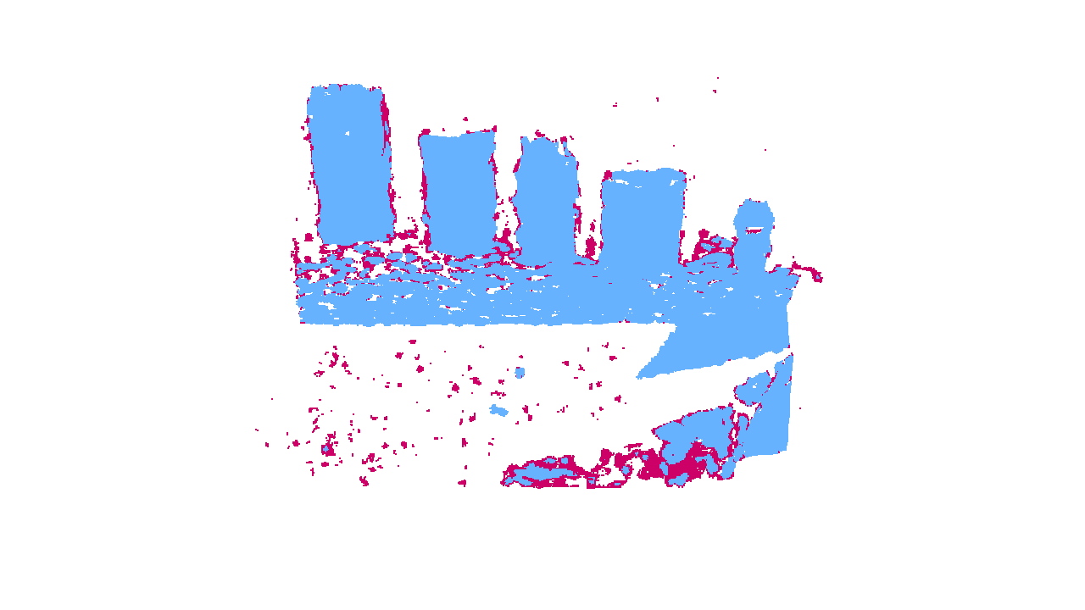

Noise Removal Filter: Standard Deviation
Standard Deviation = 0.1
Standard Deviation = 0.9

Slide 5
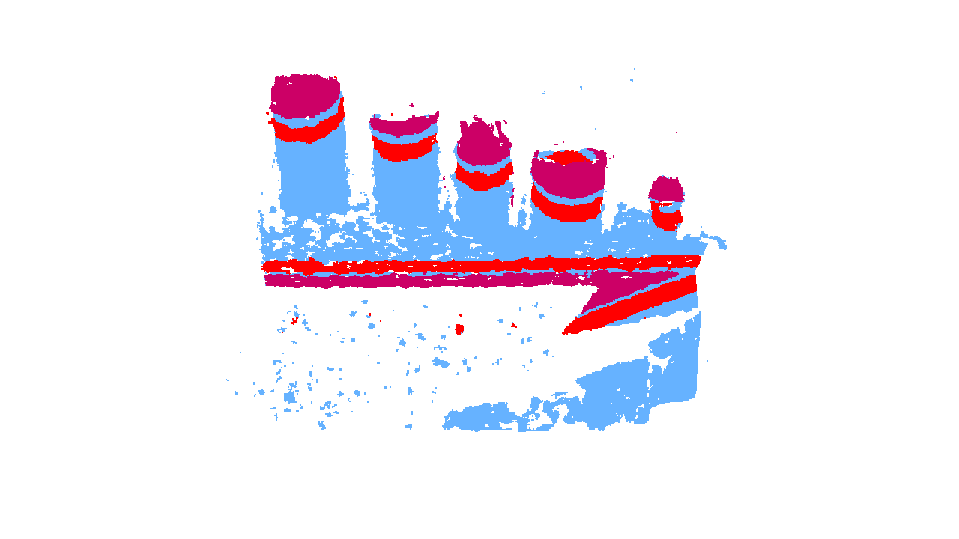
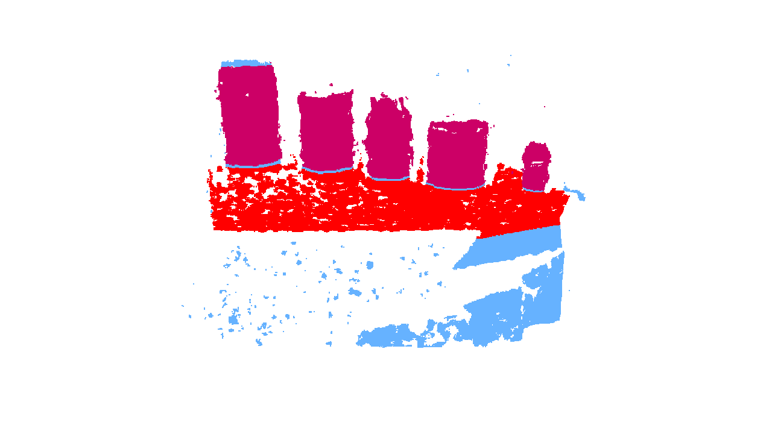
Prism Extraction: RANSAC Iterations
RANSAC Iterations = 200
RANSAC Iterations = 600

Slide 6
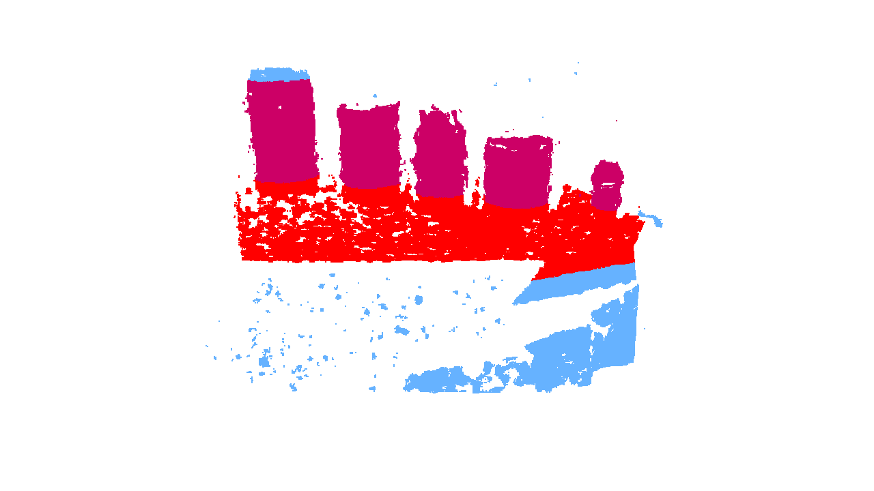
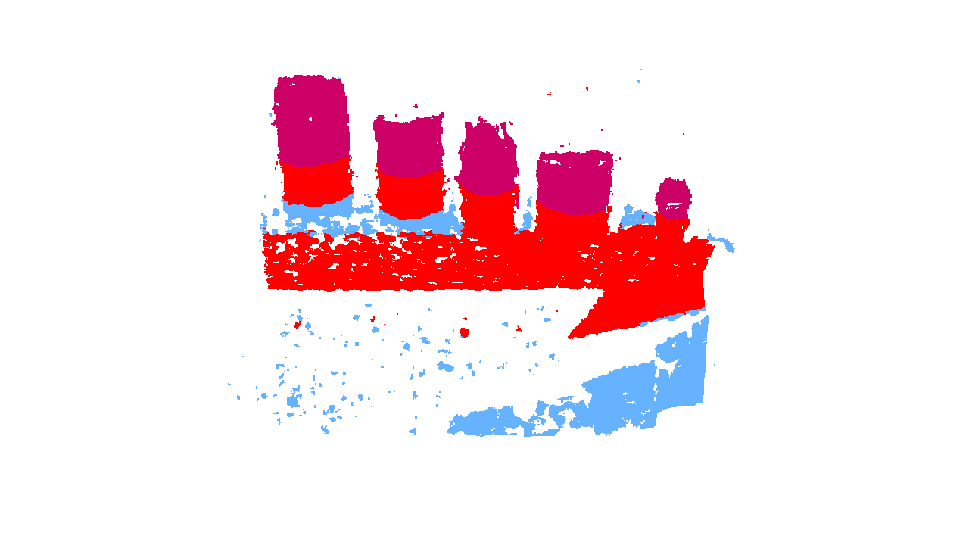
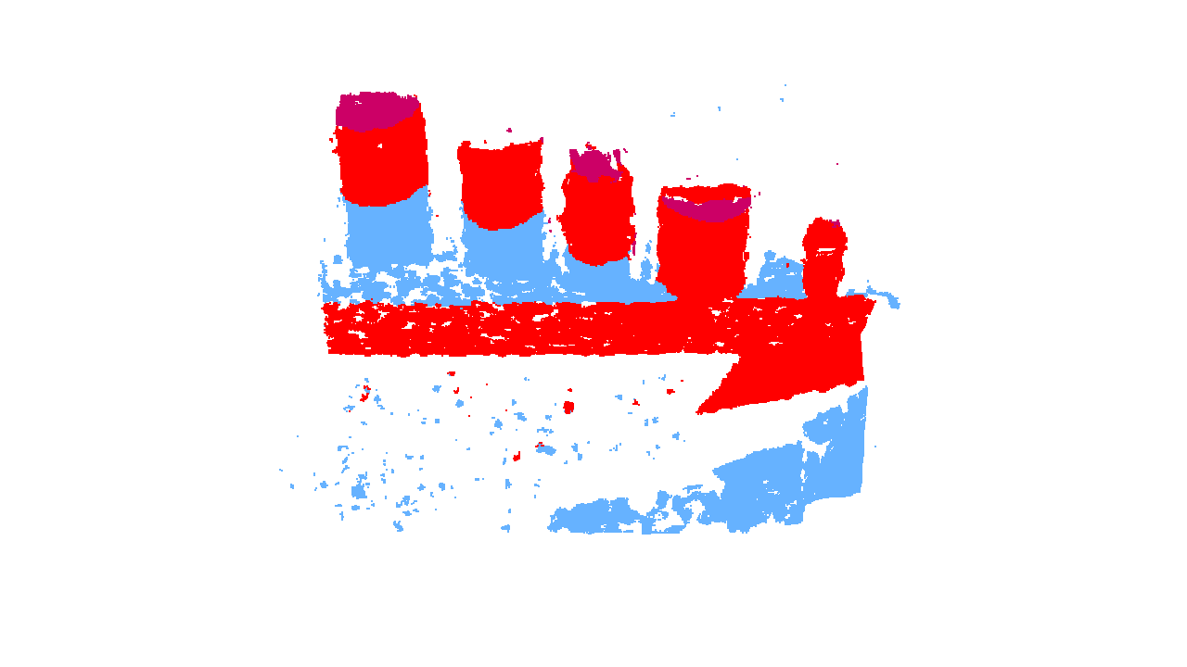
Prism Extraction: Threshold Distance
Threshold = 1 cm
Threshold = 2 cm
Threshold = 3 cm
Threshold = 4 cm

Slide 7
Testing Results

Slide 8
New Euclidean Cluster Tests
Here are the default parameters for the Euclidean Cluster Tests
Leaf Size = 2 cm
Number of Nearest Neighbors = 20
Standard Deviation = 1.0
Minimum Radius = 20 degrees
Maximum Radius = 70 degrees
RANSAC Iterations = 500
Threshold Distance = 1 cm
Minimum Inlier Distance above Plane = 2 cm
Maximum Inlier Distance above Plane = 20 cm

Slide 9
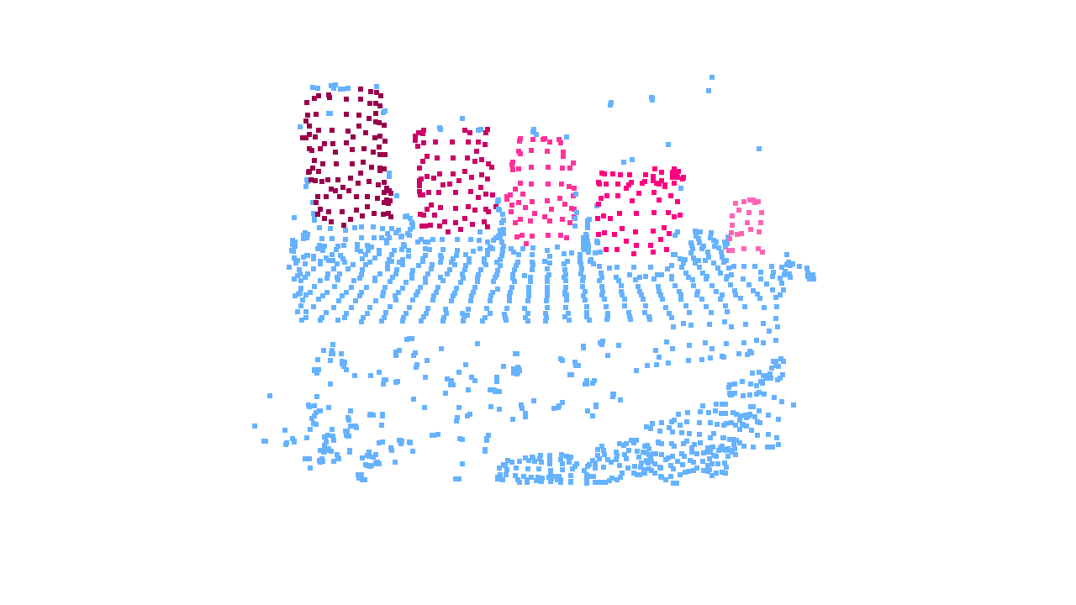
Euclidean Cluster Extraction

