Slide 1
second year project bachelor artificial intelligence TEAM PERCEPTUM
Recommending document links in the Starfish knowledge graph
Robbert van Ginkel, Jorn Peters & Lotte Weerts

Slide 2
CONTENTS
Product vision
Product pipeline
Evaluation
Demonstration

Slide 3
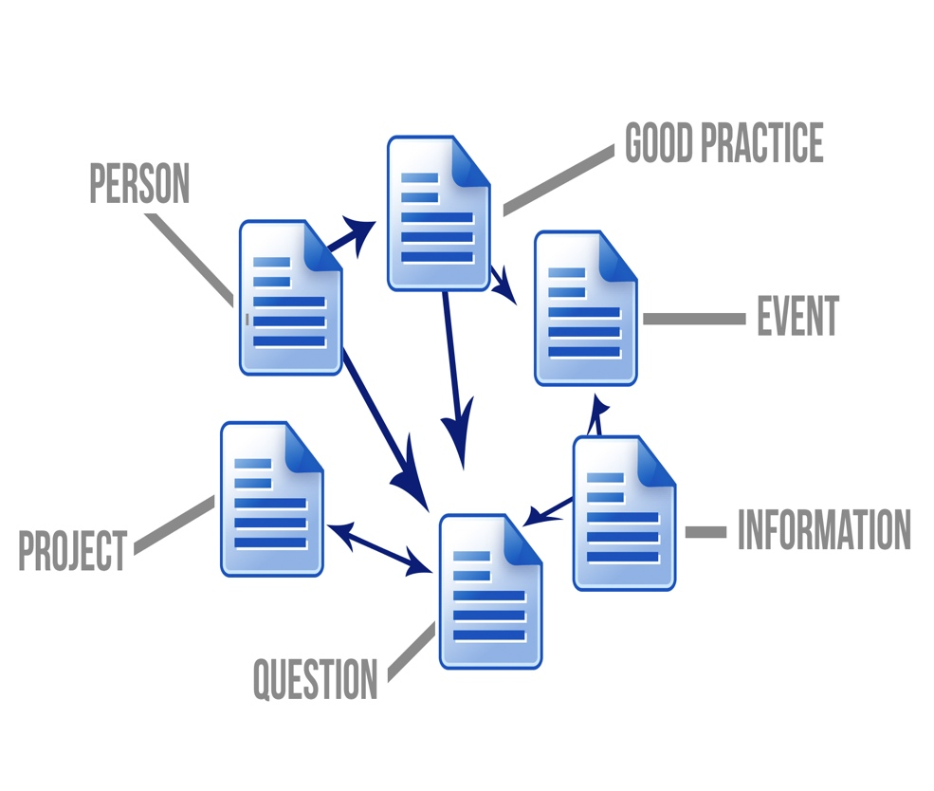
PRODUCT VISION
What is Starfish?
Platform for sharing knowledge on education innovation

Slide 4
PRODUCT VISION
Product pitch
For Startfish users
who search for and edit knowledge in Starfish
the document linker is a core system addition to StarFish
that finds related documents
Unlike moderated or individual/centralized linking our product uses algorithms and data to automatically suggest document links.

Slide 5
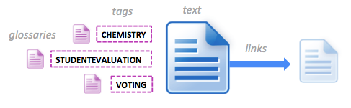
DOMAIN
Relevant document properties
Textual content of documents
Tags and their glossaries
Links to other docs

Slide 6
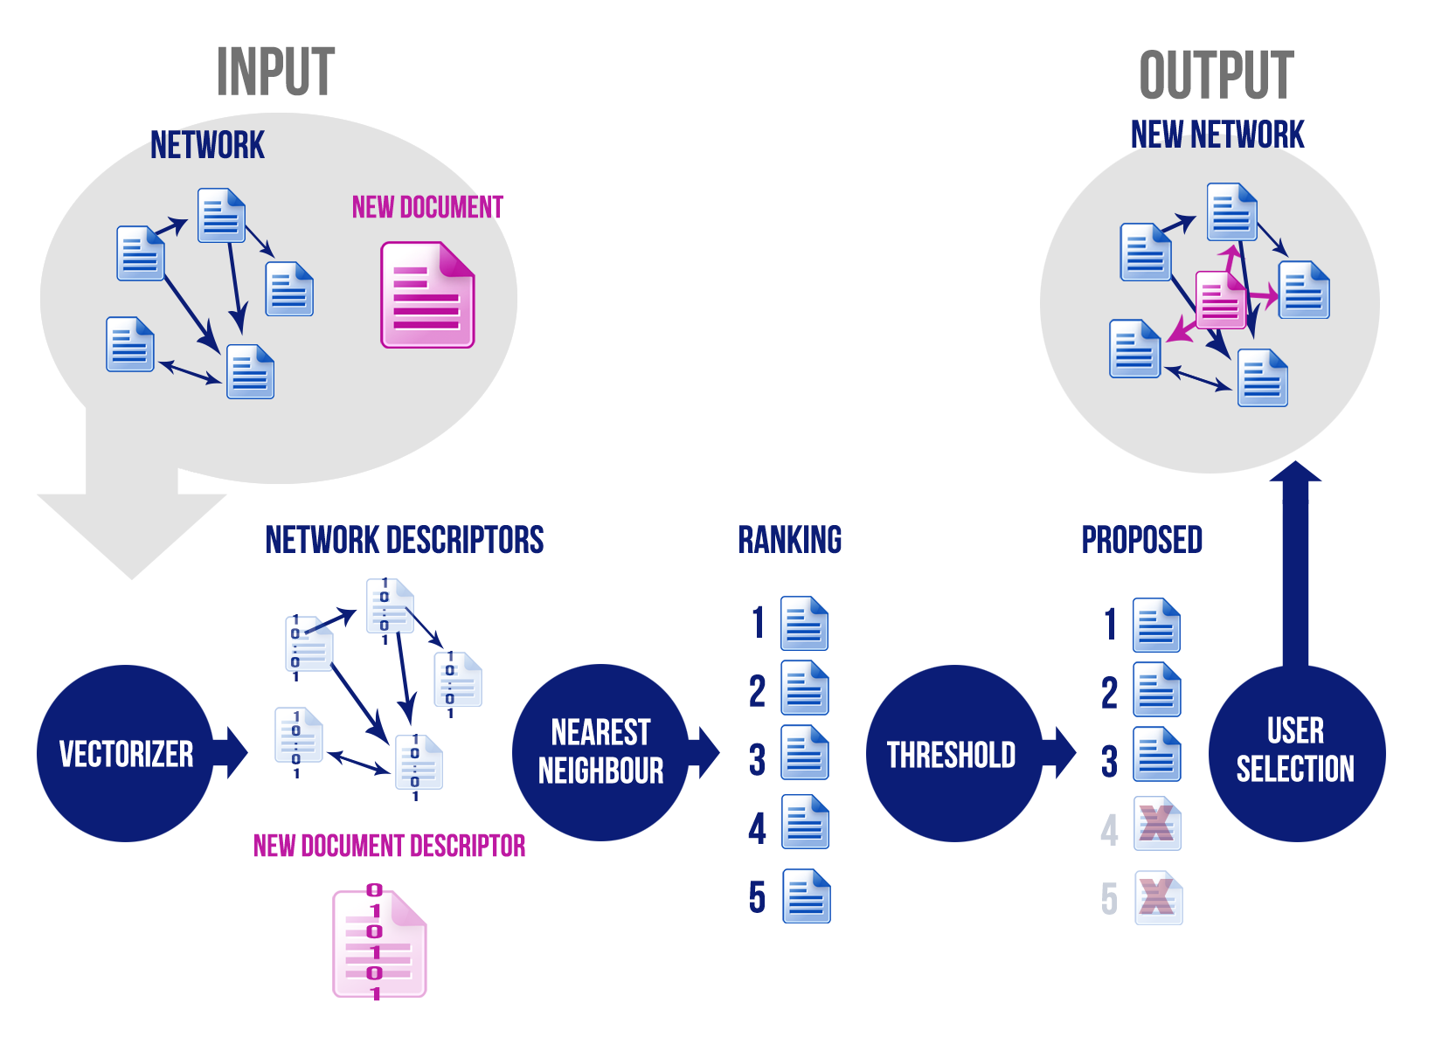
PRODUCT PIPELINE

Slide 7
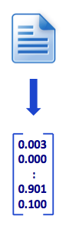
VECTORIZER
TEXT BASED: bag of words and TF-IDF
Textvectorizer
Weighted textvectorizer
TAG BASED: occurences and co-occurences of tags
Simple tag vectorizer
Tag smoothing vectorizer
HYBRID: TF-IDF of glossaries of tags
Glossaries of tags
Weighted glossaries of tags

Slide 8
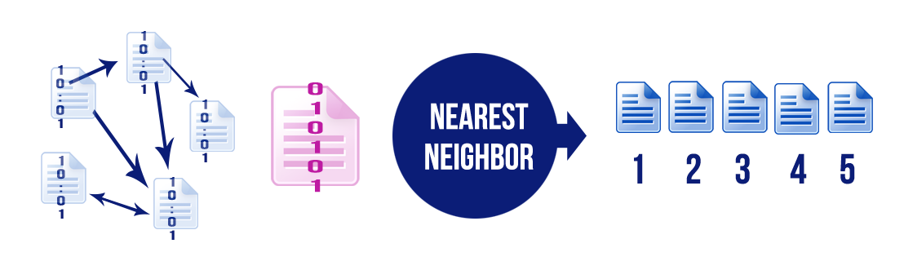
K-NEAREST NEIGHBOR
Calculate distance between descriptor of new document and descriptor of the knowledge base
Cosine
Correlation
Rank documents based on their distances

Slide 9
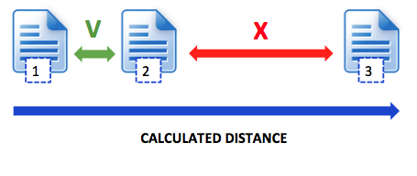
THRESHOLD
Cut off the number of returned documents based on the difference between distances of two consecutive ranks

Slide 10
EVALUATION METRICS
WITHOUT THRESHOLD: system returns same amount of links as the document is known to have Accuracy: correct docs / relevant docs
WITH THRESHOLD:
Precision: correct docs / returned docs User friendliness
Recall: correct docs / relevant docs Knowledge base coverage

Slide 11
VECTORIZER PERFORMANCE
TABLE

Slide 12
VECTORIZER PERFORMANCE
TEXT BASED + xx % accuracy on Questions - Relatively slow - Only applicable to textual content - Bad at handling language differences
TAG BASED: + xx % accuracy overall document types - xx % accuracy on Questions - Bad performance on no or badly labeled tags

Slide 13
EVALUATION THRESHOLD
TABLE

Slide 14
EVALUATION THRESHOLD
COMPARED WITH ACCURACY ON FIXED LINKS: + Higher precision/recall if tag-based/hybrid - Lower recall and precision of text-based

Slide 15
DEMONSTRATION

Slide 16
CONCLUSIONS
Use weighted text vectorizer for Questions
Use simple tag vectorizer for the rest
Overall performance of entire pipeline:
Precision: xx% of the recommendations make sense
Recall: xx% of the relevant documents in the knowledge base are shown

Slide 17
CONCLUSIONS
Use weighted text vectorizer for Questions
Use simple tag vectorizer for the rest
Overall performance of entire pipeline:
Precision: xx% of the recommendations make sense
Recall: xx% of the relevant documents in the knowledge base are shown

Slide 18
ACKNOWLEDGEMENTS
We would like to thank
Starfish expert Natasa Brouwer
Our academic supervisor Raquel Fernandez
Our clients (but also academic supervisors!) Robrecht Jurriaans and Robrecht Jurriaans

Slide 19
QUESTIONS?
Feel free to ask us!

