Slide 1

AI 623
Deep Vision-Language Models
Spring 2026
Muhammad Tahir

Slide 2

AI 623
Welcome to Class
“Computers are now able to speak, see, hear and learn. The future is already here—it’s just not evenly distributed. Welcome to this future ! ”
This is an advance course on Multimodal (Large) Language Models (MLLMs)
Large Language Model (LLM): Large model primarily trained on language and is able to understand text and generate text.
Vision Language Model (VLM): An LLM with a vision encoder, allowing it to understand language and images and generate text.
Multimodal (Large) Language Model (MLLM): A more general type of model that is built to process, understand and generate multiple modalities:
Text
Images
Video
Audio

Slide 3
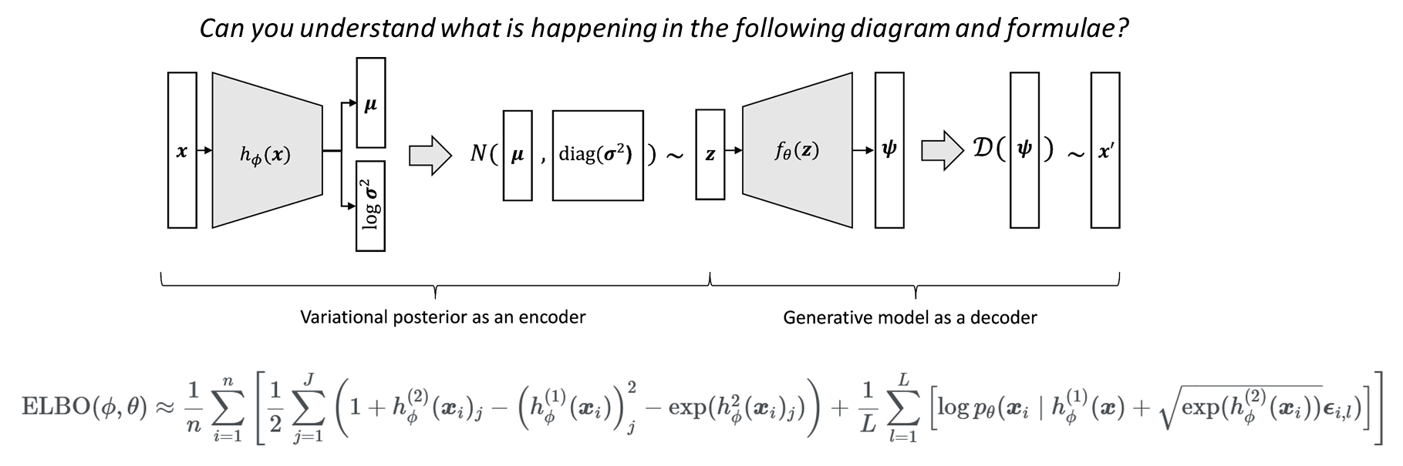

AI 623
Welcome to Class
What will we cover in the course? we will provide a rigorous treatment of Deep Generative Models for Text and Vision which serve as foundations for MLLMs.
What we will NOT cover:
Convolutions + Attention, CNNs, RNNs, LSTMs, Transformers, How to train + evaluate + build/deploy AI Models etc.
Pre-requisite: We require advance knowledge of:
Applied Probability + Multivariable Calculus + Deep Learning + PyTorch + Zero-assignment and zero-reading list

Slide 4
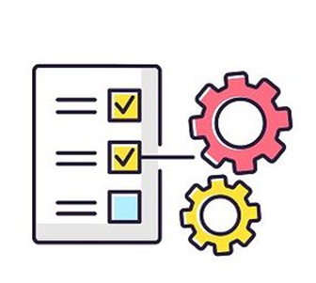
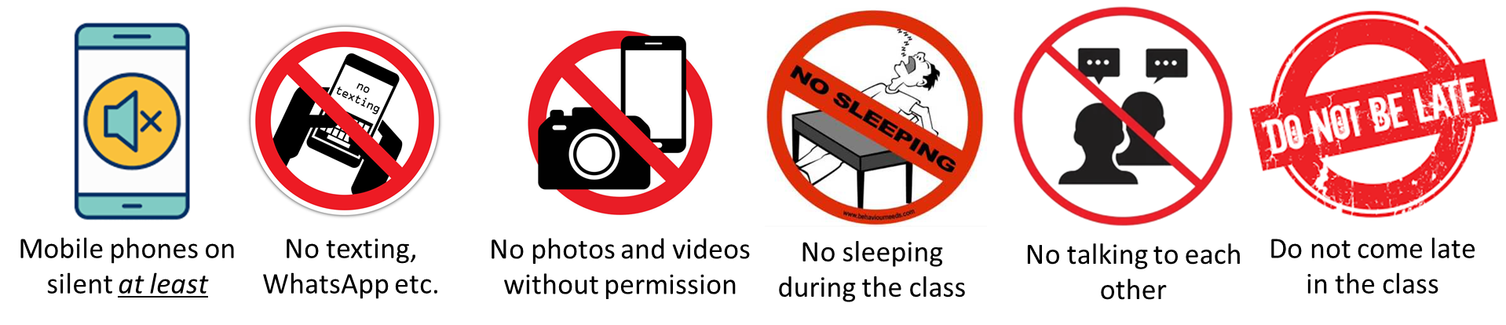
AI 623
Course Information
Course Website: Announcements, gradebook etc. on Slack + LMS course page.
Discussions: Slack Channel. We will only allow questions that are related to the course material.
Grading Breakup:
Attendance: 5%
Programming Assignments (PAs): (individual) 40%
Final Project: (in groups) 35%
Final Exam: 20%
Leave Policy:
No N-x policy for PAs.
If you have more than 2 absents by the end of the course, we will start deductions.
Missed assessments: we will require approved OSA petitions for entertaining these requests.
Open Books + Open-Notes: All written assessments will be open-book open notes.
Class Etiquettes and Rules:

Slide 5
AI 623
Course Information
Course Notes: I will provide my hand-written notes. You are highly recommended to make your notes.
Reference Material:
Books:
Holderrieth, Peter, and Ezra Erives. "An Introduction to Flow Matching and Diffusion Models." arXiv preprint arXiv:2506.02070 (2025): https://arxiv.org/abs/2506.02070
Lai, Chieh-Hsin, et al. "The principles of diffusion models." arXiv preprint arXiv:2510.21890 (2025): https://arxiv.org/abs/2510.21890
Zhang, Duzhen, et al. "Mm-llms: Recent advances in multimodal large language models." arXiv preprint arXiv:2401.13601 (2024): https://arxiv.org/abs/2401.13601
Every PA will contain a reading list of papers.
Following courses are helpful:
Stanford CS336: Language Modeling from Scratch: https://stanford-cs336.github.io/spring2025/
MIT Course 6.S184: Introduction to Flow Matching and Diffusion Models: https://diffusion.csail.mit.edu/2026/index.html
KAIST CS492(C): Diffusion and Flow Models: https://diffusion.kaist.ac.kr/
Simple Diffusion Language Modeling: https://github.com/ZHZisZZ/dllm
CMU 11-777: MultiModal Machine Learning: https://cmu-mmml.github.io/fall2024/
Stanford CS224n: Natural Language with deep Learning: https://web.stanford.edu/class/archive/cs/cs224n/cs224n.1184/syllabus.html

Slide 6
AI 623
Course Information
AI Usage Policy: Overreliance on generative AI will give you a false sense of how much you’ve actually learned, which will lead to poor performance in future work or studies after graduation. We recommend you use generative AI as a supplementary tool only for exploration and/or drafting the PA/project code/content.
Plagiarism Policy:
Collaboration on the PAs is not allowed. Discussion of assignments is allowed BUT it should be limited to concept clarification without sharing of pseudocode or code or results or solved problems.
Violation of this policy will be used as grounds for a disciplinary action in accordance with LUMS regulations.
PA Evaluations Policy:
Programming Assignments (PAs) will be conducted individually.
For each PA, all required notebooks will be released on a specified date.
Students must complete the PA within the assigned time window.
We will NOT grade your submissions. During grading period, each PA will be evaluated through two components:
Oral Assessment: 60% of the PA grade
Written Assessment: 40% of the PA grade
Final Project Evaluations:
Final project will be performed in a group of 2-3 people.
We will assign final projects in the mid of March.
As a submission, we will need: a PDF report + Code repo. + Group Presentation + Individual Oral Viva

Slide 7
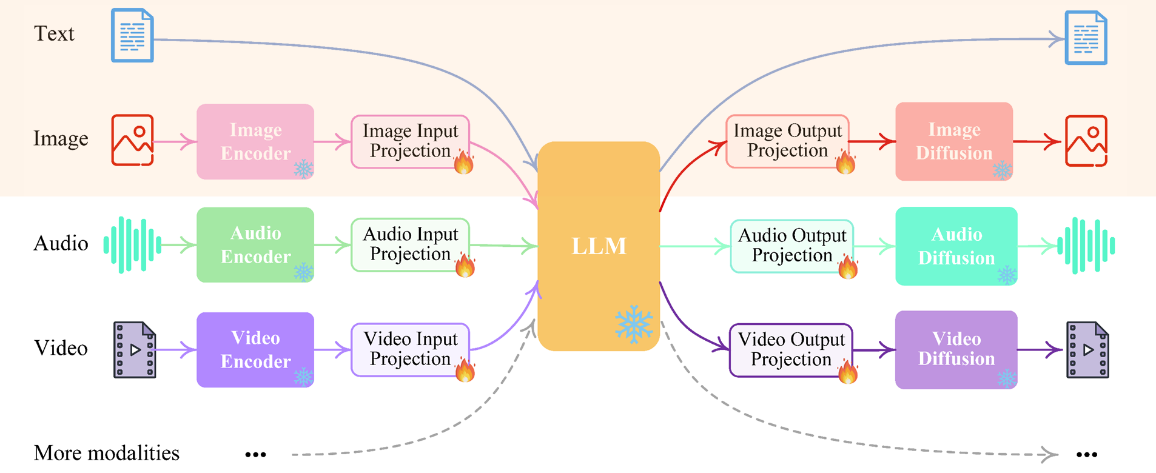
AI 623
MultiModal Basics
This is an advance course on Multimodal (Large) Language Models (MLLMs) but focuses on only two modalities: Text and Images

