Slide 1
Cryptocurrency Price Correlations
Do Bitcoin and Ethereum Move Together?
A Correlation Study Using CoinGecko Historical Data | Tableau Dashboard Analysis
Data Visualization Laboratory
Lab CA
Shreya Menon 16010123324
Shreyans Tatiya 16010123325
Siddhant Raut 16010123331

Slide 2
Source of Data & Metadata
DATA SOURCE
COLUMNS IN MERGED DATASET
Provider
CoinGecko (coingecko.com)
snapped_at (Date)
ETH_Price
BTC_Price
ETH_Volume
Assets
Bitcoin (BTC) & Ethereum (ETH)
BTC_Volume
ETH_MarketCap
Date Range
January 2016 – December 2025
BTC_MarketCap
Frequency
Daily snapshots (1 row per day)
METHODOLOGY STEPS
Format
CSV export → Python merge → Tableau
1
Download BTC & ETH CSVs from CoinGecko
Rows
~3,300 rows per asset after merge
2
Merge on 'snapped_at' date using Python pandas
3
Clean date format (remove UTC timestamp)
4
Connect crypto_merged.csv to Tableau Desktop
5
Build 4 charts + assemble interactive dashboard
6
Add Year filter applied to all worksheets

Slide 3
Objectives of Analysis
01
Measure Price Correlation
02
Track Correlation Over Time
Quantify the statistical relationship between BTC and ETH prices over 9 years (2016–2025) using Pearson correlation coefficients and rolling window analysis in Tableau.
Examine whether the BTC–ETH correlation has strengthened, weakened, or remained stable over time and identify key turning points linked to real market events.
03
Identify Decoupling Events
04
Draw Portfolio Implications
Pinpoint specific months and years where the two assets diverged, and explain the catalysts behind those decoupling events such as the Terra/Luna collapse and ETH Merge.
Assess whether holding both BTC and ETH provides meaningful portfolio diversification, or whether they represent the same underlying risk exposure for investors.

Slide 4
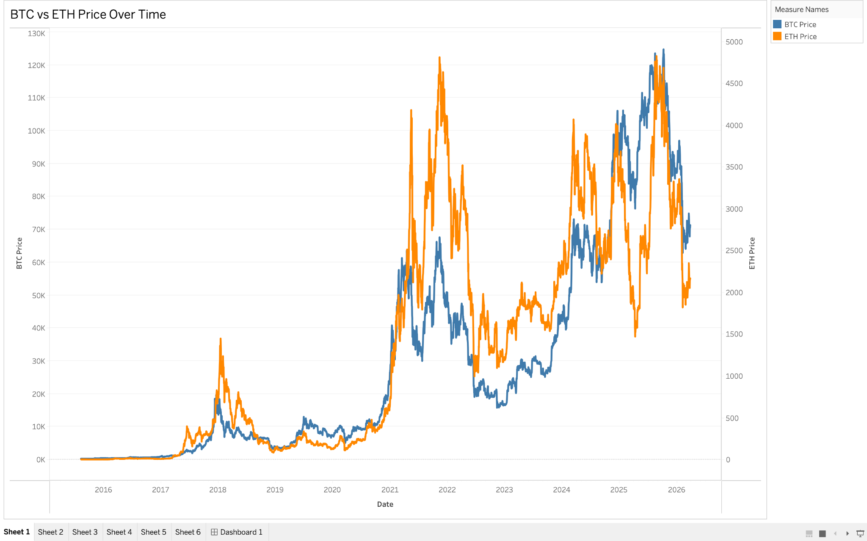
What it shows
Dual axis line chart tracking BTC (blue) and ETH (orange) daily closing prices from 2016 to 2025 on independent Y-axes
Key observation
Both coins were flatlined near zero until 2020, simultaneously exploded in 2021 reaching all time highs, crashed together in 2022, and recovered together in 2024 the shapes of both lines are nearly identical across 9 years
Critical insight
ETH in 2021 briefly outperformed BTC the orange line crossed above suggesting ETH has moments of independent momentum, but always returns to following BTC's direction

Slide 5
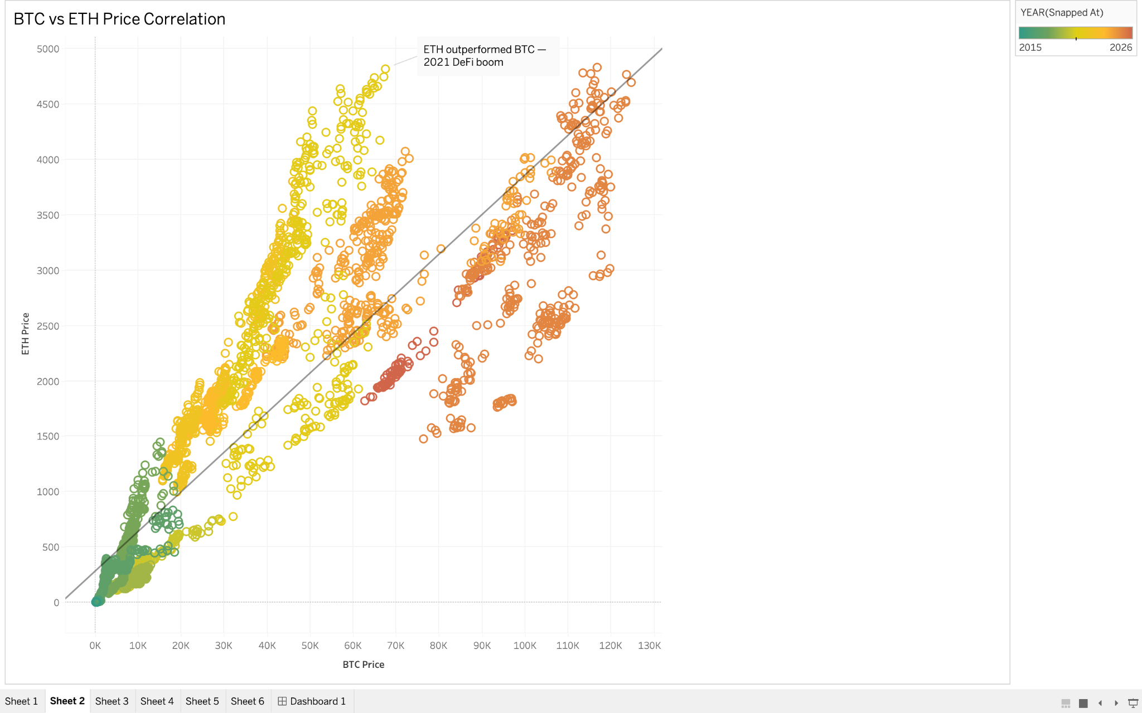
What it shows
Each dot represents one month X axis is BTC price, Y axis is ETH price with a linear trend line fitted across all data points
Key observation
Dots cluster tightly along an upward diagonal trend line with almost no horizontal or vertical outliers green dots (early years) sit bottom left, yellow dots (2021) jump to upper right, confirming both moved up together
Critical insight
The trend line never flattens or curves downward meaning there is no price level at which BTC and ETH stopped moving together. The relationship is consistent across all market conditions from bear to bull

Slide 6
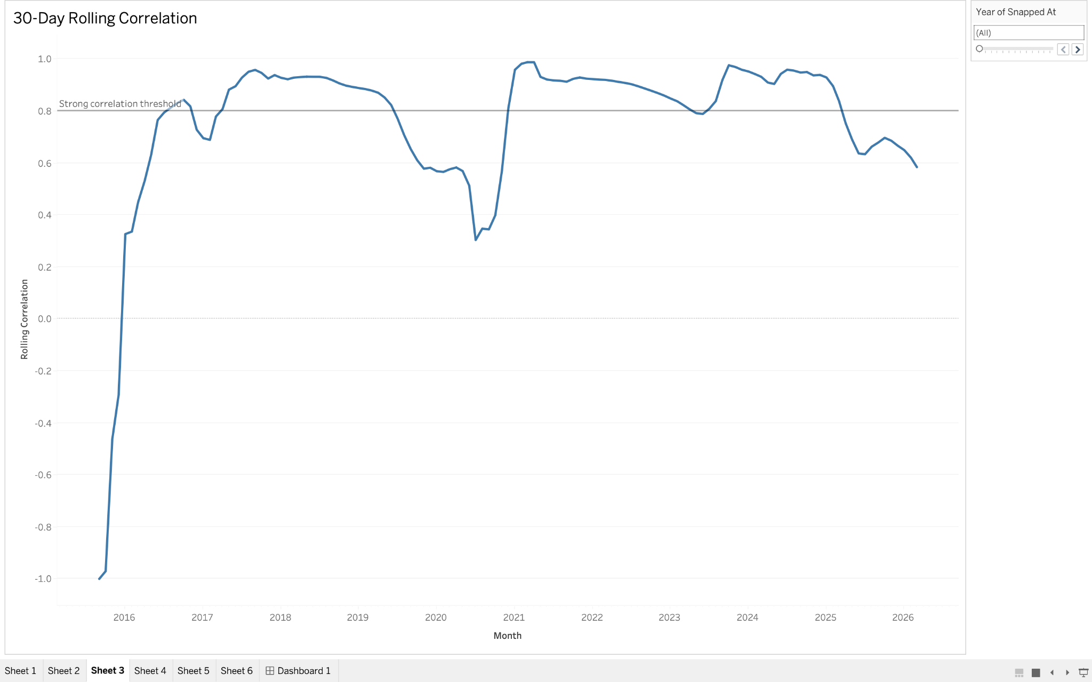
What it shows
A line tracking the 30-day rolling correlation coefficient between BTC and ETH prices over time ranging from -1 (opposite movement) to +1 (perfect co-movement) with a reference line at 0.8 marking the strong correlation threshold
Key observation
Correlation started deeply negative in 2016 (-1.0), was volatile through 2017-2019, then crossed the 0.8 threshold permanently around 2020 and has largely stayed above it with one significant dip in 2022 during the Terra/Luna and FTX collapse
Critical insight
Correlation was not always high it was built gradually as institutional investors entered the market post-2020 and began treating all crypto as a single asset class. The 2022 dip proves it can break down but only temporarily during extreme systemic shocks

Slide 7
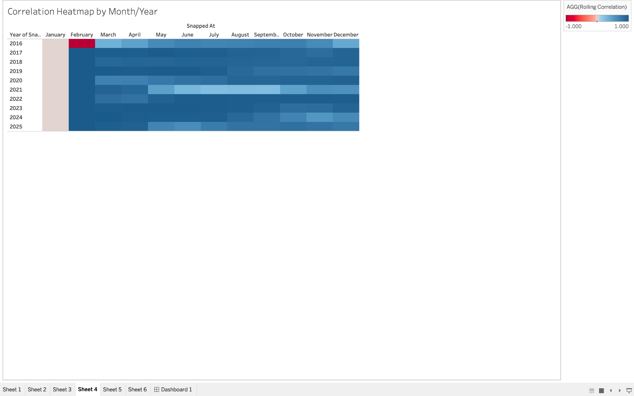
What it shows
A matrix of correlation values by month and year deep blue means strong positive correlation (close to 1.0), red means negative or weak correlation, beige means insufficient data allowing you to pinpoint exactly when and for how long correlation broke down
Key observation
2016 shows red and light cells weak or negative correlation. From 2018 onwards the heatmap turns progressively deeper blue. Light patches appear in mid-2021 and mid-2022 the only sustained periods of weaker correlation in the modern era
Critical insight
The light patches in 2021 align exactly with DeFi summer and NFT boom ETH-specific narratives that temporarily gave it an independent price story. The 2022 light patch aligns with the ETH Merge upgrade. ETH only decouples when it has its own fundamental catalyst otherwise it is a BTC follower

Slide 8
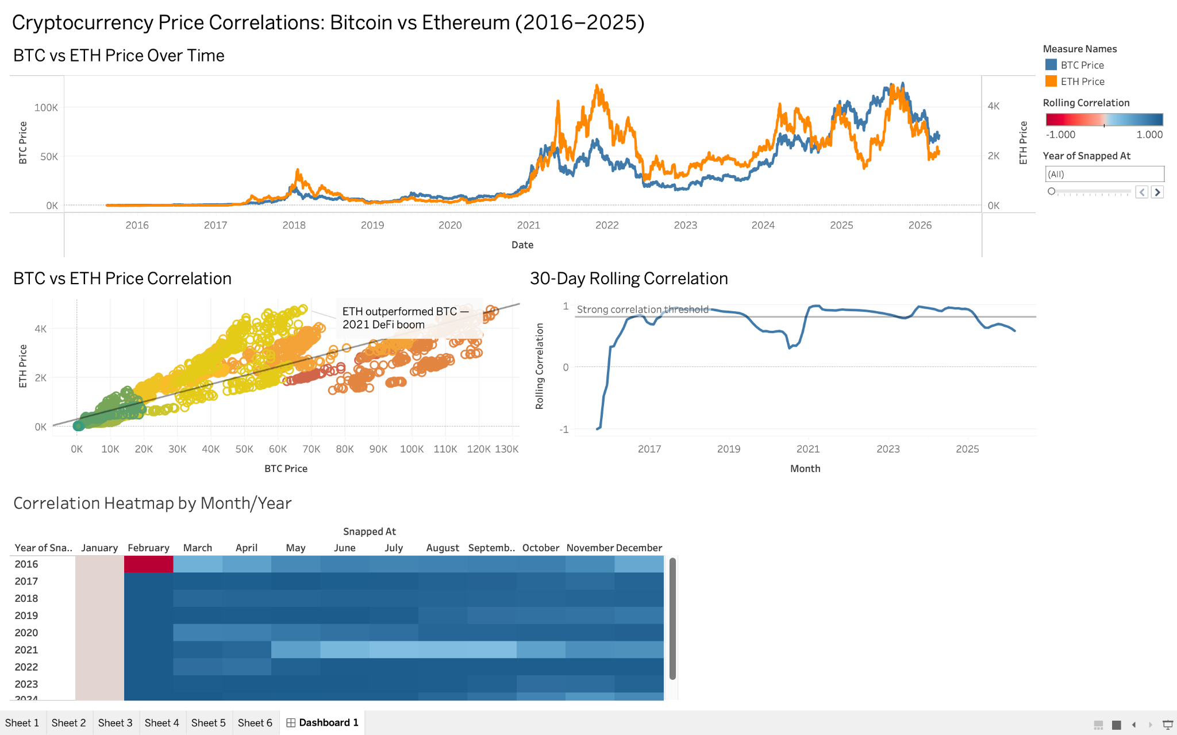

Slide 9
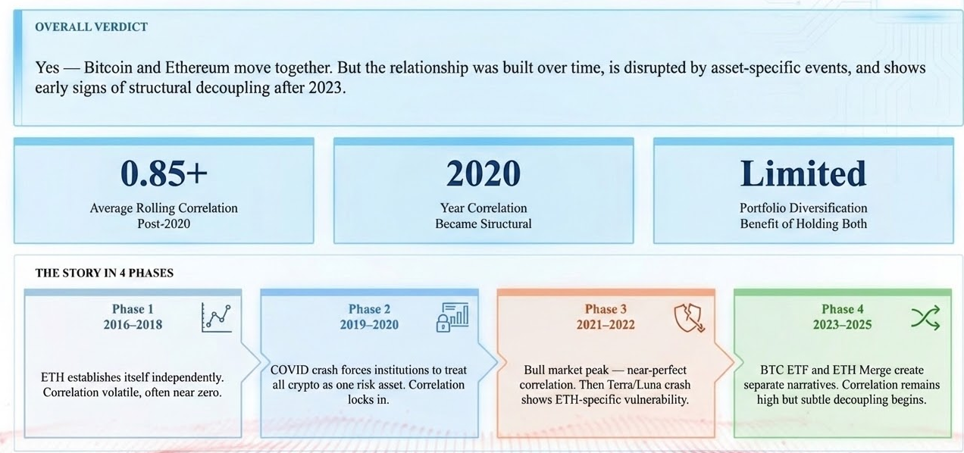
Dashboard: Final Interpretation

Slide 10
THANK YOU
"The data shows that Bitcoin and Ethereum have converged into a unified crypto risk asset — driven by the same forces, peaking together, and crashing together. Understanding their correlation is essential for any serious crypto investor or analyst."

