Slide 1
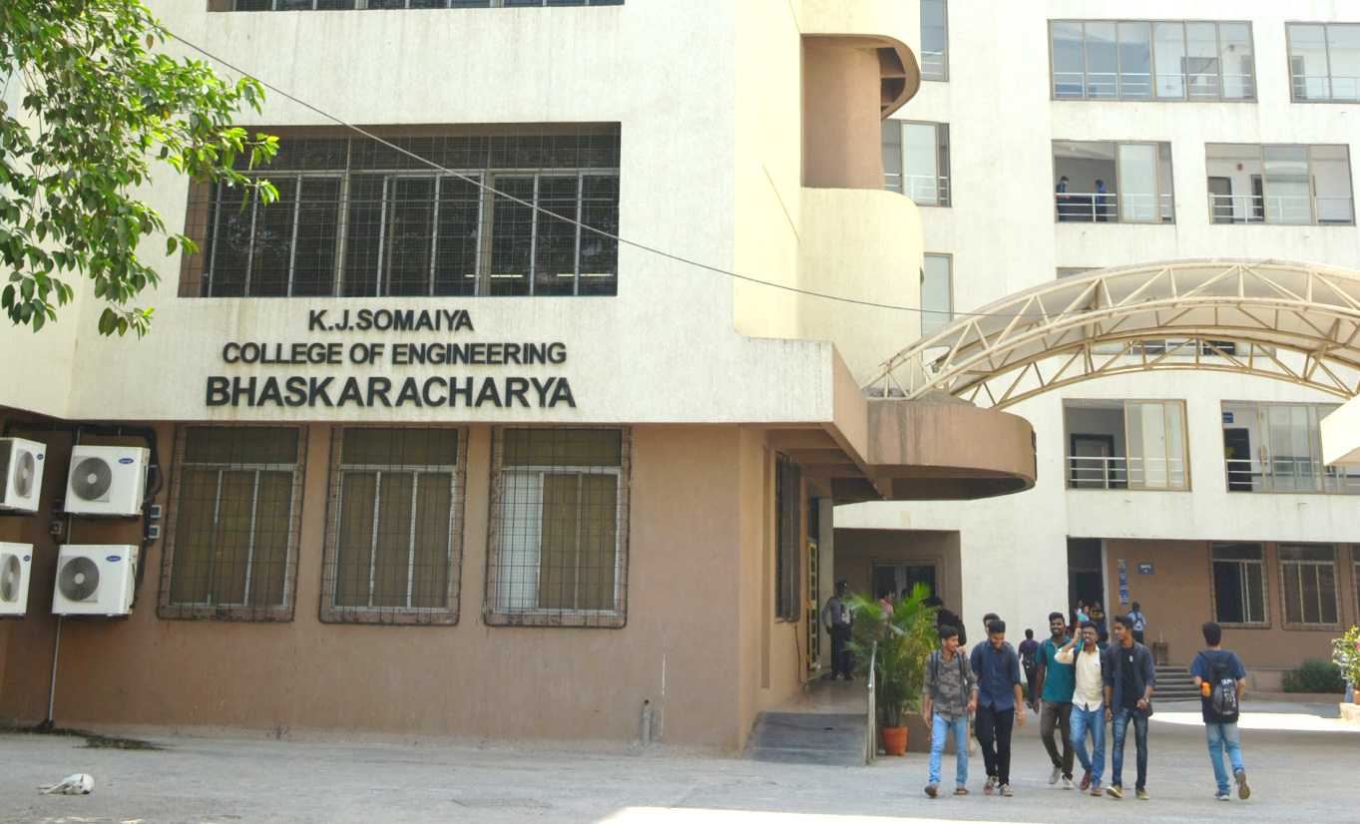
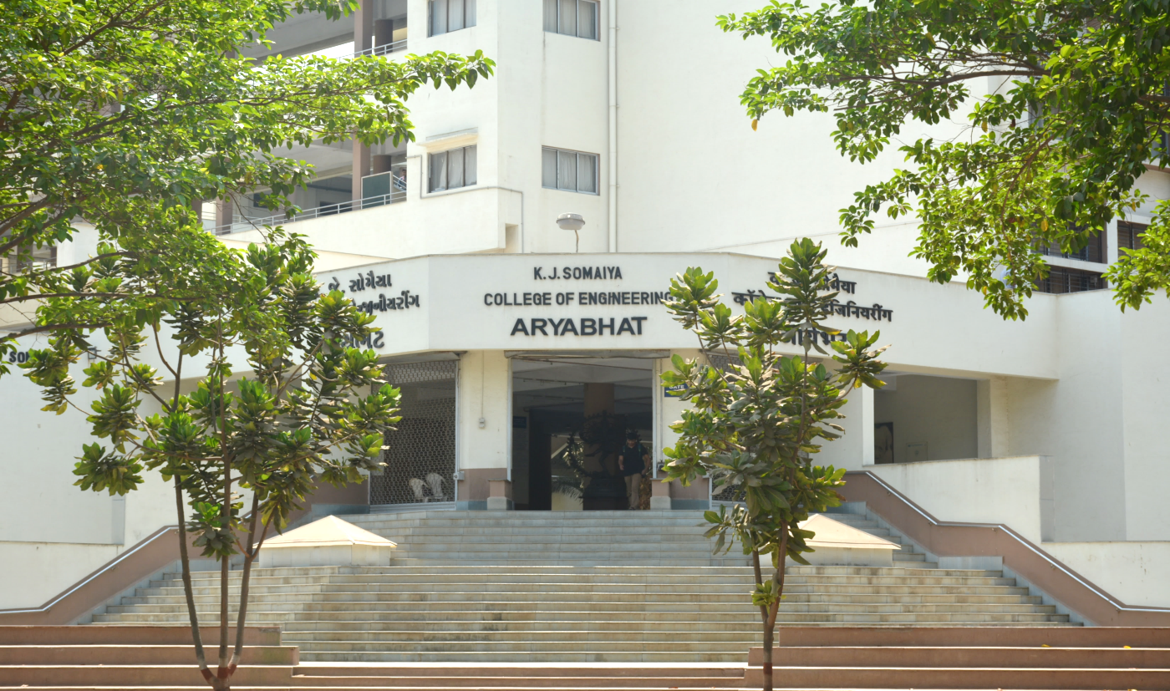
SimpleMem: Efficient Lifelong Memory for LLM Agents
Shreyans Tatiya
TY-C

Slide 2
SimpleMem: Efficient Lifelong Memory for LLM Agents
Jiaqi Liu*, Yaofeng Su*, Peng Xia, Siwei Han, Zeyu Zheng, Cihang Xie, Mingyu Ding, Huaxiu Yao
UNC Chapel Hill | UC Berkeley | UC Santa Cruz
arXiv, January 2026

Slide 3
Background
Large Language Model (LLM) Agents
Used in chatbots, assistants, autonomous agents
Limited by fixed context window
Cannot efficiently handle long multi-session conversations
Problem in Existing Systems
Full-context storage → redundant information
Iterative filtering → high token & computational cost
Context inflation → degraded reasoning performance

Slide 4
Research Problem
Core Problem
How to design an efficient lifelong memory system for LLM agents that:
Maintains long-term interaction history
Removes redundant dialogue
Preserves important semantic information
Minimizes token usage during inference

Slide 5
Motivation
Future AI agents require:
Multi-session reasoning
Temporal understanding
Personalized long-term memory
Efficient computation
Existing approaches fail to balance:
Full-context storage → redundant information
Iterative filtering → high token & computational cost
Context inflation → degraded reasoning performance

Slide 6
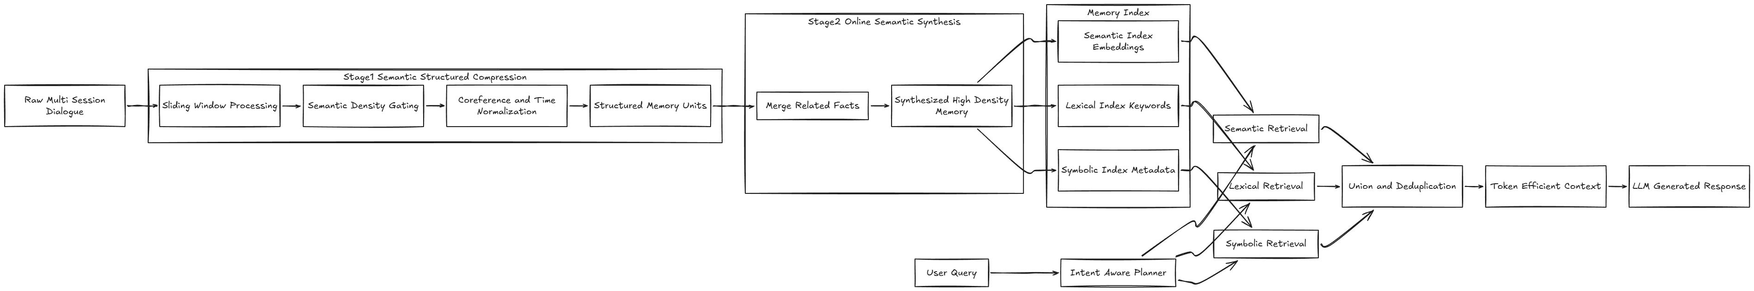
SimpleMem Architecture

Slide 7
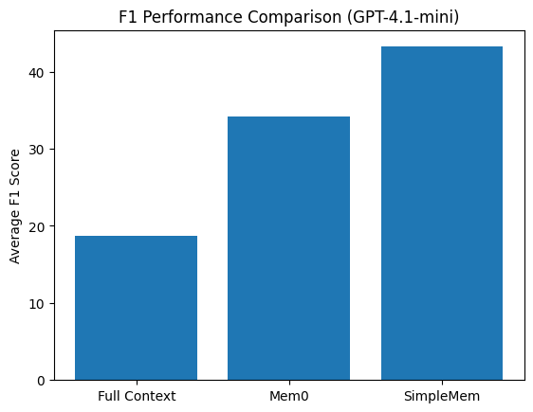
Performance Results (GPT-4.1-mini)
Average F1 Score:
Full Context: 18.70 | Mem0: 34.20 | SimpleMem: 43.24
+26.4% improvement over Mem0

Slide 8
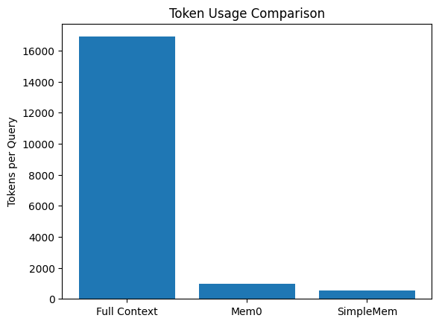
Token Efficiency
Full-context systems: ~16,900 tokens/query
SimpleMem: ~531 tokens/query
~30× reduction

Slide 9
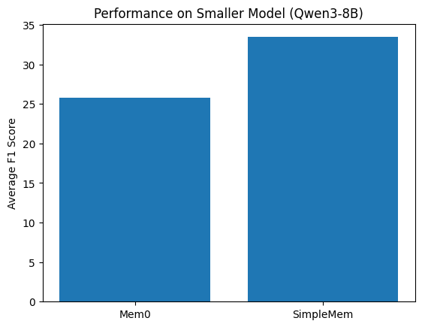
Performance on Smaller Models
Qwen3-8B: SimpleMem 33.45 F1 vs Mem0 25.80 F1
Qwen2.5-1.5B: Strong performance despite low parameters
SimpleMem enhances capability across all model sizes

Slide 10
Conclusion
Filters low-density dialogue effectively
Normalizes temporal references
Synthesizes related information intelligently
Uses adaptive multi-view retrieval
Achieves state-of-the-art performance with 30× lower token cost

