Slide 1
Python 101

Slide 2
Step 1: Download and Install Python 3
https://www.python.org/downloads/

Slide 3
Step 2: Download PyCharm
https://www.jetbrains.com/student/
Click on “Apply now” and fill out the form. Use your QuestU email address!
Download PyCharm only. JetBrains makes other programs but we only need PyCharm.
Install PyCharm Pro Version and do whatever the instructions say

Slide 4
Step 3: Configure PyCharm for SFTP
Create a new “Pure Python” project, and save it somewhere logical on your computer
After creating the project, configure DEPLOYMENT:
In Deployment, configure for SFTP to your brick. Make sure you change the IP address to match that on the brick. It will be 192.168.1.x.
Ensure you are on the Lego WiFi network.
Ensure the robot is on the Lego WiFi network.
Set up the SFTP connection with the following settings (next slides)

Slide 5
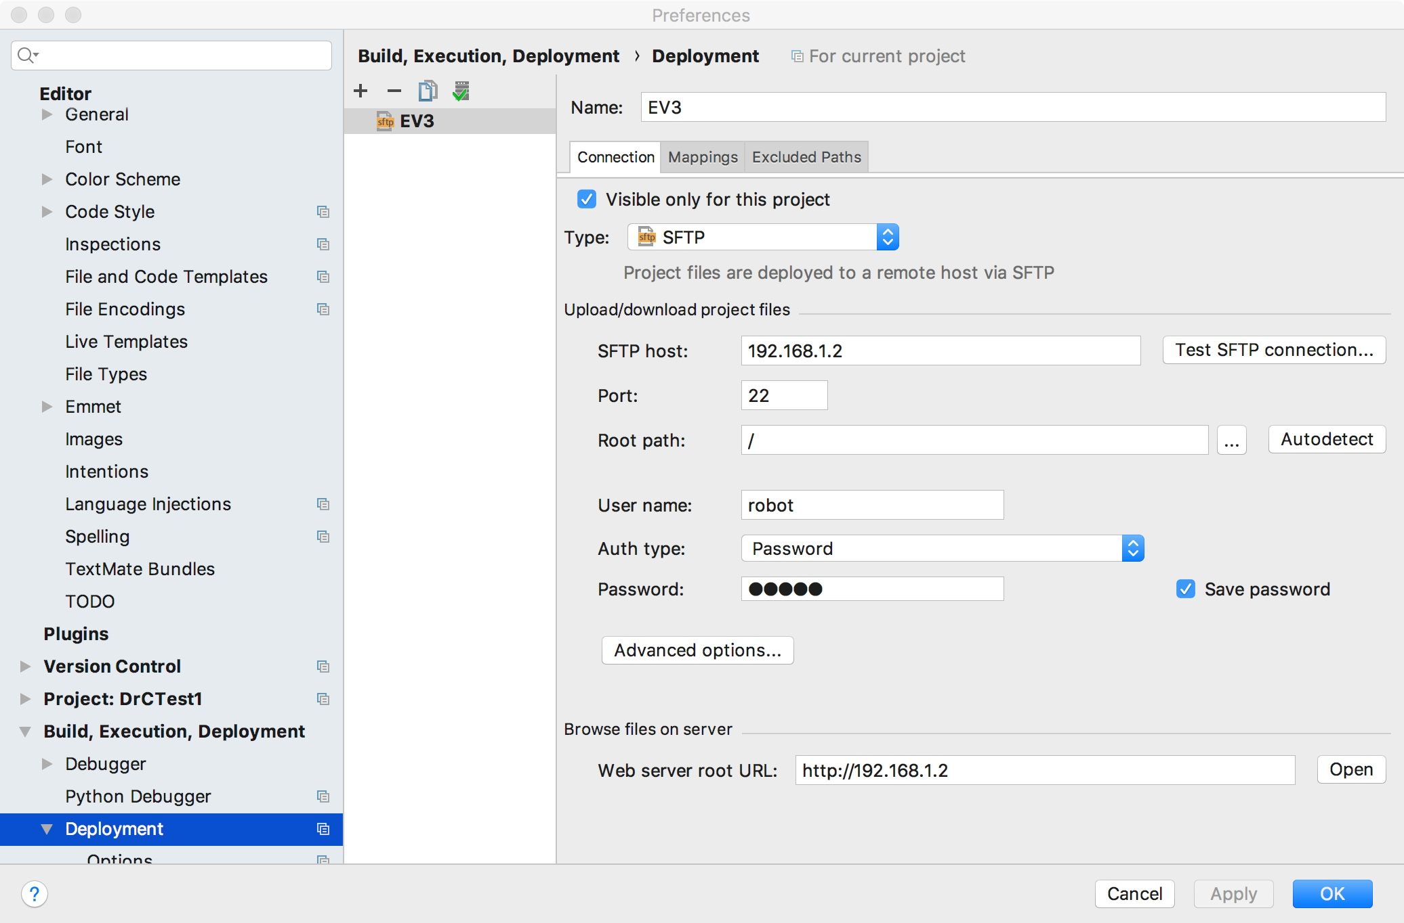

Slide 6
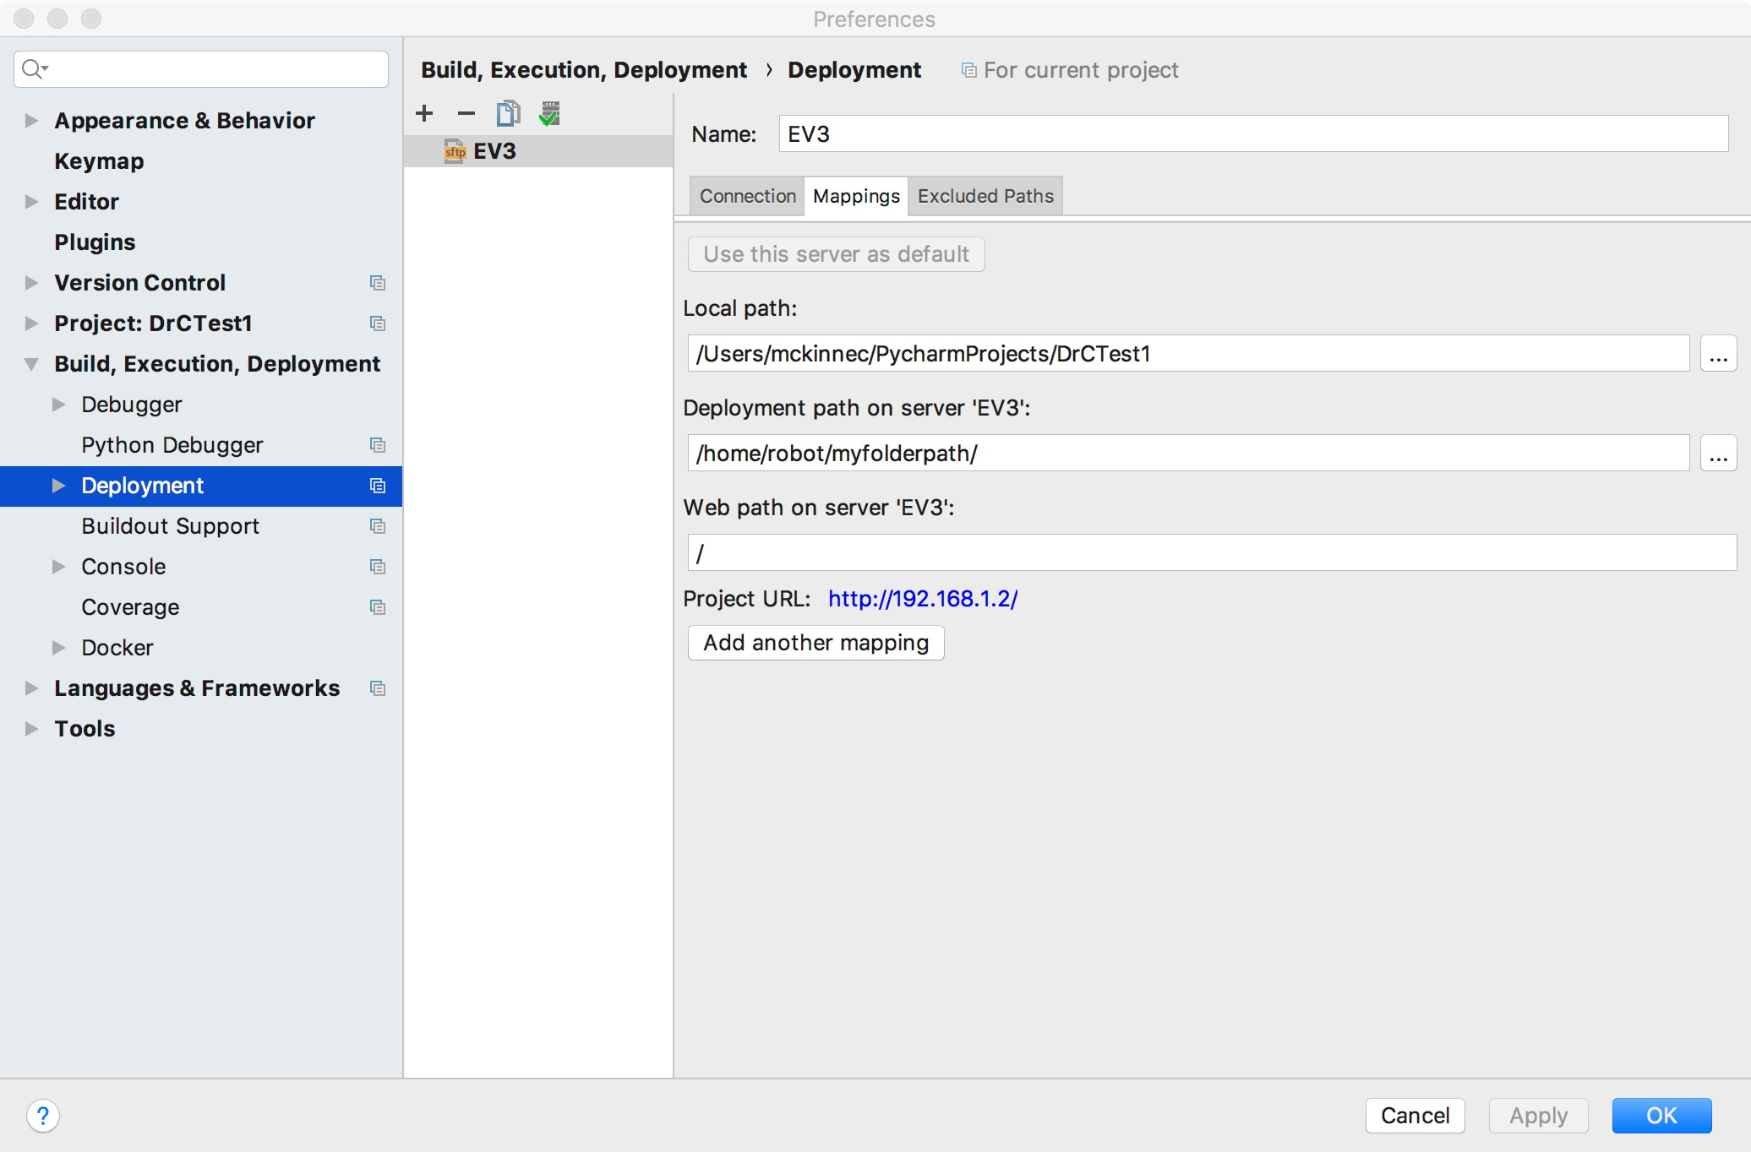

Slide 7
Step 4: Configuring EV3Dev support
In Project->Project Interpreter, add python-ev3dev to the list.
This allows EV3 specific commands to be loaded in and autoconfigured in the Python code editor

Slide 8
Step 5: Write some code
This example will run a large motor, connected to port A, for 3 seconds at speed 100. The range of speeds is 0 to 1000 in EV3DEV Python.
from ev3dev.auto import * import time m = LargeMotor(OUTPUT_A) m.run_timed(time_sp=3000, speed_sp=100)

Slide 9
Step 6: Upload code to Brick
Right click in the code editor, and select Upload to EV3.

Slide 10
Step 7: Connect to brick and execute code
Use an SSH client. For Mac, click Terminal in PyCharm, or use the Terminal app. For Windows, get a Mac.
In terminal, type: ssh robot@192.168.1.x
The password is maker
Replace x with the IP of your robot
One logged in, type cd myfolderpath to change directory
Execute program by typing python3 programname.py
Make a sandwich and wait for the code to compile/run

Slide 11
Python Basics
The top part of the program imports the necessary libraries.
The next bit should define what motors or sensors are connected, and to what ports. You can name them whatever. For example, you could say
LeftMotor = LargeMotor(OUTPUT_A), or
LM = LargeMotor(OUTPUT_A)
But you can’t use both!
Below this you should define any variables you wish to use, such as
BaseSpeed = 100

Slide 12
Python Basics
You can do math much easier now. For example, you could write
BaseSpeed = BaseSpeed + 5, or even
BaseSpeed += 5
Or even something exotic like
MotorPower = BaseSpeed + KP*(SensorValue – DesiredValue)

Slide 13
Python Basics: Control Structures
Timed waits: use sleep(1) for 1 second
If conditions:
if variable>5:
DoStuff()
Looping structures:
while variable == 5:
DoStuff()
Infinite Loops:
while 0 == 0:
DoStuffForever()

Slide 14
Example: motor speeds up and slows down
from ev3dev.auto import * from time import sleep m = LargeMotor(OUTPUT_A). # Sets up m as the large motor btn = Button() # Sets up an object to check if a brick button has been pressed DeltaSpeed = 5 CurrentSpeed = 0 while btn.any()==False: if CurrentSpeed >= 1000: DeltaSpeed = -1*DeltaSpeed if CurrentSpeed <= 0: DeltaSpeed = -1*DeltaSpeed CurrentSpeed += DeltaSpeed m.run_forever(speed_sp=CurrentSpeed) sleep(.1) Sound.beep().wait() m.stop(stop_action='brake')

Slide 15
Functions
You can define functions, equivalent to EV3’s MyBlocks.
As before, functions can take inputs and return outputs. However, they don’t have to!
Example 1:
def plusnumber(a,b):
return a+b
You would “use” example 1 in your program by saying
variable = plusnumber(1,2)
Variable would then have the value 3.

Slide 16
Functions: Example 2.
def MoveTheMotor():
m.move_timed(speed_sp=1000,time_sp=1000)
sleep(1)
m.move_timed(speed_sp=-500,time_sp=1000)
sleep(1)
return # You can use this to “end” a function, even if no value is returned
To use this procedure, you’d have MoveTheMotor() in your program.

