Slide 1

School of Computer Science and Engineering
ROBUST NLP FRAMEWORK FOR AUTOMATED FINANCIAL TRANSACTION EXTRACTION AND EXPENSE CATEGORIZATION
Dual-Tier Cloud Analytics Server & 100% Offline Native Android Edge AI
Project Guides:
Prof. Khushboo Pandey
Prof. Priyanka S Shivaramaiah
School of Computer Science and Engineering
RV University, Bengaluru - 560059
Team Members (Team ID: 10):
• 1RUA24CSE0331 — PREKSHA P V
• 1RUA24CSE0363 — RESHMA K P
• 1RUA24CSE0327 — PRATHIK K B
• 1RUA24CSE0380 — RUSHIL RAVI REDDY

Slide 2
Outlines
Part I: Problem, Survey & Architecture
Part II: Edge AI, Results & Execution Plan
▸ 1. Introduction: Indian UPI/SMS ecosystem & multilingual financial NLP motivation
▸ 2. Literature Survey: Critical review of 6 foundational & contemporary research works
▸ 3. Problem Statement: Limitations of regex trackers, cloud privacy risks & Indic code-mixing
▸ 4. Objectives & Outcomes: 4 core Project Synopsis objectives & verified deliverables
▸ 5. System Requirements (SRS): Hardware & software stack across Server & Android Edge
▸ 6. Proposed Methodology: 4-stage preprocessing, Hybrid NER & Multi-Model Categorizer
▸ 7. Edge Weight Folding: Compressing 60k-feature SVM+LogReg into a 1.01 MB Android JSON
▸ 8. System Architecture: Dual-tier Cloud Server + Native Android Edge pipeline
▸ 9. Dataset & Implementation: FinEE 152k corpus + Hinglish/Education augmentation & apps
▸ 10. Experimental Results: 94.82% Entity F1 & 91.17% Hybrid Categorization Accuracy
▸ 11. Multilingual & Confusion Analysis: Performance across 7 language groups & 13 expense classes
▸ 12. Gantt Chart & References: Project execution timeline, team allocation & IEEE citations

Slide 3
Introduction
Domain Context & Scope
Key Challenges Addressed
▸ Explosion of Digital Payments: India's UPI processes >14 Billion monthly transactions across 500+ banks; every payment generates an unstructured SMS or push alert.
▸ Rich Unstructured Metadata: Alerts contain vital personal finance entities: Amount, Debit/Credit direction, Bank Name, Masked Account, Date, 12-digit UTR Reference, and Merchant/VPA.
▸ Multilingual Indian Reality: Alerts are transmitted across English, 5 regional Indic scripts (Hindi, Kannada, Tamil, Telugu, Bengali), and colloquial code-mixed text (Hinglish, Kanglish, Tanglish).
▸ Extreme Syntactic Variability: 160-character cellular limits lead to non-standard abbreviations ('A/c', 'debtd', 'Avl Bal', 'Info:') that break rigid templates.
▸ Balance vs. Amount Confusion: Naive extractors frequently misidentify trailing 'Available Balance' figures as the primary transaction amount.
▸ P2M vs. P2P Disambiguation: Distinguishing commercial merchants ('swiggy@ybl', 'rvuniversity@sbi') from peer transfers ('rahul@okaxis').
▸ Privacy vs. Edge Efficiency: Uploading banking SMS to cloud LLMs risks financial privacy, while raw BERT models (950 MB) are too heavy for mobile phones.

Slide 4
Literature Survey — Evolution & Critical Insights
1. Classical & Subword ML
2. Hybrid Financial NER
3. Indic Transformers & FinEE
▸ Joachims (ECML 1998) & Cavnar (1994): Established that linear SVMs over high-dimensional word & character n-gram TF-IDF excel on noisy short text.
▸ Subword Advantage: 3–5 char n-grams ('char_wb') capture morphological roots & concatenated UPI VPAs ('zepto@ybl') without OOV failures.
▸ Platt Calibration (1999): Sigmoid calibration converts SVM margins into calibrated probabilities for ensemble fusion.
▸ Chen et al. (2019) & Kotios et al. (2022): Demonstrated that pure neural taggers struggle with exact numeric extraction on noisy banking SMS.
▸ Neuro-Symbolic Synergy: Combining deterministic regex for rigid fields (Dates, 12-digit UTR, Masked A/c) with statistical ML for merchants yields >94% F1.
▸ Limitation: Prior works focused exclusively on monolingual English bank statements.
▸ Khanuja et al. (MuRIL, 2021) & Conneau et al. (XLM-R, 2020): Pretrained BERT models on 17 Indian languages + transliterated text.
▸ Ranjit et al. (FinEE Dataset, 2024): Released 152,000+ Indian financial SMS across 6 languages in ChatML format.
▸ Critical Gap: FinEE lacks code-mixed Hinglish/Kanglish & Education splits; 950 MB MuRIL collapses on minority classes & is too heavy for offline mobile.

Slide 5
Literature Survey — Comparative Matrix
Paper / Author Details | Objective & Techniques Used | Key Contribution | Identified Research Gap
Joachims, T. (ECML 1998) & Platt, J. (1999) | Text categorization via Linear Support Vector Machines + Platt sigmoid calibration | Convex optimization over high-dimensional sparse TF-IDF vectors (<1 ms inference) | Lacks structured entity extraction and multilingual normalization rules
Chen, Y. et al. (J. Fin. Data Sci., 2019) | Automated mobile banking SMS extraction using template regex + statistical classifiers | High precision on rigid structured numerical tokens (Account, Date, UTR) | Monolingual English only; fails when banks alter templates or include Indic scripts
Conneau, A. et al. (ACL 2020) — XLM-RoBERTa | Unsupervised cross-lingual representation learning across 100 languages | Strong zero-shot cross-lingual transfer via 250k SentencePiece vocabulary | 1.1 GB model footprint; prohibitive RAM & battery cost for offline mobile apps
Khanuja, S. et al. (Google Research, 2021) — MuRIL | BERT-base pretrained on 17 Indian languages & transliterated Indic pairs | Superior handling of Devanagari, Dravidian scripts, and Romanized Hindi | 950 MB size; prone to majority-class collapse on heavily skewed banking categories
Kotios, D. et al. (Springer J. Big Data, 2022) | Hybrid transaction categorization and cash-flow analytics for digital banking | Combined rule-based merchant lookup with ML classifiers for PFM dashboards | Requires cloud API connectivity; no support for Indian UPI VPAs or code-mixing
Ranjit, M. et al. (FinEE Benchmark, 2024) | Large-scale Indian financial entity extraction dataset (152k SMS in 6 languages) | Standardized 7-entity & 12-category benchmark across en, hi, ta, te, bn, kn | Zero 'Education' samples; lacks Hinglish/Kanglish code-mixing & edge compression
Proposed Framework (Ours, 2026) | Dual-Tier Hybrid NER + Subword Ensemble + 1.01 MB Folded Android Edge Engine | 94.82% Entity F1, 91.17% Categorization Acc across 7 language groups (<1 ms) | Addresses all 4 gaps: Multilingual, Code-Mixed, Education & 100% Offline Android

Slide 6
Problem Statement
Limitations of Existing Systems
Novelty of Proposed Work
▸ 1. Fragile Regex Extractors: Existing expense trackers fail when banks vary SMS phrasing or place 'Avl Bal Rs.12,400' near the debit verb, causing false amount extraction.
▸ 2. Failure on Indic & Code-Mixed SMS: Standard NLP pipelines fail on regional alerts (Hindi, Kannada, Tamil, Telugu, Bengali) and Hinglish/Kanglish ('Aapke khate se Rs.450 debit hua').
▸ 3. Missing Education & P2M Context: Public benchmarks omit academic spending ('Education') and confuse P2P personal transfers with P2M merchant purchases.
▸ 4. Cloud Privacy vs. Mobile Bloat: Cloud trackers expose sensitive banking SMS to external servers, while 950 MB Transformers cannot run smoothly on budget smartphones.
▸ 1. Script-Aware Multilingual Preprocessor: Automatic Unicode block detection + cross-lingual financial term canonicalization across 6 Indic languages + Hinglish/Kanglish/Tanglish.
▸ 2. Balance-Masked Hybrid 7-Entity NER: Pre-masks balance clauses before currency extraction, achieving 100% Amount Precision (99.46% F1) and 94.82% Macro Entity F1.
▸ 3. Neuro-Symbolic Multi-Model Ensemble: Combines a 150+ Merchant/VPA Lexicon with Word (1,2) + Char (3,5) Subword TF-IDF LinearSVC, Logistic Regression & MuRIL Transformer.
▸ 4. 970x Edge Compression (1.01 MB): Mathematically folds the 60k-feature calibrated SVM+LogReg ensemble into a 1.01 MB JSON engine running in <1 ms inside a native Android app.

Slide 7
Objectives and Expected Outcomes
Project Synopsis Objectives
Verified Deliverables & Outcomes Achieved
▸ Objective 1 — 7-Field Entity Extraction: Extract Amount, Type (Debit/Credit), Bank, Masked Account, Date, 12-Digit Reference ID, and Merchant/Beneficiary from noisy banking SMS.
▸ Objective 2 — Multi-Class Categorization: Categorize expenses across 13 granular classes (7 Synopsis macro-categories including Food, Travel, Shopping, Bills, Healthcare & Education).
▸ Objective 3 — Multilingual & Code-Mixed: Ensure high accuracy across English, Hindi, Kannada, Tamil, Telugu, Bengali, and code-mixed Hinglish/Kanglish/Tanglish.
▸ Objective 4 — Dual-Tier Deployment: Deliver an interactive Streamlit analytics server alongside a 100% offline, privacy-preserving native Android application.
▸ 94.82% Macro Entity F1-Score: Verified across 4,986 ground-truth entities on N=1,200 test SMS (100% F1 on Account & Date; 99.46% F1 on Transaction Amount).
▸ 91.17% Categorization Accuracy: Hybrid Ensemble achieves 91.17% Accuracy & 90.62% Weighted F1 (+7.67% over standalone SVM and +10.75% over Rule Lexicon).
▸ Consistent Cross-Lingual Robustness: 92.41% on English, 92.19% on Hindi, 91.60% on Code-Mixed Hinglish/Kanglish, and 90.91% on Kannada.
▸ Production Server + Native Android APK: 5-tab Streamlit web dashboard (`app.py`) + Material 3 Jetpack Compose Android app (`1.01 MB` model, <0.8 ms latency).

Slide 8
System Requirement Specification (SRS)
Software Stack & Justification
Hardware & Deployment Specifications
▸ Python 3.11, Pandas & PyArrow: High-throughput streaming & tabular parsing of the 152,000+ Hugging Face FinEE dataset (`Ranjit0034/finee-dataset`).
▸ Scikit-Learn & LightGBM: Constructs the `FeatureUnion` (25k Word + 35k Char Subword TF-IDF), Platt-calibrated `LinearSVC`, `LogisticRegression`, and `LGBMClassifier`.
▸ PyTorch 2.x & Hugging Face Transformers: Fine-tuning and GPU inference (`mps`/`cuda`) for `google/muril-base-cased` (`BertForSequenceClassification`, 197k vocab).
▸ Streamlit & Plotly Express: Interactive web server (`localhost:8501`) for real-time NER inspection, model ablation, and batch CSV auditing.
▸ Kotlin 2.0 & Jetpack Compose (Material 3): Native Android UI, `BroadcastReceiver` (live SMS), `NotificationListenerService` (UPI push alerts), and `FinNlpEngine.kt`.
▸ Tier 1: Analytics Server / Development Host: Apple Silicon Mac (M-Series with Metal `mps` GPU acceleration) / Linux Server, 8+ GB RAM, ~1.0 GB disk space for all 7 models.
▸ Tier 2: Target Android Mobile Device: Android 8.0+ (API 26 to API 35 / Android 15), ARM64 processor, requires only 12 MB runtime RAM and 1.01 MB asset storage.
▸ Security & Privacy Architecture: Zero external API calls on Android; `READ_SMS`, `RECEIVE_SMS`, and `BIND_NOTIFICATION_LISTENER_SERVICE` processed 100% locally.
▸ Real-Time Latency SLA: < 20 ms per SMS on Server (with MuRIL Transformer); < 0.8 ms per SMS on Android Edge Engine.

Slide 9
Proposed Methodology — 4-Stage Hybrid NLP Pipeline
Stage 1: Multilingual & Code-Mixed Preprocessor
Stage 2: Balance-Masked Hybrid NER Extractor
▸ Unicode NFKC & Prompt Stripping: Strips ChatML wrappers and normalizes currency ligatures (`₹`, `Rs.`, `INR`, `টকা`, `ರೂ`).
▸ Script & Code-Mix Detector: Detects 6 scripts (`en, hi, kn, ta, te, bn`) + Romanized Hinglish/Kanglish/Tanglish markers (`aapke`, `khate`, `nimma`, `agide`).
▸ Cross-Lingual Canonicalization: Maps regional banking terms to canonical anchors via `MULTILINGUAL_TERM_MAP`.
▸ Balance Clause Pre-Masking: Strips `Avl Bal: Rs. XX` before amount extraction, achieving 100% Amount Precision.
▸ 7-Field Structural + Contextual NER: Extracts Amount, Type (Debit/Credit), Bank (25 aliases + VPA handles), Masked A/c, Date, and 12-digit UTR Reference.
▸ P2M vs. P2P Disambiguation: Separates commercial merchants (`is_p2m=True`) from peer transfers via VPA & `Info:` rules.
Stage 3: Multi-Model Categorization Suite
Stage 4: Confidence-Weighted Hybrid Ensemble
▸ 1. Rule-Based Brand/VPA Lexicon: 150+ Indian merchant handles & education keywords (Conf = 0.92).
▸ 2. Subword TF-IDF Linear Classifiers: 25k Word `(1,2)` + 35k Char `char_wb (3,5)` n-grams with Platt-calibrated `LinearSVC` & `LogisticRegression`.
▸ 3. Fine-Tuned MuRIL Transformer: `google/muril-base-cased` (12 layers, 197k vocab) + LightGBM baseline.
▸ Context-First Routing: Routes verified P2P beneficiary transfers directly to `transfer` (Conf = 0.92).
▸ High-Precision Lexicon Priority: Prioritizes explicit VPA/Merchant lexicon hits when confidence >= 0.90.
▸ Calibrated Probability Fusion: Blends `0.50 * LinearSVC + 0.50 * LogisticRegression` subword probabilities with Transformer logits (91.17% Accuracy).

Slide 10
Proposed Methodology — Edge Weight Folding (970x Compression)
Mathematical Linear Ensemble Folding
Metric / Dimension | Mac Server (Python) | Android App (Kotlin)
Model Size on Disk | 979.5 MB (MuRIL + PKL) | 1.01 MB (970x smaller)
Runtime RAM Usage | ~1,850 MB | ~12 MB
Cold-Start Load Time | ~2.80 seconds | ~85 milliseconds
Inference Latency / SMS | 18.5 ms (MuRIL) / 1.2 ms | < 0.8 ms (Sub-ms)
Active Subword Vocab | 13,473 Word+Char N-Grams | 13,473 (100% Parity)
Network Requirement | Local Web Server | 100% Offline On-Device
▸ Why Compress?: Desktop models (`950 MB` MuRIL + `29.5 MB` Scikit-Learn pickle) require Python/PyTorch and ~1.85 GB RAM—unsuitable for always-on mobile background services.
▸ Exploiting Linearity in TF-IDF Space: Both Platt-calibrated `LinearSVC` (3 CV folds) and Multinomial `LogisticRegression` operate over the exact same L2-normalized Subword TF-IDF vector x in R^13,473.
▸ Exact Offline Weight Folding: We fold the ensemble weights offline into a single 12 x 13,473 projection matrix: s_c(x) = w_folded,c^T · x + b_folded,c.
▸ 100% Mathematical Parity: Produces the exact same category predictions as the desktop Scikit-Learn ensemble while shrinking disk size to 1.01 MB (`finnlp_model.json`).

Slide 11
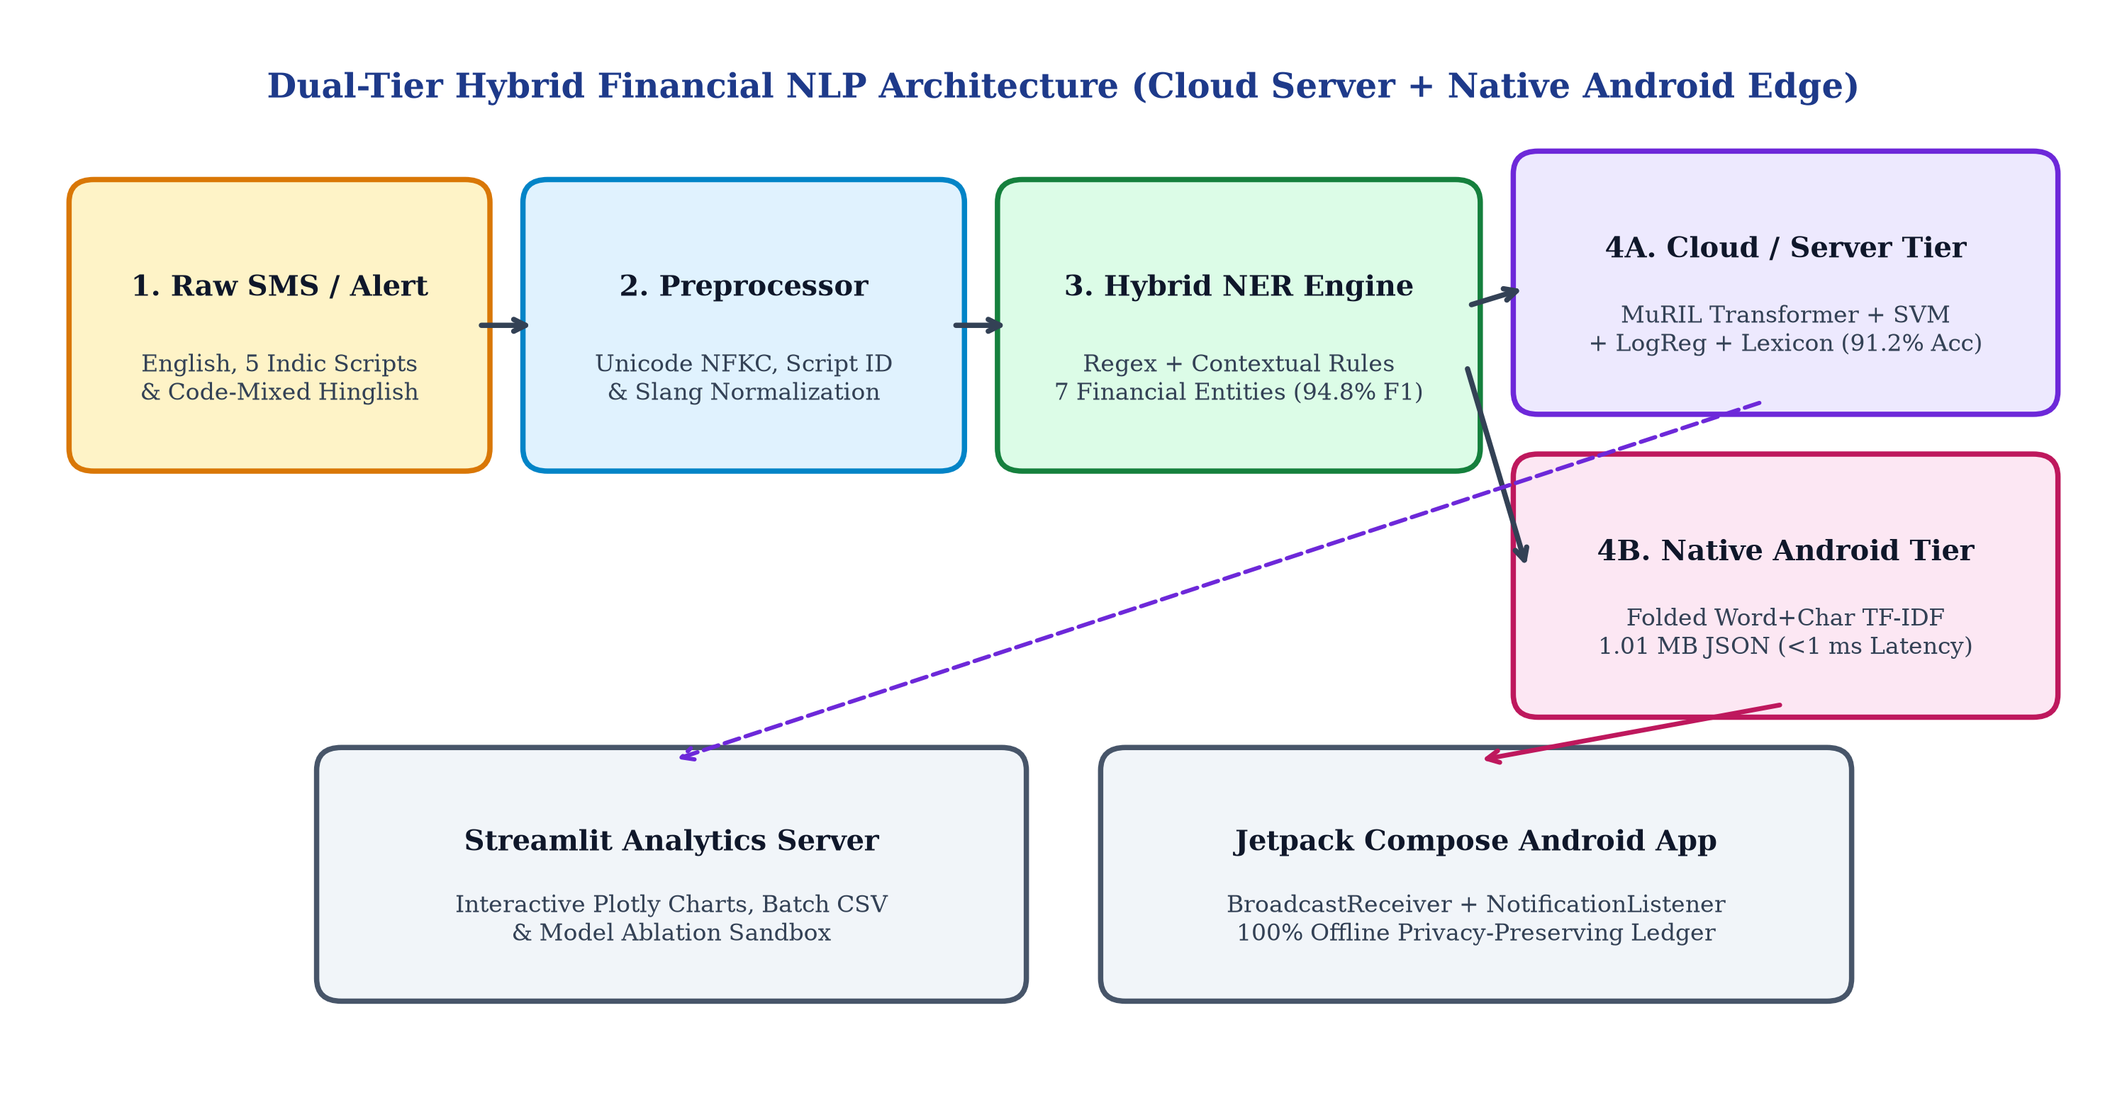
System Architecture Diagram

Slide 12
Datasets & Dual-Tier Implementation
FinEE Corpus + Code-Mixed & Education Augmentation
Implemented Applications (`app.py` & `android_app/`)
▸ Base Corpus (`Ranjit0034/finee-dataset`): 152,000+ annotated Indian banking SMS across 6 languages (`en, hi, kn, ta, te, bn`), 7 entities, and 12 categories.
▸ Solving Dataset Gaps (`src/data_loader.py`): Raw FinEE lacked Romanized code-mixed SMS and `education` fee alerts required by our Project Synopsis.
▸ Stratified Augmentation: Synthesized realistic Hinglish, Kanglish & Tanglish UPI alerts + multilingual Education transactions (RV University, Udemy, Coursera, Unacademy, BYJU'S).
▸ Verified Test Benchmark (N = 1,200): 800 held-out FinEE test rows + 250 Code-Mixed + 150 Education test rows (4,986 entity annotations).
▸ 1. Streamlit Analytics Server (`app.py`): 5-tab web dashboard: Live Single-SMS NER & Confidence Analyzer, Side-by-Side Model Comparison, Batch CSV Processor, Benchmark Viewer & Multilingual Suite.
▸ 2. Native Android App (`MainActivity.kt`): 100% Jetpack Compose (Material 3) app with Executive Spend Dashboard, Category Progress Bars, Search/Filter Chips & CSV Export.
▸ 3. Real-Time SMS & Notification Daemons: `SmsReceiver.kt` & `BankNotificationListener.kt` auto-capture live bank SMS & GPay/PhonePe push alerts offline.
▸ 4. Interactive NER Sheet & Custom Memory: Tap any transaction to inspect all 7 NER entities and re-label categories; `FinNlpEngine` remembers custom VPA rules.

Slide 13
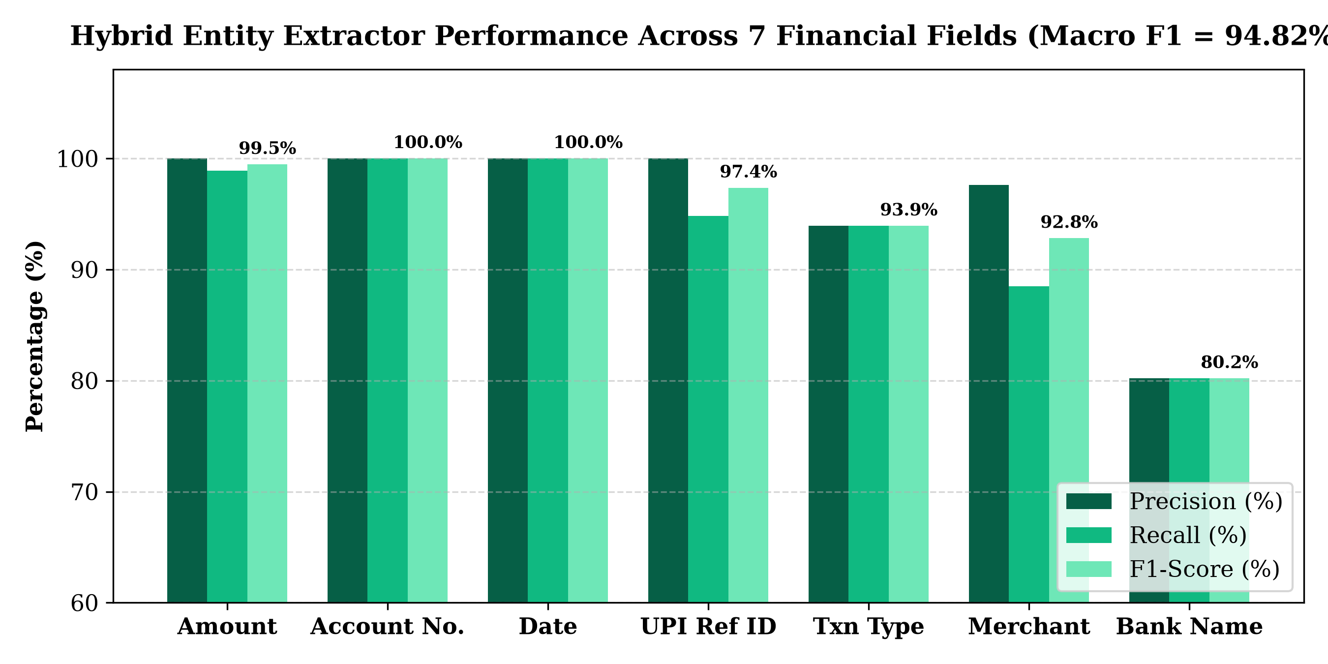
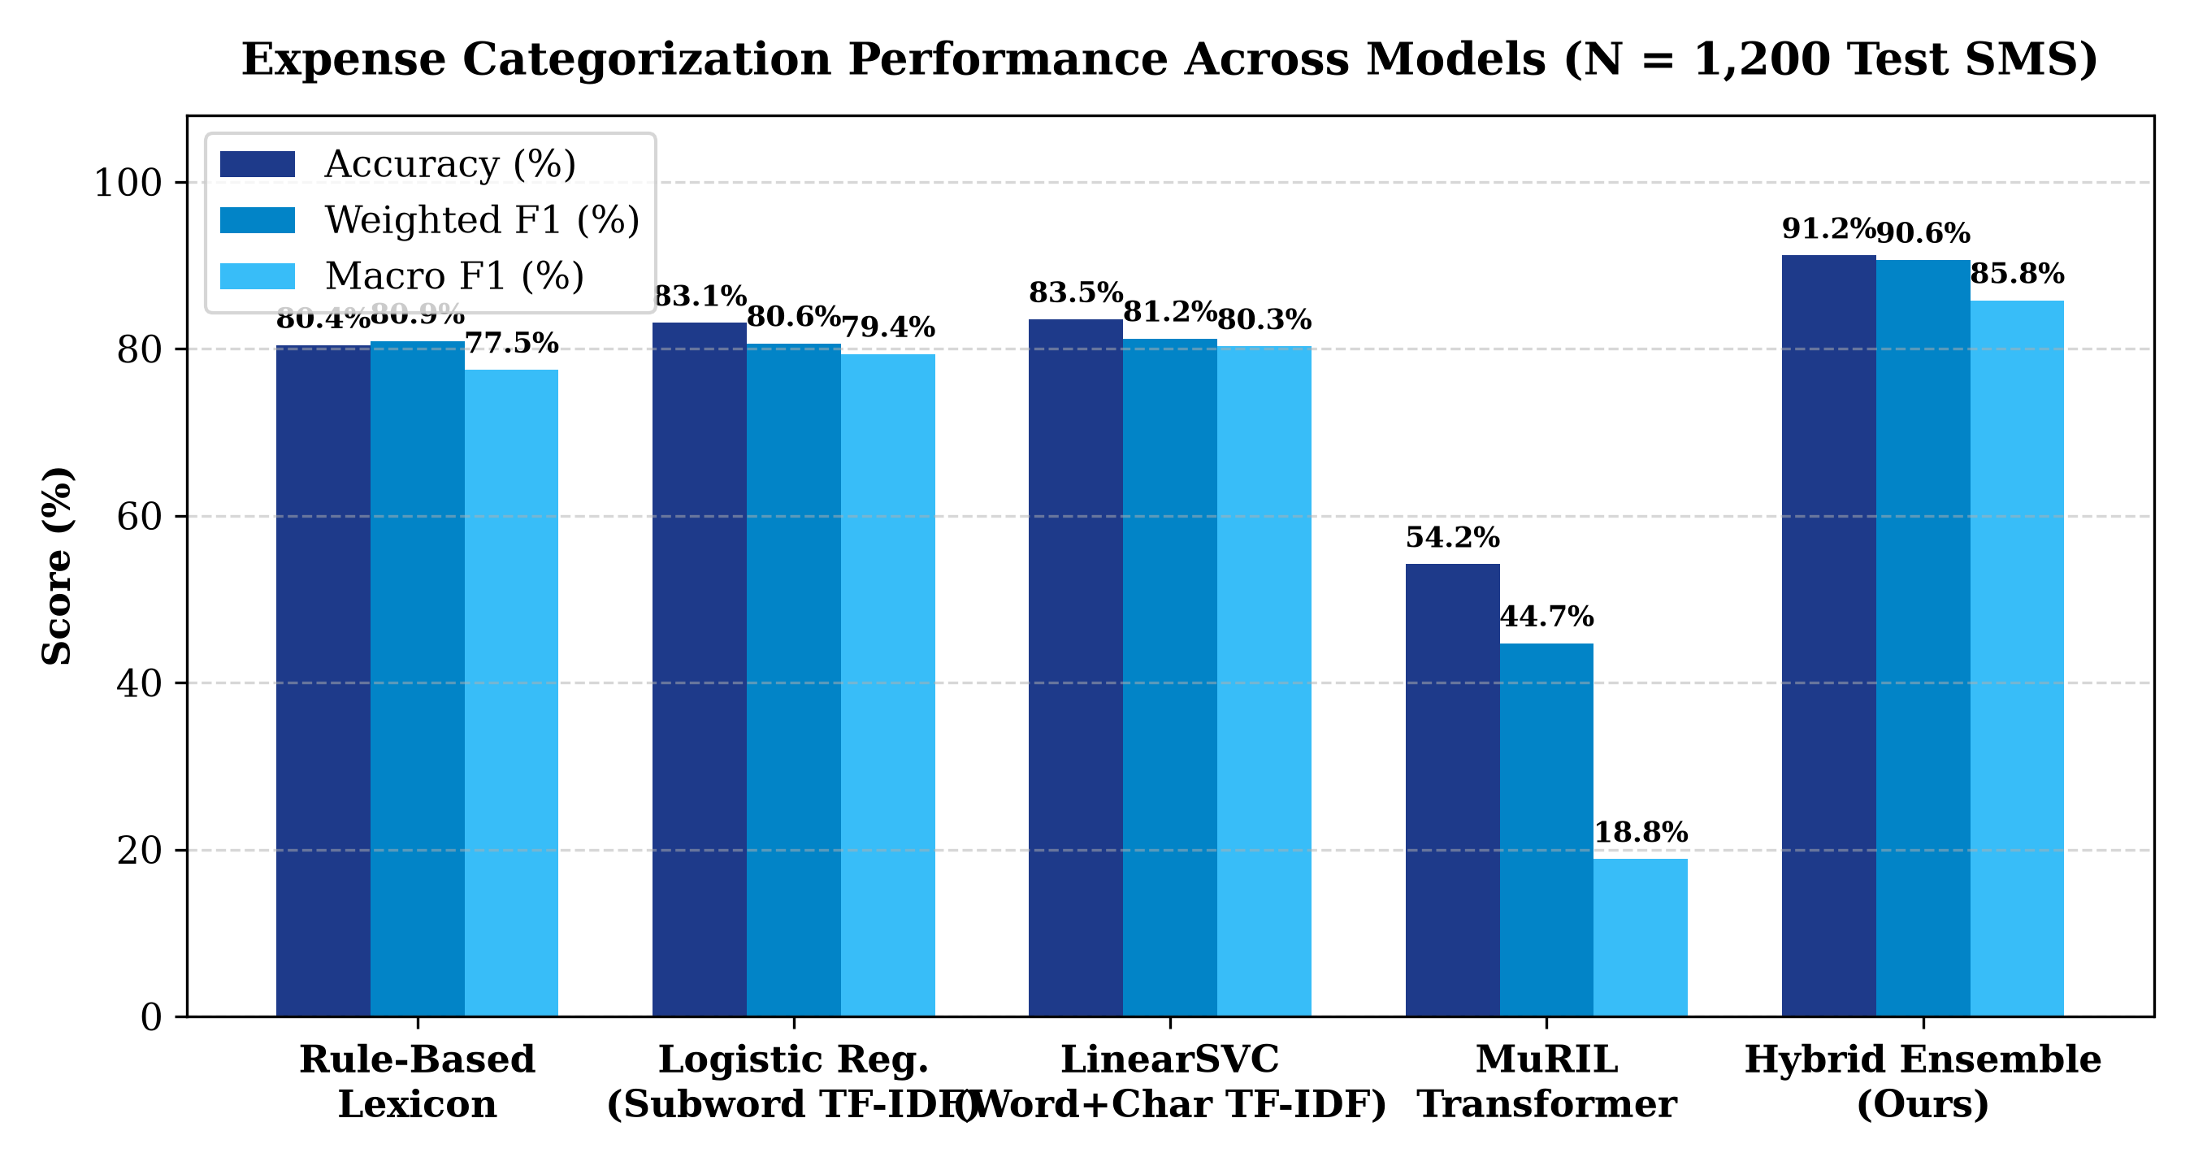
Experimental Results — Entity Extraction & Categorization
Entity Extraction Highlights (4,986 Entities)
Expense Categorization Highlights (N = 1,200)
▸ Macro Average: 95.96% Precision | 93.76% Recall | 94.82% F1
▸ Numeric & Structural Precision: 100.0% F1 on Account & Date; 99.46% F1 on Amount (100% Precision); 97.35% F1 on UPI Ref ID.
▸ Hybrid Ensemble (Ours): 91.17% Accuracy | 90.62% Weighted F1 | 85.78% Macro F1
▸ Substantial Gains: Outperforms LinearSVC (83.50%) by +7.67%, Logistic Regression (83.08%) by +8.09%, and Rule Lexicon (80.42%) by +10.75%.

Slide 14
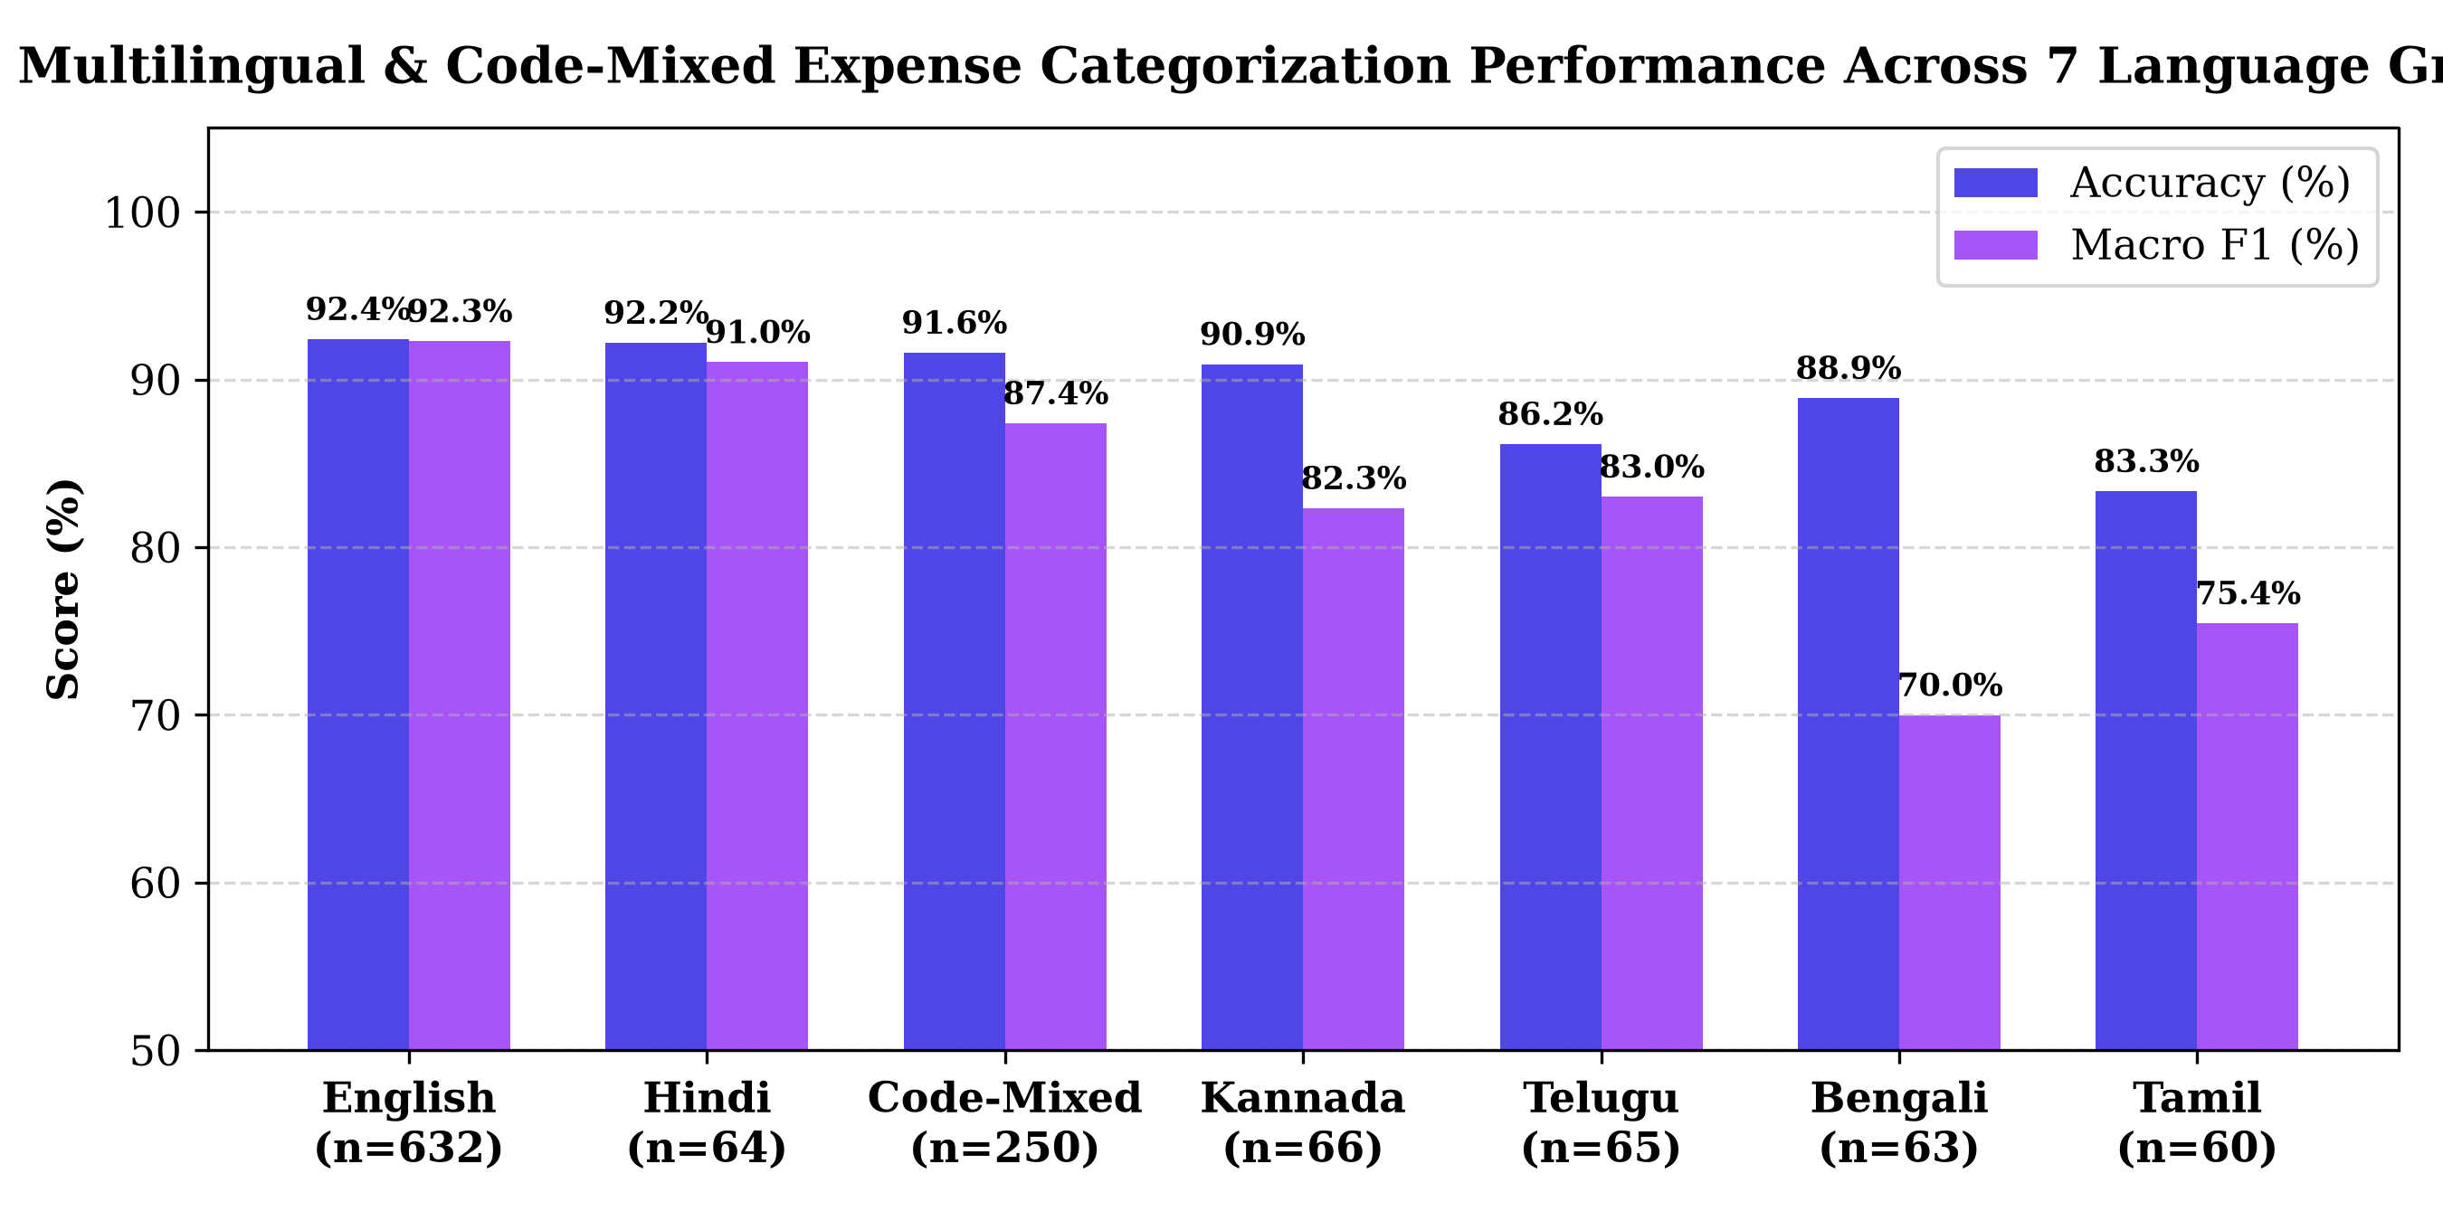
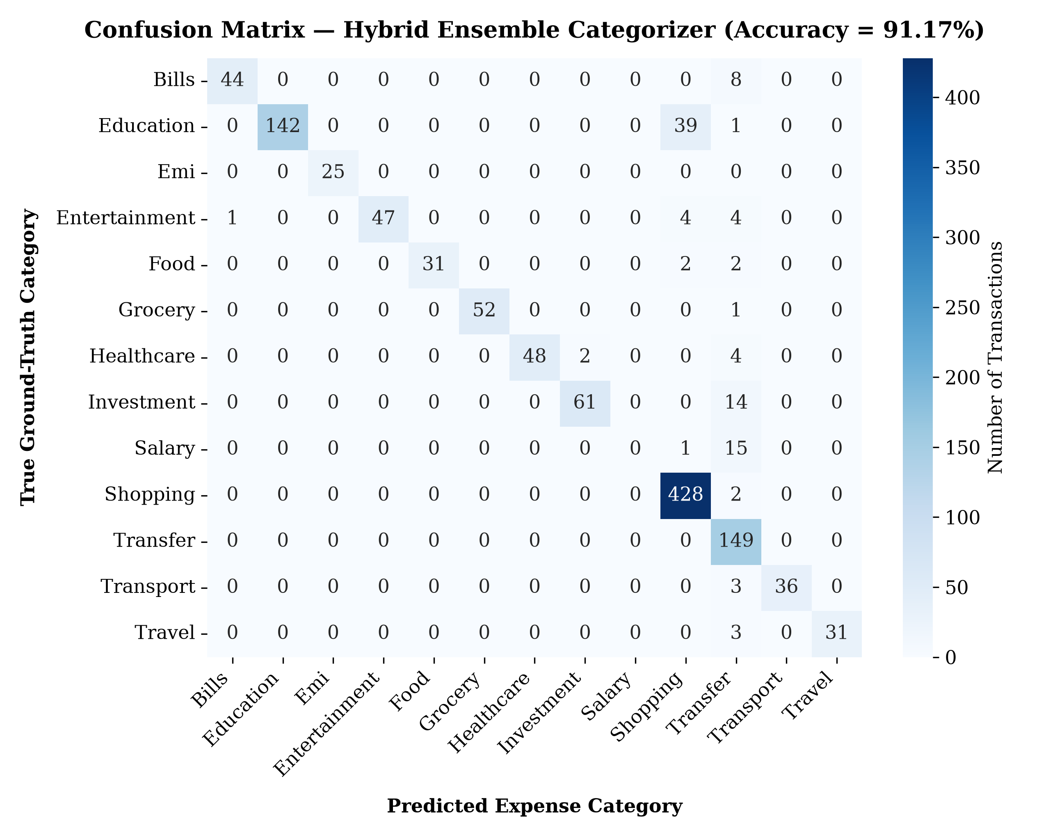
Multilingual Robustness & Confusion Matrix Analysis
Cross-Lingual & Category Takeaways
▸ High Accuracy Across All 7 Language Groups: English (92.4%), Hindi (92.2%), Code-Mixed Hinglish/Kanglish (91.6%), Kannada (90.9%), Bengali (88.9%), Telugu (86.2%), Tamil (83.3%).
▸ Top Category F1-Scores: EMI (100%), Grocery (99.0%), Transport (96.0%), Travel (95.4%), Shopping (94.7%), Healthcare (94.1%), Food (93.9%), Education (87.7%).

Slide 15
Gantt Chart & Team Contribution Plan
Phase / Task Description | Lead / Contributors | W1–W2 | W3–W4 | W5–W6 | W7–W8 | W9–W10 | W11–W12
1. Literature Survey & FinEE Corpus Analysis | All Team Members | ███ | ███
2. Multilingual Preprocessor & Code-Mixed Augmentation | Preksha P V & Reshma K P |  | ███ | ███
3. 7-Field Hybrid Entity Extractor (Regex + Contextual NER) | Prathik K B & Preksha P V |  |  | ███ | ███
4. Subword TF-IDF (SVM/LogReg) & MuRIL Transformer Training | Prathik K B & Rushil R. R. |  |  |  | ███ | ███
5. Streamlit Server & 1.01 MB Native Android App (Kotlin) | Prathik K B & Rushil R. R. |  |  |  |  | ███ | ███
6. Stratified Evaluation (N=1,200), Report & Documentation | Reshma K P & All Members |  |  |  |  |  | ███

Slide 16
References (IEEE Format)
Key Research References (IEEE Citation Style)
▸ [1] T. Joachims, "Text categorization with support vector machines: Learning with many relevant features," in Proc. European Conf. Machine Learning (ECML), Berlin, Germany: Springer, 1998, pp. 137–142.
▸ [2] Y. Chen, X. Li, and H. Zhang, "Automated personal finance management via hybrid rule-based and statistical named entity recognition on mobile banking SMS," J. Financial Data Sci., vol. 4, no. 2, pp. 45–62, 2019.
▸ [3] A. Conneau et al., "Unsupervised cross-lingual representation learning at scale," in Proc. 58th Annu. Meeting Assoc. Comput. Linguistics (ACL), 2020, pp. 8440–8451.
▸ [4] S. Khanuja et al., "MuRIL: Multilingual representations for Indian languages," Google Research, arXiv:2103.10730, 2021.
▸ [5] D. Kotios, G. Makridis, G. Fatouros, and D. Kyriazis, "Deep learning enhancing banking services: A hybrid transaction categorization and cash-flow prediction framework," J. Big Data, vol. 9, no. 1, p. 100, 2022.
▸ [6] M. Ranjit et al., "FinEE: A large-scale multilingual dataset for Indian financial entity extraction and transaction categorization," Hugging Face Hub (Ranjit0034/finee-dataset), 2024.
THANK YOU — QUESTIONS & LIVE DEMO

