Slide 1
Book1
File created on: 11/21/23 11:36:57 PM PST

Slide 2
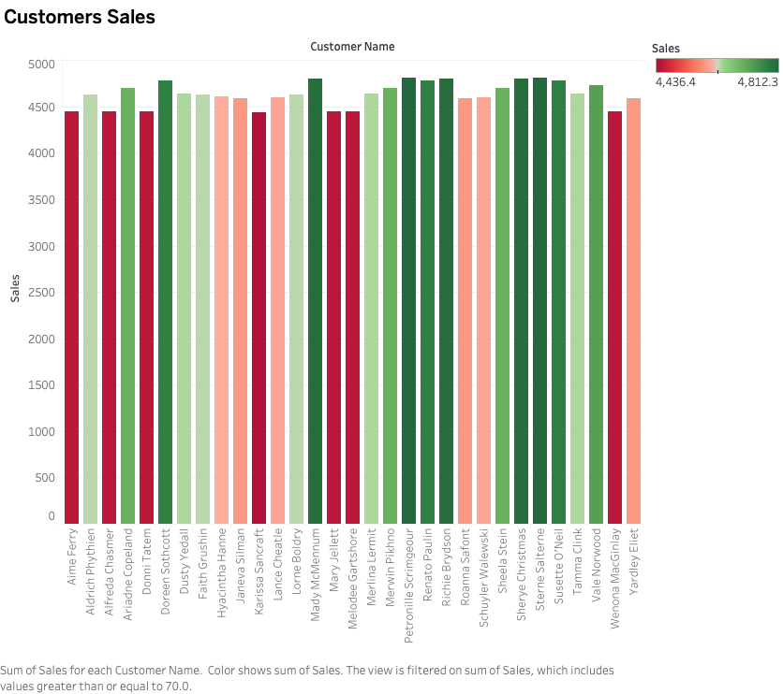

Slide 3
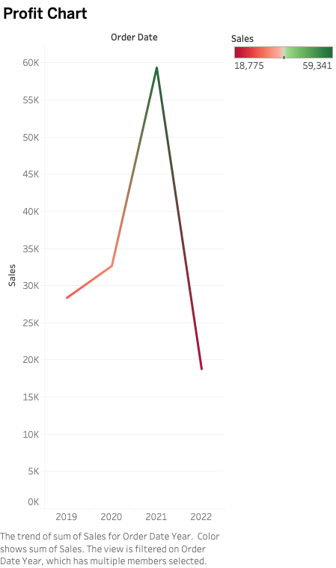

Slide 4
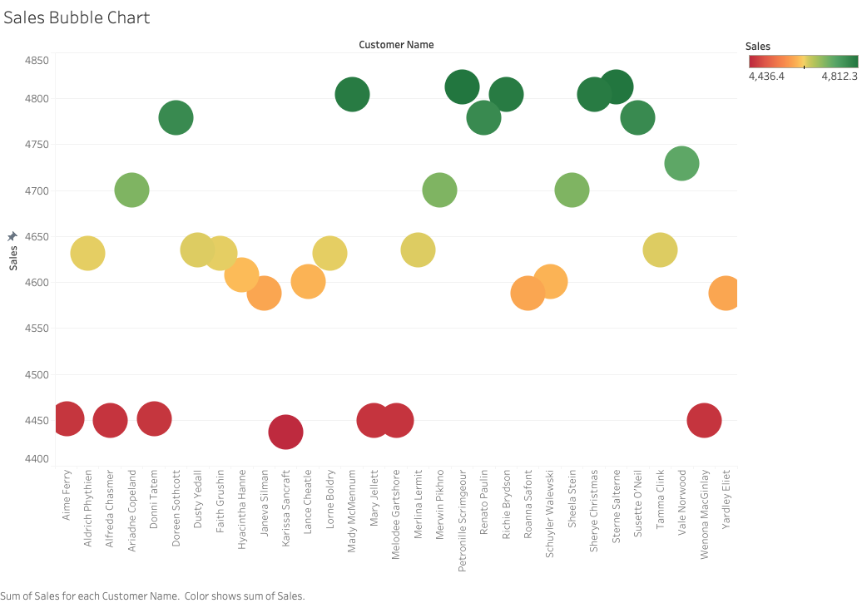

Slide 5
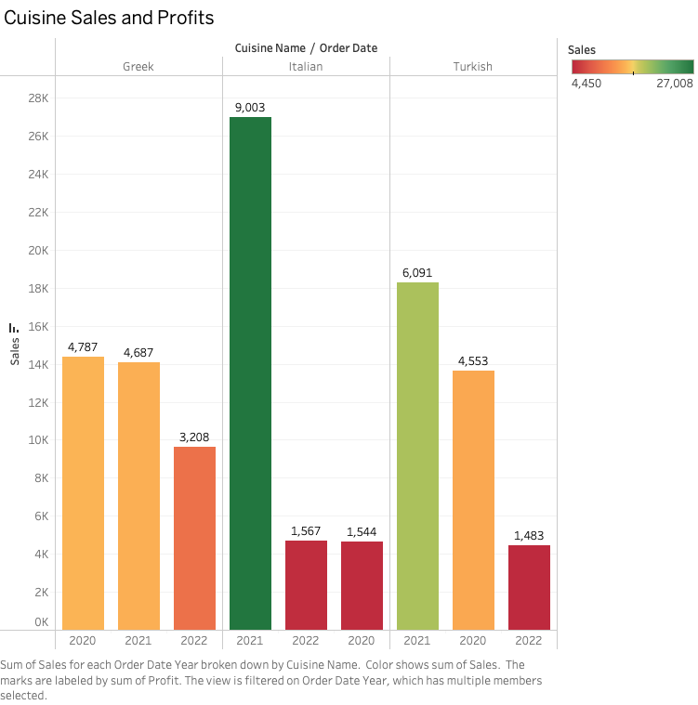

Slide 6
