Slide 1
Music, Maths & Programming
Notes:
Hello, my name is Duncan and I am going to talk about music and computer programming, and whether there is any link between the too.
I'd like to try and explain how I think music and computer programming are linked.
Before I got this job I did a music degree, and since then interviewers have wanted to know how a music degree prepares you to write computer programs.
Many people can name people who are good at maths or computer programming and also play and instrument or compose.
Please stop me if I go too fast – I have no idea the level of knowledge people have about music so bear with me!

Slide 2
Mathematics in music?
Notes:
Before explaining the link between programming and music I want to show the patterns that appear in music.
I've put mathematics up there because generally maths is good for showing patterns in nature. I've no real idea what to call this kind of thing.

Slide 3
Counting & Rhythmic Proportion
base 4
(musicians usually count in 4s)
(phrases are usually 8 or 12 bars long)
Notes:
The most obvious but most fundamental link is that you need to know how to count. And you need to recognise regularity to listen to and perform music.
In musical rhythm the number 4 is key – it makes up most time signatures, and most phrases are 4, 8 or 12 bars long.

Slide 4
Harmonic Frequencies
Name | Musical Letter + Hz | Multiple of Fundamental
Fundamental | A₂ 110Hz | 1x
Octave | A₃ 220Hz | 2x
Perfect Fifth | E₄ 330Hz | 3x
Octave | A₄ 440Hz | 4x
Major Third | C#₅ 550Hz | 5x
Perfect Fifth | E₅ 660Hz | 6x
Harmonic Seventh | G₅ 770Hz | 7x
Octave | A₅ 880Hz | 8x
A B C# D E F# G# A
Notes:
The same appreciation of regularity and form is present with our choice of pitches. The most important notes in Western music come from frequencies that are multiples of the fundamental.
The table here shows a fundamental A, which when doubled gives you the octave above. When you multiply by 3 you get a fifth, then a third and so on.
The fifth and third are what make up a major chord, which is one of the main building blocks of all Western music.
Interestingly the 7th in there is what is called a dominant 7th, which is used all the time in some classical music, and also particualarly in jazz music.

Slide 5
Pentatonic Scale
E
fifth
major pentatonic scale
C D E G A
A
fifth
D
fifth
G
fifth
C
Notes:
Fifths are particularly important in musical scales.
A prime example of this is the major pentatonic scale, which is simply a load of fifths stacked on top of each other.
This scale can be found all over the world, in Javanese Gamelan, in Blues, in Jazz, in Folk music, in pop, in the music of Ancient Greece. And to some extend in classical music also.

Slide 6
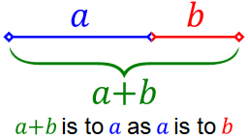
Golden Ratio
Notes:
The golden ratio also crops up from time to time.
The golden ratio is summed up here, as a+b is to a as a is to b.

Slide 7
Golden Ratio
Eric Satie – Sonneries de la Rose+Croix (1891)
Claude Debussy – Reflections in Water (1905)
Bela Bartok – Music for Strings, Percussion and Celesta (1936)
Notes:
All these pieces contain a climax or conclusion at about 1.6 way through the piece.
Interestingly, they were all written roughly around the same time, and is possible this sort of thing was symptomatic of the time, when science and technology were making great strides and these artists were simply responding to that.
Apparently the golden ratio turns up in many pop songs as well. I have it on good authority from the internet.

Slide 8
Dodecophonic Music
Created from atonal music (music with no key)
Invented by Arnold Schoenberg in 1921
Opus 23
All notes have equal weight within a 'tone row'
A tone row has all 12 notes in it
The tone row is repeated, reversed and transposed throughout the piece
Notes:
Finally, there is dodecophonic music, which mainly happened around the 1940s and 50s in Germany as a reaction to tonal music of the time.
Arnold Schoenberg and a few others started writing music that had no key. Schoenberg went one step further and created a system for writing such music using a tone row. A tone row is an arrangement of all 12 notes in the chromatic scale, with no repeats.
The tone row is then used throughout the piece, and is often inverted and reversed to generate more patterns.
I personally find this kind of music fairly unlistenable, and it must be said that this kind of rigorous system for making music has not really lasted or gained much weight nowadays.

Slide 9
Programming in Music?
Notes:
So: how about elements of computer programming in music?
What similarities or links are there between the process of writing a computer program, and writing or performing music?

Slide 10
Control Flow
Notes:
For me, the big similiarity is control flow. Just like a computer, music must repeat itself to do anything useful, and musicians have come up with ways of communicating repeats that look similar to computer programmers.

Slide 11

c(4); d(2); c(2);
2.times do
g(2);
a(2);
b(2);
g(2)
end
Notes:
The most basic is a for loop.
Here a set of functions is repeated, and on the right is how you would right that in classical Western notation.

Slide 12
Event Loop =~ Rondo
A – B – A – C – A
start event loop → go do something else → return to event loop → respond to something else → return to event loop
Notes:
I'm stretching a point here, but this holds true for how themes are arranged in classical music. In Western classical music a popular form was called the rondo, where you'd introduce a theme, then digress to another theme, then return to the orginal theme before going on another digression.
I've also thought this is rather like how an event loop works for a computer: it starts it's loop, then digresses to deal with input, then returns to it's loop again.

Slide 13
Key Stacks
Tonic – Dominant = most of Western music
Stacks are generally shallow, or we get lost
J.S Bach – Little Harmonic Labyrinth
Notes:
This one I have to credit to a book called Godel, Escher and Bach: a book about patterns in art and science.
In this book the author points out that to appreciate a lot of music you have to have an internal stack, which keeps track of what key you are in.
In most classical music you begin with a clearly defined key. Then the composer wanders off into another key, then another and another, then there is a satisfying effect when we are returned to the orginal key. This would be impossible without a 'key stack', that allows us to subconciously keep track of the previous key, just like a computer will keep track of variables while executing a nested function.

Slide 14
Common Link?
Notes:
So after all that, is there a common link between music, maths and programming?
Does anyone have any thoughts?

Slide 15
Some Common Skills
Abstraction
Pattern Matching
Mental Dicipline / Practise
Notes:
I think there are defintely some common skills shared by people who are interested in both programming and music.
It helps to be able to think abstractly, to like recognising and creating patterns.
It also takes a lot of mental focus and discipline – you have to be able to practise something and concentrate on perfecting your creation for extended periods of time.

Slide 16
Evidence
Very little
  Mainly because there have been very few studies on it
Anecdotal
  Myself, many composers at uni, many friends who are programmers and musicians
In my experience, it is very difficult to find dual masters
  Mainly becuase of the amount of time needed to master both
  You generally get people who are pro at one and dabble in the other
Notes:
So I was hoping to have several physcology papers to back up what I've been saying here, but in the time available I wasn't able to find anything conclusive. There seem to be more established links between maths and music.
The only other evidence I can present is anecdotal – my own experience of both fields, and also several other friends who I know have a strong interest in both fields.
From this I would also say that you generally get people who do one for a living and dabble in the other.

Slide 17
Evidence
"The common thread probably is that both are very structured environments,"
- Galen H. Graham, president of DeVry Institute of Technology in Columbus, Ohio.
"There seems to be a high correlation between musical ability and reasoning skills. It has to do with recognizing and manipulating patterns. That happens in music and in programming."
- Terry Skwarek, director of the Institute for Professional Development in the School of Computer Science, Telecommunications and Information Systems, DePaul University in Chicago
Notes:
So some quotes here from academics on the subject. This is them talking about the links between music and computer programming. The only real conclusion is that both require a high level of abstract thought and an affinity for patterns, which doesn't get us very far.

Slide 18
code & music are both
languages
describing abstract forms
Notes:
My personal take on this is that they can be viewed as two different languages with a common goal: to express abstract forms and concepts.
Musicians are given an incomplete score which roughly describes an invisible piece of music. They must then make decisions about how they will describe this piece to an audience, using music as the language.
In the same way programmers work from an incomplete system spec, which they must then describe to the computer using a programming language.

Slide 19
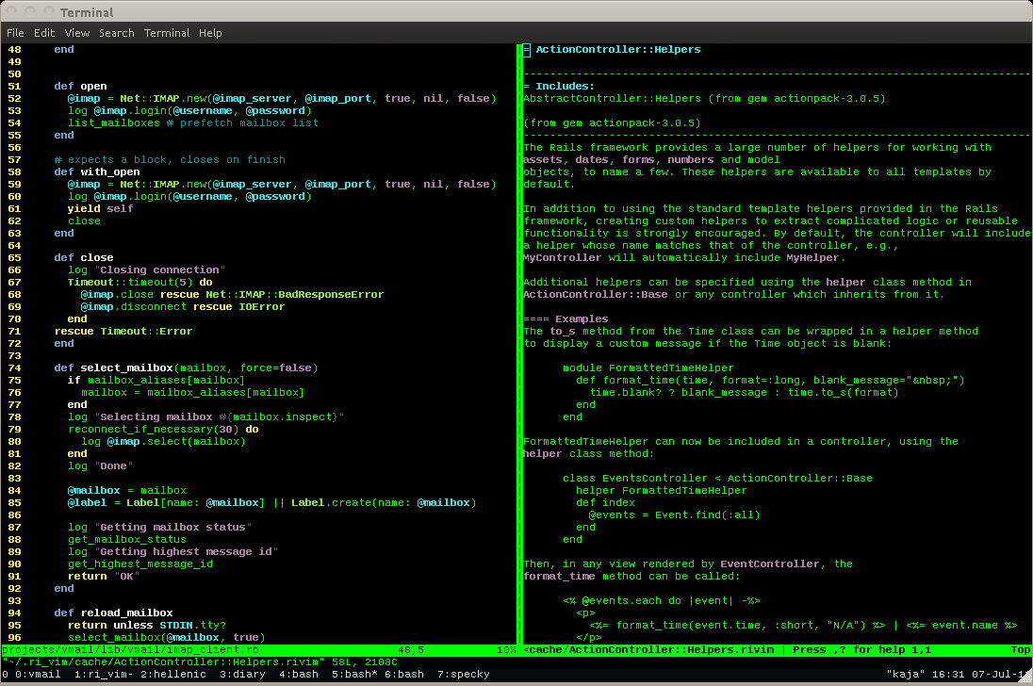
Musicians are becoming programmers
Notes:
Something to take away from all this is that like so many other walks of life, many composers and performers are becoming programmers, in order to use computers as instruments and compositional tools.

Slide 20
Sample-based music
(loops, processing, drum machines)
Notes:
This has led to the rise of sample-based music. Music based around looping a pattern over and over, and then changing the sound of that pattern over time to create a piece.

Slide 21
Sample-based music
(Hip-hop, Trip-hop, Dub, Minimalism)
Notes:
This has given rise to entirely new genres of music. The final one in that list, minimalism, is particularly interesting as that comes from the classical world, with human performers playing the pieces from scores that have been written down. But the composers, such as Steve Reich and Philip Glass, cite computers, and modern life generally, as an influence for their repetitive, hypnotic music.

Slide 22
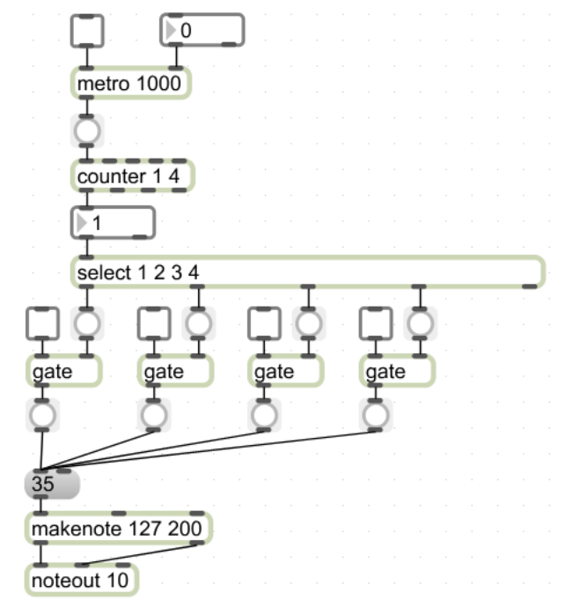
MaxMSP/Pure Data
MIDI
Functions
Libraries
Loops
Conditions
Notes:
There are computer programs that have been designed for musiicians to use, usually to create new sounds and compose pieces.
Of particular interest is Pure Data and it's cousin MaxMSP, both of which use a visual programming language to describe quite complex structures, including function calls, message passing, loops and conditional statements. Libraries exist that extend the language and give new functionality. Both MaxMSP and Pure Data are implemented in C++ under the hood.

Slide 23
Conclusions
?
Notes:
Does anyone have any conclusions from this?

Slide 24
Parrallel Notation
Piano Music
Conductor's Scores

Slide 25
Collaboration
Bands
Orchestras
Chamber Groups
Composer writes a spec, performed by a group of specialists

